Slide 1
Evolving Robust GP Solutions for Hedge Fund Stock Selection in Emerging Markets
Wei Yan, Christopher D. Clack Soft Computing, 2011
Presenter: Cheng-Han Lee
Date:2013/8/6

Slide 2
Abstract
Stock selection for hedge fund portfolios is a challenging problem for Genetic Programming (GP) because the markets (the environment in which the GP solution must survive) are dynamic, unpredictable and unforgiving. How can GP be improved so that solutions are produced that are robust to non-trivial changes in the environment? We explore an approach that uses subsets of extreme environments during training.

Slide 3
Algorithm
S = {s₁ . . . , s_{n}} (scenarios)
V = A separate out-of-sample validation vector.
Three methods:
Standard GP
Multiple-scenario Evaluation in the Last Generation (MELG)
Multiple-scenario Evolution (MEVO)

Slide 4
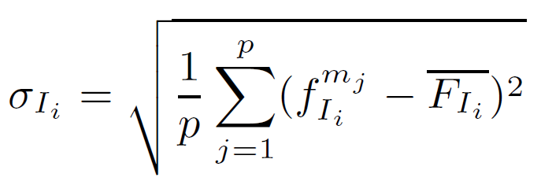
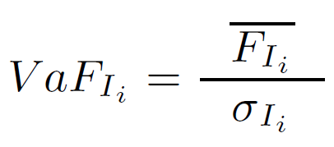
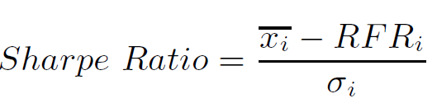
Volatility-Adjusted Fitness
M = {m₁ . . . m_{p}} is a subset of S that is used for fitness evaluation.
FI_{i} is the "fitness vector" of I_{i} when evaluated on a subset of scenarios
The fitness f for an individual is the Sharpe ratio

Slide 5
Hedge Fund Simulation
33 Malaysian stocks
Predict the return expectation for each stock over a 4-week forward horizon.
At all times, 24 stocks are maintained in the portfolio.
Each stock is given equal weight in the portfolio.

Slide 6
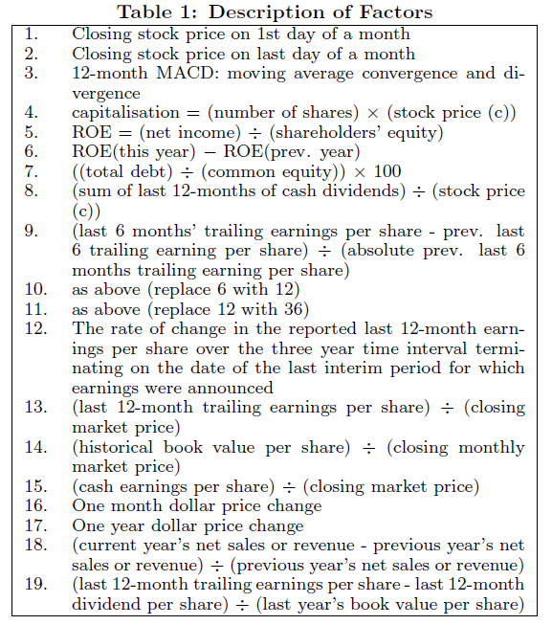

Slide 7
Experiment
Three scenarios:
1. Bull market: 31/05/2003 to 31/12/2004 (19 months)
2. Bear market: 31/01/2000 to 31/05/2001 (16 months)
3. Volatile market: 31/01/1999 to 31/03/2000 (14 months)
Out-of-Sample Validation
31st July 1997 to 31st December 1998.

Slide 8
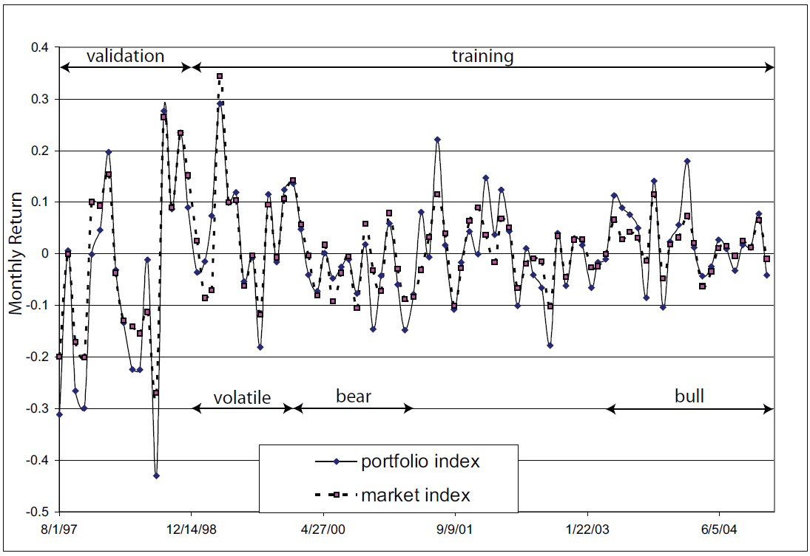

Slide 9
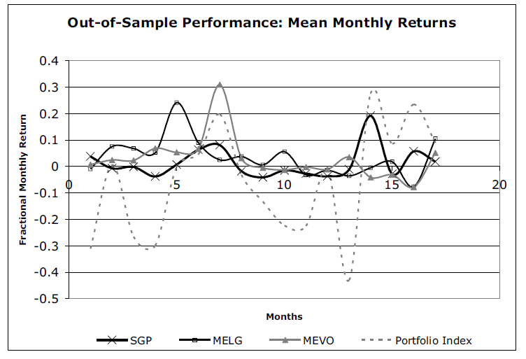

Slide 10
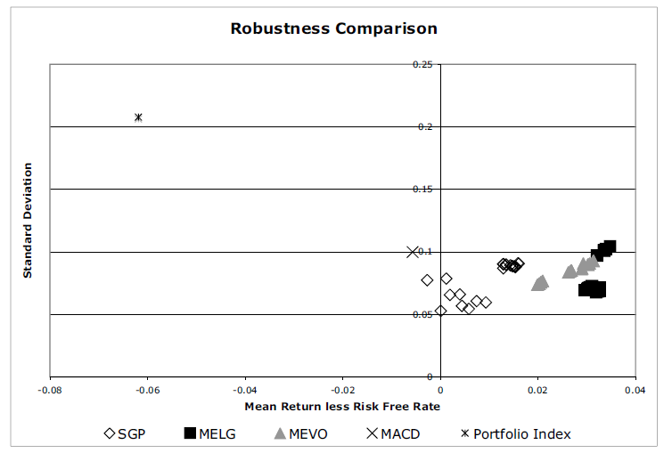

Slide 11
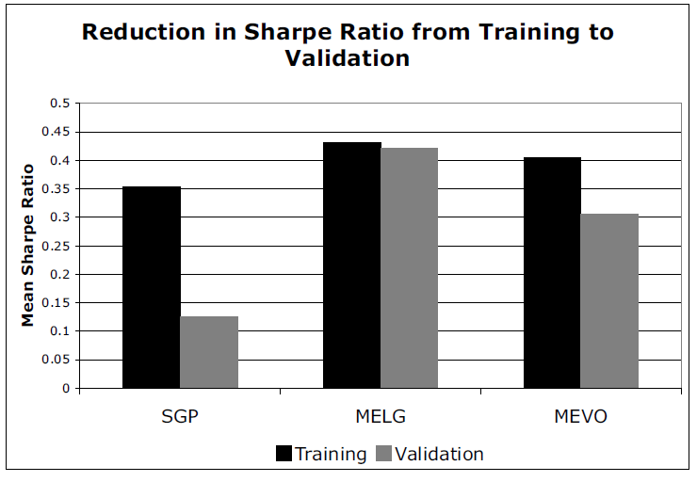

Slide 12
THE END

