Slide 1
A genetic clustering algorithm using a message-based similarity measure
Dongxia Chang(常冬霞), Yao Zhao(趙耀), Changwen Zheng(鄭昌文), Xianda Zhang
Expert Systems with Applications 39 (2012) 2194–2202
Presenter: 許竣傑
2013/8/6

Slide 2
Abstract
In this paper, a genetic clustering algorithm is described that uses a new similarity measure based message passing between data points and the candidate centers described by the chromosome. In the new algorithm, a variable-length real-value chromosome representation and a set of problem-specific evolutionary operators are used.

Slide 3
Abstract
Therefore, the proposed GA with message-based similarity (GAMS) clustering algorithm is able to automatically evolve and find the optimal number of clusters as well as proper clusters of the data set. Effectiveness of GAMS clustering algorithm is demonstrated for both artificial and real-life data set. Experiment results demonstrated that the GAMS clustering algorithm has high performance, effectiveness and flexibility.

Slide 4
Message-based similarity
Responsibility r(i,k)
Availability a(i,k)
S(i,j)= r(i,k)+ a(i,k) j=1,2,3,…,k
X_{i} will be assign to the cluster with the maximum similarity

Slide 5

Message-based similarity
Responsibility r(i,k)
$r\left(i,k\right)=d\left(i,k\right)−\max\left\{d\left(i,k^{′}\right)\right\}$
$i=1,2,…,n k=1,2,…,k$
d(i,k)=-|x_{i}-c_{k}|²
C₂
C₁
-3
-4
x_{i}
-1
C_{k}
r(i,k)=-1-(-3)=2

Slide 6

Message-based similarity
Availability a(i,k)
$a\left(i,k\right)=min⁡\{0,R\left(k\right)+\sum{max⁡\{0,r(i^{′},k)\}}$
$R\left(k\right)=IP\left(k\right)−max⁡\{d(c_{k},c_{k′})\}$
R(k)=-2-(-4)=2
-2
C₂
r(1,k)=-4-(-2)=-2
x₁
r(2,k)=-2-(-4)=2
x_{i}
r(3,k)=-2-(-5)=3
C₁
-3
-6
r(4,k)=-5-(-2)=-3
-4
x₂
-5
C_{k}
-2
x₄
x₃
-2
a(i,k)=min{0,2+2+3} = 0

Slide 7

Fitness evaluation
S(i,j)= r(i,k)+ a(i,k) j=1,2,3,…,k
Chromosome:
$$V=[v_{11},v_{12},…,v_{1n},v_{21,…,}v_{2n},…v_{kn}]$$

Slide 8
Fitness evaluation
(1) A measure of the cohesiveness of clusters, favoring dense clusters.
(2) A measure of the distance between clusters and the global center, which favors well-separated clusters.
(3) A measure of the ‘‘implicit’’ of the number of clusters, which favors candidate solutions with a smaller number of clusters.

Slide 9





Fitness evaluation
u_{i} is the center of Ci

Slide 10
Evolutionary operators
1.Crossover
2.Mutation
(1)perturb mutation
(2)insert mutation
(3)delete mutation
(4)merge mutation
(5)split mutation
(6)move mutation

Slide 11
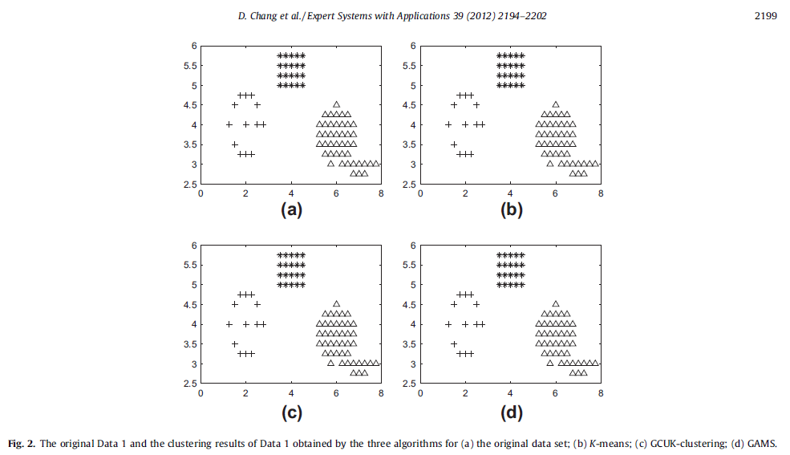
Experiments results

Slide 12
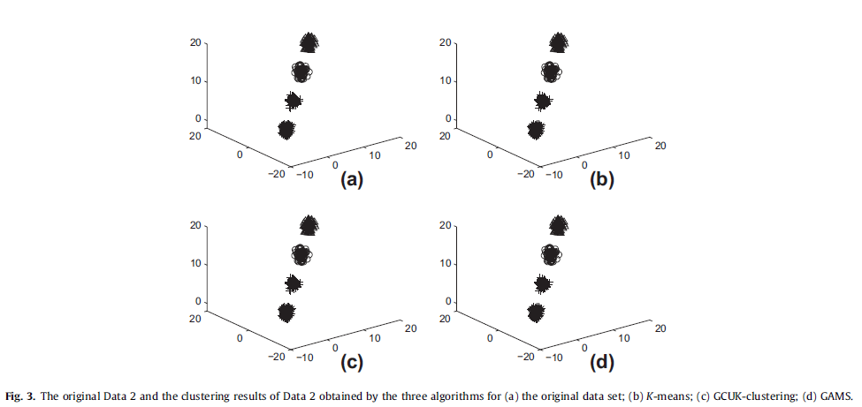
Experiments results

Slide 13
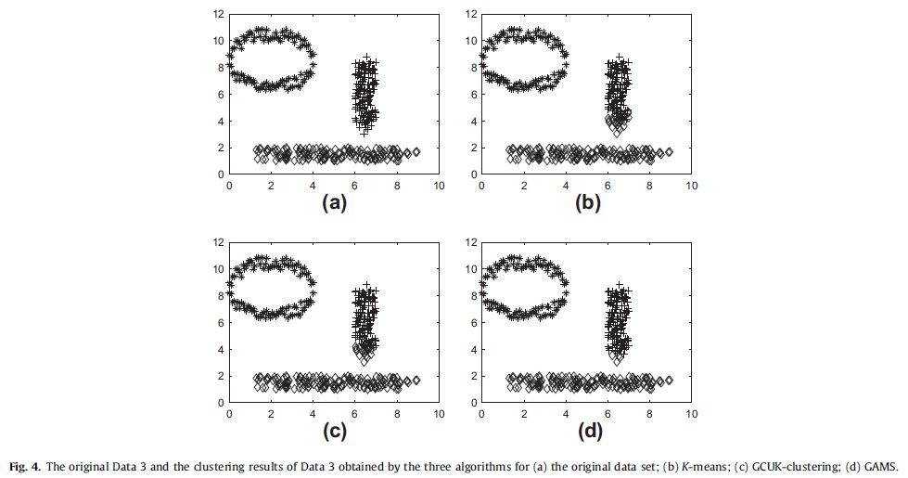
Experiments results

Slide 14
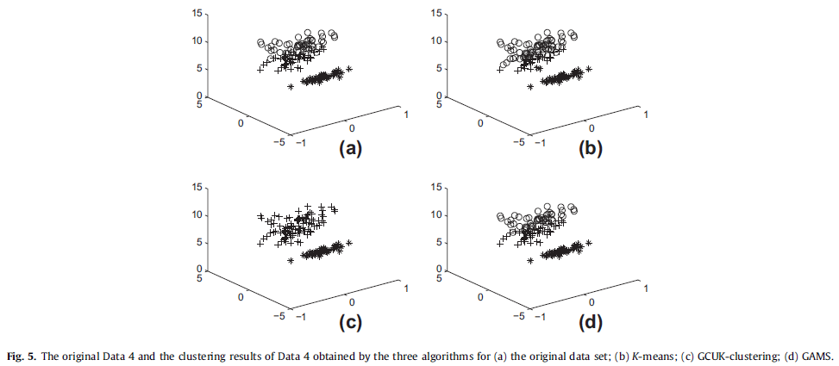
Experiments results

Slide 15
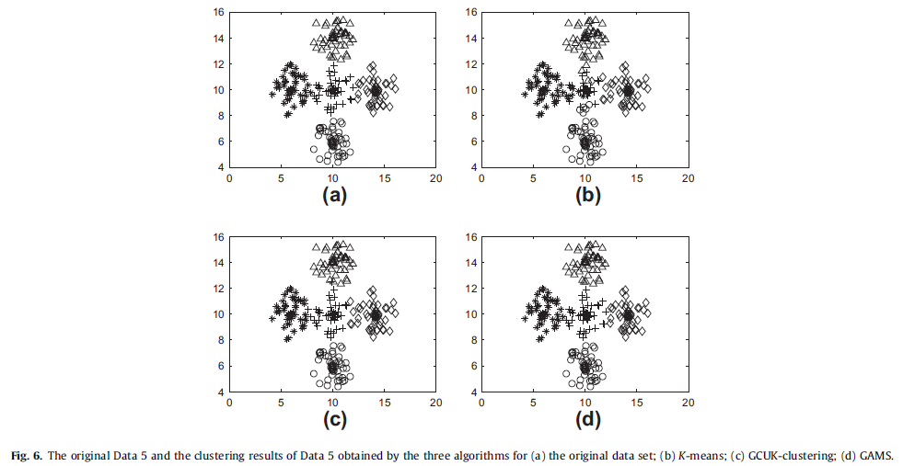
Experiments results

Slide 16
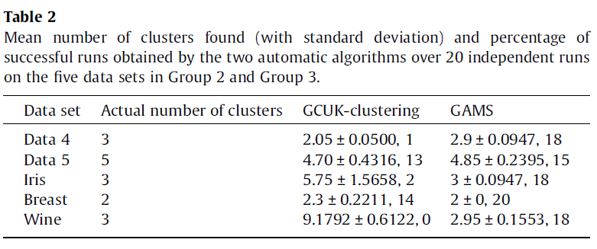
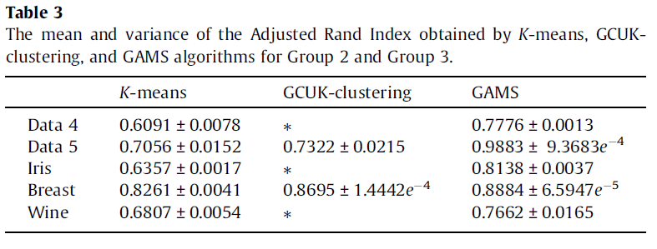

Slide 17
Thank You!

