Slide 1
32-Bit Cyclic Redundancy Codes for Internet Applications
Philip Koopman ,ECE Department & ICES,Carnegie Mellon University
egular paper to appear in The International Conference on Dependable Systems and Networks (DSN) 2002.
REPORTER : CING-YAO,Chen 2013/8/13

Slide 2
Abstract
Standardized 32-bit Cyclic Redundancy Codes provide fewer bits of guaranteed error detection than they could, achieving a Hamming Distance (HD) of only 4 for maximum-length Ethernet messages, whereas HD=6 is possible. Although research has revealed improved codes, exploring the entire design space has previously been computationally intractable, even for specialpurpose hardware. Moreover, no CRC polynomial has yet been found that satisfies an emerging need to attain both HD=6 for 12K bit messages and HD=4 for message lengths beyond 64K bits. This paper presents results from the first exhaustive search of the 32-bit CRC design space. Results from previous research are validated and extended to include identifying all polynomials achieving a better HD than the IEEE 802.3 CRC-32 polynomial. A new class of polynomials is identified that provides HD=6 up to nearly 16K bit and HD=4 up to 114K bit message lengths, providing the best achievable design point that maximizes error detection for both legacy and new applications, including potentially iSCSI and application-implemented error checks.

Slide 3
Introduction
CRC : Cyclic Redundancy Codes
HD : Hamming Distance
MTU : Maximum Transmission Unit
In this paper we present the results of the first exhaustive exploration of the design space for 32-bit CRCs.
The entire set of 1,073,774,592 distinct polynomials has been evaluated for effectiveness for data word sizes of 12112 bits.

Slide 4
Cyclic redundancy codes
A CRC can be described as treating a binary data word as a polynomial over GF(2).
EX: F(x) = x¹⁹ + x¹⁶ + x + 1

Slide 5
Background
The prime factorization of the generator polynomial brings with it certain potential characteristics, and in particular gives a tradeoff between maximum number of possible detected errors vs. data word length for which the polynomial is effective.

Slide 6
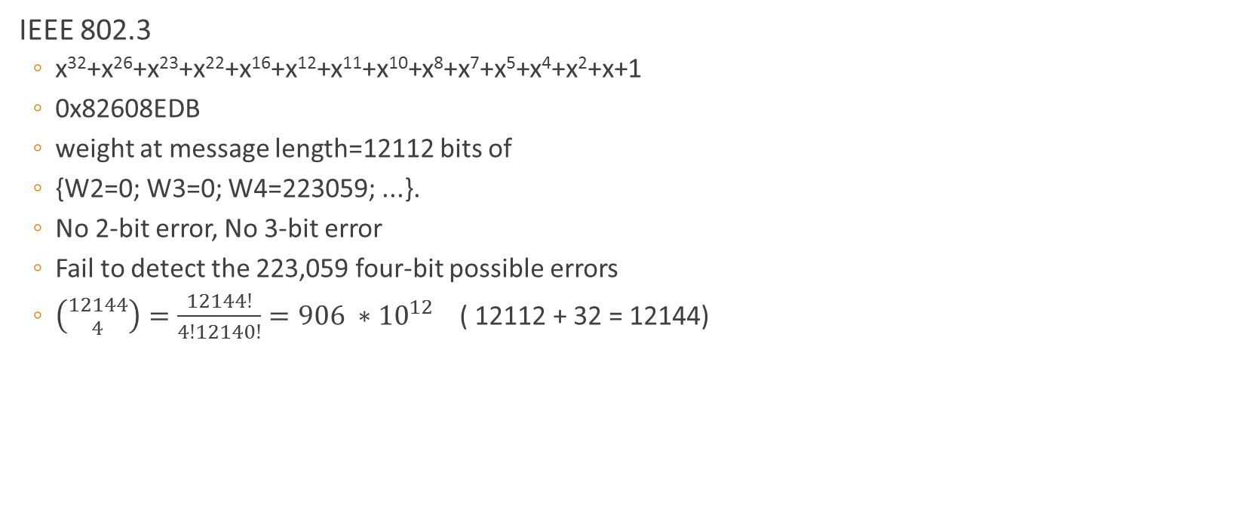
Previously known 32-bit CRC polynomials
IEEE 802.3
x³²+x²⁶+x²³+x²²+x¹⁶+x¹²+x¹¹+x¹⁰+x⁸+x⁷+x⁵+x⁴+x²+x+1
0x82608EDB
weight at message length=12112 bits of
{W2=0; W3=0; W4=223059; ...}.
No 2-bit error, No 3-bit error
Fail to detect the 223,059 four-bit possible errors
$\left({12144 \atop 4}\right)=\frac{12144!}{4!12140!}=906 ∗{10}^{12}$ ( 12112 + 32 = 12144)

Slide 7
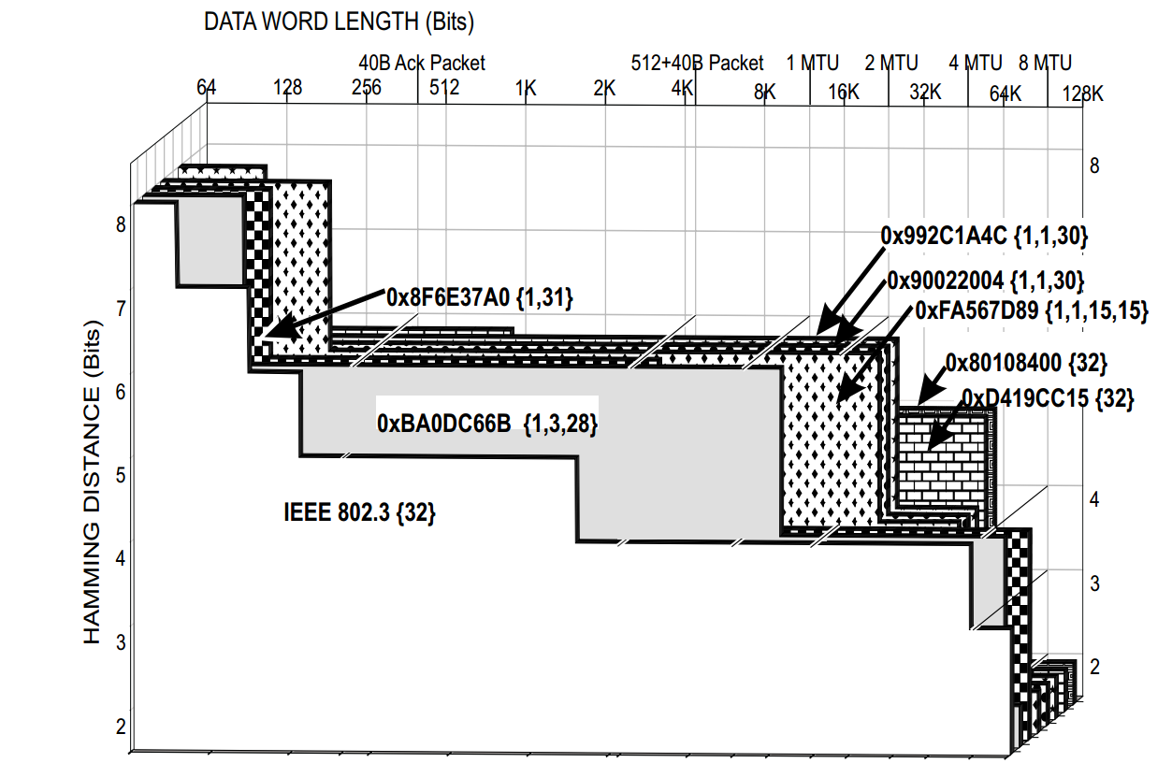
Error detection capabilities of selected 32-bit CRC polynomials

Slide 8
