Slide 1
Acceleration of sequence clustering using longest common subsequence filtering
Youhei Namiki, Takashi Ishida, Yutaka Akiyama The 2012 International Conference on Intelligent Computing Huangshan, China. 25-29 July 2012
Presenter: Guo Yi-Pu 2013-08-13

Slide 2
Abstract (1/2)
Background: Huge numbers of genomes can now be sequenced rapidly with recent improvements in sequencing throughput. However, data analysis methods have not kept up, making it difficult to process the vast amounts of available sequence data. This increased processing time is especially critical in DNA sequence clustering because of the intrinsic difficulty in parallelization. Thus, there is a strong demand for a faster clustering algorithm.
Results: We developed a new fast DNA sequence clustering method called LCS-HIT, based on the popular CD-HIT program. The proposed method uses a novel filtering technique based on the longest common subsequence

Slide 3
Abstract (2/2)
to identify similar sequence pairs. This filtering technique makes the LCS-HIT considerably faster than CD-HIT, without loss of sensitivity. For a dataset of two million DNA sequences, our method was approximately 7.1, 4.4, and 2.2 times faster than CD-HIT for 100, 150, and 400 bases, respectively.
Conclusions: The LCS-HIT clustering program, using a novel filtering technique based on the longest common subsequence, is significantly faster than CD-HIT without compromising clustering accuracy. Moreover, the filtering technique itself is independent from the CD-HIT algorithm. Thus, this technique can be applied to similar clustering algorithms.

Slide 4
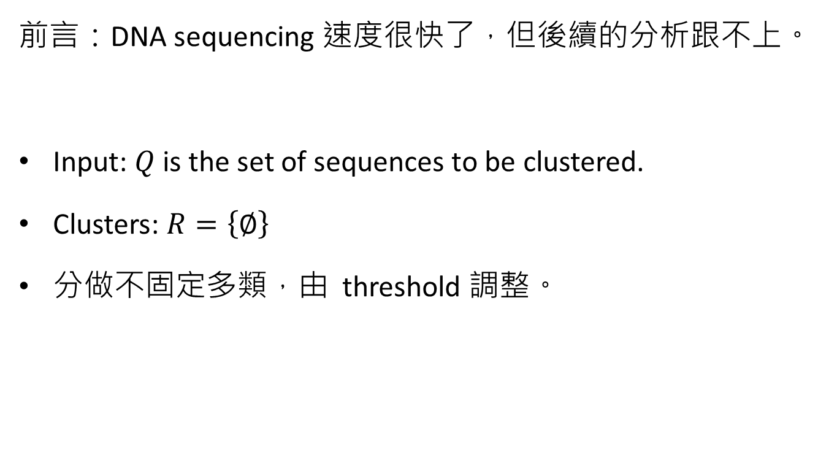
Problem to Solve: Clustering
前言：DNA sequencing 速度很快了，但後續的分析跟不上。
Input: $Q$ is the set of sequences to be clustered.
Clusters: $R=\left\{∅\right\}$
分做不固定多類，由 threshold 調整。

Slide 5
Algorithm
逐一比對 LCS 十分耗時。
基於 CD-HIT
先做過濾，有可能的才進一步計算。
增加了 LCS filtering。

Slide 6
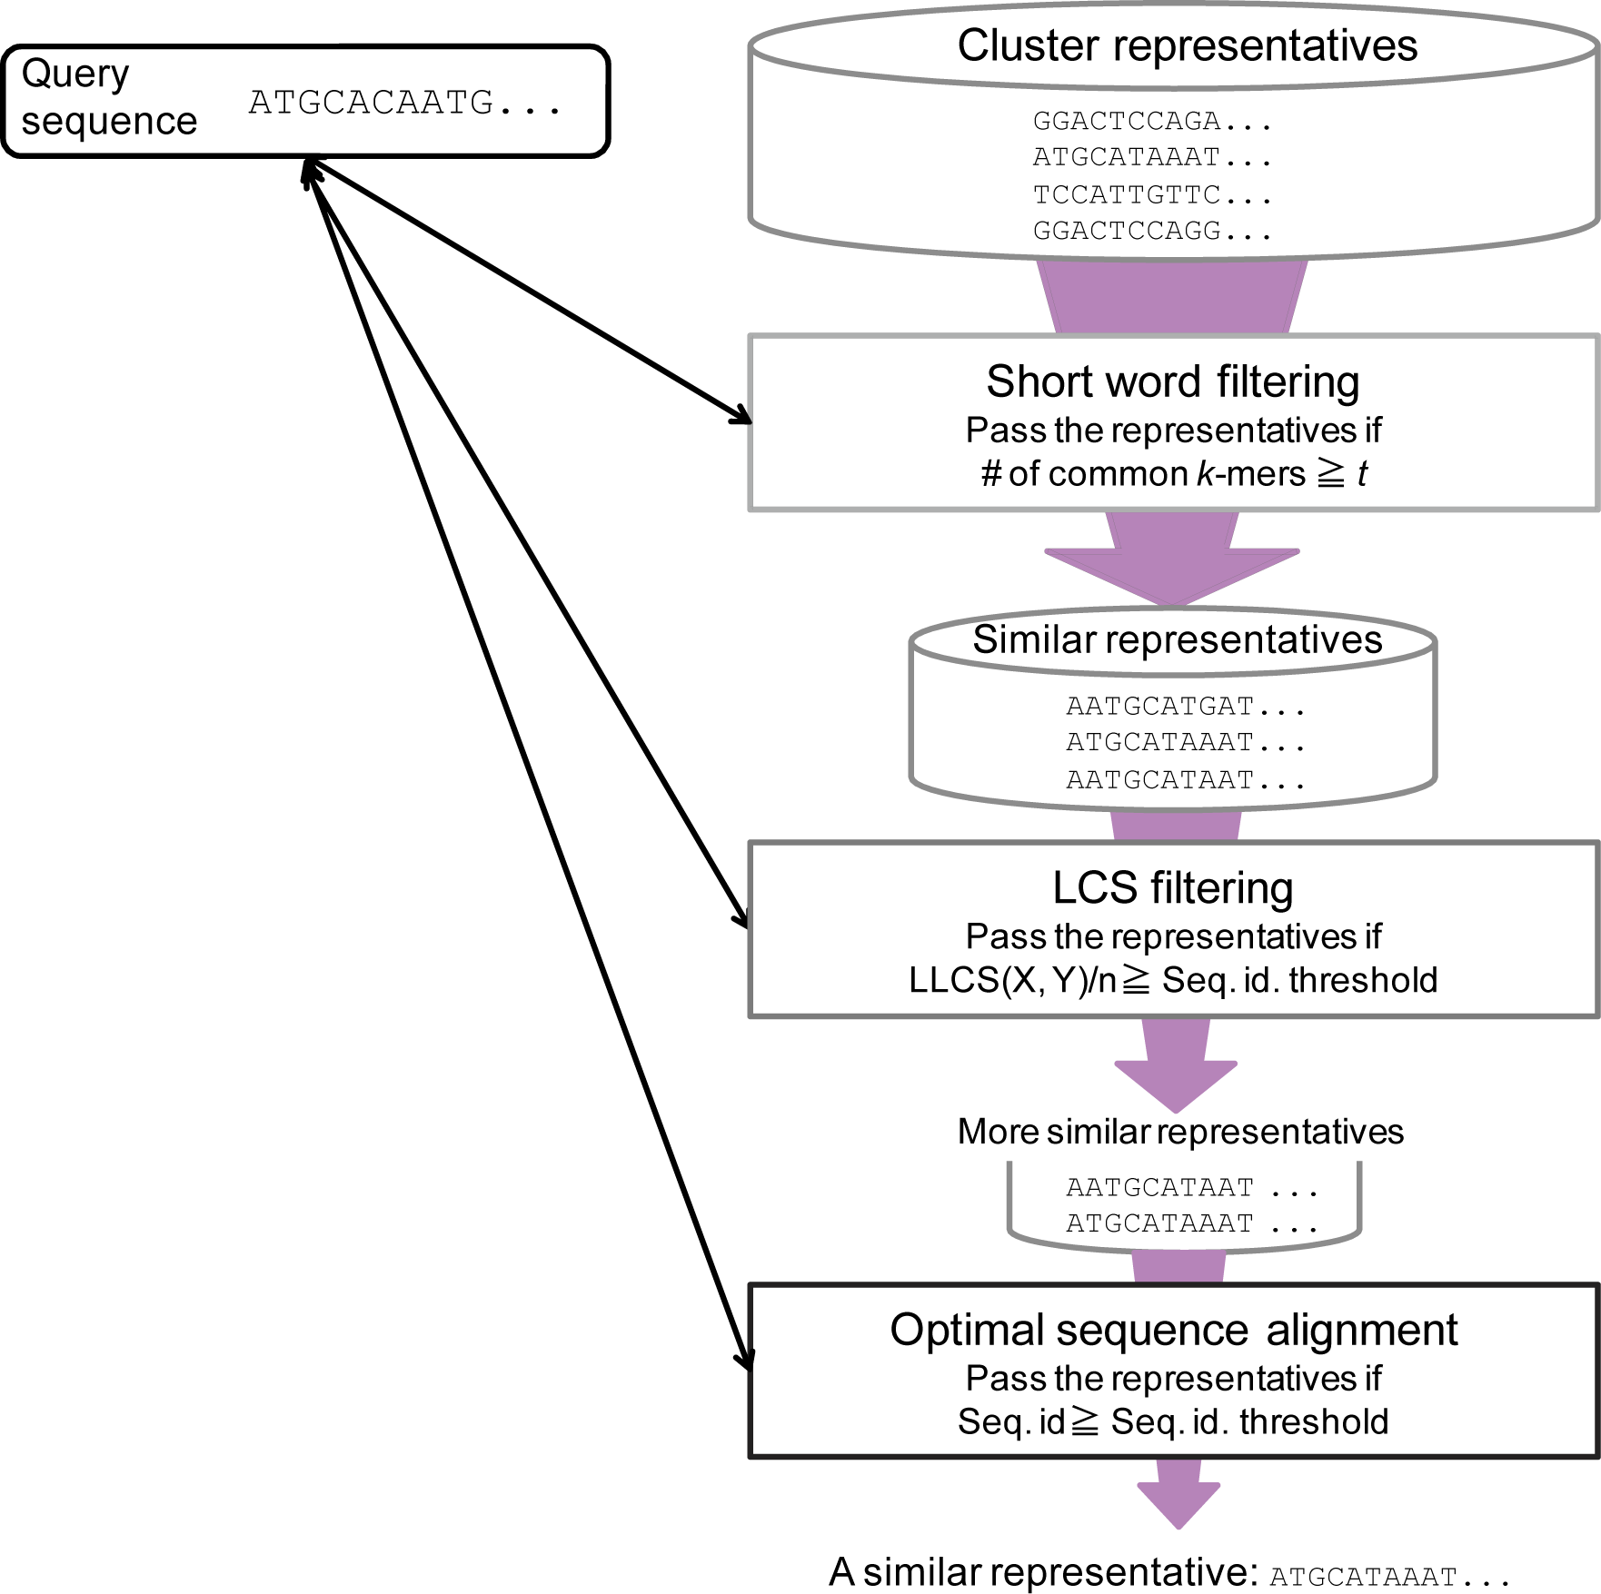



$$r∈R$$
For each $q∈Q$
很粗糙的過濾
以 bit-parallel 加速
若沒有任何相似的類，則增添一類至 $R$。
這裡用 affine gap penalties
Notes:
關鍵詞？http://en.wikipedia.org/wiki/Wordfilter

Slide 7
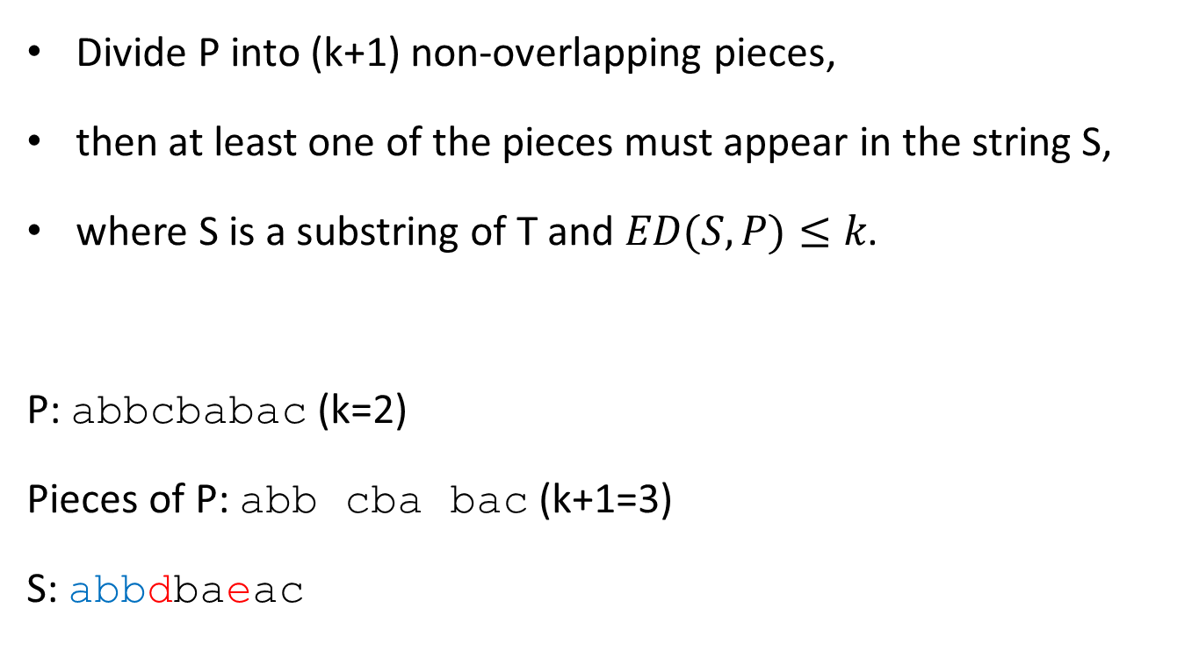
The Partial Exact Matching
Divide P into (k+1) non-overlapping pieces,
then at least one of the pieces must appear in the string S,
where S is a substring of T and $ED(S,P)≤k$.
P: abbcbabac (k=2)
Pieces of P: abb cba bac (k+1=3)
S: abbdbaeac

Slide 8
Short Word Table
CD-HIT
All the k-mers
# common k-mer > t’
This paper
Every kth k-mer
aatcg cacgc tacgg tacga (ex: k=5)
# common k-mer > t’/k
aatcg
ccata
cacgc
tacgg
tacga
...
空間最多 4^{k}

Slide 9
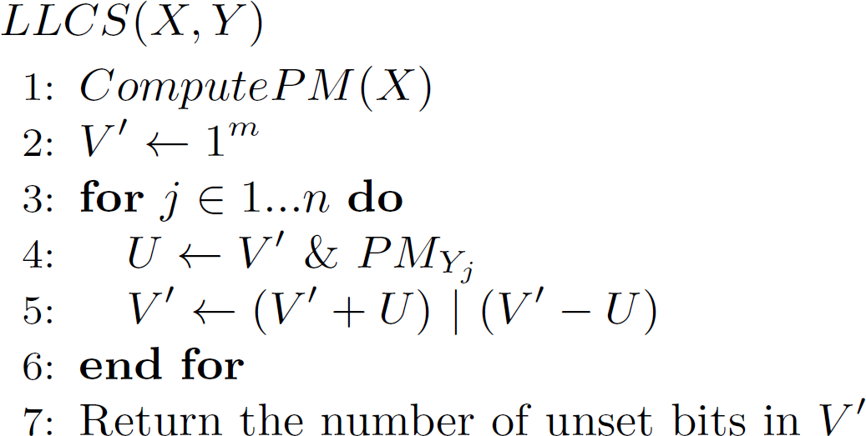
Bit-parallel Algorithm
Example: LCS(tgtca, tgac)
v’: 11111
PMt: 00101
u: 00101
v+u: 00100
v-u: 11010
v’: 11110
PMg: 00010
u: 00010
v+u: 00000
v-u: 11100
v’: 11100
X: | t | g | t | c | a
PMa | 0 | 0 | 0 | 0 | 1
PMt | 1 | 0 | 1 | 0 | 0
PMc | 0 | 0 | 0 | 1 | 0
PMg | 0 | 1 | 0 | 0 | 0
2^{k} | 0 | 1 | 2 | 3 | 4
PMa: 10000
u: 10000
v+u: 01100
v-u: 01100
v’: 01100
PMc: 01000
u: 01000
v+u: 10100
v-u: 00100
v’: 10100

Slide 10

Experiment
Sequence identity $s$ = 0.9
Length of short word = 9
# common k-mer
For 100~150 bases: 1
For 400~ bases: 4

Slide 11
