Slide 1
Mining frequent patterns from network flows for monitoring network Expert Systems with Applications vol.37 (2010) pp.8850–8860
Xin Li, Zhi-Hong Deng
Peking University, Key Laboratory of Machine Perception (Ministry of Education), School of Electronic Engineering and Computer Science
Presentor：Hsin-Chuan Yuan

Slide 2
Abstract
Because of the varying and dynamic characteristics of network traffic, such as fast transfer, huge volume, shot-lived, inestimable and infinite, it is a serious challenge for network administrators to monitor network traffic in real time and judge whether the whole network works well. Currently, most of the existing techniques in this area are based on signature training, learning or matching, which may be too complicated to satisfy timely requirements. Other statistical methods including sampling, hashing or counting are all approximate methods and compute an incomplete set of results. Since the main objective of network monitoring is to discover and understand the active events that happen frequently and may influence or even ruin the total network.

Slide 3
Abstract
So in the paper we aim to use the technique of frequent pattern mining to find out these events. We first design a sliding window model to make sure the mining result novel and integrated; then, under the consideration of the distribution and fluidity of network flows, we develop a powerful class of algorithms that contains vertical re-mining algorithm, multi-pattern re-mining algorithm, fast multi-pattern capturing algorithm and fast multi-pattern capturing supplement algorithm to deal with a series of problems when applying frequent pattern mining algorithm in network traffic analysis.

Slide 4
Abstract
Finally, we develop a monitoring system to evaluate our algorithms on real traces collected from the campus network of Peking University. The results show that some given algorithms are effective enough and our system can definitely identify a lot of potentially very valuable information in time which greatly help network administrators to understand regular applications and detect network anomalies. So the research in this paper not only provides a new application area for frequent pattern mining, but also provides a new technique for network monitoring.

Slide 5
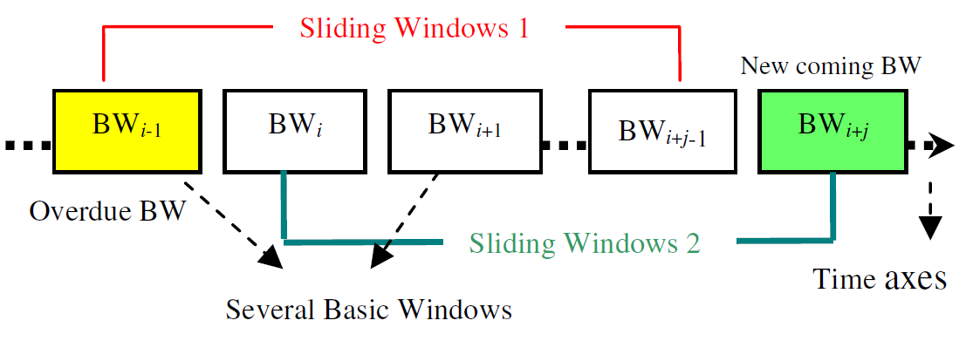
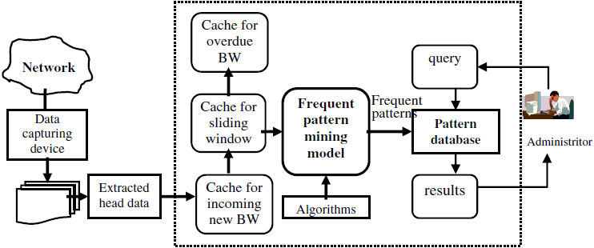
Model and framework

Slide 6
Algorithms
Vertical re-mining
Multi-pattern re-mining
Fast multi-pattern capturing
Fast multi-pattern capturing supplement

Slide 7
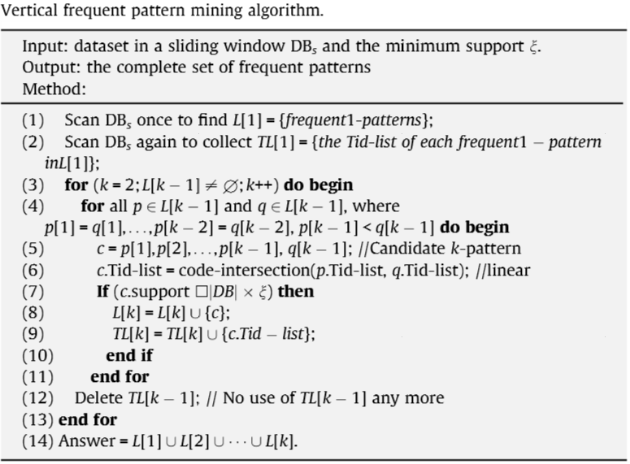
Vertical re-mining(Apriori)

Slide 8
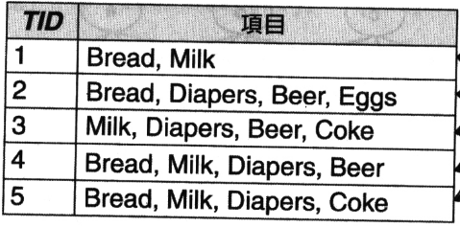
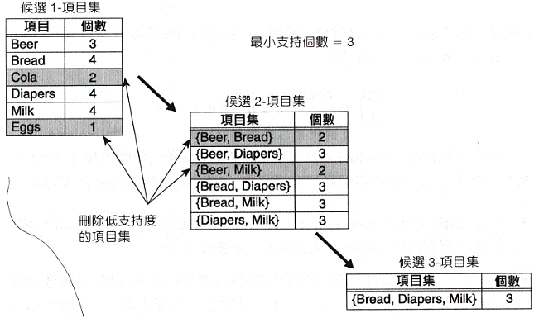
Vertical re-mining(Apriori)

Slide 9
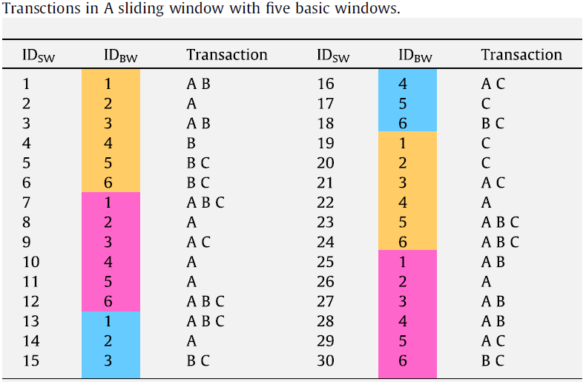
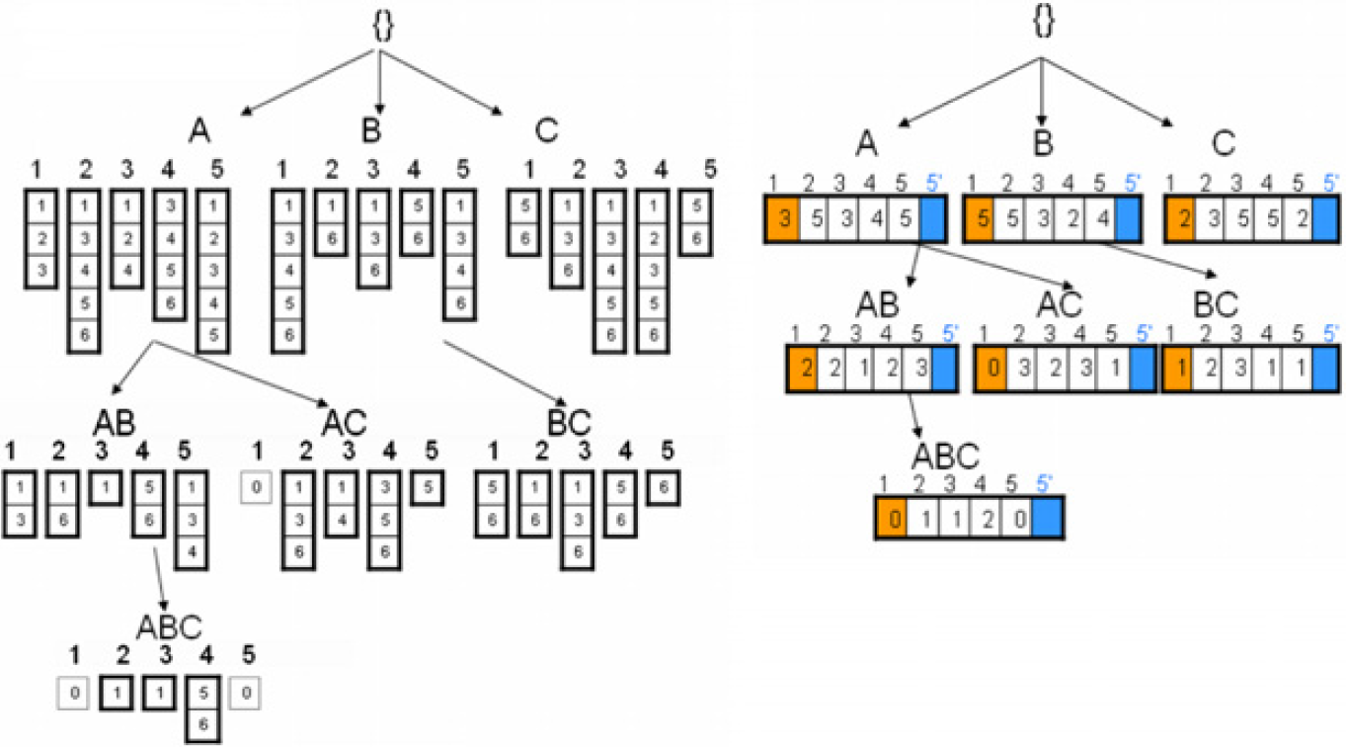
Fast update mining algorithm

Slide 10
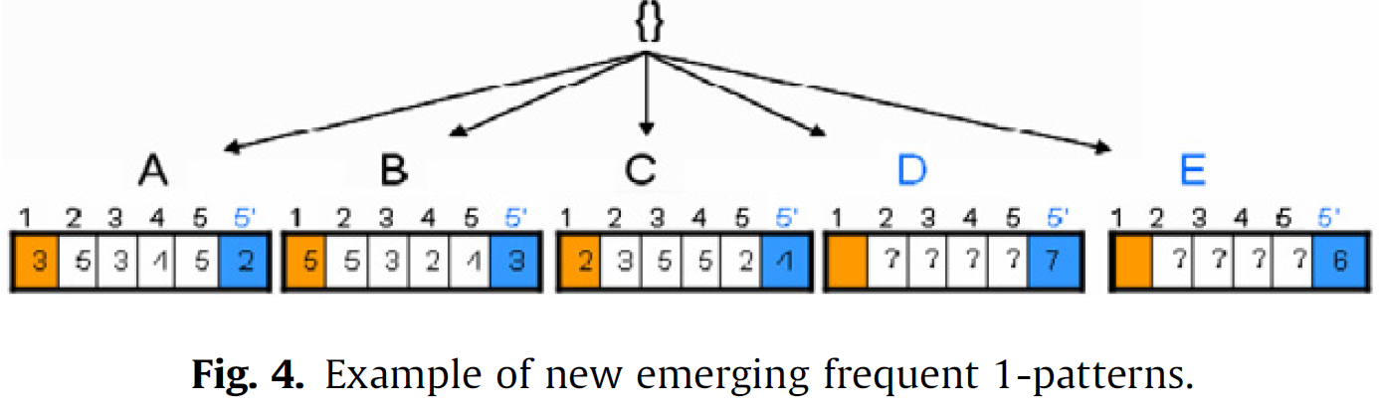
Candidate queue
Candidate queue for D

Slide 11
Multi-pattern re-mining algorithm
(1) Scan the new incoming basic window BW to collect 1-patterns that exist in pattern tree, or exist in candidate queue, or appear frequent in BW with their TidBW-list.
(2) Use fast update mining algorithm to calculate only frequent 1-patterns in pattern tree.
(3) Update candidate queue:
(a) add new 1-patterns into it
(b) delete unsatisfied ones
(c) for the ones that are frequent globally, delete them as well and allocate new nodes in pattern tree to denote them
(4) Calculate the support of frequent (k + 1)-patterns using the Tid-lists of frequent k-pattern.

Slide 12
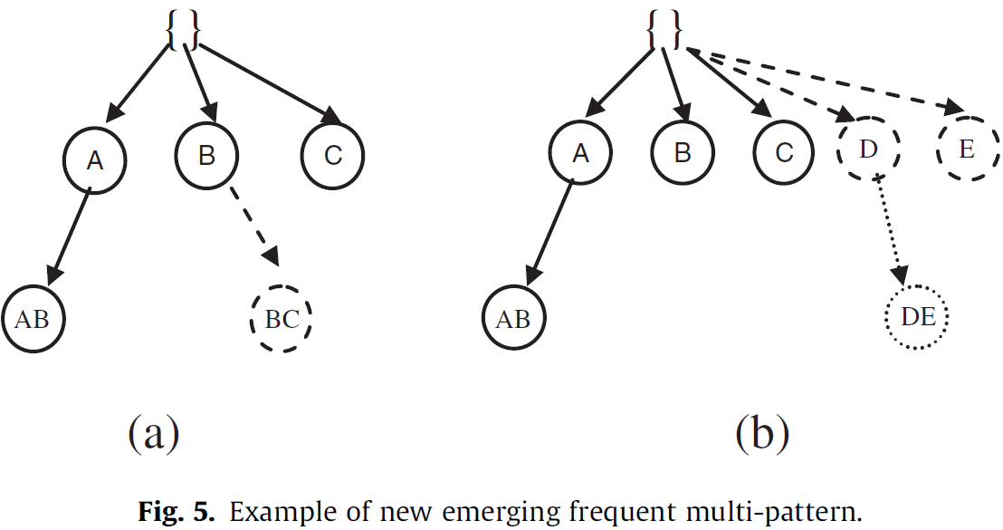
Fast multi-pattern capturing algorithm
Usually a server or a host that appears very active in the network almost always is combined within a fixed pattern.

Slide 13
Fast multi-pattern capturing supplement
Usually a server or a host that appears very active in the network almost always is combined within a fixed pattern.

Slide 14
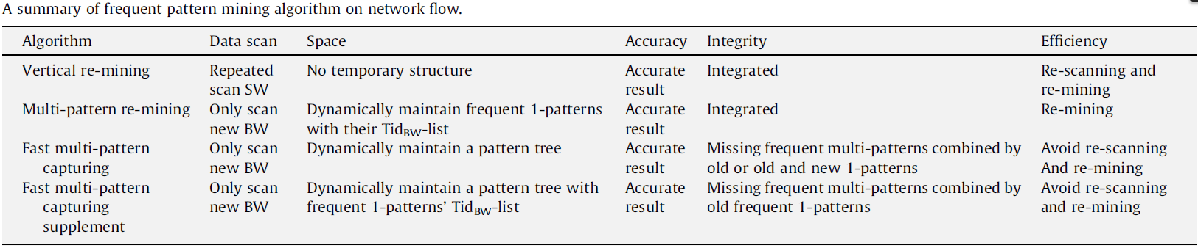
Summary of frequent pattern mining algorithm

Slide 15
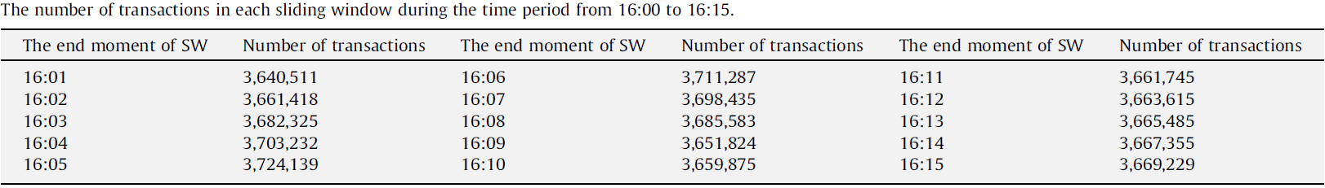
Experiments
Gathering network traces from the campus network of Peking University.

Slide 16
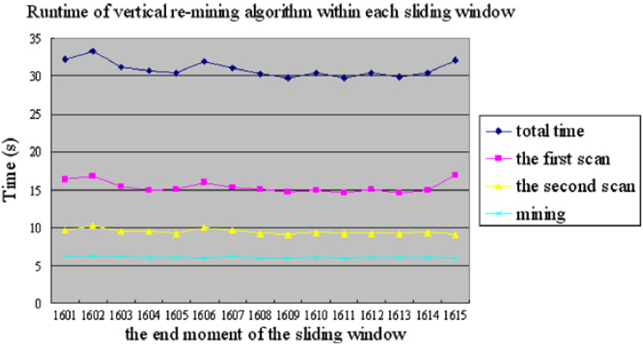
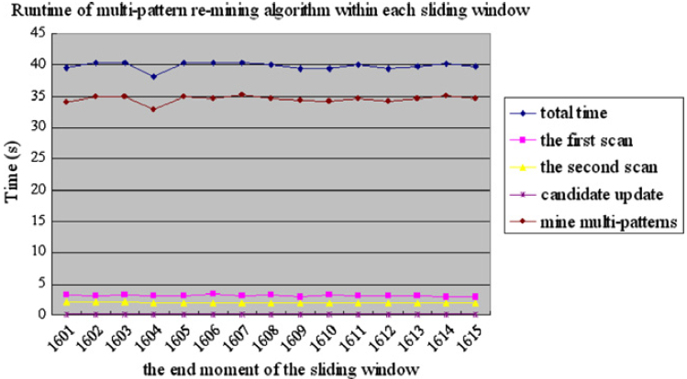
Experiments

Slide 17
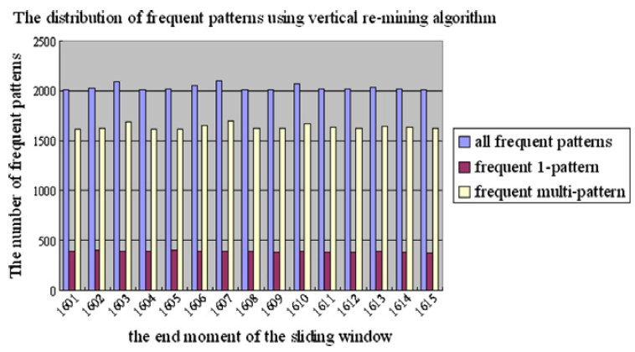
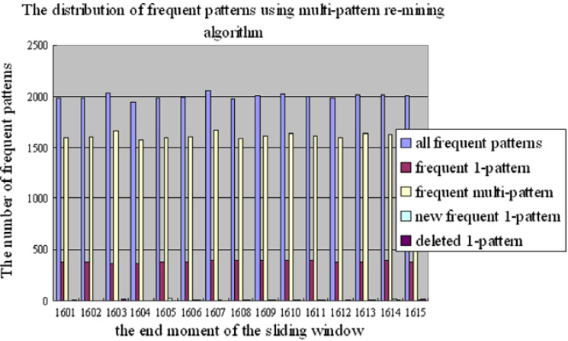
Experiments

Slide 18
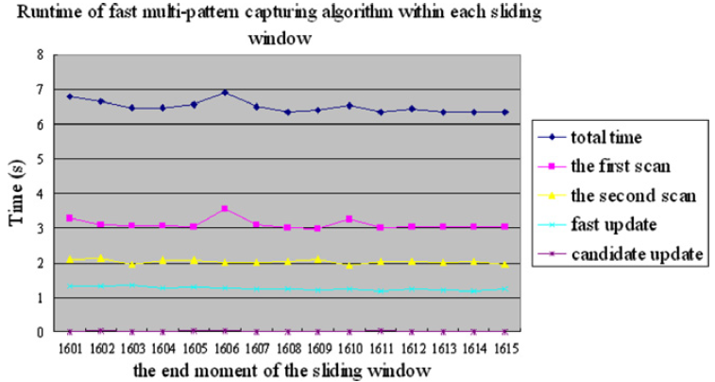
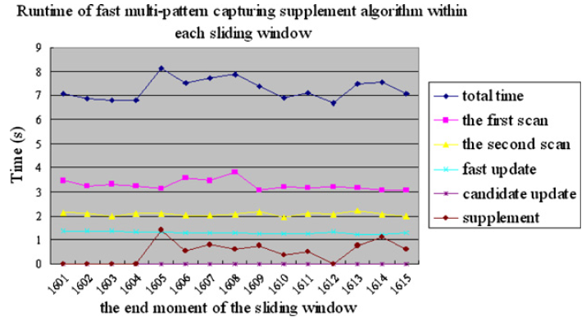
Experiments

Slide 19
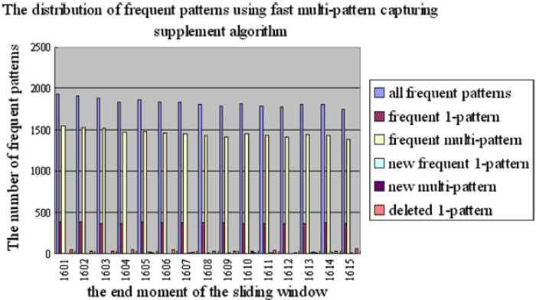
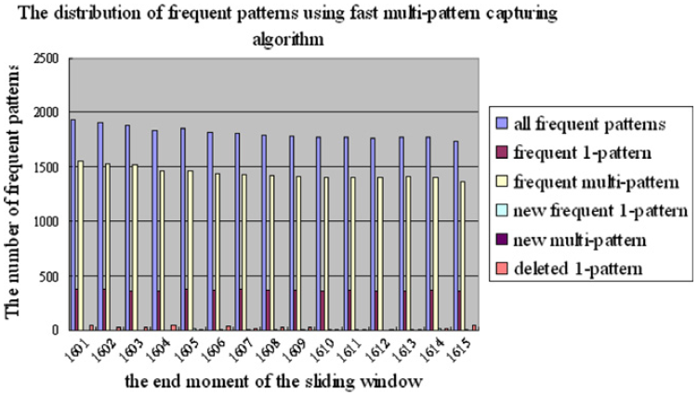
Experiments

Slide 20
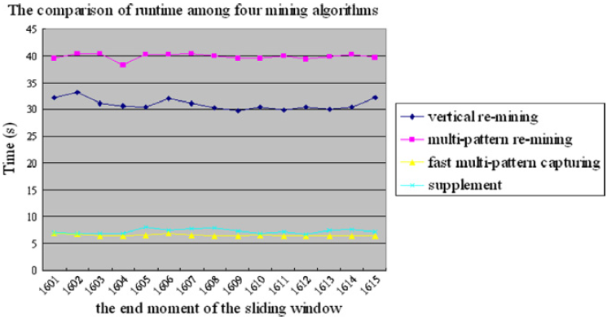
Experiments

Slide 21
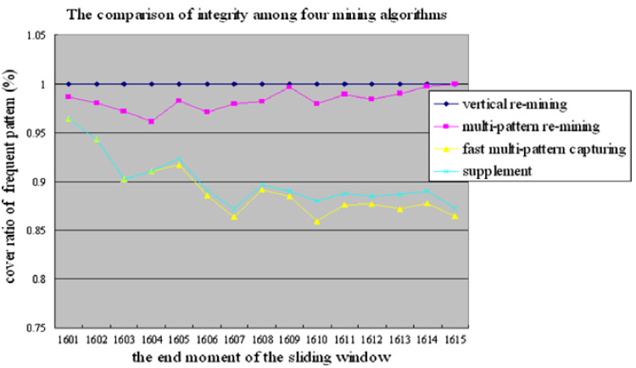
Experiments

Slide 22
Conclusions
We plan to improve this work by applying algorithms of closed-pattern mining, top-k pattern mining, or maximal mining to condense the mount of frequent patterns.
Exploiting a system interface to automatically reveal the patterns with which the administrator may be interested.
Designing a self-learning model that can identify normal and anomaly actions automatically.

