Slide 1
Prediction of disulfide bonding pattern based on a support vector machine and multiple trajectory search
Lin-Yu Tseng, Hsuan-Hung Lin
Information Sciences 199 (2012)
pp. 167–178
講者:方鈞毅

Slide 2
Abstract
To determine protein folding, accurately predicting the connectivity pattern of disulfide bridges can significantly reduce the search space, helping to solving the protein-folding problem.
Therefore, developing an effective means of predicting disulfide connectivity patterns facilitates the estimation of the three-dimensional structure of a protein and its function.
To our knowledge, with the prior knowledge of the bonding states of cysteines, the highest accuracy rate in the literature for predicting the overall disulfide connectivity pattern (Qp) is 74.4% for dataset SP39. Dataset SP39 is conventionally adopted to predict disulfide connectivity.

Slide 3
Abstract
This work presents a novel classifier based on the support vector machine (SVM) that incorporates features of position-specific scoring matrix (PSSM), normalized bond lengths, the predicted secondary structure of protein, and indices for the physico-chemical properties of amino acid.
The support vector machine is trained to derive the connectivity probabilities of cysteine pairs. Additionally, an evolutionary algorithm called the multiple trajectory search (MTS) is integrated with the SVM model to tune the SVM parameters and window sizes for the above features. Moreover, the disulfide connectivity pattern is identified by using the maximum weight perfect matching algorithm.
Experimental results indicate that the accuracy rate for predicting the overall disulfide connectivity pattern (Qp) reaches 79.8% when tested using the same dataset SP39.

Slide 4
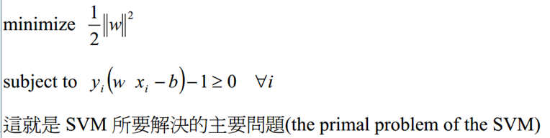
Support Vector Machine(SVM)
支援向量機(Support Vector Machine, SVM)是一種監督式學習的方法，應用於二元的分類問題。
其精神是:找出一個超平面，將兩群做分離，距離(margin)愈遠，分類效過愈好。

Slide 5
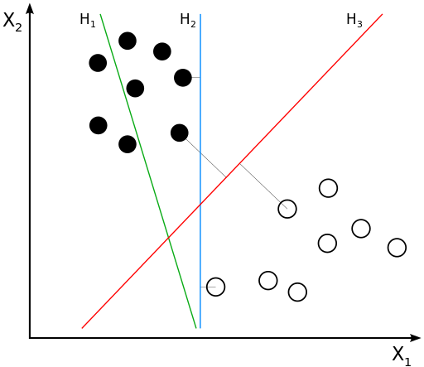
SVM

Slide 6
Multiple Trajectory Search (MTS)
To solve the large scale global optimization problem.
Problem definition:
Minimize F(X) : objective function.
Subject to L ≤ X ≤ U
F(X) X = (x₁, x₂, .., x_{n}), L = (l₁, l₂, .., l_{n}), U = (u₁, u₂, .., u_{n})
Feasible solution X satisfies l_{i} ≤ x_{i} ≤ u_{i} , i = 1 to n

Slide 7
Multiple Trajectory Search (MTS)
Steps
產生 M 個均勻散布的 clients (initial solutions)
根據clients所在的環境執行較佳的local search，並將結果較好的clients做為下一次的疊代(local search)。
執行step2.，直到到達指定次數，或條件。

Slide 8
Local Search
論文中提出三種local search，其行為，為藉由search range(SR)不斷的修改client的座標，並帶入目標凾式判斷好壞。
SR初始為當前維度，上界與下界的二分之一

Slide 9
Local Search
local search1做法: 維度從1到N分開處理，對處理中的維度減去SR，若結果提升，則修改原值，並跳至下一個維度處理，若無提升則恢復原值，再加上SR/2，若提升則修改原值，退化則恢復原值，並跳至下一維度。
若SR經過一輪(1至N)無法再有改進，則SR的範圍再做修改:eg: SR = SR*0.4

Slide 10
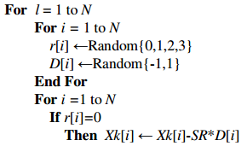
Local Search
Local search2:與Local search1相似，從第一維開始，每個維度有1/4的機會，要做增刪SR，較好則保留，退化則恢復原值，再加減SR/2，同樣較好保留，退化則恢復原值，重複直到第n維的值。

Slide 11
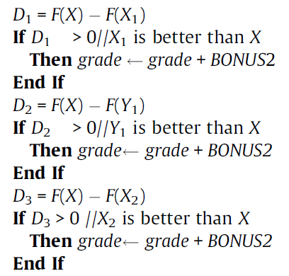

Local Search
Local Search3:從第一維開始，增減微小量值得到X₁ , Y₁, X₂ ，再利用目標凾式與random的結果作移動 。

Slide 12
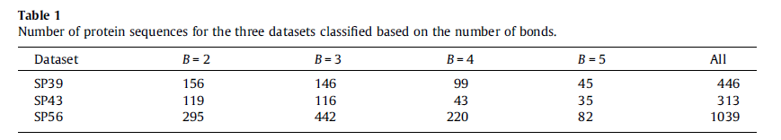
Datasets
SP39 :adopted from the SWISS-PROT database, release No. 39 ,其中最高bond數為5
使用four-fold cross-validation實驗

Slide 13
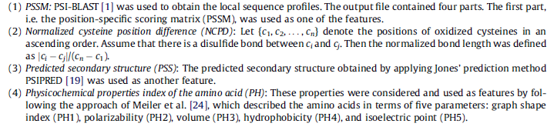
Features
(4)分別是 分子形狀、極化、質量、疏水性等電點
the features were linearly scaled to [1, 1].
GCCSDPRCNMNNPDY

Slide 14
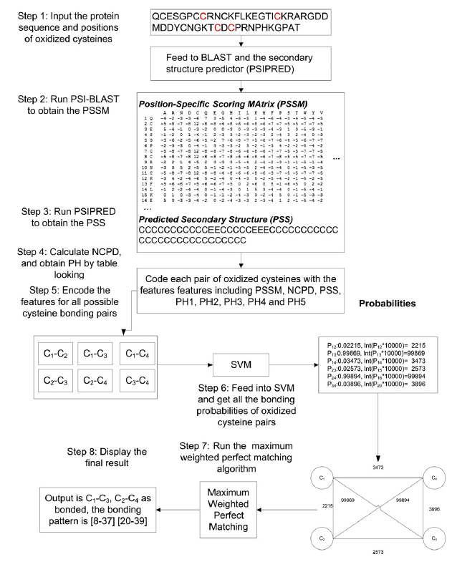

Slide 15
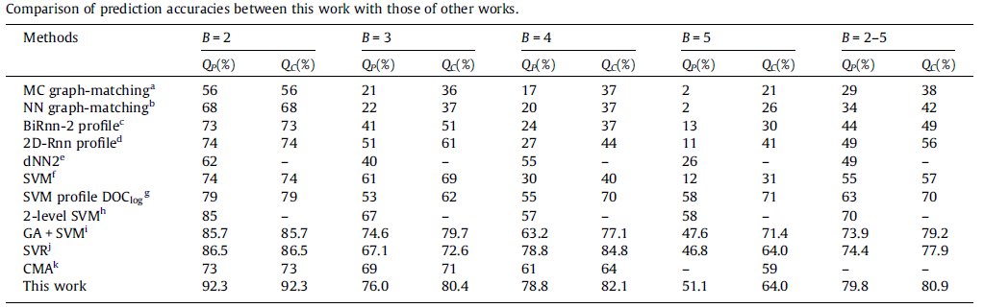
Experimental Result
與前人的方法比較，皆採sp39資料庫
Q_{p} 為整條protein猜中的機率
Q_{c} 為一對cycteine猜中的機率

Slide 16
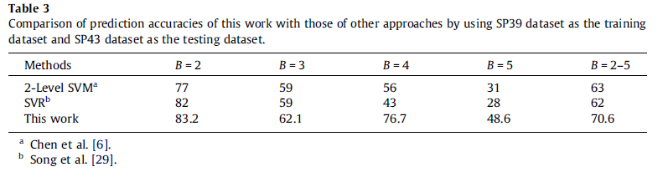
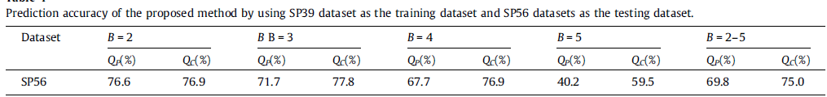
Experimental Result
已下是用sp39訓練，分別用sp43與sp56測試

