Slide 1
DTW-D: Time Series Semi-Supervised Learning from a Single Example
Yanping Chen, Bing Hu, Eamonn Keogh, Gustavo E.A.P.A Batista
Proceedings of the 19th ACM SIGKDD international conference on Knowledge discovery and data mining, Pages 383-391, 2013
Presenter: Che-Jui Hsu (許哲睿)
Date: 2013/9/16
Notes:
http://dl.acm.org/citation.cfm?id=2487633

Slide 2
Abstract (1/2)
Classification of time series data is an important problem with applications in virtually every scientific endeavor. The large research community working on time series classification has typically used the UCR Archive to test their algorithms. In this work we argue that the availability of this resource has isolated much of the research community from the following reality, labeled time series data is often very difficult to obtain.

Slide 3
Abstract (2/2)
The obvious solution to this problem is the application of semi-supervised learning; however, as we shall show, direct applications of off-the-shelf semi-supervised learning algorithms do not typically work well for time series. In this work we explain why semi-supervised learning algorithms typically fail for time series problems, and we introduce a simple but very effective fix. We demonstrate our ideas on diverse real word problems.

Slide 4
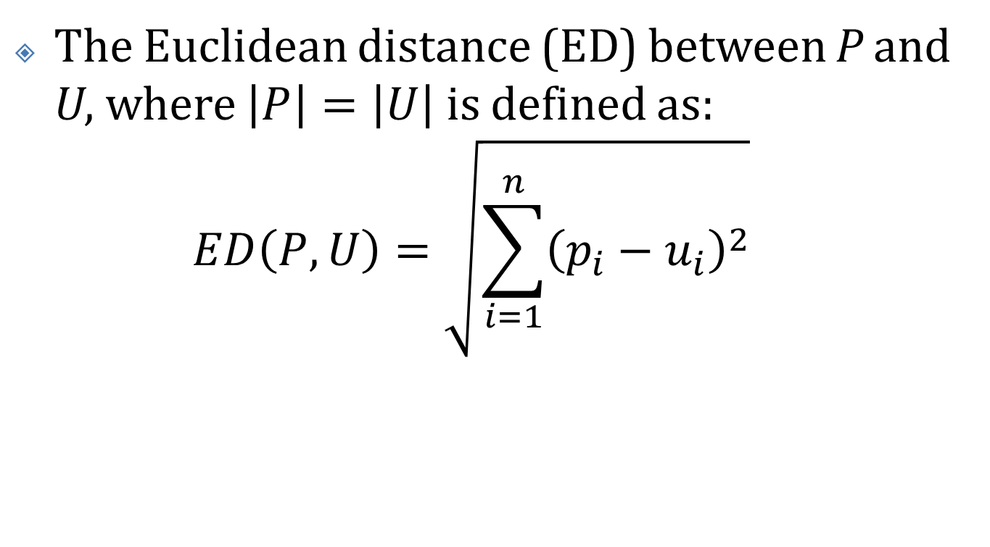
Euclidean Distance
The Euclidean distance (ED) between P and U, where $\left|P\right|=\left|U\right|$ is defined as: $ED\left(P, U\right)=\sqrt{\sum_{i=1}^{n}{{\left(p_{i}−u_{i}\right)}^{2}}}$

Slide 5
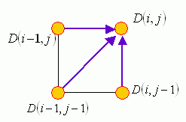

Dynamic Time Warping (1/2)
$DTW\left(i, j\right)=\text{cost}\left(i, j\right)+$ $\min\left(D\left(i−1, j\right),D\left(i, j−1\right),D\left(i,−1 j−1\right)\right)$
Notes:
Ref: http://mirlab.org/jang/books/dcpr/dpDtw.asp?title=8-4%20Dynamic%20Time%20Warping&language=all

Slide 6
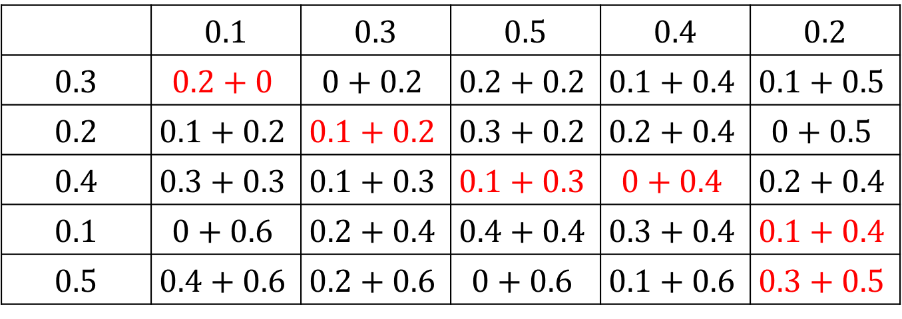

Dynamic Time Warping (2/2)
$P\left[i\right]=\left\{0.1, 0.3, 0.5, 0.4, 0.2\right\}$
$U\left[j\right]=\left\{0.3, 0.2, 0.4, 0.1, 0.5\right\}$
$cost\left(i, j\right)=\left|P\left[i\right]−U\left[j\right]\right|$
 | 0.1 | 0.3 | 0.5 | 0.4 | 0.2
0.3 | $$0.2+0$$ | $$0+0.2$$ | $$0.2+0.2$$ | $$0.1+0.4$$ | $$0.1+0.5$$
0.2 | $$0.1+0.2$$ | $$0.1+0.2$$ | $$0.3+0.2$$ | $$0.2+0.4$$ | $$0+0.5$$
0.4 | $$0.3+0.3$$ | $$0.1+0.3$$ | $$0.1+0.3$$ | $$0+0.4$$ | $$0.2+0.4$$
0.1 | $$0+0.6$$ | $$0.2+0.4$$ | $$0.4+0.4$$ | $$0.3+0.4$$ | $$0.1+0.4$$
0.5 | $$0.4+0.6$$ | $$0.2+0.6$$ | $$0+0.6$$ | $$0.1+0.6$$ | $$0.3+0.5$$

Slide 7

Dynamic Time Warping-Delta (DTW-D) (1/2)
$DTW\text{−}D\left(x, y\right)=\frac{DTW\left(x, y\right)}{ED\left(x, y\right)+ε}$

Slide 8
Why?

Slide 9
Dynamic Time Warping-Delta (DTW-D) (2/2)
Assumption 1: The positive class (the target concept) contains time warped versions of some platonic ideal (some prototypical shape), possibly with other types of noise/distortions.
Assumption 2: The negative class may be very diverse, and occasionally by chance produces objects close to a member of the positive class, even under DTW.

Slide 10
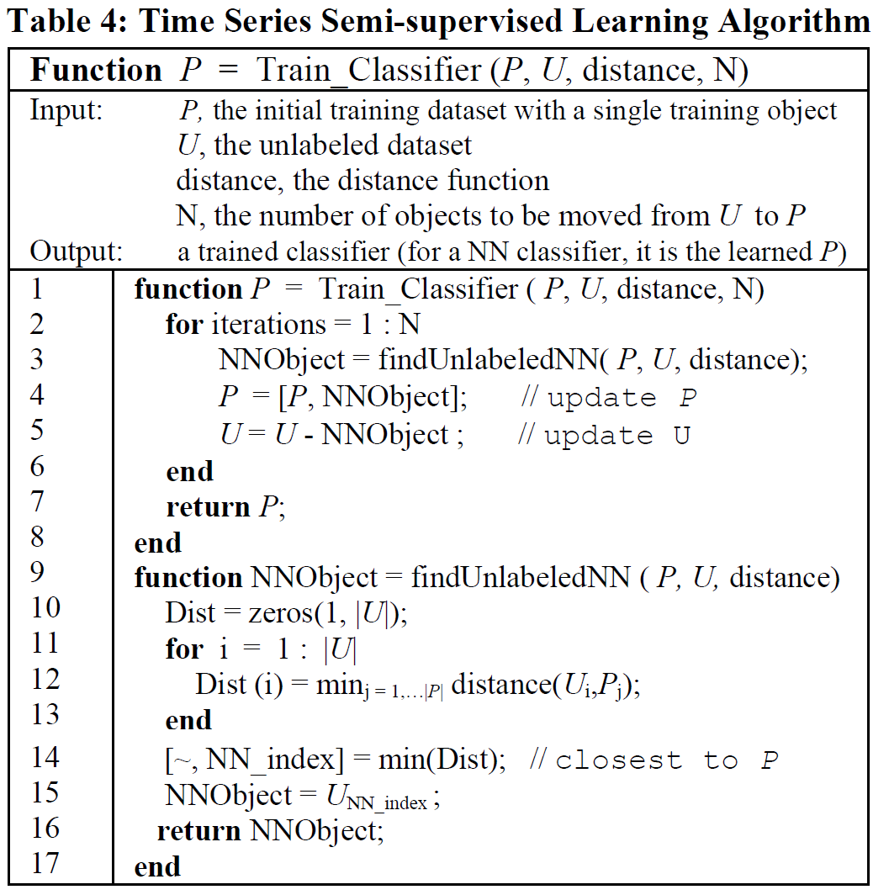
Training the Classifier (1/3)

Slide 11
Training the Classifier (2/3)
Step 1: The classifier is trained on the initial labeled dataset, which contains as few as only one object from the positive class. Note that the labeled dataset is augmented gradually during the training process.
Step 2: For each object in the unlabeled dataset U, we compute its distance to the labeled dataset using DTW-D (Line 10 to Line 13). An object’s distance to the labeled dataset is the distance of the object to its nearest neighbor in the labeled dataset.

Slide 12
Training the Classifier (3/3)
Step 3: Among all the unlabeled objects, the one we can most confidently classify as positive is the object that is closest to the labeled dataset (Line 3). The object is added into the labeled dataset (Line 4) and removed from the unlabeled dataset (Line 5). With the labeled dataset being adjusted, we return to Step 1 to retrain the classifier. The procedure repeated until some stopping criterion is met.

Slide 13
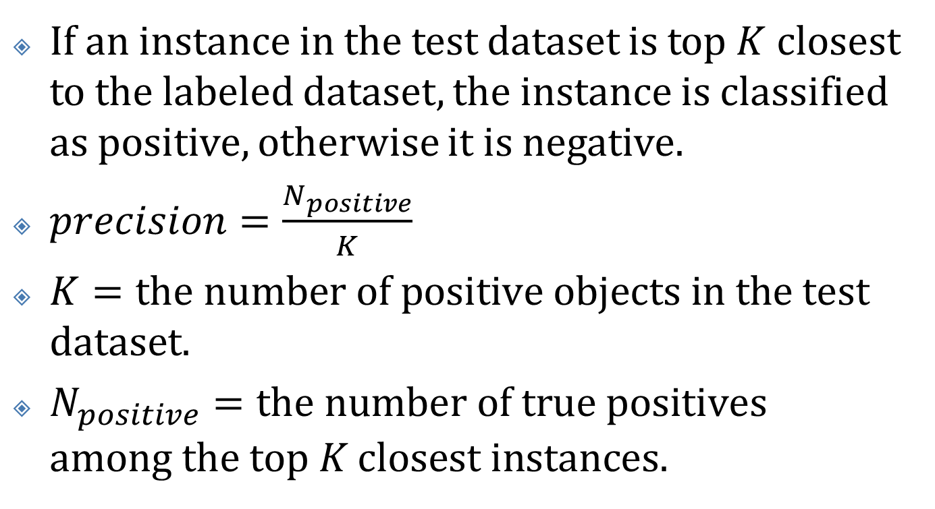
Evaluating the Classifier
If an instance in the test dataset is top $K$ closest to the labeled dataset, the instance is classified as positive, otherwise it is negative.
$precision=\frac{N_{positive}}{K}$
$K=\text{the} \text{number} \text{of} \text{positive} \text{objects} \text{in} \text{the} \text{test} \text{dataset}\text{.}$
$N_{positive}=\text{the} \text{number} \text{of} \text{true} \text{positives} \text{among} \text{the} \text{top} K \text{closest} \text{instances}\text{.}$

Slide 14
Experimental Evaluation
Learning dataset: The learning dataset is used in the SSL process to train the classifier. It is divided into the labeled dataset P and the unlabeled dataset U. The labeled dataset includes a single positive example, which is a randomly selected true positive object from the learning dataset. The rest of objects in the learning dataset are regarded as unlabeled objects and are included in U.
Holdout dataset: The holdout dataset is used to test the accuracy of the learned classifier. Objects in the holdout dataset are hidden from the SSL process.

Slide 15
Insect Wingbeat Sound Detection (1/3)
Learning: 500 insect sounds and 2000 non-insect sounds.
Holdout: 500 insect sounds and 2,200 radio sounds.

Slide 16
Insect Wingbeat Sound Detection (2/3)

Slide 17
Insect Wingbeat Sound Detection (3/3)

Slide 18
Historical Manuscript Mining
Learning: 16 positive objects and 207 negatives.
Holdout: 51 positive objects and 621 negatives.

Slide 19
Activity Recognition
Learning: 100 positive objects and 400 negatives.
Holdout: 300 positive objects and 1,200 negatives.

