Slide 1
Learning Optimal Warping Window Size of DTW for Time Series Classification
Qian Chen, Guyu Hu, Fanglin Gu, Peng Xiang
Information Science, Signal Processing and their Applications (ISSPA), 2012 11th International Conference p.1272 – p.1277
Date: 2013/10/15
Presenter: 周展億

Slide 2
Abstract
The dynamic time warping (DTW) is a classic similarity measure which can handle the time warping issue in similarity computation of time series. And the DTW with constrained warping window is the most common and practical form of DTW. In this paper, the traditional learning method for optimal warping window of DTW is systematically analyzed. Then the time distance to measure the time deviation between two time series is introduced. Finally a new learning method for optimal warping window size based on DTW and time distance is proposed which can improve DTW classification accuracy with little additional computation. Experimental data show that the optimal DTW with best warping window get better classification accuracy when the new learning method is employed. Additionally, the classification accuracy is better than that of ERP and LCSS, and is close to that of TWED.

Slide 3
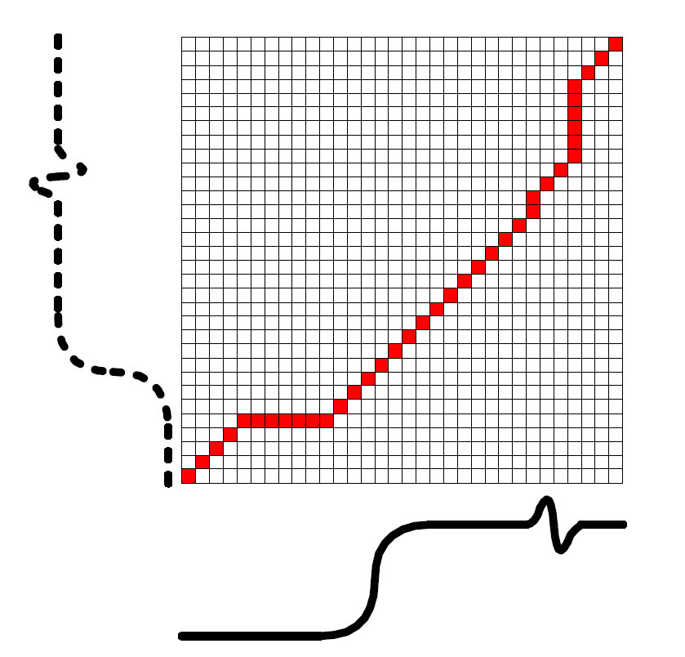
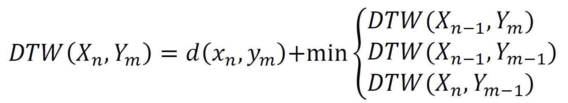
DTW and Warping Path
有兩時間序列：X與Y
X的長度為n，Y的長度為m
時間複雜度為O ( n * m )

Slide 4
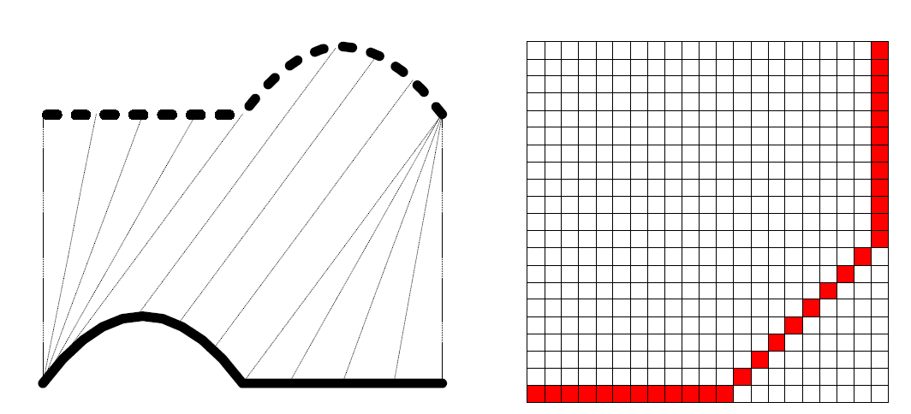
Global Constraints of DTW
可依照某些物理意義的需要，給予範圍的限制。

Slide 5
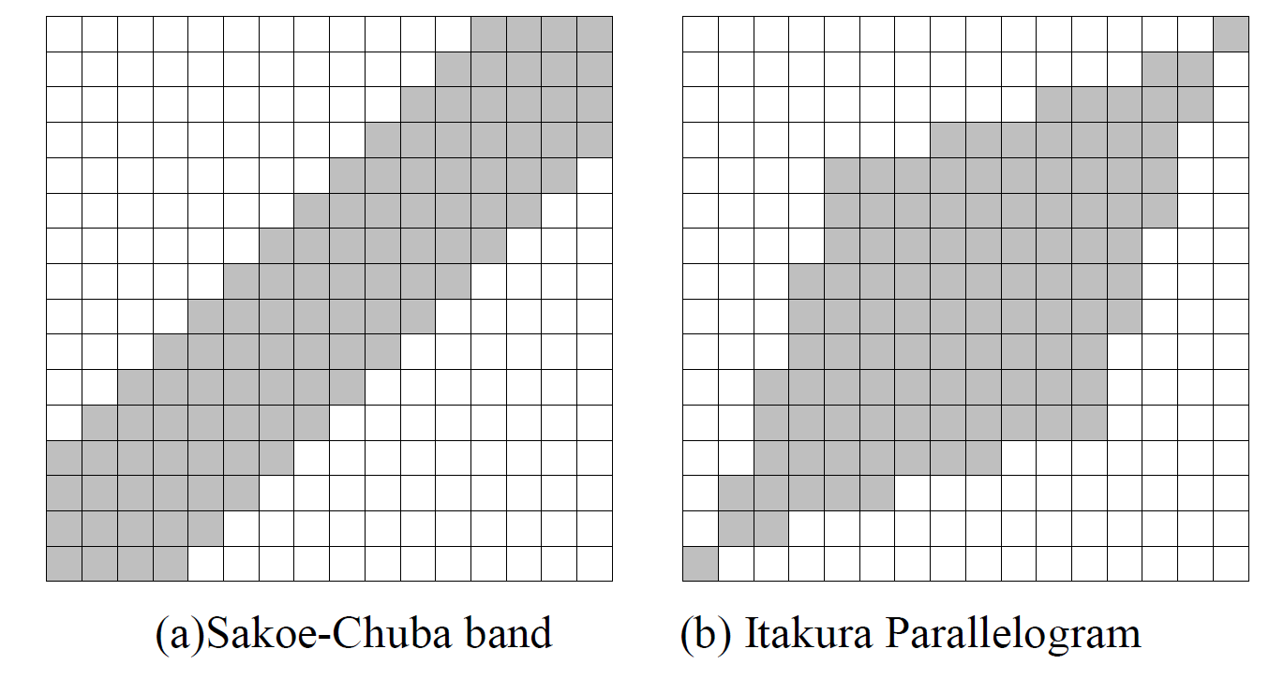
Global Constraints of DTW
常被使用的範圍限制：

Slide 6
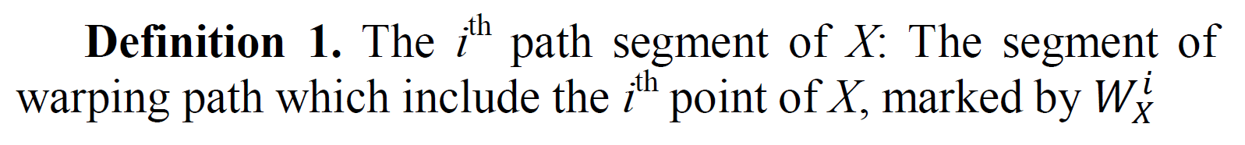
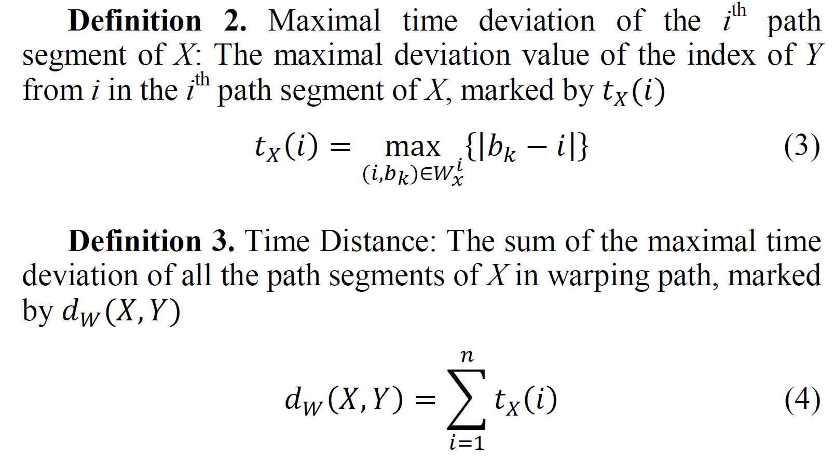
Learning Optimal Warping Window of DTW
DTW Distance：增加Warping window size，觀察哪次的結果最好。
Time Distance between the Time Series：

Slide 7
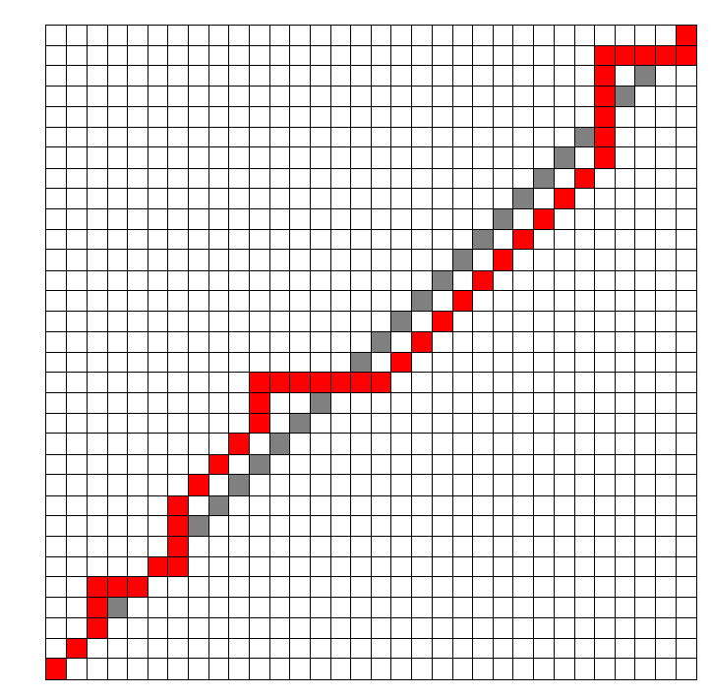
Learning Optimal Warping Window of DTW
Time Distance 即為理想的Warping Path 與實際的Warping Path 的垂直距離。

Slide 8
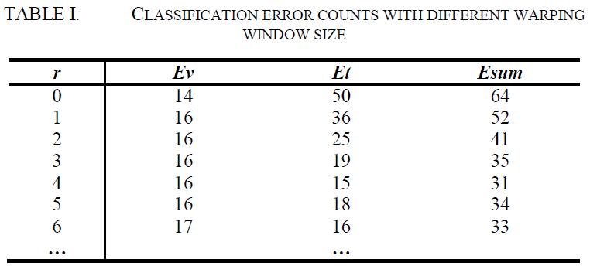
New Learning Method based on both Distances
Ev : the results of DTW distance
Et : the results of time distance
Esum : the sum of Ev and Et

Slide 9

New Learning Method based on both Distances
條件：

Slide 10
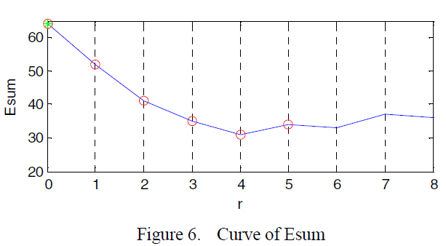
New Learning Method based on both Distances
1. Setting the candidates, select the segment that contains minimum of Ev if candidates consist of several segments.
2. If Ev and Et. changes with all candidates, select the size leading to the first relative minimal point of Esum .
3. If Ev is a constant with all candidates, select the size leading to the minimum of Et .
4. If different values lead to the first relative minimal, select the median.

Slide 11
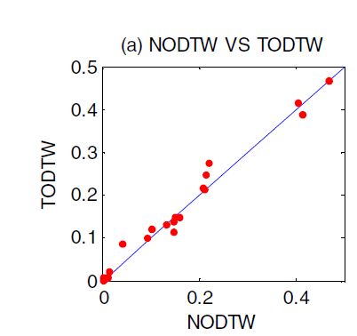
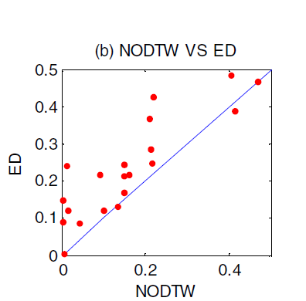
Experiment
Comparison of distance pairs

Slide 12
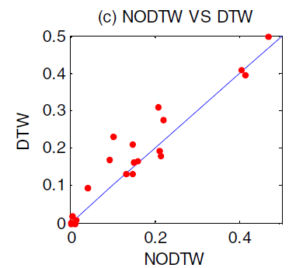
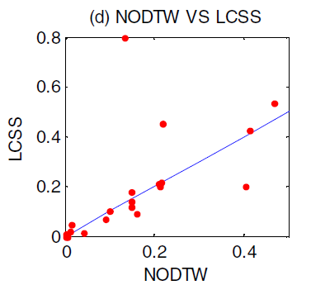
Experiment
Comparison of distance pairs

Slide 13
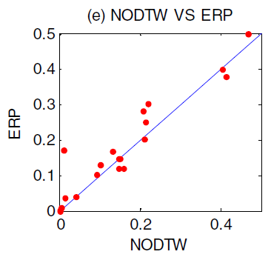
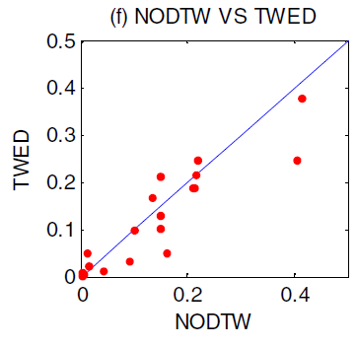
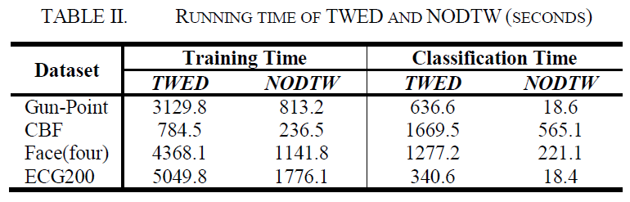
Experiment

