Slide 1
Support Vector Data Description
DAVID M.J. TAX and ROBERT P.W. DUIN
Machine Learning, 54, pp. 45–66, 2004

Slide 2
Abstract
Data domain description concerns the characterization of a data set. A good description covers all target data but includes no superfluous space. The boundary of a dataset can be used to detect novel data or outliers. We will present the Support Vector Data Description (SVDD) which is inspired by the Support Vector Classifier. It obtains a spherically shaped boundary around a dataset and analogous to the Support Vector Classifier it can be made flexible by using other kernel functions. The method is made robust against outliers in the training set and is capable of tightening the description by using negative examples. We show characteristics of the Support Vector Data Descriptions using artificial and real data.

Slide 3
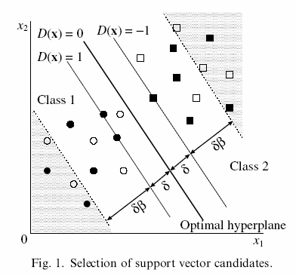
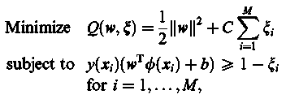
Support Vector Machines
■●: Original data
δ: Optimal separating hyperplane
□: Newly added data
δβ: Tolerance margin

Slide 4
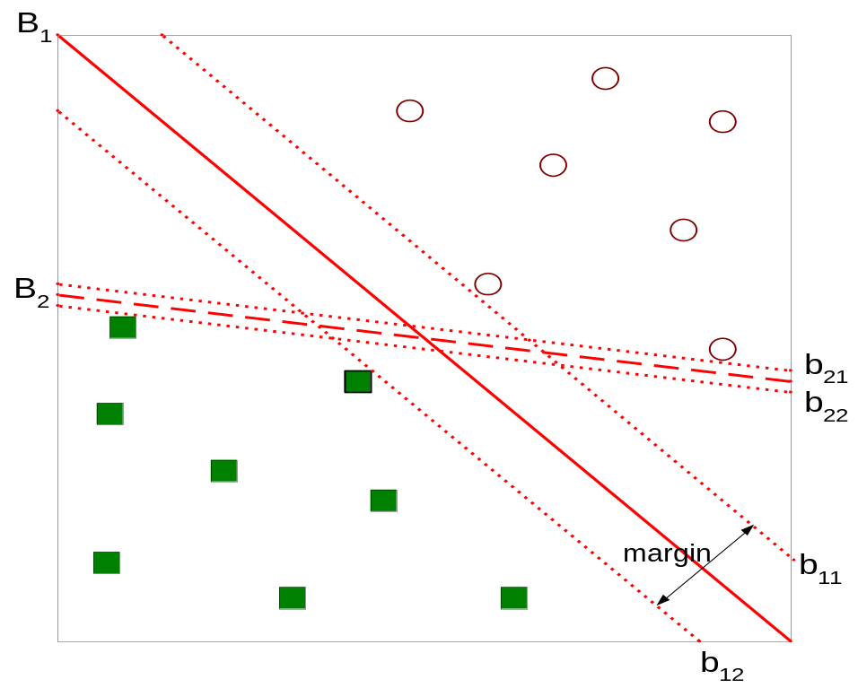
Support Vector Machines
The problem is linearly separable.
Find hyperplane maximizes the margin => b1 is better than b2
Taken from the textbook: Introduction to Data Mining

Slide 5
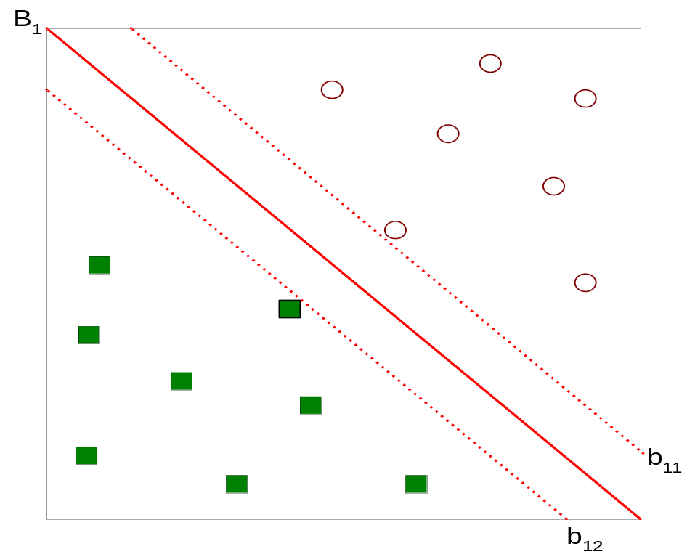



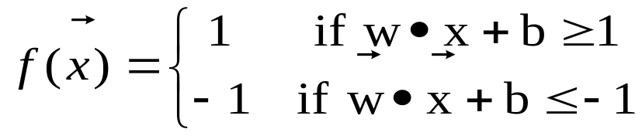
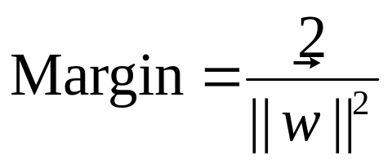
Support Vector Machines
The problem is linearly separable.
Taken from the textbook: Introduction to Data Mining

Slide 6
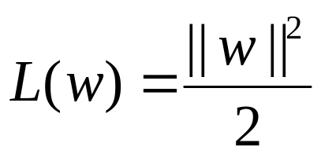
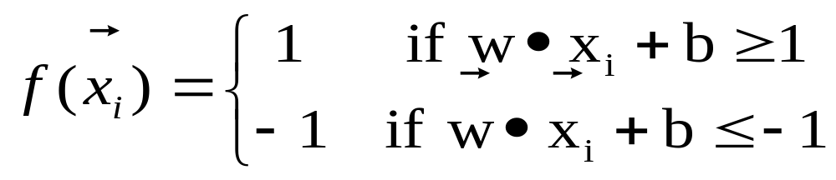
Support Vector Machines
The linearly separable problem.
We want to maximize:
  Which is equivalent to minimizing:
  But subjected to the following constraints:
    This is a constrained optimization problem
      Numerical approaches to solve it (e.g., quadratic programming)
Taken from the textbook: Introduction to Data Mining

Slide 7
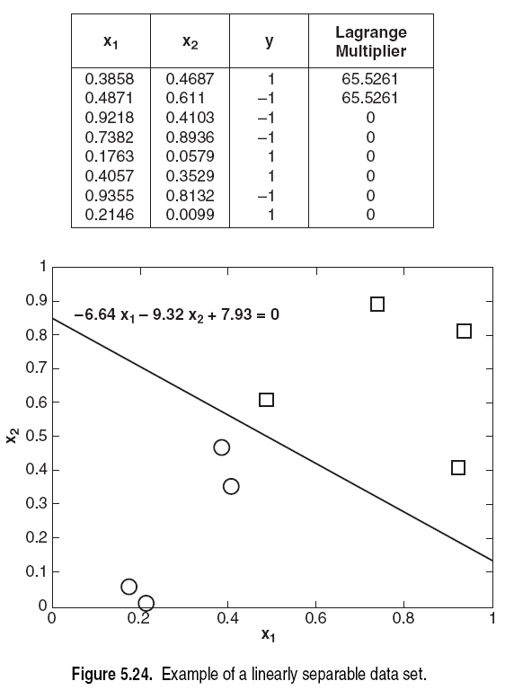
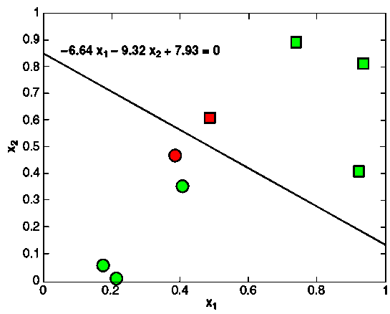
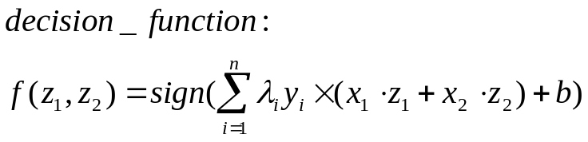
λ_{i}
Informative samples
Non-informative samples
Taken from the textbook: Introduction to Data Mining

Slide 8
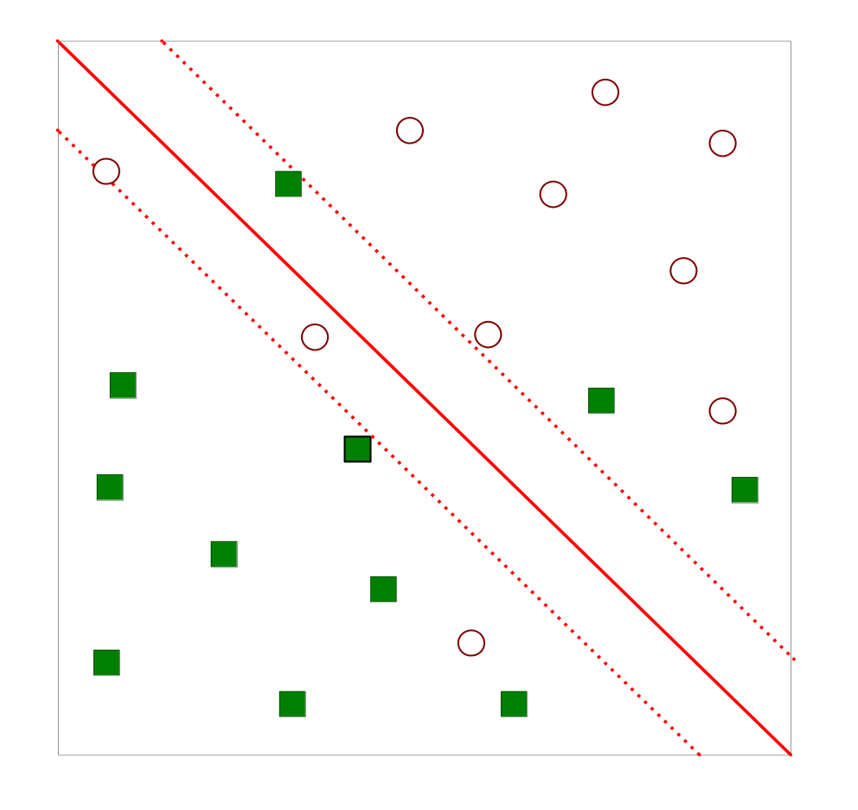
Support Vector Machines
What if the problem is not linearly separable?
Taken from the textbook: Introduction to Data Mining

Slide 9
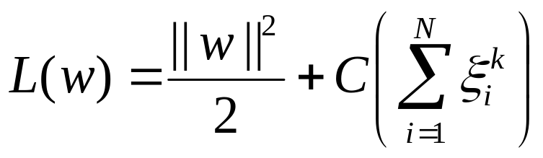
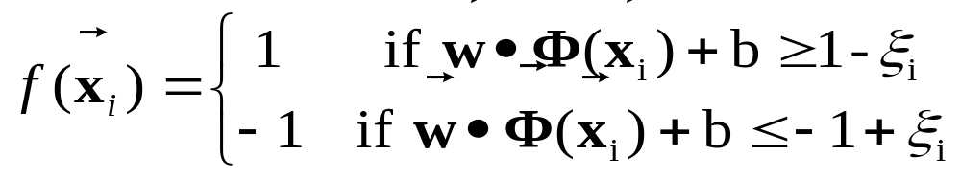
Nonlinear Support Vector Machines
What if the problem is not linearly separable?
  Introduce slack variables
    Need to minimize:
    Subject to:
    w & Φ are higher dimensional then x.
Taken from the textbook: Introduction to Data Mining

Slide 10
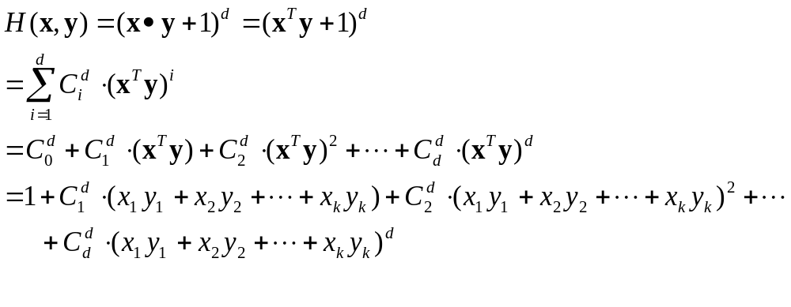
How to map x to φ(x)?
For polynomial kernel
  Define H(x,y)=(x·y+1)^{d} = φ(x) ·φ(y)

Slide 11
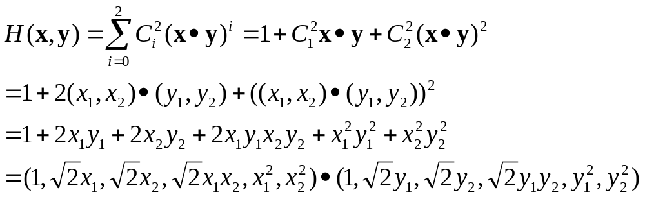
How to map x to φ(x)?
Polynomial kernel example
  If x=(x₁,x₂), d=2, H(x,y)=(x·y+1)²

Slide 12
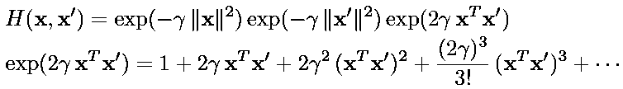
How to map x to φ(x)?
Radial basis function (RBF) kernels
  H(x,x’)=exp(-γ||x-x’||²)

Slide 13
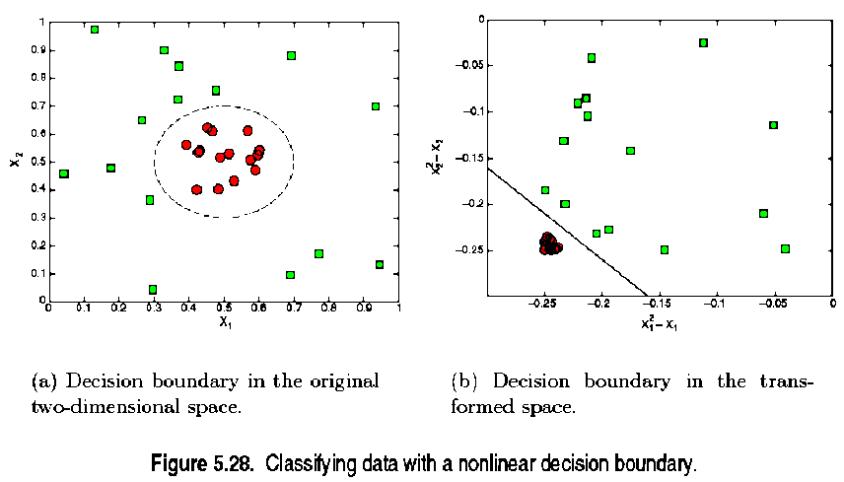
Nonlinear SVM Example 1
(x₁-0.5)² +(x₂-0.5)² =2 ⇒(x₁²-x₁)+(x₂² -x₂)-0.46=0
Taken from the textbook: Introduction to Data Mining

Slide 14
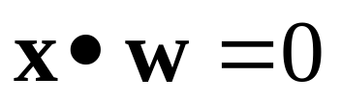
Nonlinear SVM Example 1
Original decision boundary is:
  (x₁-0.5)²+(x₂-0.5)²=2 ⇒
  x₁²-x₁+x₂ ²-x₂-0.46=0 ⇒
  (x₁²,x₂²,x₁,x₂,1)• (1,1,-1,-1,1)=0
The transformation is:
  Φ:(x₁, x₂)_{2D}→(x₁²,x₂², x₁, x₂,1)_{4D}
  Class1: (x₁²,x₂², x₁, x₂,1)•(1,1,-1,-1,1)>0
  Class2: (x₁²,x₂², x₁, x₂,1)•(1,1,-1,-1,1)<0
The transformed decision boundary has the following form. It is linear in the higher dimension.
Taken from the textbook: Introduction to Data Mining

Slide 15
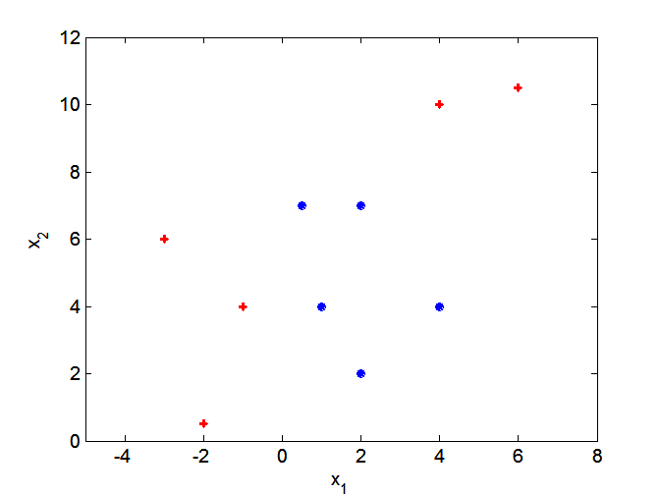
Nonlinear SVM Example 2
What if decision boundary is not linear?
Taken from the textbook: Introduction to Data Mining

Slide 16
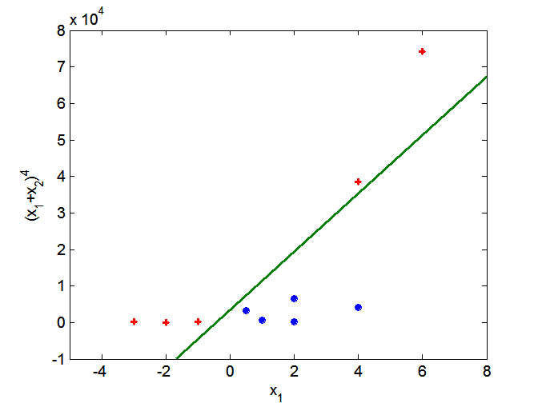
Nonlinear SVM Example 2
Transform data into higher dimensional space
Taken from the textbook: Introduction to Data Mining

Slide 17
Support Vector Machines
SVM learning problem can be formulated as a convex optimization problem, in which efficient algorithm are available to find the global minimization. (eg. The neural network is not.)
SVM can be applied to categorical data (eg. Modeling marital (婚姻的) status∈{single, married, divorced} as [0/1,0/1,0/1])
It is possible to extend SVM to multi-class problems.
Taken from the textbook: Introduction to Data Mining

Slide 18
VC (Vapnik Chernovenkis) Dimension
The VC dimension of the class {f(x, a)} is defined to be the largest number of points (in some configuration) that can be shattered by members of {f(x, a)}.
The Vapnik Chernovenkis dimension is a way of measuring the complexity of a class of functions by assessing how wiggly its members can be.
One can use the VC dimension in constructing an estimate of in-sample prediction error.
Taken from the textbook: The elements of statistical learning

Slide 19
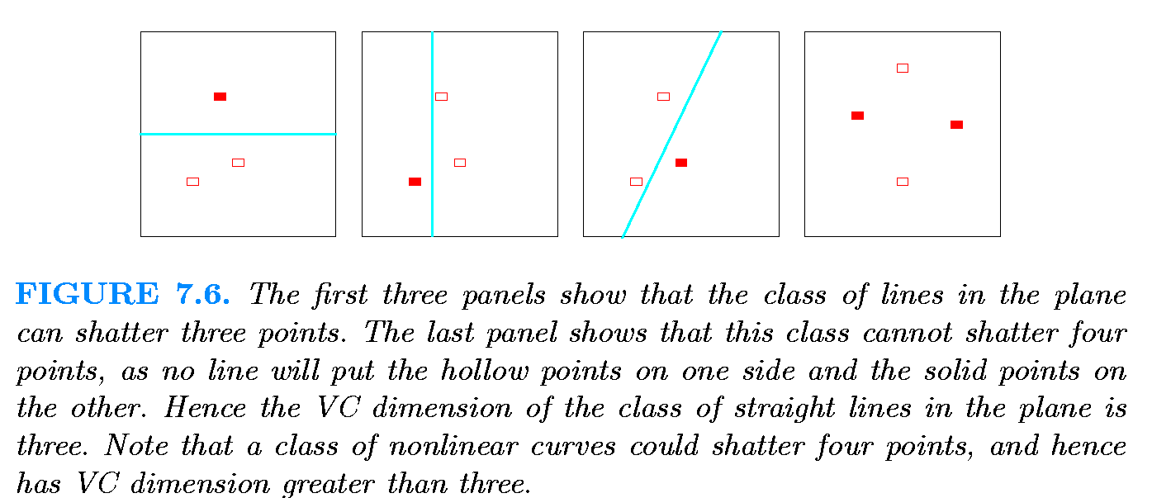
VC Dimension
In general, a linear indicator function in p dimensions has VC dimension p + 1, which is also the number of free parameters.
Taken from the textbook: The elements of statistical learning

Slide 20

VC Dimension for SVM kernels
Assuming the dimension of the feature space is n, then the VC dimension is as follows
  Linear SVMs: n+1
  2nd degree polynomial SVMs: n(n+3)/2
  Gaussian RBF(radial basis function): no explicit VC dimension

Slide 21


VC Dimension
VC Dimension for error bound calculation
  α: selected parameters of a trained machine
  R(α): the expectation of the test error for a trained machine
  l : training sample #
  R_{emp}(α): The empirical(觀察或實驗的) test error
  h: VC Dimension
  (1-η ): the probability for the following bound to hold

Slide 22
Methods to preserve data near the separating hyper-planes
y=+1
f(x) > β+1
f(x) > +1
f(x) = β+1
Preserving data
y*f(x)≤ (β+1)
y=-1
f(x) < -(β+1)
f(x) < -1
f(x) = -β-1
f(x) = +1
f(x) = -1
Decision function f(x) = 0

Slide 23
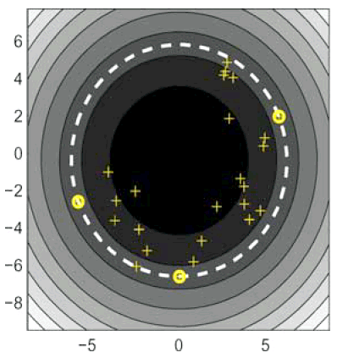


Support vector data description (SVDD)
The error function to minimize is
Constraint
a
x_{i}
R
Data description can be used for a classification problem where one of the classes is sampled very well, while the other class is severely undersampled. An example is a machine monitoring system in which the current condition of a machine is examined.
Support vector

Slide 24
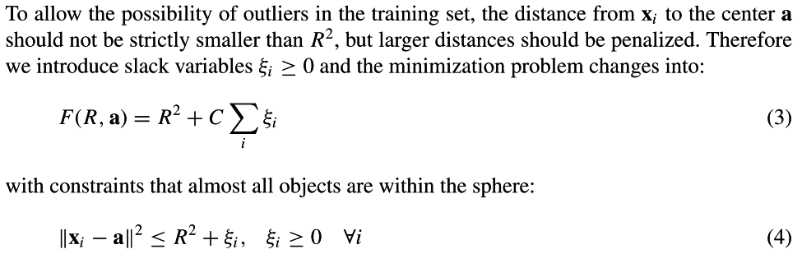
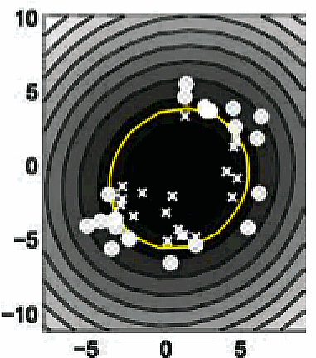

Slide 25
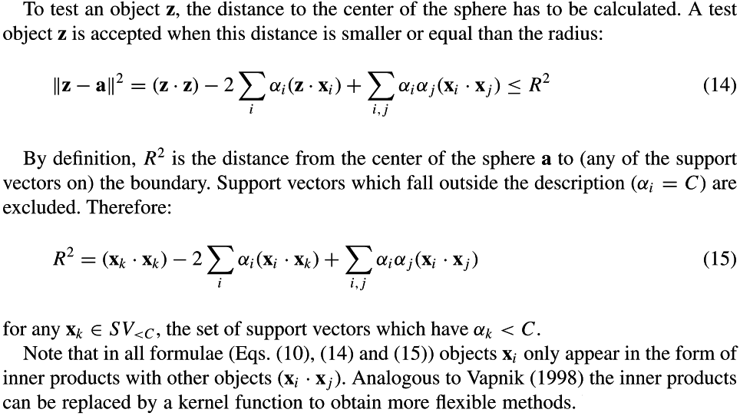
Testing outliers

Slide 26
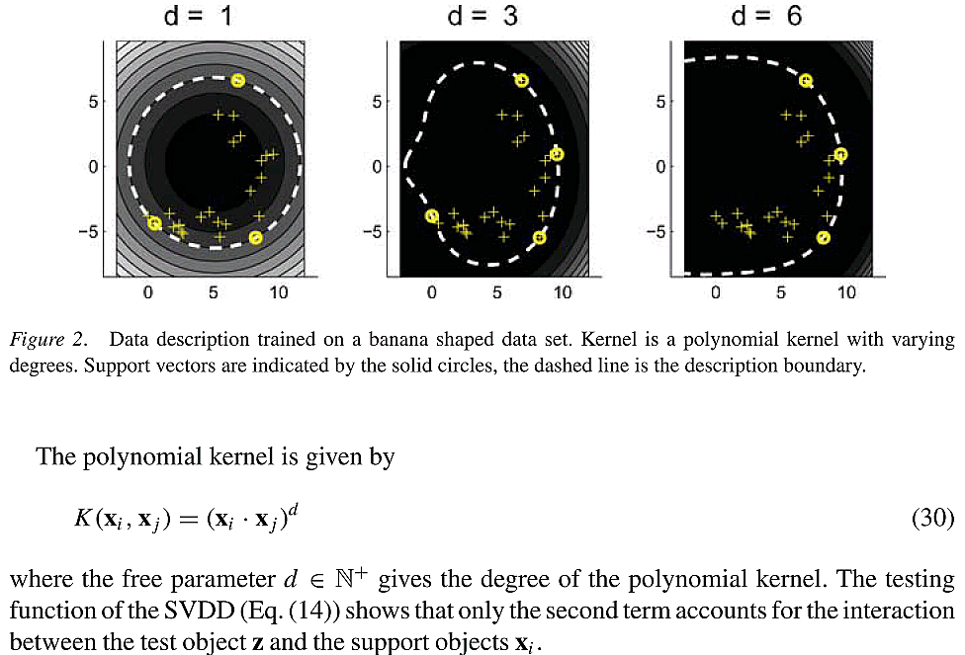
Mapping x to φ(x) for Flexible descriptions - polynomial kernel

Slide 27
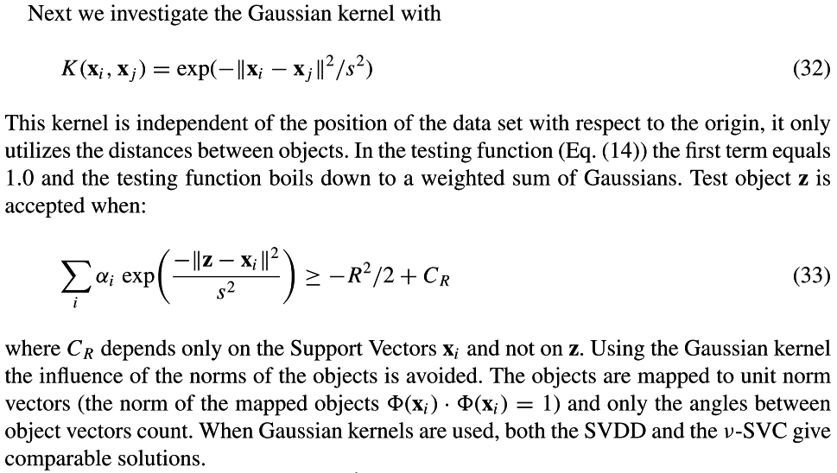
Mapping x to φ(x) for Flexible descriptions - Gaussian kernel

Slide 28
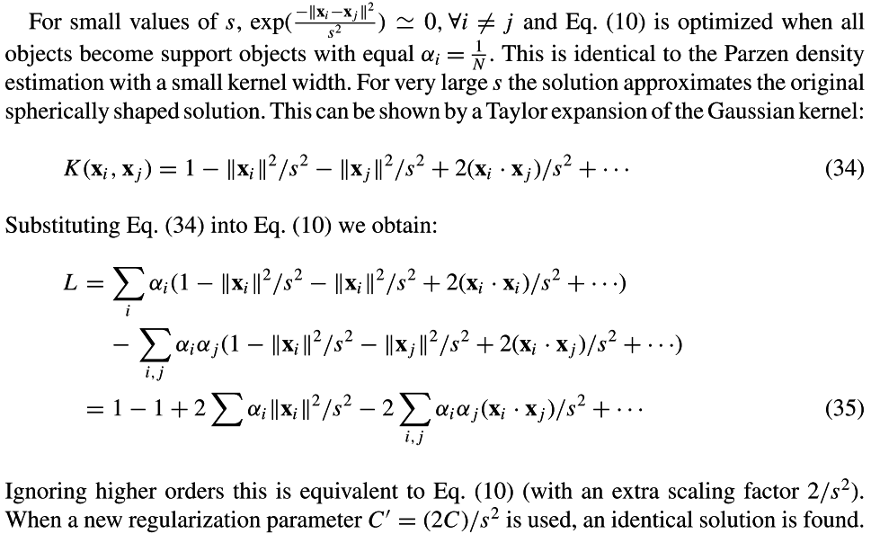
Mapping x to φ(x) for Flexible descriptions - Gaussian kernel

Slide 29
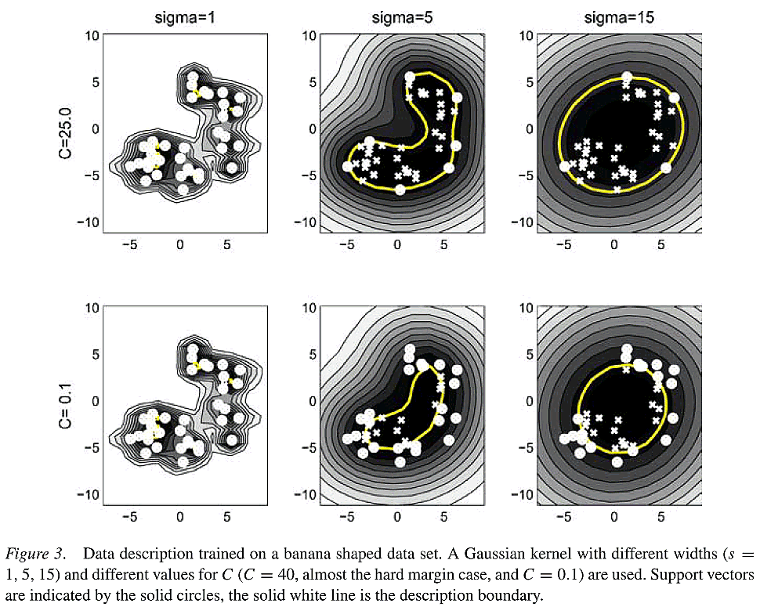
Mapping x to φ(x) for Flexible descriptions - Gaussian kernel

Slide 30
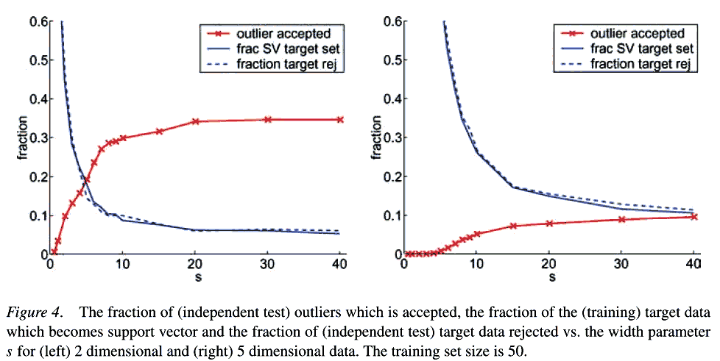
Number of support vectors
The Gaussian kernel is used.

Slide 31
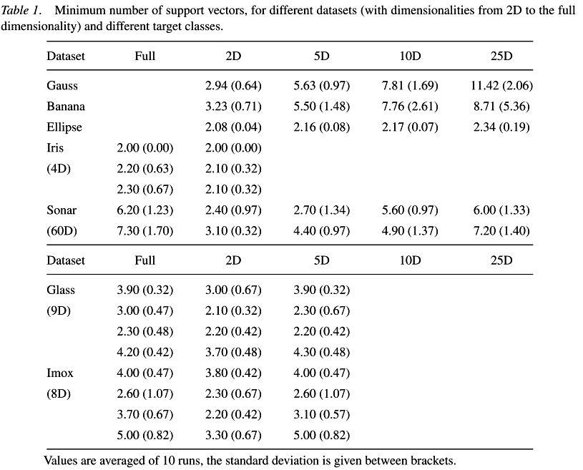
Number of support vectors
The Gaussian kernel is used and an upper bound on the error on the target set is set a priori and the width parameter s is optimized.

Slide 32
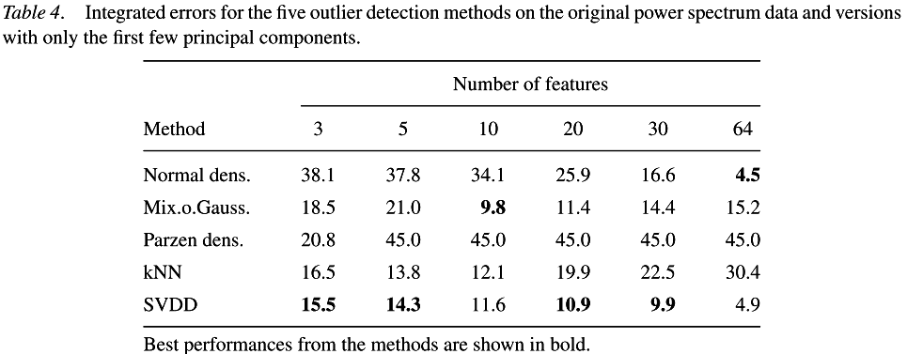
Outlier detection experiments with real data
The methods are applied to both the original 64 dimensional data set and to the first principal components of that data, ranging from 3 up to 30 features. For higher dimensionalities the normal densities and the SVDD perform well. This indicates that for higher dimensions, approximating the target class by one ellipse is sufficient.

Slide 33
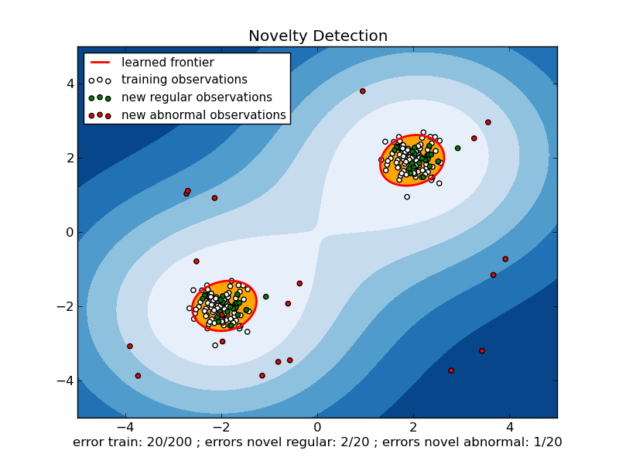
Scikit-learn implementation
One-class SVM is an unsupervised algorithm that learns a decision function for novelty detection: classifying new data as similar or different to the training set.
http://scikit-learn.org/stable/auto_examples/svm/plot_oneclass.html

Slide 34
SVDD with negative examples
When negative examples (objects which should be rejected) are available, they can be incorporated in the training to improve the description. In contrast with the training (target) examples which should be within the sphere, the negative examples should be outside it.
a
x_{i}
R

Slide 35
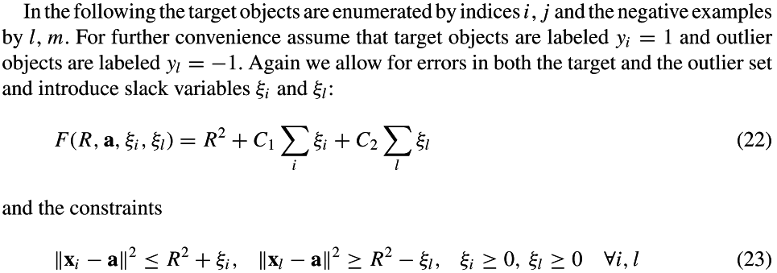
SVDD with negative examples
a
x_{i}
R

Slide 36
Training with outliers (negatives)
Ten-fold cross validation
Bayes: Gaussian-density based linear classiﬁer
SVC: Support vector classiﬁer
p3: polynomial kernel of degree 3
SVDD-neg: SVDD with outliers

Slide 37
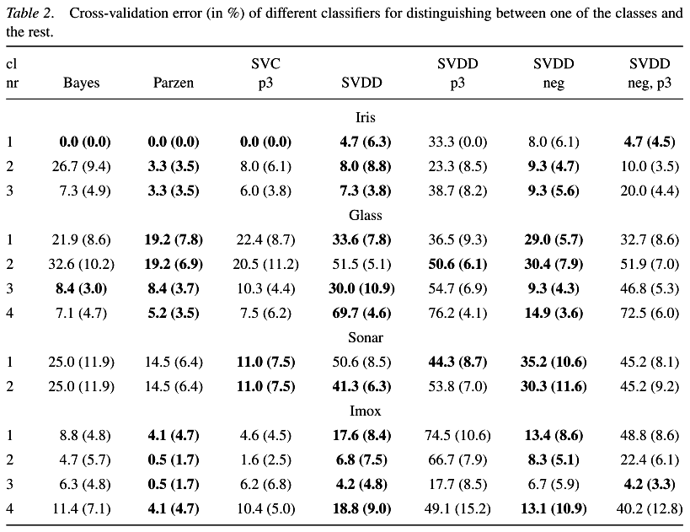
Training with outliers (negatives)

