Slide 1
A Subquadratic Sequence Alignment Algorithm for Unrestricted Scoring Matrices
Maxime Crochemore, Gad M. Landau, and Michal Ziv-Ukelson, SIAM Journal on Computing, Vol. 32, No. 6, pp. 1654–1673, 2003.
Presenter: Shao-Xuan Lee
Date: Feb. 2, 2021

Slide 2
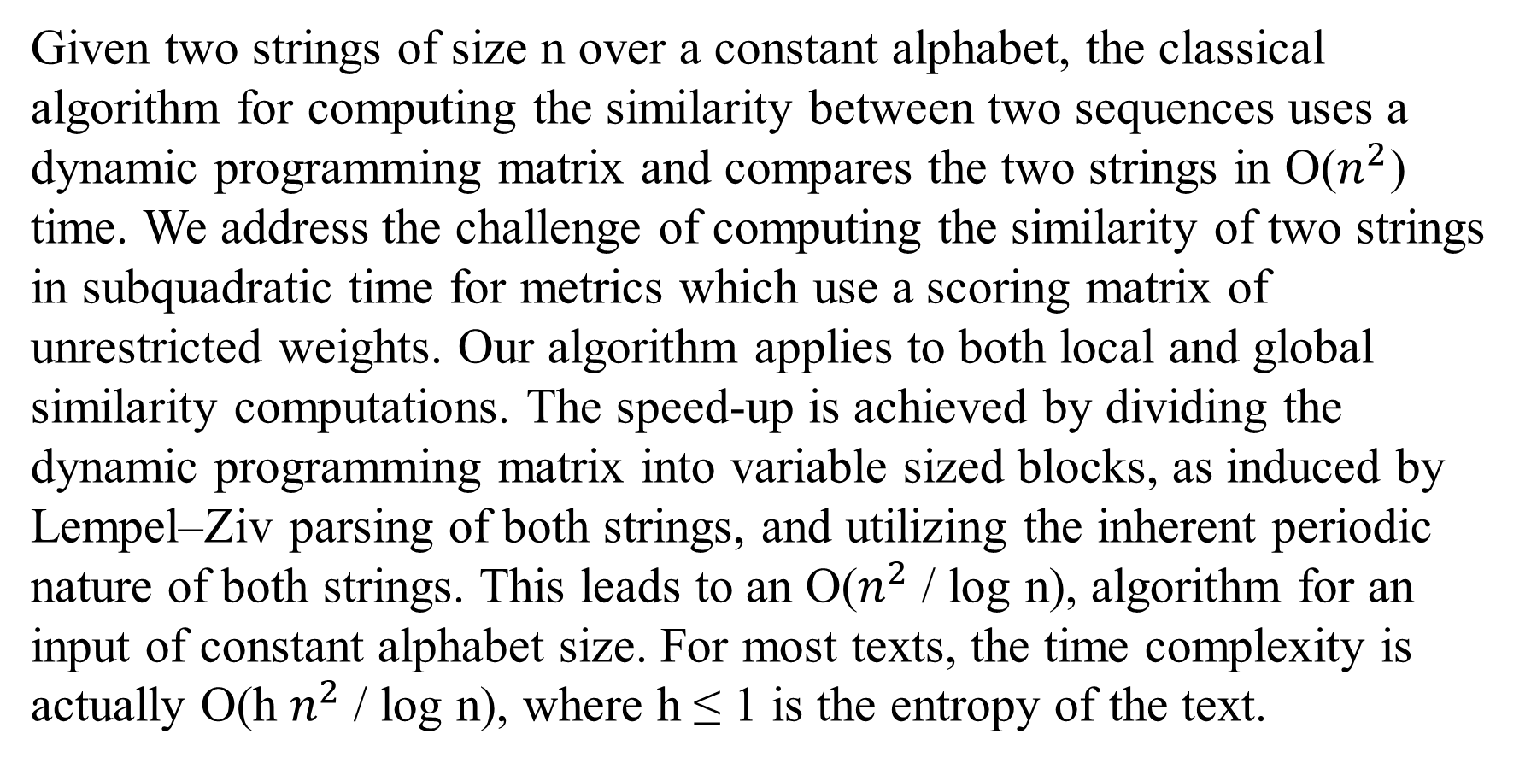
Abstract
Given two strings of size n over a constant alphabet, the classical algorithm for computing the similarity between two sequences uses a dynamic programming matrix and compares the two strings in O($n^{2}$) time. We address the challenge of computing the similarity of two strings in subquadratic time for metrics which use a scoring matrix of unrestricted weights. Our algorithm applies to both local and global similarity computations. The speed-up is achieved by dividing the dynamic programming matrix into variable sized blocks, as induced by Lempel–Ziv parsing of both strings, and utilizing the inherent periodic nature of both strings. This leads to an O($n^{2}$/ log n), algorithm for an input of constant alphabet size. For most texts, the time complexity is actually O(h $n^{2}$/ log n), where h ≤ 1 is the entropy of the text.

Slide 3
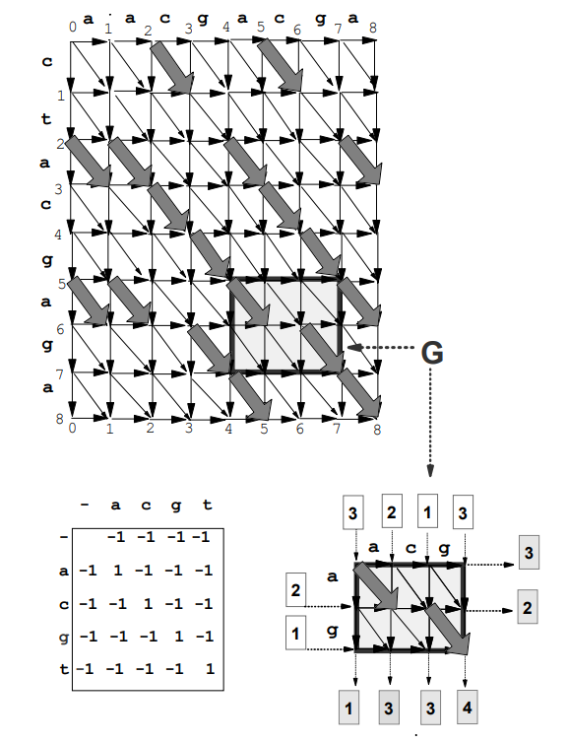
A = c t a c g a g a
B = a a c g a c g a

Slide 4
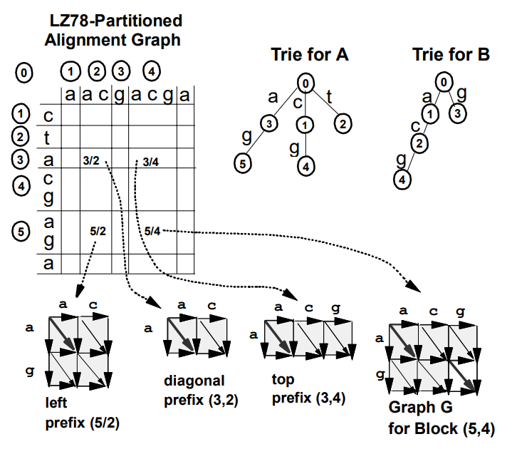
A = c t a c g a g a
B = a a c g a c g a

Slide 5
A = c t a c g a g a
B = a a c g a c g a

Slide 6
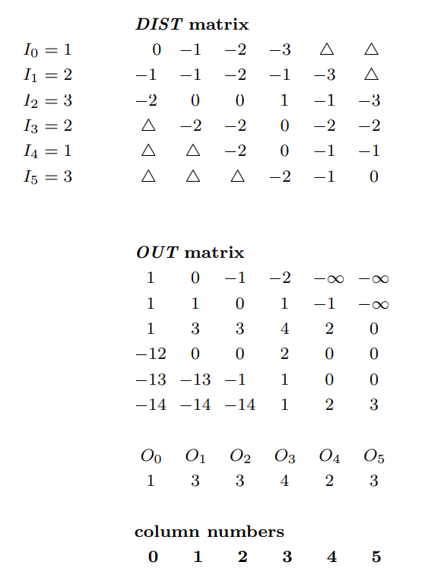
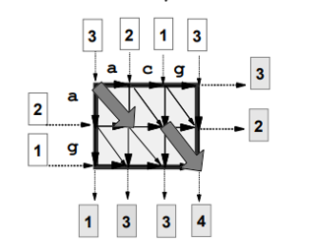


















$$O_{0}$$
$$O_{1}$$
$$O_{2}$$
$$O_{3}$$
$$O_{4}$$
$$O_{5}$$
$$I_{2}$$
$$I_{3}$$
$$I_{4}$$
$$I_{5}$$
$$O_{5}$$
$$I_{1}$$
$$O_{4}$$
$$I_{0}$$
$$O_{0}$$
$$O_{1}$$
$$O_{2}$$
$$O_{3}$$

Slide 7
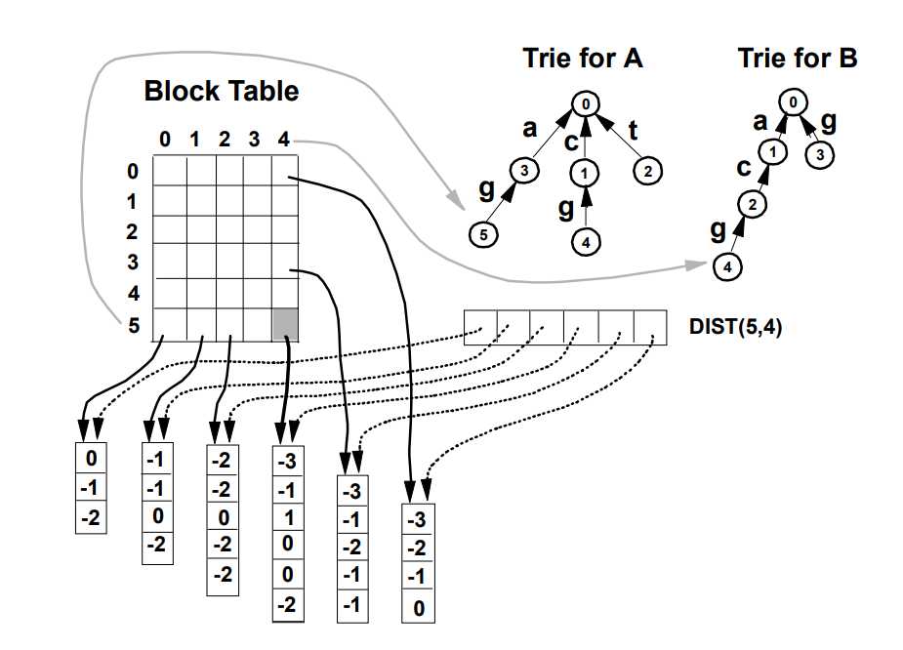

Slide 8
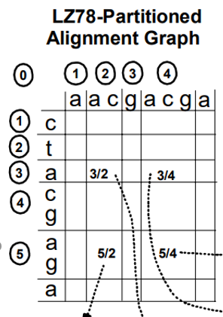
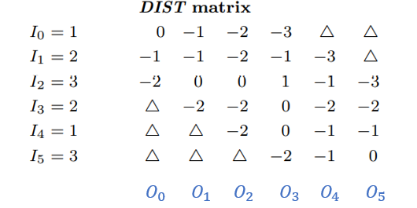

Slide 9
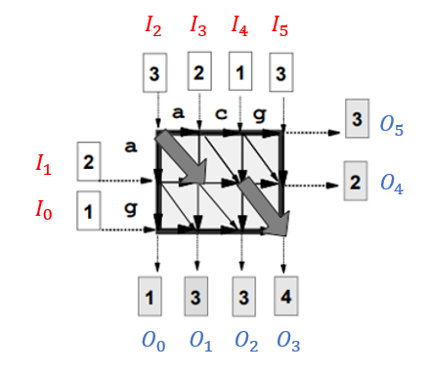

Slide 10
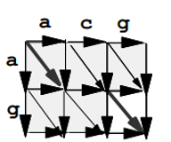
-2
0
-1
-1

Slide 11
-2
0
-1
-1
-3
-1
-2
-1
-1

Slide 12
-2
-2
0
-2
-2
-2
0
-1
-1
-3
-1
-2
-1
-1

Slide 13
-3
-3
-1
-3
-3
-1
1
0
0
-4
-2
-3
-2
-2

Slide 14
-3
-3
-1
-3
-3
-1
1
0
0
-4
-2
-3
-2
-2

Slide 15
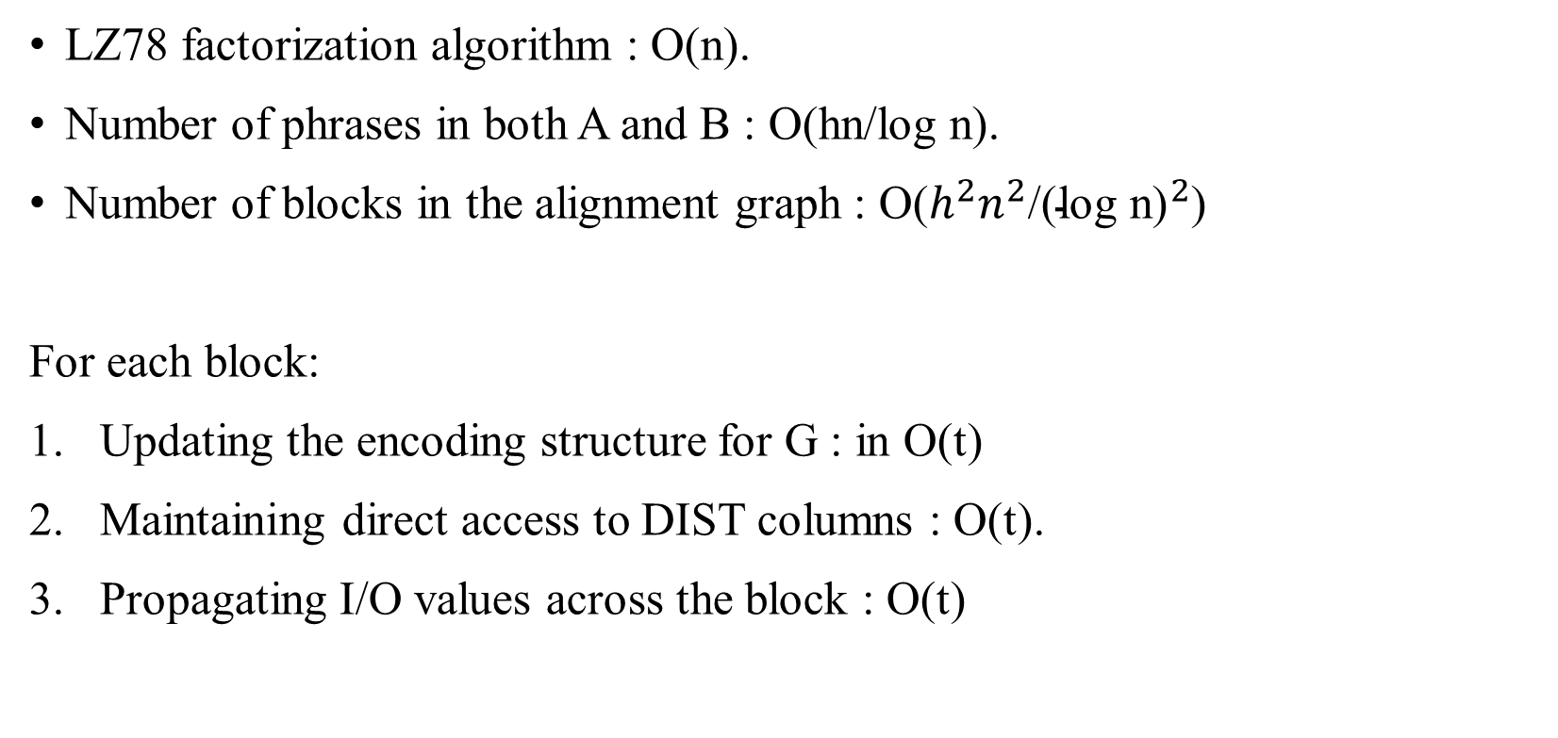
Time complexity
LZ78 factorization algorithm : O(n).
Number of phrases in both A and B : O(hn/log n).
Number of blocks in the alignment graph : O($h^{2}n^{2}$/${\text{(}\text{log} \text{n}\text{)}}^{2}$)
For each block:
Updating the encoding structure for G : in O(t)
Maintaining direct access to DIST columns : O(t).
Propagating I/O values across the block : O(t)

Slide 16
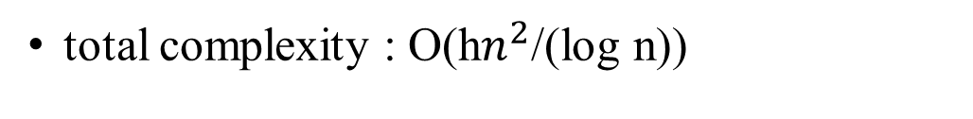
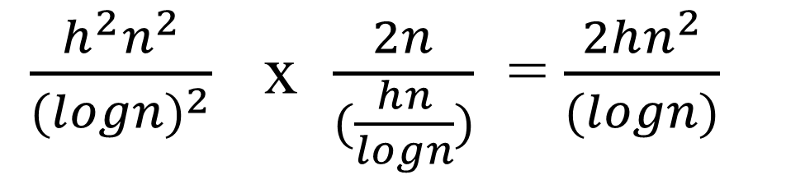
Time complexity
total complexity : O(h$n^{2}$/(log n))
a | acg | g | ac | a
 |  |  |  |  | c
 |  |  |  |  | t
 |  |  |  |  | a
 |  |  |  |  | c g
 |  |  |  |  | a g
 |  |  |  |  | a
$\frac{h^{2}n^{2}}{{(logn)}^{2}}$ x $\frac{2n}{(\frac{hn}{logn})}$ = $\frac{2hn^{2}}{(logn)}$

