Slide 1
Maximum Independent Set of A Permutation Graph in k Tracks
D. T. Lee and Majid Sarrafzadeh
International Journal of Computational Geometry & Applications
Vol. 3. No. 3 (1993) Page 291-304
Presenter：Yu-Cheng Chang
Date：March 2, 2021
Notes:
https://zh.wikipedia.org/wiki/%E6%9D%8E%E5%BE%B7%E8%B2%A1
李德財，中興大學教授(校長)，中央研究院院士

Slide 2
Abstract
A maximum weighted independent set of a permutation graph is a maximum subset of noncrossing chords in a matching diagram (i.e., a set Φ of chords with end-points on two horizontal lines). The problem of finding, among all noncrossing subsets of Φ with density at most k, one with maximum size is considered, where the density of a subset is the maximum number of chords crossing a vertical line and k is a given parameter. A Θ(nlogn) time and Θ(n) space algorithm, for solving the problem with n chords, is proposed. As an application, we solve the problem of finding, among all proper subsets with density at most k of an interval graph, one with maximum number of intervals.

Slide 3
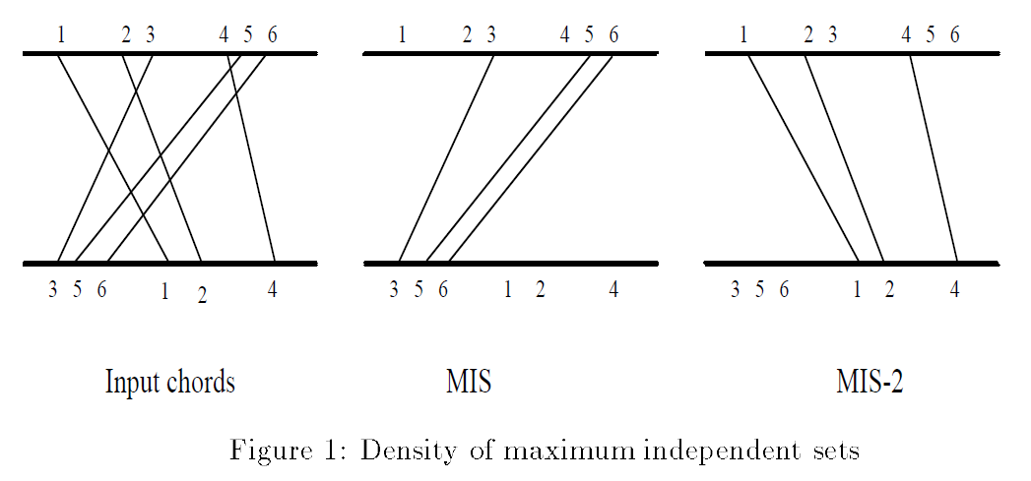
Maximum Independent Sets (MIS 、 MIS-k)

Slide 4
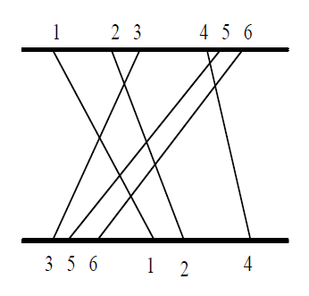
MIS-k to xy-plane
y_{i}
x_{i}

Slide 5
MIS-2 — Ψ、H(Ψ) Ψ ： psi
= {P₁, P₂, … P_{n}}：points set, such that x_{i} < x_{j}, i < j
chain：subset of Ψ, if its points are pairwise noncrossing
H(Ψ)：header k-subchain
y_{i}
x_{i}

Slide 6
MIS-2 — Critical Point, K(P_{i})
K(P₃)
K(P₂)
y_{i}
P₃
P₂
P₆
P₁
P₅
x_{i}
P₄
if d_{i} < k, K(P_{i}) = x_{i}’
if d_{i} = k, K(P_{i}) = y_{i}’
K(P₁)

Slide 7
MIS-2 — Critical Point, K(P_{i})
K(P₂)
K(P₂)
P₃
P₃
P₂
P₂
P₆
P₆
P₁
P₁
P₅
P₅
P₄
P₄
K(P₁)
K(P₁)

Slide 8

MIS-k canonical match / extension / chain
Match： (smallest lexicographically) if P_{j} dominates P_{i}，and x_{j}’ ≥ K(P_{i}) － match ，but not match Extension： Ψ_{j} = Ψ_{i} $\bigcup{\left\{Pj\right\}}$
Canonical match ↓ Canonical extension ↓ Canonical chain

Slide 9
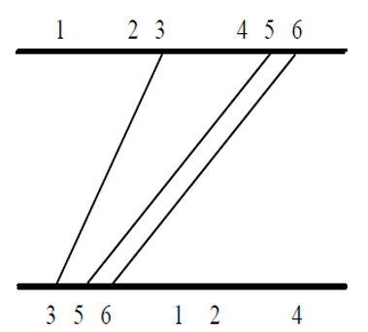
MIS-2 — Level
K(P₃)
K(P₂)
3
2
3
2
1
K(P₁)

Slide 10
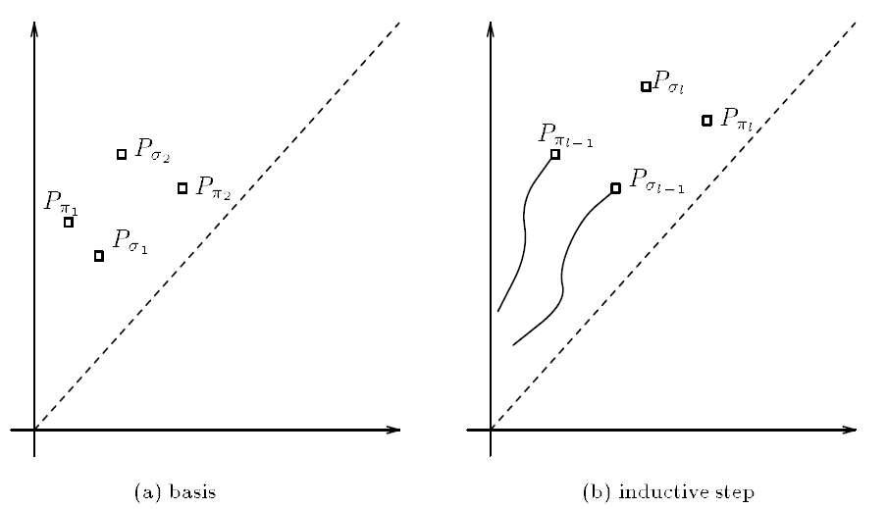

MIS-2 — T
T is a height-balanced tree with n leaves and is organized with respect to y-coordinates of the points
values (λ_{i}, -H(Ψ_{i})) → Lemma 4 → values (λ_{i}, -y_{i}’))
Lemma 4: If $y_{_{1}}^{′}  y_{_{1}}^{′}$then H($P_{_{1}}$) is lexicographically smaller than H($P_{_{1}}$)

Slide 11
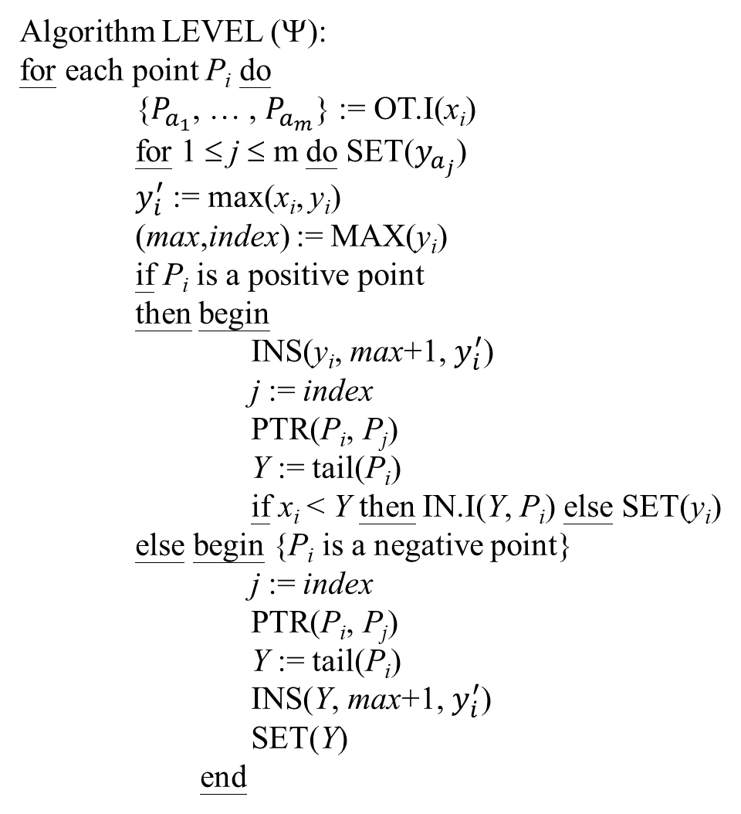
MIS-2 — Level
Algorithm LEVEL (Ψ):
for each point P_{i} do
{$P_{a_{1}}$, … , $P_{a_{m}}$} := OT.I(x_{i})
for 1 ≤ j ≤ m do SET($y_{a_{j}}$)
$y_{i}^{′}$ := max(x_{i}, y_{i})
(max,index) := MAX(y_{i})
if P_{i} is a positive point
then begin
INS(y_{i}, max+1, $y_{i}^{′}$)
j := index
PTR(P_{i}, P_{j})
Y := tail(P_{i})
if x_{i} < Y then IN.I(Y, P_{i}) else SET(y_{i})
else begin {P_{i} is a negative point}
j := index
PTR(P_{i}, P_{j})
Y := tail(P_{i})
INS(Y, max+1, $y_{i}^{′}$)
SET(Y)
end
K(P₃)
K(P₂)
3
2
3
2
1
K(P₁)

Slide 12
MIS-2 — Level
Algorithm LEVEL (Ψ):
for each point P_{i} do
{$P_{a_{1}}$, … , $P_{a_{m}}$} := OT.I(x_{i})
for 1 ≤ j ≤ m do SET($y_{a_{j}}$)
$y_{i}^{′}$ := max(x_{i}, y_{i})
(max,index) := MAX(y_{i})
if P_{i} is a positive point
then begin
INS(y_{i}, max+1, $y_{i}^{′}$)
j := index
PTR(P_{i}, P_{j})
Y := tail(P_{i})
if x_{i} < Y then IN.I(Y, P_{i}) else SET(y_{i})
else begin {P_{i} is a negative point}
j := index
PTR(P_{i}, P_{j})
Y := tail(P_{i})
INS(Y, max+1, $y_{i}^{′}$)
SET(Y)
end
1

Slide 13
MIS-2 — Level
Algorithm LEVEL (Ψ):
for each point P_{i} do
{$P_{a_{1}}$, … , $P_{a_{m}}$} := OT.I(x_{i})
for 1 ≤ j ≤ m do SET($y_{a_{j}}$)
$y_{i}^{′}$ := max(x_{i}, y_{i})
(max,index) := MAX(y_{i})
if P_{i} is a positive point
then begin
INS(y_{i}, max+1, $y_{i}^{′}$)
j := index
PTR(P_{i}, P_{j})
Y := tail(P_{i})
if x_{i} < Y then IN.I(Y, P_{i}) else SET(y_{i})
else begin {P_{i} is a negative point}
j := index
PTR(P_{i}, P_{j})
Y := tail(P_{i})
INS(Y, max+1, $y_{i}^{′}$)
SET(Y)
end
1

Slide 14
MIS-2 — Level
Algorithm LEVEL (Ψ):
for each point P_{i} do
{$P_{a_{1}}$, … , $P_{a_{m}}$} := OT.I(x_{i})
for 1 ≤ j ≤ m do SET($y_{a_{j}}$)
$y_{i}^{′}$ := max(x_{i}, y_{i})
(max,index) := MAX(y_{i})
if P_{i} is a positive point
then begin
INS(y_{i}, max+1, $y_{i}^{′}$)
j := index
PTR(P_{i}, P_{j})
Y := tail(P_{i})
if x_{i} < Y then IN.I(Y, P_{i}) else SET(y_{i})
else begin {P_{i} is a negative point}
j := index
PTR(P_{i}, P_{j})
Y := tail(P_{i})
INS(Y, max+1, $y_{i}^{′}$)
SET(Y)
end
2
// 暫存其level
1

Slide 15
MIS-2 — Level
Algorithm LEVEL (Ψ):
for each point P_{i} do
{$P_{a_{1}}$, … , $P_{a_{m}}$} := OT.I(x_{i})
for 1 ≤ j ≤ m do SET($y_{a_{j}}$)
$y_{i}^{′}$ := max(x_{i}, y_{i})
(max,index) := MAX(y_{i})
if P_{i} is a positive point
then begin
INS(y_{i}, max+1, $y_{i}^{′}$)
j := index
PTR(P_{i}, P_{j})
Y := tail(P_{i})
if x_{i} < Y then IN.I(Y, P_{i}) else SET(y_{i})
else begin {P_{i} is a negative point}
j := index
PTR(P_{i}, P_{j})
Y := tail(P_{i})
INS(Y, max+1, $y_{i}^{′}$)
SET(Y)
end
2
2
// 暫存其level
1

Slide 16
MIS-2 — Level
Algorithm LEVEL (Ψ):
for each point P_{i} do
{$P_{a_{1}}$, … , $P_{a_{m}}$} := OT.I(x_{i})
for 1 ≤ j ≤ m do SET($y_{a_{j}}$)
$y_{i}^{′}$ := max(x_{i}, y_{i})
(max,index) := MAX(y_{i})
if P_{i} is a positive point
then begin
INS(y_{i}, max+1, $y_{i}^{′}$)
j := index
PTR(P_{i}, P_{j})
Y := tail(P_{i})
if x_{i} < Y then IN.I(Y, P_{i}) else SET(y_{i})
else begin {P_{i} is a negative point}
j := index
PTR(P_{i}, P_{j})
Y := tail(P_{i})
INS(Y, max+1, $y_{i}^{′}$)
SET(Y)
end
3
// 暫存其level
2
2
1

Slide 17
MIS-2 — Level
Algorithm LEVEL (Ψ):
for each point P_{i} do
{$P_{a_{1}}$, … , $P_{a_{m}}$} := OT.I(x_{i})
for 1 ≤ j ≤ m do SET($y_{a_{j}}$)
$y_{i}^{′}$ := max(x_{i}, y_{i})
(max,index) := MAX(y_{i})
if P_{i} is a positive point
then begin
INS(y_{i}, max+1, $y_{i}^{′}$)
j := index
PTR(P_{i}, P_{j})
Y := tail(P_{i})
if x_{i} < Y then IN.I(Y, P_{i}) else SET(y_{i})
else begin {P_{i} is a negative point}
j := index
PTR(P_{i}, P_{j})
Y := tail(P_{i})
INS(Y, max+1, $y_{i}^{′}$)
SET(Y)
end
3
3
2
2
1

Slide 18
MIS-2
Algorithm LEVEL (Ψ):
for each point P_{i} do
{$P_{a_{1}}$, … , $P_{a_{m}}$} := OT.I(x_{i})
for 1 ≤ j ≤ m do SET($y_{a_{j}}$)
$y_{i}^{′}$ := max(x_{i}, y_{i})
(max,index) := MAX(y_{i})
if P_{i} is a positive point
then begin
INS(y_{i}, max+1, $y_{i}^{′}$)
j := index
PTR(P_{i}, P_{j})
Y := tail(P_{i})
if x_{i} < Y then IN.I(Y, P_{i}) else SET(y_{i})
else begin {P_{i} is a negative point}
j := index
PTR(P_{i}, P_{j})
Y := tail(P_{i})
INS(Y, max+1, $y_{i}^{′}$)
SET(Y)
end
n
Time complexity： O(n(logn + k))
but tail(P_{i}) can be reduce from O(k) to O(logk)
→ O(n(logn + logk))
→ O(nlogn)
logn
k
k

Slide 19
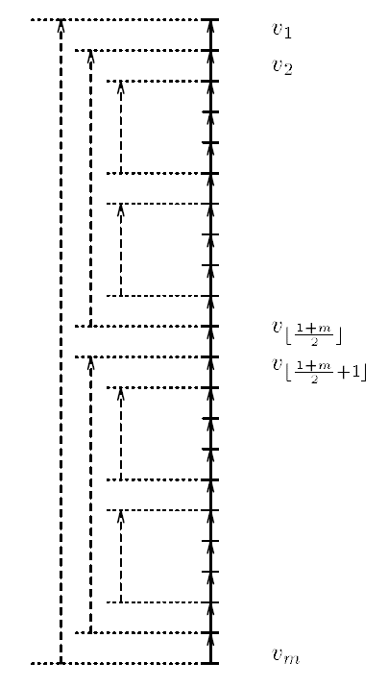

MIS-2 — Tail
v₃
Block(a, b), if b – a > 3, is partitioned into two subblocks B(a+1, $\left\lfloor \frac{a+b}{2}\right\rfloor$)、B($\left\lfloor \frac{a+b}{2}\right\rfloor$+1, b-1)
if we want to add a dashed line & b – a = 3： v₆ --- v₃ we need to follow exactly 3 solid edges if we want to add a dashed line & b – a > 3：v₂₂ --- v₁ we need to follow exactly 2 dashed edges & 3 solid edges Length of path from any v_{i} to v_{j} , i ≤ j, is O(logm) Here, m is at most k ( tail of header k-subchain )
v₆
, m = 22

Slide 20
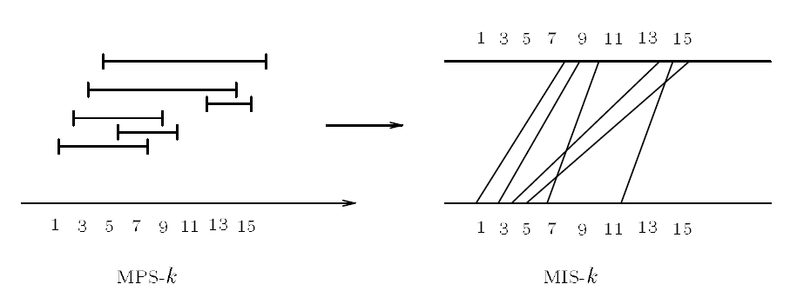
Application
MPS-k problem ： find, among all proper subsets of I with density at most k, one with maximum cardinality.

