Slide 1
Contract Bridge Bidding by Learning
Chun-Yen Ho and Hsuan-Tien Lin
2015 AAAI Workshop, Hyatt Regency in Austin, Texas, USA
Presenter: Jing-Ping Jan
Date: March 2, 2021
Notes:
Journal of Internet Technology 網際網路技術學刊 2009

Slide 2
Abstract
Contract bridge is an example of an incomplete information game for which computers typically do not perform better than expert human bridge players. In particular, the typical bidding decisions of human bridge players are difficult to mimic with a computer program, and thus automatic bridge bidding remains to be a challenging research problem. Currently, the possibility of automatic bidding without mimicking human players has not been fully studied. In this work, we take an initiative to study such a possibility for the specific problem of bidding without competition. We propose a novel learning framework to let a computer program learn its own bidding decisions
Notes:
Ʃ = sigma
Ε = epsilon

Slide 3
Abstract
The framework transforms the bidding problem into a learning problem, and then solves the problem with a carefully designed model that consists of cost-sensitive classifiers and upper-confidence-bound algorithms. We validate the proposed model and find that it performs competitively to the champion computer bridge program that mimics human bidding decisions.
Notes:
Ʃ = sigma
Ε = epsilon

Slide 4
Introduction
Bidding stage Find the most profitable contract for the playing stage
Playing stage 13 rounds of a card-strength competition

Slide 5
Introduction-Bidding Stage
PASS
 | ♣ | ♦ | ♥ | ♠ | NT
1 | 1♣ | 1♦ | 1♥ | 1♠ | 1NT
2 | 2♣ | 2♦ | 2♥ | 2♠ | 2NT
3 | 3♣ | 3♦ | 3♥ | 3♠ | 3NT
4 | 4♣ | 4♦ | 4♥ | 4♠ | 4NT
5 | 5♣ | 5♦ | 5♥ | 5♠ | 5NT
6 | 6♣ | 6♦ | 6♥ | 6♠ | 6NT
7 | 7♣ | 7♦ | 7♥ | 7♠ | 7NT

Slide 6
Problem
Goal : learn a bidding strategy G(x_{n},x_{s}) for predicting B
x : the cards of a player
B : the bids of that player and the bids of her/his teammate

Slide 7
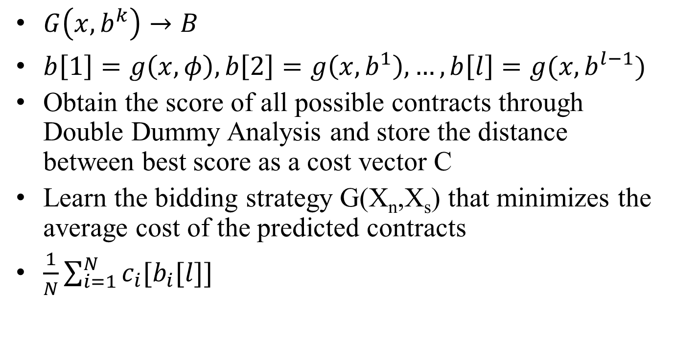
Problem
$G\left(x,b^{k}\right)→B$
$b\left[1\right]=g\left(x,φ\right),b\left[2\right]=g\left(x,b^{1}\right),…,b\left[l\right]=g(x,b^{l−1})$
Obtain the score of all possible contracts through Double Dummy Analysis and store the distance between best score as a cost vector C
Learn the bidding strategy G(X_{n},X_{s}) that minimizes the average cost of the predicted contracts
$\frac{1}{N}\sum_{i=1}^{N}{c_{i}[b_{i}[l]]}$

Slide 8
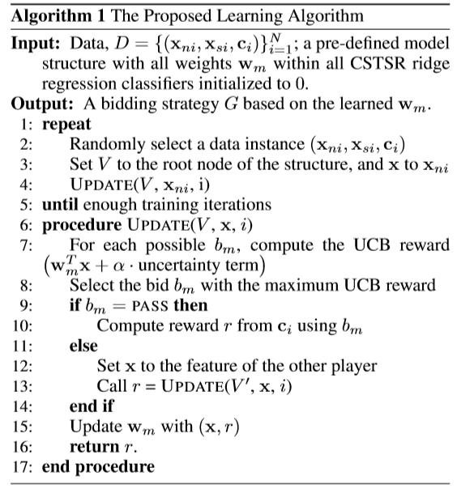
Algorithm
Notes:
$r_{m}$ : 所有m這個叫品所能獲得的分數
$r$ : vector c 中的最大值減掉預測叫品在c中的值

Slide 9
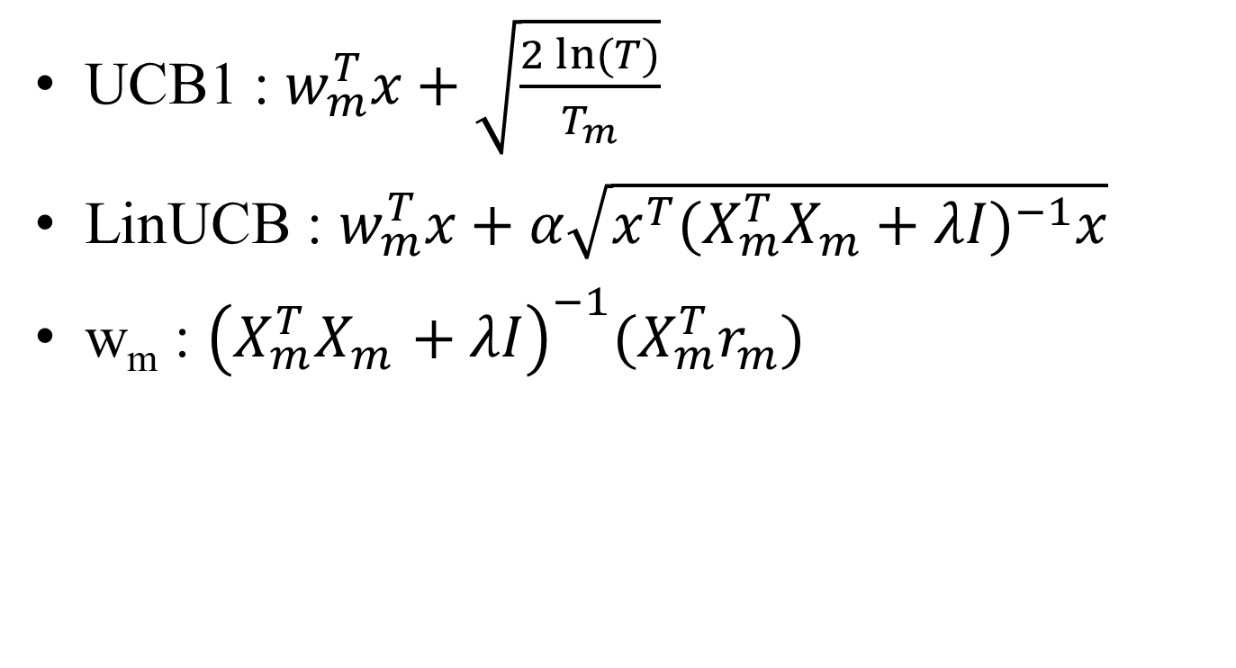
Upper Confidence Bound (UCB)
UCB1 : $w_{m}^{T}x+\sqrt{\frac{2\ln{(T)}}{T_{m}}}$
LinUCB : $w_{m}^{T}x+α\sqrt{x^{T}{(X_{m}^{T}X_{m}+λI)}^{−1}x}$
w_{m} : ${\left(X_{m}^{T}X_{m}^{}+λI\right)}^{−1}(X_{m}^{T}r_{m})$
Notes:
$w_{m}^{T}x$ :對選取第m個叫品，所能獲得的預估收益。
$T$ : 嘗試的次數
$T_{m}$ : 嘗試m的次數
$x$ : 一玩家手上的手牌
$X_{m}$ : 包含所有跟m這個叫品相關的$x$
$r_{m}$ : 所有m這個叫品所能獲得的分數
$r$ : vector c 中的最大值減掉預測叫品在c中的值

Slide 10
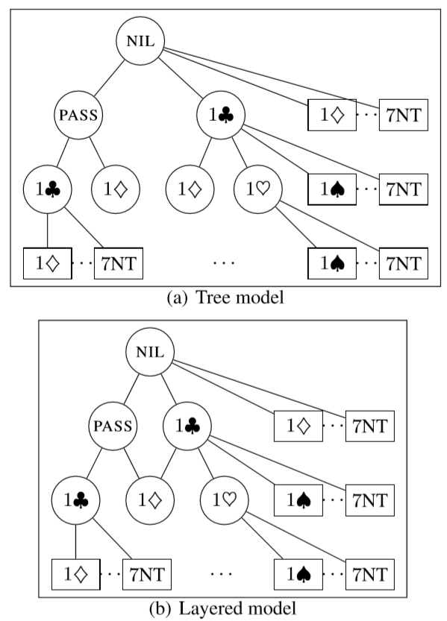
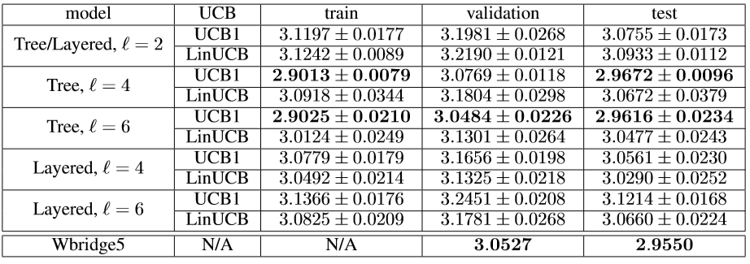
Experimental Results
Notes:
Wbridge5 : 用2-over-1 Bidding System

Slide 11
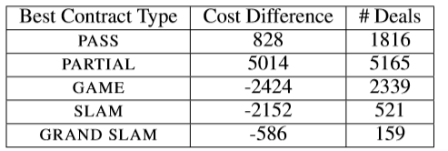
Experimental Results
Notes:
成局以上需要特別的叫牌方式，所以wbridge5能有較好的成績
但是在成局以下的狀況，電腦提出的叫牌方法會有較好的表現

