Slide 1
A diagonal-based algorithm for the longest common increasing subsequence problem
Shou-Fu Lo, Kuo-Tsung Tseng, Chang-Biau Yang and Kuo-Si Huang
Theoretical Computer Science, Volume 815,
May 2020, Pages 69-78.
Presenter: Shin-Cheng Lin
Date: Mar. 02, 2021

Slide 2
Abstract(1/2)
The longest common increasing subsequences(LCIS) problem is to find out a common increasing subsequence with the maximal length of two given sequences A and B. In this paper, we propose an algorithm for solving the LCIS problem with O((n +L(m −L)) loglog|Σ|)time and O(n) space, where m and n denote the lengths of A and B, respectively, m ≤n, L denotes the LCIS length, and Σ denotes the alphabet set. The main idea of our algorithm is to extend the answer from some previously feasible solutions, in which the domination function is invoked.

Slide 3
Abstract(2/2)
To accomplish the extension and domination functions, the data structure of the van Emde Boas tree is utilized. From the time complexity, it is obvious that our algorithm is extremely efficient when L is very small or L is close to m. Some experiments are performed to demonstrate the efficiency of our algorithm.

Slide 4
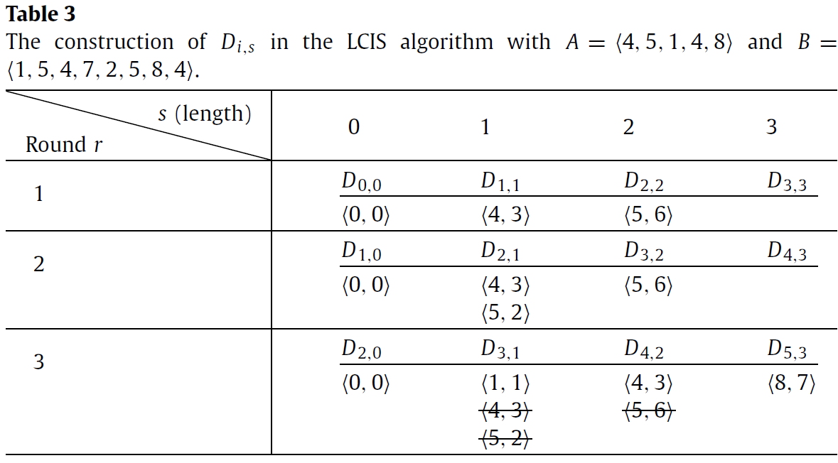
A=(4,5,1,4,8)
B=(1,5,4,7,2,5,8,4)

Slide 5
Round 1, length 1
D_{a,s}={(B_{b}(=A_{a}), b}
A=(|4,5,1,4,8)
B=(1,5,4,7,2,5,8,4)

Slide 6
Round 1, length 2
D_{a,s}={(B_{b}(=A_{a}), b}
A=(4,|5,1,4,8)
B=(1,5,4,|7,2,5,8,4)

Slide 7
Round 1, length 3
D_{a,s}={(B_{b}(=A_{a}), b}
A=(4,5,|1,4,8)
B=(1,5,4,7,2,5,|8,4)

Slide 8
Round 2, length 1
D_{a,s}={(B_{b}(=A_{a}), b}
A=(4,|5,1,4,8)
B=(1,5,4,7,2,5,8,4)

Slide 9
Round 2, length 2
D_{a,s}={(B_{b}(=A_{a}), b}
A=(4,5,|1,4,8)
B=(1,5,|4,7,2,5,8,4)

Slide 10
Round 3, length 1
D_{a,s}={(B_{b}(=A_{a}), b}
A=(4,5,|1,4,8)
B=(1,5,4,7,2,5,8,4)

Slide 11
Round 3, length 2
D_{a,s}={(B_{b}(=A_{a}), b}
A=(4,5,1,|4,8)
B=(1,|5,4,7,2,5,8,4)

Slide 12
Round 3, length 3
D_{a,s}={(B_{b}(=A_{a}), b}
A=(4,5,1,4,|8)
B=(1,5,4,|7,2,5,8,4)

Slide 13
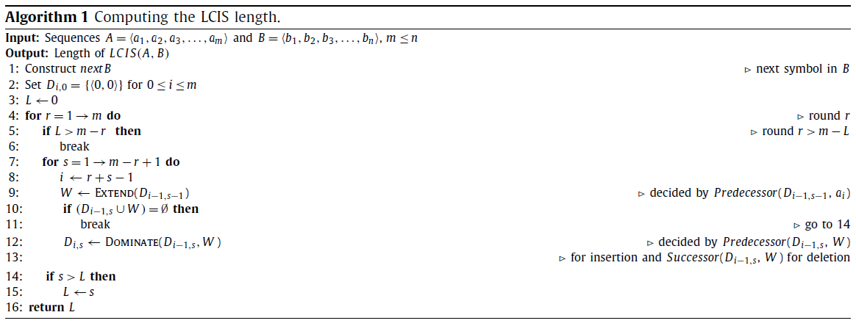

Slide 14
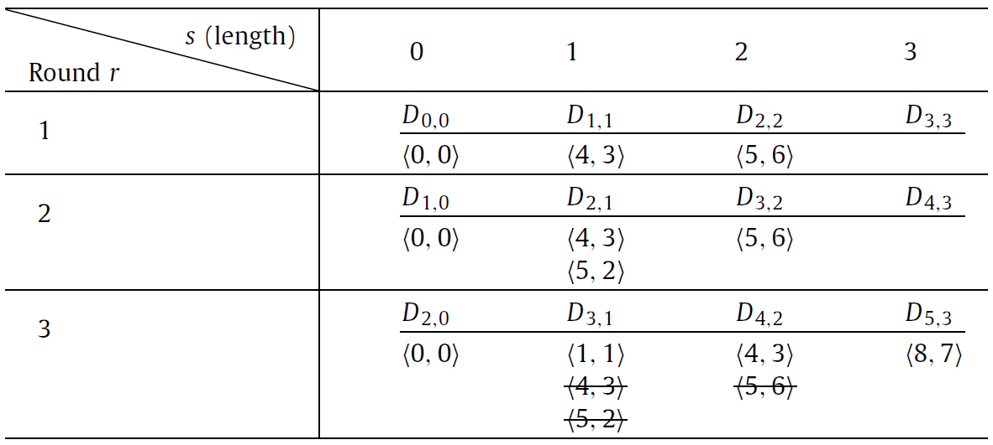
m-L
L
L(m-L) steps, each step needs insertion or deletion.
Each insertion or deletion takes O(loglog|Σ|)) using next_{b} table.
Construct next_{b} table takes O(nloglog|Σ|)
Time complexity : O( (n+L(m-L)) loglog|Σ| )

