Slide 1
The Experiential Heterogeneous Earliest Finish Time Algorithm for Task Scheduling in Clouds
Artan Mazrekaj, Arlinda Sheholli, Dorian Minarolli, Bernd Freisleben Faculty of Contemporay Sciences and Technologies, SEEU University, Tetovo, Republic of North Macedonia
9th International Conference on Cloud Computing and Services Science (CLOSER 2019), pages 371-379
Persenter : Jue-Jun Wu
Date : Mar. 9th , 2021
Notes:
北馬其頓 (North Macedonia) 東南歐的巴爾幹半島南部的內陸國家 (South East European University)
任務調度可能會對系統的性能產生重大影響，並且當云資源由於執行速度，內存容量和處理器之間的通信速率不同而在計算，內存和通信特性方面異構時。
我們提出了一種針對異構資源的雲環境的新型動態任務調度算法。它利用以往的任務執行經驗擴展了異構最早完成時間（HEFT）算法
新的雲環境任務調度算法，該參數指定每個相關任務的最小平均執行時間資源

Slide 2
Abstract
Task scheduling in cloud environments is the problem of assigning and executing computational tasks on the available cloud resources. Effective task scheduling approaches reduce the task completion time, increase the efficiency of resource utilization, and improve the quality of service and the overall performance of the system. In this paper, we present a novel task scheduling algorithm for cloud environments based on the Heterogeneous Earliest Finish Time (HEFT) algorithm, called experiential HEFT.
It considers experiences with previous executions of tasks to determine the workload of resources. To realize the experiential HEFT algorithm, we propose a novel way of HEFT rank calculation to specify the minimum average execution time of previous runs of a task on all relevant resources. Experimental results indicate that the proposed experiential HEFT algorithm performs better than HEFT and the popular Critical-Path-on-a-Processor (CPOP) algorithm considered in our comparison.
Notes:
Acronym a cru num
雲環境中的任務調度是在可用雲資源上分配和執行計算任務的問題。 有效的任務調度方法可減少任務完成時間，提高資源利用效率，並提高服務質量和系統整體性能
它考慮了先前任務執行的經驗以確定資源的工作量，用於指定任務在所有相關資源上的先前運行的最小平均執行時間。
實驗結果表明，所提出的EHEFT算法的性能優於HEFT，CPOP

Slide 3
Outline
Heterogeneous Earliest Finish Time (HEFT) algorithm
Critical-Path-on-a-Processor (CPOP) algorithm
Experiential HEFT
Experimential Results
Conclusion
Notes:
我們提出了一種針對異構資源的雲環境的新型動態任務調度算法。它利用以往的任務執行經驗擴展了異構最早完成時間（HEFT）算法，因此我們將其稱為體驗性HEFT（EHEFT）算法。

Slide 4
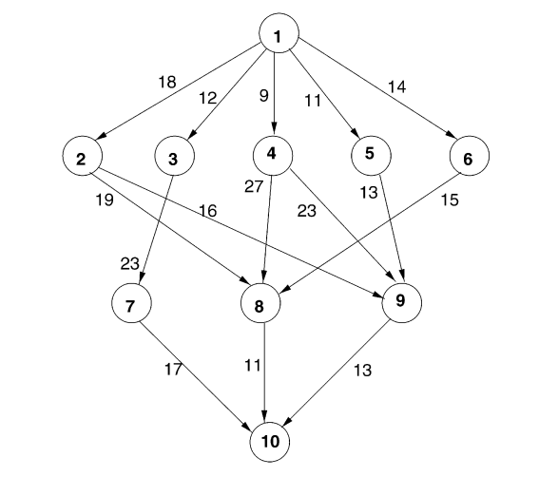
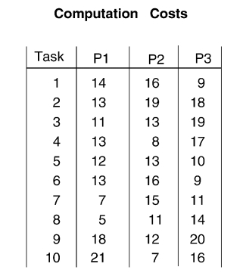
HEFT
1 | 13
2 | 16.6
3 | 14.3
4 | 12.6
5 | 11.6
6 | 12.6
7 | 11
8 | 10
9 | 16.6
10 | 14.6

Slide 5
HEFT
1 | 13
2 | 16.6
3 | 14.3
4 | 12.6
5 | 11.6
6 | 12.6
7 | 11
8 | 10
9 | 16.6
10 | 14.6 | 0+14.6+0=14.6
Notes:
Task平均處理時間+平均接收時間+傳輸時間 下往上疊加

Slide 6
HEFT
1 | 13
2 | 16.6
3 | 14.3
4 | 12.6
5 | 11.6
6 | 12.6
7 | 11
8 | 10
9 | 16.6 | 13+16.6+14.6=44.2
10 | 14.6 | 0+14.6+0=14.6
Notes:
Task平均處理時間+平均接收時間+傳輸時間 下往上疊加

Slide 7
HEFT
1 | 13
2 | 16.6
3 | 14.3
4 | 12.6
5 | 11.6
6 | 12.6
7 | 11 | 17+11+14.6=42.6
8 | 10 | 11+10+14.6=35.6
9 | 16.6 | 13+16.6+14.6=44.2
10 | 14.6 | 0+14.6+0=14.6

Slide 8
1 | 13 | 18+13+76.8=107.8 12+13+79.9=104.9 9+13+79.8=101.8 11+13+68.8=92.8 14+13+63.2=90.2
2 | 16.6 | 19+16.6+35.6=71.2 16+16.6+44.2=76.8
3 | 14.3 | 23+14.3+42.6=79.9
4 | 12.6 | 27+12.6+35.6=75.2 23+12.6+44.2=79.8
5 | 11.6 | 13+11.6+44.2=68.8
6 | 12.6 | 15+12.6+35.6=63.2
7 | 11 | 17+11+14.6=42.6
8 | 10 | 11+10+14.6=35.6
9 | 16.6 | 13+16.6+14.6=44.2
10 | 14.6 | 0+14.6+0=14.6

Slide 9
 |  |  | rank
1 | 13 | 18+13+76.8=107.8 12+13+79.9=104.9 9+13+79.8=101.8 11+13+68.8=92.8 14+13+63.2=90.2 | 1
2 | 16.6 | 19+16.6+35.6=71.2 16+16.6+44.2=76.8 | 4
3 | 14.3 | 23+14.3+42.6=79.9 | 2
4 | 12.6 | 27+12.6+35.6=75.2 23+12.6+44.2=79.8 | 3
5 | 11.6 | 13+11.6+44.2=68.8 | 5
6 | 12.6 | 15+12.6+35.6=63.2 | 6
7 | 11 | 17+11+14.6=42.6 | 8
8 | 10 | 11+10+14.6=35.6 | 9
9 | 16.6 | 13+16.6+14.6=44.2 | 7
10 | 14.6 | 0+14.6+0=14.6 | 10

Slide 10
 | P1 |  |  | P2 |  |  | P3 |  |  | choice
 | start | cost | Finish | start | cost | finish | start | cost | finish
1 | 0 | 14 | 14 | 0 | 16 | 16 | 0 | 9 | 9 | P3
3 | 9+12 | 11 | 32 | 9+12 | 13 | 34 | 9 | 19 | 28 | P3
4 | 9+9 | 13 | 31 | 9+9 | 8 | 26 | 28 | 17 | 45 | P2
2 | 9+18 | 13 | 40 | 9+18 | 19 | 44 | 28 | 18 | 46 | P1
5 | 40 | 12 | 52 | 26 | 13 | 38 | 28 | 10 | 38 | P3
6 | 40 | 13 | 53 | 26 | 16 | 42 | 38 | 9 | 47 | P2
9 | 40 38+13 25+26 | 18 | 58 72 66 | 40+16 38+13 42 | 12 | 68 63 54 | 40+16 38+13 25+23 | 20 | 76 71 68 | P2
7 | 28+23 | 8 | 58 | 28+23 68 | 15 | 83 | 38 | 11 | 49 | P3
8 | 40 25+27 42+15 | 5 | 45 57 62 | 40+16 68 | 11 | 67 79 | 40+16 25+27 42+15 | 14 | 70 66 71 | P1
10 | 49+17 62 68+13 | 21 | 87 83 102 | 49+17 62+11 68 | 7 | 73 80 75 | 49 62+11 68+13 | 16 | 65 89 97 | P2

Slide 11
 |  | rank(up) | Rank(down) | Rank(up+down)
1 | 13 | 18+77+13=108 12+80+13=105 9+77+13=99 11+80+13=104 14+68.9+13=95.9 | 0 | 108+0=108
2 | 16.6 | 19+35.6+16.6=71.2 16+44.3+16.6=77 | 13+18=31 | 77+31=108
3 | 14.3 | 23+42.6+14.3=80 | 13+12=25 | 80+25=105
4 | 12.6 | 27+35.6+12.6=75.32 23+44.3+12.6=80 | 13+9=22 | 80+22=102
5 | 11.6 | 13+11.6+44.3=68.9 | 13+11=24 | 69+24=93
6 | 12.6 | 15+35.6+12.6=63.2 | 13+14=27 | 63.3+2=90.3
7 | 11 | 17+14.6+11=42.6 | 25+23+14.3=62.3 | 42.6+62.3=105
8 | 10 | 10+14.6+11=35.6 | 31+19+16.6=66.6 22+27+12.6=61.6 27+15+12.6=54.6 | 35.6+66.6=102.3
9 | 16.6 | 13+16.6+14.6=44.3 | 21+16+16.6=63.6 22+23+12.6=57.6 24+13+11.6=48.6 | 44.3+63.6=108
10 | 14.6 | 0+14.6+0=14.6 | 62.3+17+11=90.3 66.6+11+10=87.6 63.6+13+16.6=93.3 | 14.6+93.3=108
Notes:
Critical-Path-on-a-Processor (CPOP) algorithm

Slide 12
Critical path{1,2,9,10}
P1: 14+13+18+21=60
P2: 16+19+12+7=54
P3: 9+18+20+16= 63

Slide 13
 |  | rank(up) | Rank(down) | Rank(up+down)
1 | 13 | 18+77+13=108 12+80+13=105 9+77+13=99 11+80+13=104 14+68.9+13=95.9 | 0 | 108+0=108
2 | 16.6 | 19+35.6+16.6=71.2 16+44.3+16.6=77 | 13+18=31 | 77+31=108
3 | 14.3 | 23+42.6+14.3=80 | 13+12=25 | 80+25=105
4 | 12.6 | 27+35.6+12.6=75.32 23+44.3+12.6=80 | 13+9=22 | 80+22=102
5 | 11.6 | 13+11.6+44.3=68.9 | 13+11=24 | 69+24=93
6 | 12.6 | 15+35.6+12.6=63.2 | 13+14=27 | 63.3+2=90.3
7 | 11 | 17+14.6+11=42.6 | 25+23+14.3=62.3 | 42.6+62.3=105
8 | 10 | 10+14.6+11=35.6 | 31+19+16.6=66.6 22+27+12.6=61.6 27+15+12.6=54.6 | 35.6+66.6=102.3
9 | 16.6 | 13+16.6+14.6=44.3 | 21+16+16.6=63.6 22+23+12.6=57.6 24+13+11.6=48.6 | 44.3+63.6=108
10 | 14.6 | 0+14.6+0=14.6 | 62.3+17+11=90.3 66.6+11+10=87.6 63.6+13+16.6=93.3 | 14.6+93.3=108
Notes:
Critical-Path-on-a-Processor (CPOP) algorithm
O(v*v*p) v:task , p:procesor

Slide 14
 | Rank(up+down)
1 | 108+0=108
2 | 77+31=108
3 | 80+25=105
4 | 80+22=102
5 | 69+24=93
6 | 63.3+2=90.3
7 | 42.6+62.3=105
8 | 35.6+66.6=102.3
9 | 44.3+63.6=108
10 | 14.6+93.3=108
 | rank
 | 1
23456 | 2
3456 | 123
4567 | 1237
456 | 12374
56 | 123745
69 | 1237459
6 | 12374596
8 | 123745968
10 | 123745968 10

Slide 15
 | P1 |  |  | P2 |  |  | P3 |  |  | choice
 | start | cost | Finish | start | cost | finish | start | cost | finish
1 | 0 | 14 | 14 | 0 | 16 | 16 | 0 | 9 | 9 | P2
2 | 16+18 | 13 | 47 | 16 | 19 | 35 | 16+18 | 18 | 52 | P2
3 | 16+12 | 11 | 39 | 35 | 13 | 48 | 16+12 | 19 | 47 | P1
7 | 39 | 7 | 46 | 39+23 | 15 | 77 | 29+23 | 11 | 73 | P1
4 | 46 | 13 | 59 | 35 | 8 | 43 | 16+9 | 17 | 42 | P3
5 | 46 | 12 | 58 | 35 | 13 | 48 | 41 | 10 | 51 | P2
9 | 35+16 41+23 48+13 | 18 | 69 82 72 | 48 41+23 48 | 12 | 60 76 60 | 35+16 41 48+13 | 20 | 71 61 81 | P2
6 | 46 | 13 | 59 | 48 76 | 16 | 64 82 | 42 | 9 | 51 | P3
8 | 35+19 42+27 51+15 | 5 | 59 74 71 | 35 42+27 51+15 76 | 11 | 46 80 77 87 | 38+19 42 51 | 14 | 68 56 65 | P3
10 | 47 68+11 76+13 | 21 | 68 100 110 | 47+17 68+11 76 | 7 | 71 86 83 | 47+17 68 76+13 | 16 | 80 84 95 | P2

Slide 16
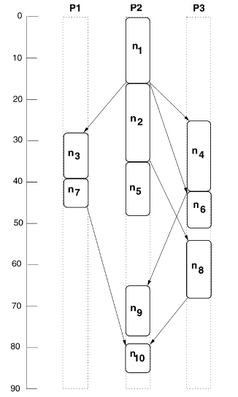
 | P1 |  |  | P2 |  |  | P3 |  |  | choice
 | start | cost | Finish | start | cost | finish | start | cost | finish
1 | 0 | 14 | 14 | 0 | 16 | 16 | 0 | 9 | 9 | P2
2 | 16+18 | 13 | 47 | 16 | 19 | 35 | 16+18 | 18 | 52 | P2
3 | 16+12 | 11 | 39 | 35 | 13 | 48 | 16+12 | 19 | 47 | P1
7 | 39 | 7 | 46 | 39+23 | 15 | 77 | 29+23 | 11 | 73 | P1
4 | 46 | 13 | 59 | 35 | 8 | 43 | 16+9 | 17 | 42 | P3
5 | 46 | 12 | 58 | 35 | 13 | 48 | 41 | 10 | 51 | P2
9 | 35+16 41+23 48+13 | 18 | 69 82 72 | 48 41+23 48 | 12 | 60 76 60 | 35+16 41 48+13 | 20 | 71 61 81 | P2
6 | 46 | 13 | 59 | 48 76 | 16 | 64 82 | 42 | 9 | 51 | P3
8 | 35+19 42+27 51+15 | 5 | 59 74 71 | 35 42+27 51+15 76 | 11 | 46 80 77 87 | 38+19 42 51 | 14 | 68 56 65 | P3
10 | 47 68+11 76+13 | 21 | 68 100 110 | 47+17 68+11 76 | 7 | 71 86 83 | 47+17 68 76+13 | 16 | 80 84 95 | P2

Slide 17
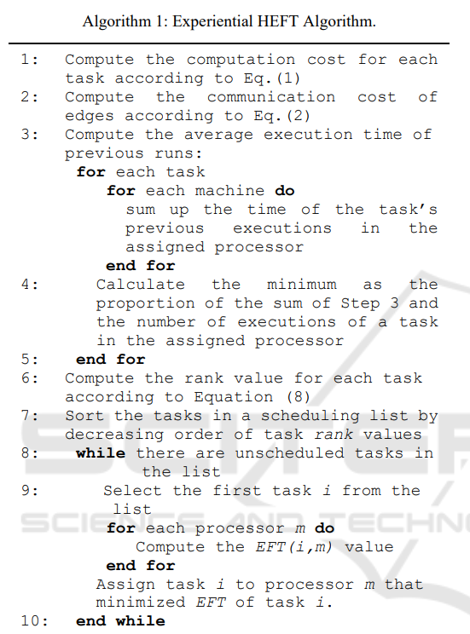



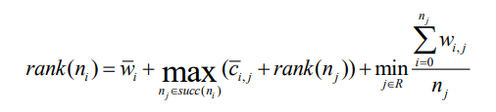
Notes:
原本:任務優先(rank) ,再來是處理器的選擇
它使原始的HEFT算法能夠在將任務分配給處理器時 .考慮資源的工作量和計算能力
附加參數來計算任務在所有相關資源上 ，過去運行的最小平均執行時間

Slide 18
 |  | Rank
1 | 18+13+105.9+(14+13+18+21/4,16+39/4,9+54/4)=150.65 | 1
2 | 16+16.6+60.7+(13+18+21/3,19+12+7/3,18+20+16/3)=105.9 | 3
3 | 23+14.3+61.6+(11+7+21/3,13+22/3,19+11+16/3)=110.5 | 2
4 | 23+12.6+60.7+(13+18+21/3,8+12+7/3,17+20+16/3)=105.3 | 4
5 | 13+11.6++60.7+(12+18+21/3,13+12+7/3,10+20+16/3)=103.9 | 5
6 | 15+12.6+51.6+(13+15+21/3,16+11+7/3,9+14+16/3)=90.5 | 6
7 | 17+11+21.6+(7+21/2,15+17/2,11+16/2)=61.6 | 7
8 | 11+10+21.6(5+21/2,15+17/2,11+16/2)=51.6 | 9
9 | 13+16.6+21.6+(18+21/2,12+7/2,20+16/2)=60.7 | 8
10 | 0+0+14.6+(21/1,7/1,16/1)=14.6+7=21.6 | 10

Slide 19
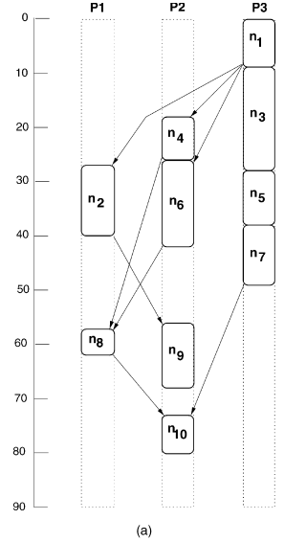
 | P1 |  |  | P2 |  |  | P3 |  |  | choice
 | start | cost | Finish | start | cost | finish | start | cost | finish
1 | 0 | 14 | 14 | 0 | 16 | 16 | 0 | 9 | 9 | P3
3 | 9+12 | 11 | 32 | 9+12 | 13 | 34 | 9 | 19 | 28 | P3
2 | 9+18 | 13 | 40 | 9+18 | 19 | 46 | 28 | 18 | 46 | P2
4 | 40 | 13 | 53 | 9+9 | 8 | 26 | 28 | 17 | 45 | P1
5 | 40 | 12 | 52 | 26 | 13 | 39 | 28 | 10 | 38 | P3
6 | 40 | 13 | 53 | 26 | 16 | 42 | 38 | 9 | 47 | P2
7 | 28+23 | 8 | 58 | 28+23 | 15 | 66 | 38 | 11 | 49 | P3
9 | 40 26+23 38+13 | 18 | 58 67 69 | 40+16 42 38+13 | 12 | 68 54 63 | 40+16 38+13 25+23 | 20 | 76 71 68 | P2
8 | 40 25+27 42+15 | 5 | 45 57 62 | 40+16 68 | 11 | 79 | 40+19 26+27 42+15 | 14 | 73 67 71 | P1
10 | 49+17 62 68+13 | 21 | 87 83 102 | 49+17 62+11 68 | 7 | 73 80 75 | 49 62+11 68+13 | 16 | 65 89 97 | P2

Slide 20
Five input parameters
Beta = {0.1, 0.2, 0.3, 0.4, 0.5, 0.6, 0.7, 0.8, 0.9, 1.0}
Number of DAG Tasks = {5, 10, 15, 20, 25}
Connectivity = {0.1, 0.2, 0.3, 0.4, 0.5, 0.6, 0.7, 0.8,0.9, 1.0}
Number of Processors = {2, 3, 4, 5, 6} for each task.
Previous information
Intel Core i7-6500U CPU with a 2.50 GHz × 4 speed, 16 GB of RAM, on Ubuntu 16.04 LTS.
Notes:
resource異構性 ，雲中的資源（即處理器）數量，DAG節點（即任務）數量，任務之間的連接性，以及每個任務的先前運行統計信息。
通過在模擬器中設置Beta參數可以實現資源異構性。
它的值定義了雲中資源之間處理能力差異的比率。
為模擬器提供不同的輸入值，以測試算法在不同條件下的有效期和運行時間方面的差異。

Slide 21
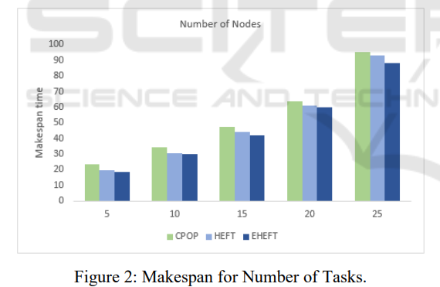
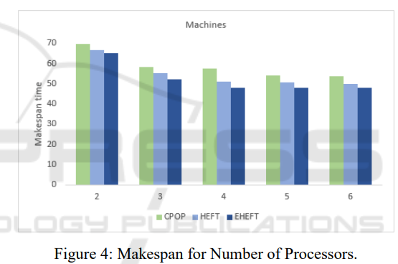
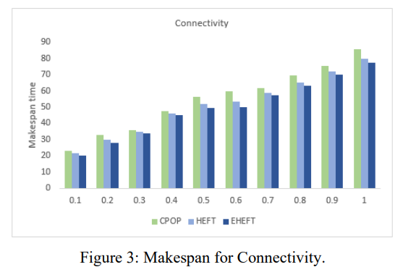
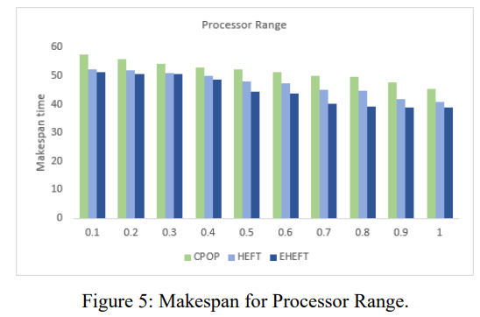
Notes:
scheduling length ratio and runtime
此演算法較佳

Slide 22
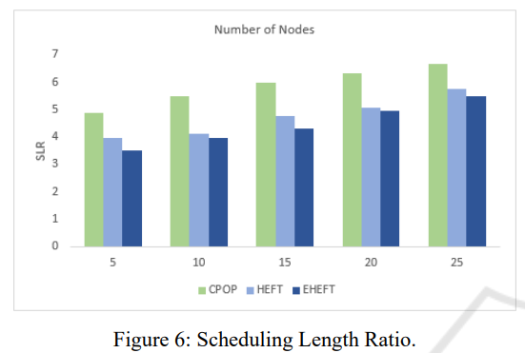

Notes:
分母是關鍵路徑任務的最小計算成本，表示為CPMIN。
考慮到使用了大量具有不同屬性的任務圖，計劃長度 應歸一化為下限，

Slide 23
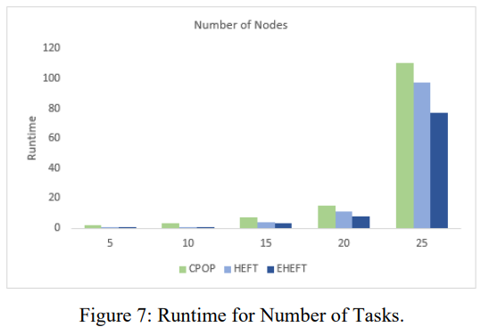
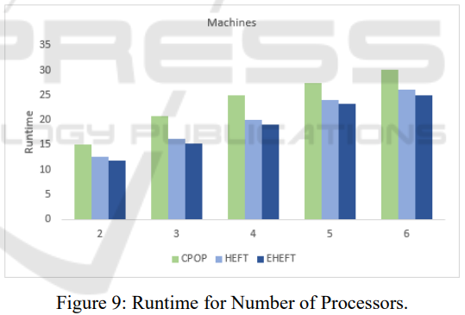
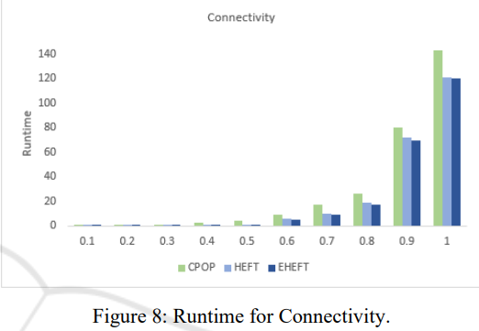
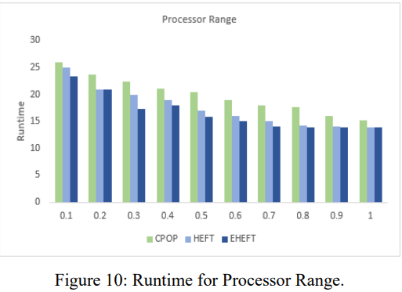

Slide 24
Conclution
EHEFT algorithm is highly dependent on the value of the past execution time of the tasks and it assigns tasks to resources that were better suited to execute such tasks in the past.
For more efficient task scheduling, other factors such as availability and scalability should be considered.
Notes:
EHEFT將任務分配給過去更適合執行此類任務的資源。
參數:任務分配給處理器時考慮到工作負載和resource處理能力的能力。
為了區分過去以更有效的方式執行了給定任務的處理器的優先級，存儲了雲中每個資源的任務的先前執行時間的總和和計數。

Slide 25
Thanks for listening.

Slide 26
 | P1 |  |  | P2 |  |  | P3 |  |  | choice
 | start | cost | finish | start | cost | finish | start | cost | finish
1
3
4
2
5
6
9
7
8
10

Slide 27
 | P1 |  |  | P2 |  |  | P3 |  |  | choice
 | start | cost | finish | start | cost | finish | start | cost | finish
1
3
4
2
5
6
9
7
8
10 | 0+14.6
Notes:
每個相關資源上的最小平均執行時間來計算等級

Slide 28
1
3
4
2
5
6
9
7
8
10

