Slide 1
New Amino Acid Substitution Matrix brings Sequence Alignments into Agreement with Structure Matches
Kejue Jia, Robert L. Jernigan and Roy J. Carver
Proteins: Structure, Function, and Bioinformatics, 2021
Presenter : Tzu-Hsu Lee
Date : Mar. 09, 2021.
Notes:
journal

Slide 2
Abstract(1/2)
Protein sequence matching presently fails to identify many structures that are highly similar, even when they are known to have the same function. The high packing densities in globular proteins lead to interdependent substitutions, which have not previously been considered for amino acid similarities. At present, sequence matching compares sequences based only upon the similarities of single amino acids, ignoring the fact that in densely packed protein, there are additional conservative substitutions representing exchanges between two interacting amino acids, such as a small-large pair changing to a large-small pair substitutions that are not individually so conservative.

Slide 3
Abstract(2/2)
Here we show that including information for such pairs of substitutions yields improved sequence matches, and that these yield significant gains in the agreements between sequence alignments and structure matches of the same protein pair. The result shows sequence segments matched where structure segments are aligned. There are gains for all 2002 collected cases where the sequence alignments that were not previously congruent with the structure matches. Our results also demonstrate a significant gain in detecting homology for “twilight zone” protein sequences. The amino acid substitution metrics derived have many other potential applications, for annotations, protein design, mutagenesis design, and empirical potential derivation.

Slide 4
Datasets(1/2)
Training set : Pfam
Test set :
1. CATH database : contains 4184 homolog families with a total of 8901 protein sequences in CATHS20.
2. SCOP database : contains 1454 homolog families and a total of 4066
sequences in ASTRAL20.
Notes:
a protein domain family database

Slide 5
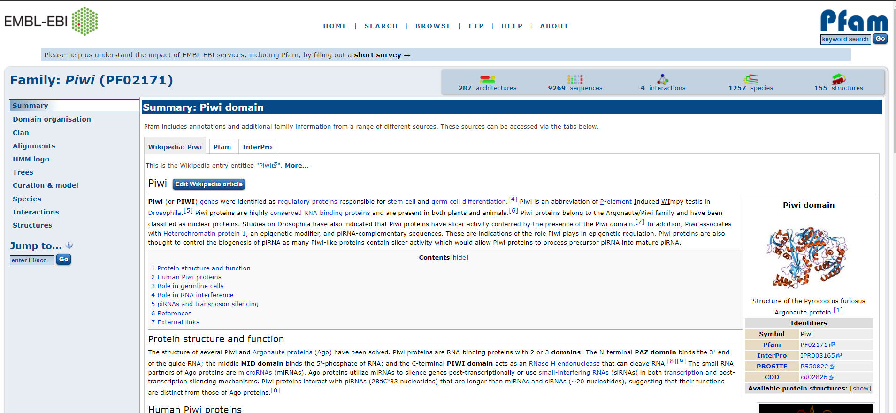
Datasets(2/2)

Slide 6
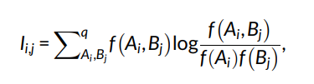
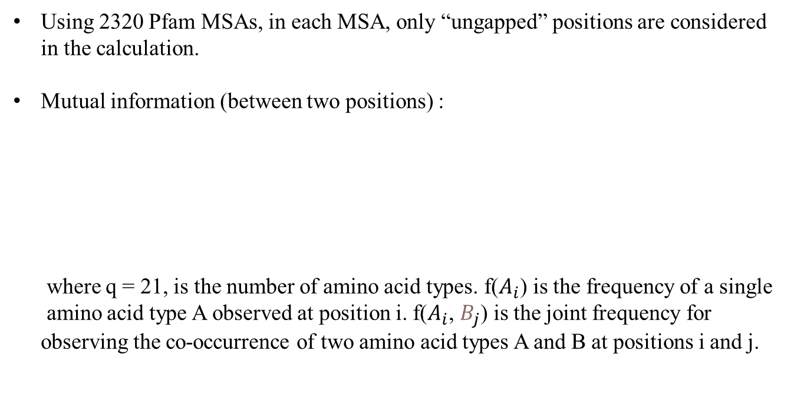
Extract Coevolution Correlations from Multiple Sequence Alignments
Using 2320 Pfam MSAs, in each MSA, only “ungapped” positions are considered in the calculation.
Mutual information (between two positions) :
where q = 21, is the number of amino acid types. f($A_{i}$) is the frequency of a single
amino acid type A observed at position i. f($A_{i}$, $B_{j}$) is the joint frequency for
observing the co-occurrence of two amino acid types A and B at positions i and j.
Notes:
Each family contains at least 1000 sequences and has at least one representative of an experimentally determined structure.
共演化，指的是胺基酸之間因為在三維空間的交互作用，雙方產生相對應改變的演化過程。
“ungapped” position is defined as a position containing fewer than 10% of gaps.

Slide 7
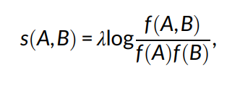
Derive a New Matrix from Contextual Substitutions
where f(A, B) is the joint frequencies and f(A)f(B) are the expected single amino
acid type frequencies. λ is a scalar factor .
Notes:
Each family contains at least 1000 sequences and has at least one representative of an experimentally determined structure.
共演化，指的是胺基酸之間因為在三維空間的交互作用，雙方產生相對應改變的演化過程。
“ungapped” position is defined as a position containing fewer than 10% of gaps.
2.4

Slide 8
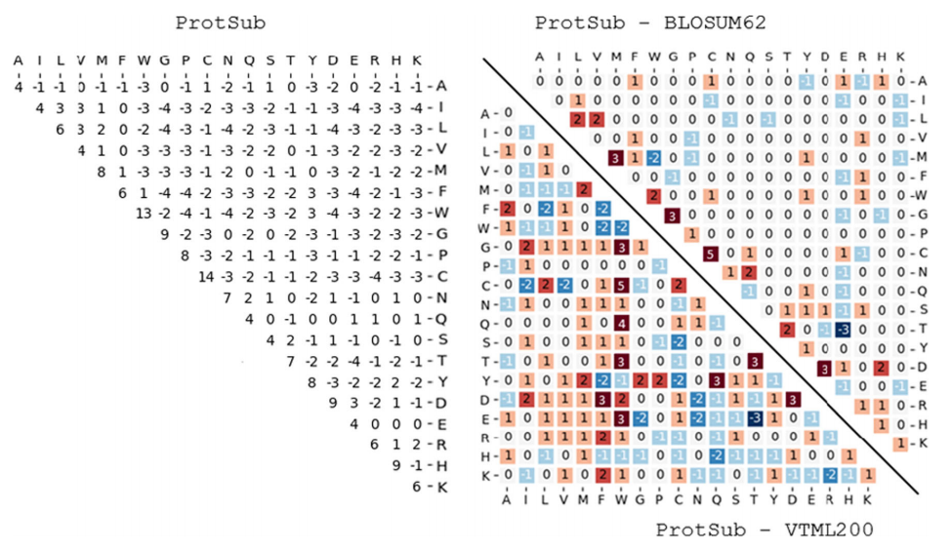
Result(1/4)
Notes:
compared with BLOSUM62, there are 63 out of the 210 elements changed
.A total of 139 of the 210 scores are changed (59 increases, 80 decreases) from VTML200

Slide 9
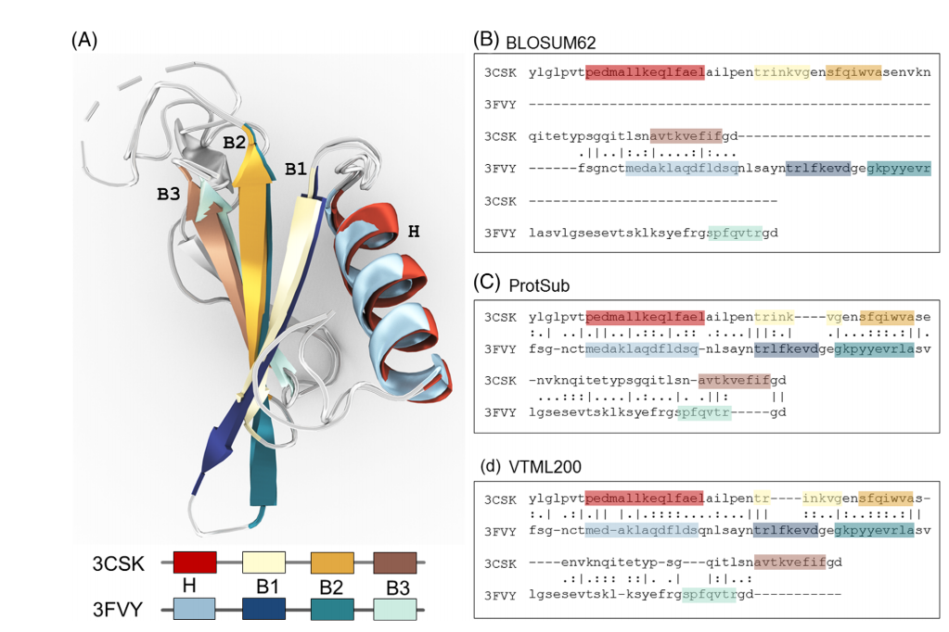
Result(2/4)
Notes:
extract in total 2002 nonredundant pairs of sequences from the CATHS20 dataset
there are at least two pairs of sequences selected from each homolog family; and
(b) the selected sequences do not contain any Pfam domains used in deriving the new matrix.

Slide 10
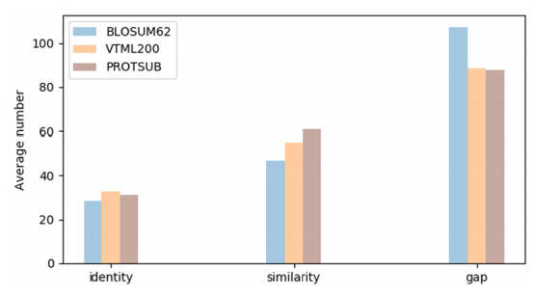
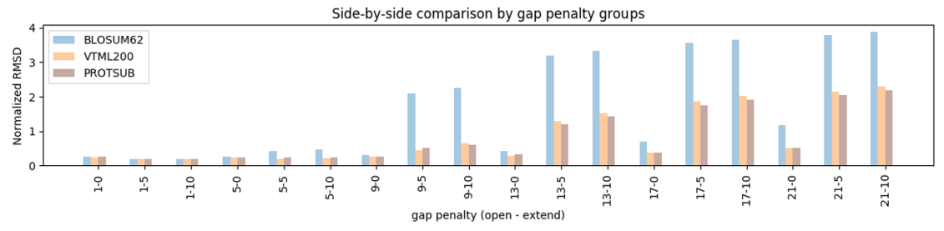
Result(3/4)
Notes:
The summary of sequence alignments for all 2002 cases under a default gap penalties (gap opening: 10, gap extension: 0.5)

Slide 11
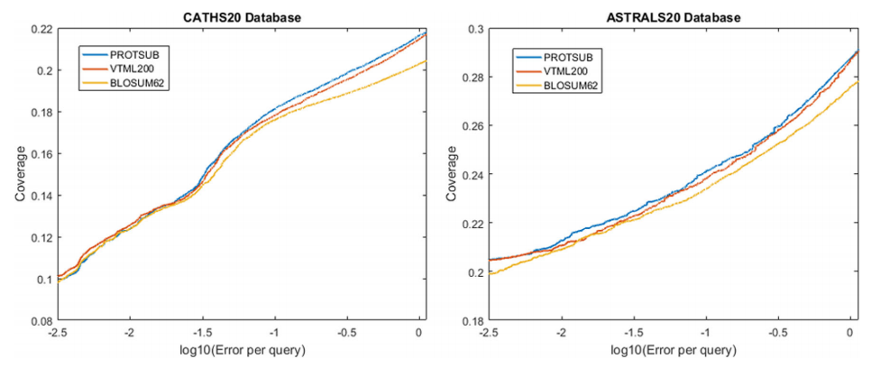
Result(4/4)
Notes:
twilight zone <20% sequence identity
with no greater than 20% identity
“errors per query” (EPQ), which shows the number of non-homologous sequences above the threshold divided by the number of queries

