Slide 1
On minimization of the Number of Branches in Branch-and-Bound Algorithms for the Maximum Clique Problem
Chu-Min Li, Hua Jianga, Felip Manyà
Computers & Operations Research, 2017
Volume 84, pp.1-15
Presenter: Tsung-Lin Lu
Date: Mar. 09, 2021

Slide 2
Abstract
When searching for a maximum clique in a graph G, branch-and-bound algorithms in the literature usually focus on the minimization of the number of branches generated at each search tree node. We call dynamic strategy this minimization without any constraint, because it induces a dynamic vertex ordering in G during the search. In this paper, we introduce a static strategy that minimizes the number of branches subject to the constraint that a static vertex ordering in G must be kept during the search. We analyze the two strategies and show that they are complementary. From this complementarity, we propose a new algorithm, called MoMC, that combines the strengths of the two strategies into a single algorithm. The reported experimental results show that MoMC is generally better than the algorithms implementing a single strategy.

Slide 3
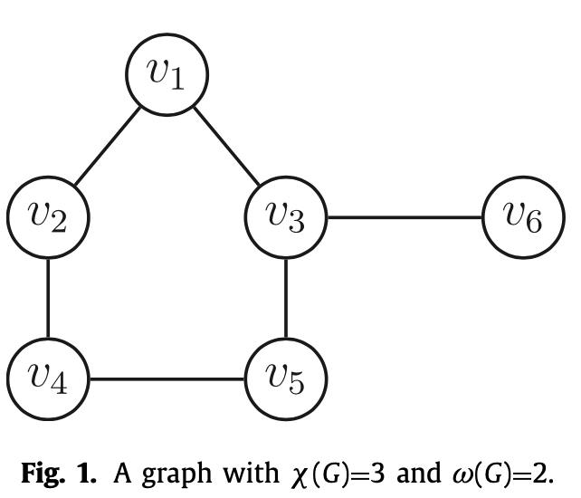
Introduction - Graph
Γ(v) = the neighbors of v
Density = 2m / (n(n-1))
𝜔(G) = a max clique
𝜒(G) = min number of colors
𝜔(G) ≤ 𝜒(G)
Max clique

Slide 4
Introduction - MaxSAT
MaxClique can be reduced to partial MaxSAT.
Hard clause：each pair of non-adjacent
{~x1 ∨ ~x4, ~x1 ∨ ~x5,
~x1 ∨ ~x6, ........}
Soft clause：Independent set
{x1∨ x4 ∨ x6, x2 ∨ x3, x5}

Slide 5
Introduction - MaxSAT
MaxClique can be reduced to partial MaxSAT.
Hard clause：each pair of non-adjacent
{~x2 ∨ ~x3, ~x2 ∨ ~x5,
~x2 ∨ ~x6, ........}
Soft clause：Independent set
{x1∨ x4 ∨ x6, x2 ∨ x3, x5}

Slide 6
Introduction - MaxSAT
MaxClique can be reduced to partial MaxSAT.
Hard clause：each pair of non-adjacent
{~x1 ∨ ~x4, ~x1 ∨ ~x5,
~x1 ∨ ~x6, ........}
Soft clause：Independent set
{x1∨ x4 ∨ x6, x2 ∨ x3, x5}

Slide 7
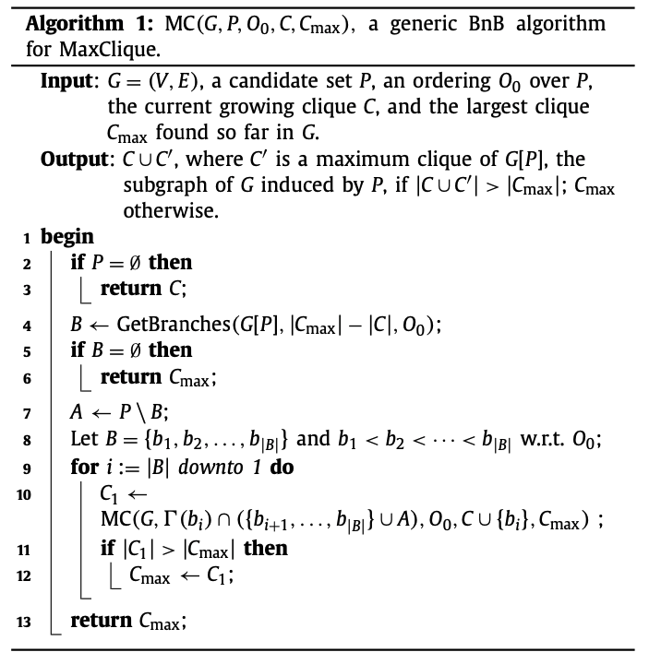
A basic BnB algorithm for MaxClique : DoMC
V (vertices) = A + B
A：The size of max clique is NOT greater than |Cmax|.
B (branches)
BnB algo focus on minimization of B

Slide 8
A basic BnB algorithm for MaxClique : DoMC
V (vertices) = A + B
A：The size of max clique is NOT greater than |Cmax|.
B (branches)
BnB algo focus on minimization of B
Recursion

Slide 9
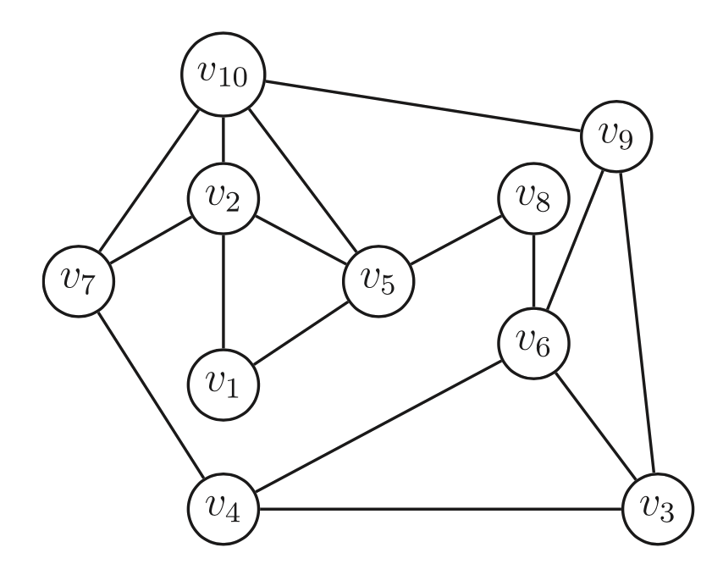
GetBranchesd0()
B (branches)
BnB algo focus on min of B
Ordering：v1<v2<......<v10
|Cmax| = 2, |C| = 0
D1 = {v10, v8}, D2 = {v9, v7}

Slide 10
GetBranchesd0()
B (branches)
BnB algo focus on min of B
Ordering：v1<v2<......<v10
|Cmax| = 2, |C| = 0
D1 = {v10, v8}, D2 = {v9, v7}

Slide 11
GetBranchesd0()
B (branches)
BnB algo focus on min of B
Ordering：v1<v2<......<v10
|Cmax| = 2, |C| = 0
D1 = {v10, v8}, D2 = {v9, v7}

Slide 12
GetBranchesd0()
B (branches)
BnB algo focus on min of B
Ordering：v1<v2<......<v10
|Cmax| = 2, |C| = 0
D1 = {v10, v8}, D2 = {v9, v7}

Slide 13
GetBranchesd0()
B (branches)
BnB algo focus on min of B
Ordering：v1<v2<......<v10
|Cmax| = 2, |C| = 0
D1 = {v10, v8}, D2 = {v9, v7}
Bd0 = {v6}
Re-NUMBER

Slide 14
GetBranchesd0()
B (branches)
BnB algo focus on min of B
Ordering：v1<v2<......<v10
|Cmax| = 2, |C| = 0
D1 = {v10, v6}, D2 = {v9, v8, v7}
Re-NUMBER

Slide 15
GetBranchesd0()
B (branches)
BnB algo focus on min of B
Ordering：v1<v2<......<v10
|Cmax| = 2, |C| = 0
D1 = {v10, v6, v1}, D2 = {v9, v8, v7}
Bd0 = {v5, v4, v3, v2}
Ad0 = D1 + D2

Slide 16
Ordering
The vertex ordering O0 is a key component of efficient BnB
Degeneracy ordering：Find smallest degree.
v1 ➝ v8 ➝ v5 ➝ ......
MIS ordering：
Sort the vertices of ~G in the degeneracy ordering.
Find max clique of ~G.

Slide 17
Ordering
The vertex ordering O0 is a key component of efficient BnB
Degeneracy ordering：Find smallest degree.
MIS ordering：
Sort the vertices of ~G in the degeneracy ordering.
Find max clique of ~G.

Slide 18
Ordering
Degeneracy ordering：
MIS ordering：
Density < 0.7 ➝ Degeneracy ordering
Density ≥ 0.7 ➝ MIS ordering

Slide 19
Contradictions
Unit resolution rule
- CNF = x + y
Failed literal detection
Upper bound：𝜔(G) ≤ r - t
r：The number of independent sets
t：The number of disjoint conflicting subsets of independent sets

Slide 20
Contradictions
Unit resolution rule
- CNF = x + y
Failed literal detection
Prove that G has no clique of size three.
Because the set formed by the three independent sets is conflicting

Slide 21
Contradictions
Prove that G has no clique of size three.
x5 = 1 (3rd independent set)
→ (~x1, ~x2, ~x6) ∨ ~x5
→ x1, x2, x6 = 0
→ x1 ∨ x4 ∨ x6, x2 ∨ x3
→x3, x4 = 1
→ ~x3 ∨ ~x4
→ 0 → Contradictions
1

Slide 22
Contradictions
Prove that G has no clique of size three.
x5 = 1 (3rd independent set)
→ (~x1, ~x2, ~x6) ∨ ~x5
→ x1, x2, x6 = 0
→ x1 ∨ x4 ∨ x6, x2 ∨ x3
→x3, x4 = 1
→ ~x3 ∨ ~x4
→ 0 → Contradictions
1

Slide 23
Contradictions
Prove that G has no clique of size three.
x5 = 1 (3rd independent set)
→ (~x1, ~x2, ~x6) ∨ ~x5
→ x1, x2, x6 = 0
→ x1 ∨ x4 ∨ x6, x2 ∨ x3
→x3, x4 = 1
→ ~x3 ∨ ~x4
→ 0 → Contradictions
0
0
0
1

Slide 24
Contradictions
Prove that G has no clique of size three.
x5 = 1 (3rd independent set)
→ (~x1, ~x2, ~x6) ∨ ~x5
→ x1, x2, x6 = 0
→ x1 ∨ x4 ∨ x6, x2 ∨ x3
→x3, x4 = 1
→ ~x3 ∨ ~x4
→ 0 → Contradictions
0
0
0
1

Slide 25
Contradictions
Prove that G has no clique of size three.
x5 = 1 (3rd independent set)
→ (~x1, ~x2, ~x6) ∨ ~x5
→ x1, x2, x6 = 0
→ x1 ∨ x4 ∨ x6, x2 ∨ x3
→x3, x4 = 1
→ ~x3 ∨ ~x4
→ 0 → Contradictions
0
1
0
0
1
1

Slide 26
Contradictions
Prove that G has no clique of size three.
x5 = 1 (3rd independent set)
→ (~x1, ~x2, ~x6) ∨ ~x5
→ x1, x2, x6 = 0
→ x1 ∨ x4 ∨ x6, x2 ∨ x3
→x3, x4 = 1
→ ~x3 ∨ ~x4
→ 0 → Contradictions
0
1
0
0
1
1

Slide 27
Contradictions
Prove that G has no clique of size three.
x5 = 1 (3rd independent set)
→ ~x3 ∨ ~x4
→ 0 → Contradictions
→ The set formed by the three independent sets is conflicting
0
1
0
0
1
1

Slide 28
Improve upper bound 𝜔(G)
Unit resolution rule
- CNF = x + y
Failed literal detection
Upper bound：𝜔(G) ≤ r - t
r：The number of independent sets
t：The number of disjoint conflicting subsets of independent sets

Slide 29
Improve upper bound
Upper bound：𝜔(G) ≤ r - t
r：independent sets
t：disjoint conflicting
The set formed by the three independent sets is conflicting
Weaken soft clause
x1~2 = 1, x3~6 = 0
{x1 ∨ x4 ∨ x6 ∨ z1, x2 ∨ x3 ∨ z2, x5 ∨ z3, z1 + z2 + z3 = 1}
𝜔(G) ≤ r - t = 3 - 1 = 2

Slide 30
Reduce the set of branching vertices
Ordering：v1<v2<......<v10
|Cmax| = 2, |C| = 0
D1 = {v10, v6, v1}, D2 = {v9, v8, v7}
B = {v5, v4, v3, v2}
{D1, D2, v5} can't form a clique of size 3 and is conflicting.
Weaken soft clause.
B' = {v5}

Slide 31
Reduce the set of branching vertices
Ordering：v1<v2<......<v10
|Cmax| = 2, |C| = 0
D1 = {v10, v6, v1}, D2 = {v9, v8, v7}
B = {v5, v4, v3, v2}
{D1, D2, v4} can't form a clique of size 3 and is conflicting.
Weaken soft clause.
B' = {v5 , v4}

Slide 32
Reduce the set of branching vertices
Ordering：v1<v2<......<v10
|Cmax| = 2, |C| = 0
D1 = {v10, v6, v1}, D2 = {v9, v8, v7}
B = {v5, v4, v3, v2}
{D1, D2, v3} can't form a clique of size 3 and is'n conflicting.
Don't weaken soft clause.
B' = {v5 , v4}

Slide 33
Reduce the set of branching vertices
Ordering：v1<v2<......<v10
|Cmax| = 2, |C| = 0
D1 = {v10, v6, v1}, D2 = {v9, v8, v7}
B = {v5, v4, v3, v2}
Reduce v5, v4 from B
B ← {v3, v2}
A ← D1 + D2 + B'

Slide 34
SoMC (static ordering MaxClique solver)
Ordering：v1<v2<......<v10
A = {v10, v9, v8, v7 ,v6, v5, v4, v1}
B = {v3, v2}
SoMC：B are smaller than A w.r.t O0.
A = {v10, v9, v8, v7 ,v6, v5, v4}
B = {v3, v2, v1}

Slide 35
MoMc, DoMC2 and SoMC2 : Upper bound
Inheritance rule:
Vi ⊆Ui ➞ vertexUB[vi, O] on Vi ⟵ vertexUB[vi, O] on Ui
Incremental rule:
Vi ∩ Γ(vi) = ∅ ➞ IncUB(vi,O) = 1
Vi ∩ Γ(vi) ≠ ∅ ➞ IncUB(vi,O) = 1 + maxu∈Vi ∩Γ(vi) vertetUB[u, O]
In other words, the maximum vertexUB of its neighbors in Vi + 1

Slide 36
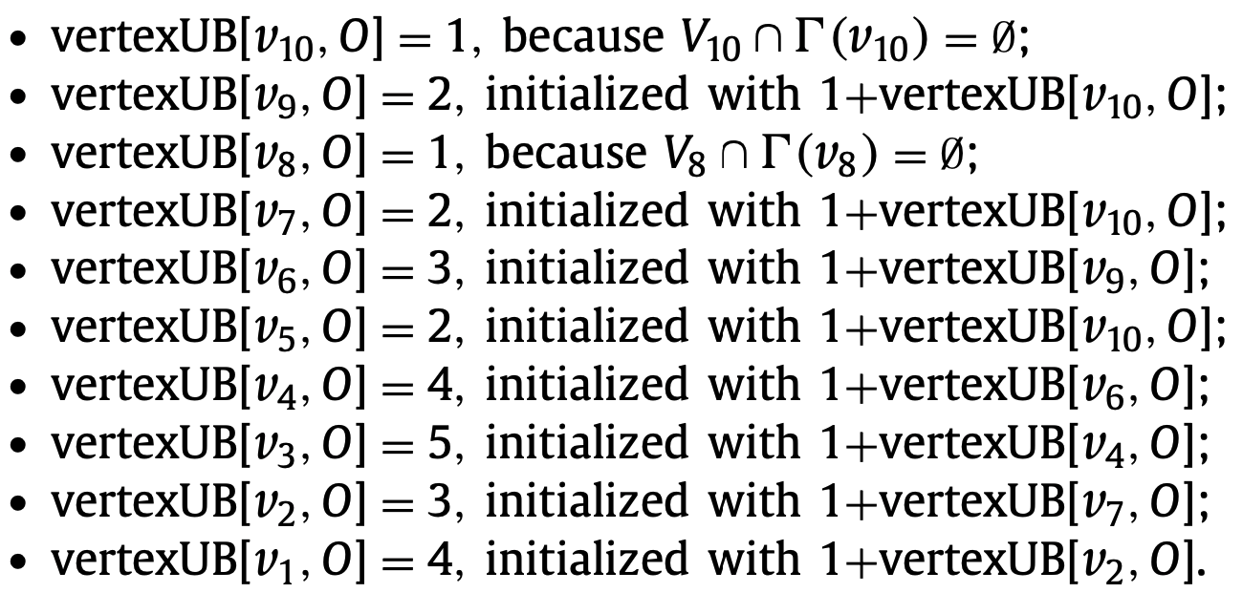
DoMC2₀, DoMC2 and SoMC2 : Upper bound
Incremental rule: The maximum vertexUB of its neighbors in Vi + 1

Slide 37
DoMC2₀, DoMC2 and SoMC2 : Upper bound
Coloring rule:
Vi _{i} can be partitioned into r independent sets ➞ vertexUB[vi, O] = r.
MaxSAT rule:
Vi can be partitioned into r independent sets and
t disjoint conflicting subsets of independent sets
➞ vertexUB[vi, O] = r − t

Slide 38
DoMC2₀, DoMC2 and SoMC2 : Upper bound
Branching rule:
VertexUB[vi, O] = |C1| - |C|, after a BnB algorithm branches on v_{i} with the growing clique C to obtain a clique C₁.
Compatibility rule:
Let O and O' be two different vertex orderings.
{u | vi < u w.r.t. O'} ⊆ {u | vi < u w.r.t. O}
➞ vertexUB[vi, O'] ⟵ vertexUB[vi, O]

Slide 39
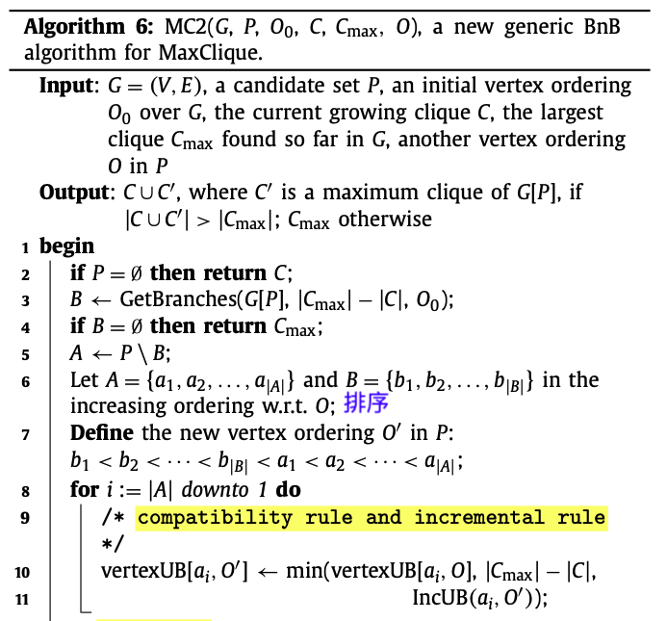
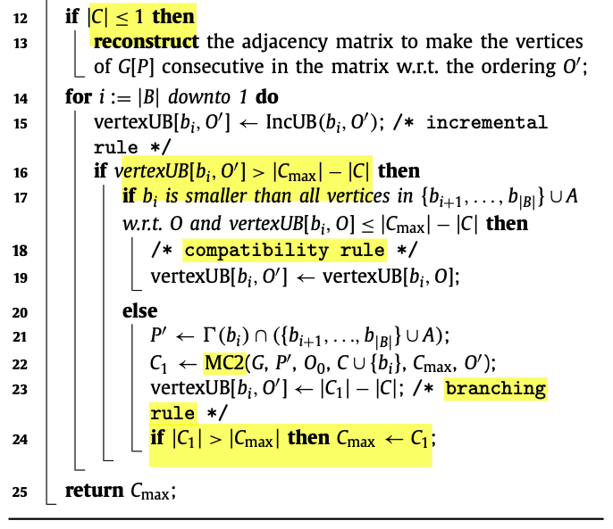
DoMC2

Slide 40
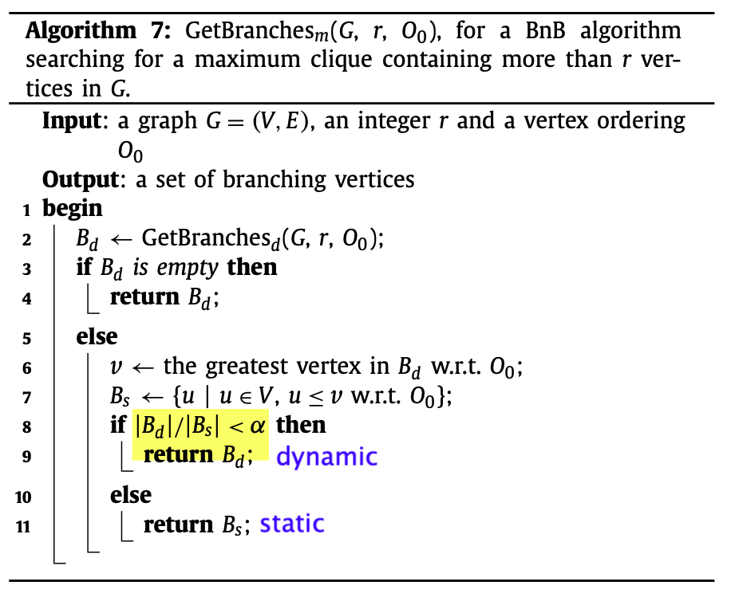
MoMC：DoMC2 + SoMC2
Uses a parameter 𝛼 (0~1) to control the choice of either dynamic or static.
𝛼 = 0.6 from experiments.

Slide 41
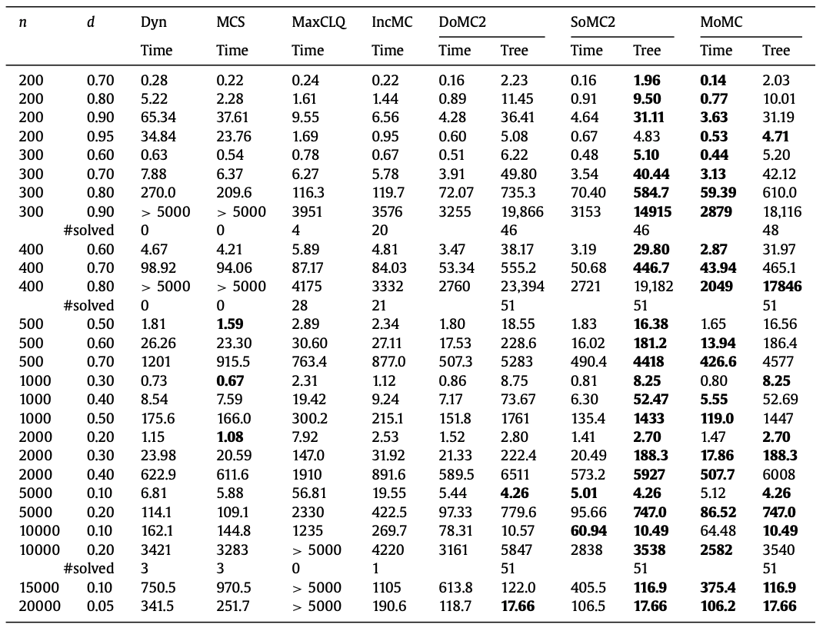
Result
Random graphs

Slide 42
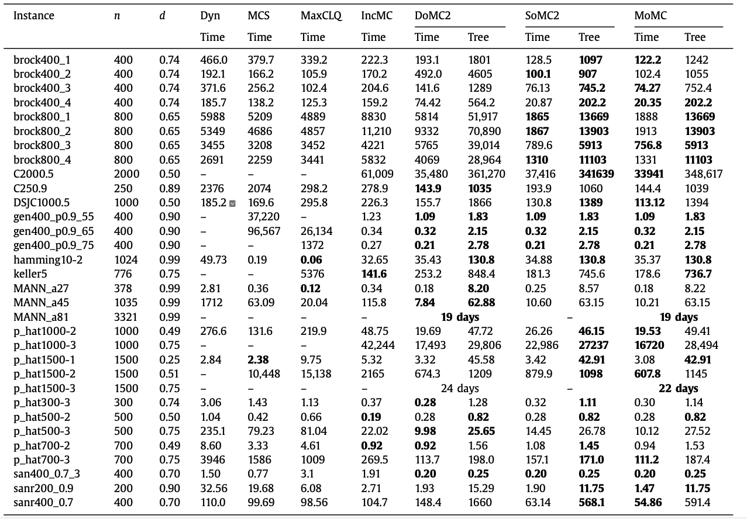
Result
DIMAC graphs

Slide 43
Conclusion
DoMC (dynamic ordering MaxClique solver)
SoMC (static ordering MaxClique solver)
MoMC：Combine the dynamic and static strategies.
MoMC is generally better than the algorithms implementing a single strategy.
Incremental MaxSAT reasoning to improve the minimization of branches.
The static strategy allows a more incremental search.
Restruct adjacency matrix and improve upper bound.

Slide 44
Thank you for listening

