Slide 1
Longest common subsequence between run-length-encoded strings: a new algorithm with improved parallelism Valerio Freschi, Alessandro Bogliolo Information Processing Letters, Vol. 90, pp. 167-173, 2004
Presenter:Chen Yun-syuan
Date:Mar. 1, 2011

Slide 2
Abstract
Data compression can be used to simultaneously reduce memory, communication and computation requirements of string comparison. In this paper we address the problem of computing the length of the longest common subsequence (LCS) between run-length-encoded (RLE) strings. We exploit RLE both to reduce the complexity of LCS computation from O(M × N) to O(mN + Mn − mn), where M and N are the lengths of the original strings and m and n the number of runs in their RLE representation, and to improve the inherent parallelism of the proposed algorithm, so that it may execute in O(m + n) steps on a systolic array of M + N units. We also discuss the application of the proposed algorithm to the related problem of edit distance (ED) computation.

Slide 3
Run-length-encoded (RLE)
a string-compression technique that represents a string as a sequence of runs rather than as a sequence of characters
a run is a sequence of consecutive characters taking the same value
“accccttggg” -> “1a,4c,2t,3g”
10 character expressed as 4 runs

Slide 4
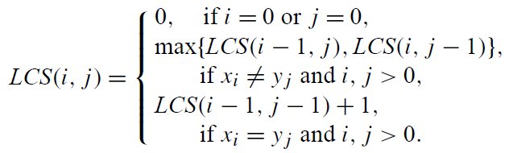
Original LCS algorithm

Slide 5
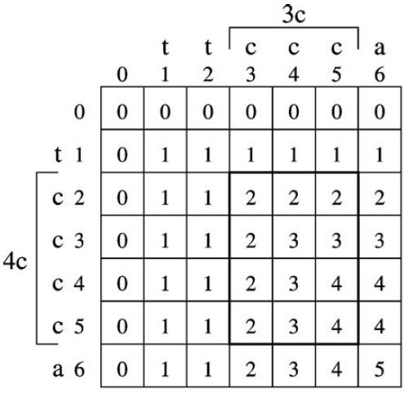
Original LCS algorithm

Slide 6
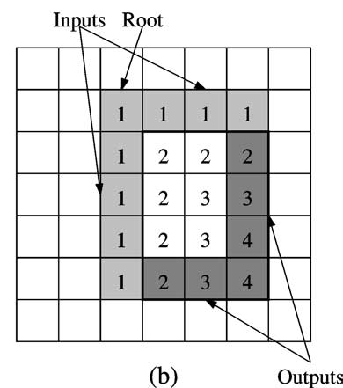
LCS with RLE
Fill only the output part of the block according to the roots and input part, and ignore the remain part of the block.

Slide 7
LCS with RLE
If matching, the value of the output element LCS(i, j ) of a match block rooted in (i0, j0) is given by
LCS(i, j ) = LCS(i − d, j − d)+ d , d = min{i −i0, j − j0}
If mismatching, the value of the output element LCS(i, j ) of a mismatch block rooted in (i0, j0) is given by
LCS(i, j ) = max LCS(i, j0) , LCS(i0, j)

Slide 8
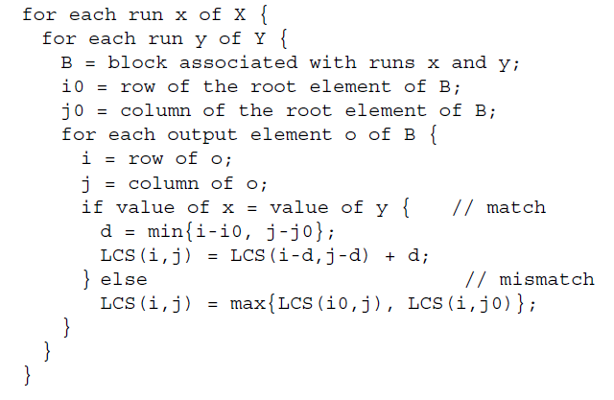
Algorithm of LCS with RLE

Slide 9
Example of LCS with RLE
 | 0 | t | t | c | c | c | a
0 | 0 | 0 | 0 | 0 | 0 | 0 | 0
t | 0 | 1 | 1
c | 0
c | 0
c | 0
c | 0
a | 0

Slide 10
Example of LCS with RLE
 | 0 | t | t | c | c | c | a
0 | 0 | 0 | 0 | 0 | 0 | 0 | 0
t | 0 | 1 | 1 | 1 | 1 | 1
c | 0 |  | 1
c | 0 |  | 1
c | 0 |  | 1
c | 0 | 1 | 1
a | 0

Slide 11
Example of LCS with RLE
 | 0 | t | t | c | c | c | a
0 | 0 | 0 | 0 | 0 | 0 | 0 | 0
t | 0 | 1 | 1 | 1 | 1 | 1 | 1
c | 0 |  | 1 |  |  | 2
c | 0 |  | 1 |  |  | 3
c | 0 |  | 1 |  |  | 4
c | 0 | 1 | 1 | 2 | 3 | 4
a | 0 | 1 | 1

Slide 12
Example of LCS with RLE
 | 0 | t | t | c | c | c | a
0 | 0 | 0 | 0 | 0 | 0 | 0 | 0
t | 0 | 1 | 1 | 1 | 1 | 1 | 1
c | 0 |  | 1 |  |  | 2 | 2
c | 0 |  | 1 |  |  | 3 | 3
c | 0 |  | 1 |  |  | 4 | 4
c | 0 | 1 | 1 | 2 | 3 | 4 | 4
a | 0 | 1 | 1 | 2 | 3 | 4

Slide 13
Example of LCS with RLE
 | 0 | t | t | c | c | c | a
0 | 0 | 0 | 0 | 0 | 0 | 0 | 0
t | 0 | 1 | 1 | 1 | 1 | 1 | 1
c | 0 |  | 1 |  |  | 2 | 2
c | 0 |  | 1 |  |  | 3 | 3
c | 0 |  | 1 |  |  | 4 | 4
c | 0 | 1 | 1 | 2 | 3 | 4 | 4
a | 0 | 1 | 1 | 2 | 3 | 4 | 5

Slide 14
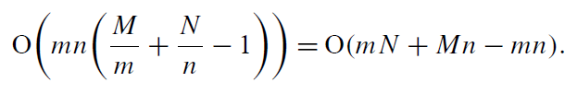
Time complexity
times of block computing : mn
average run length of X : M/m
average run length of Y : N/n
1 for counting twice the corner output

Slide 15
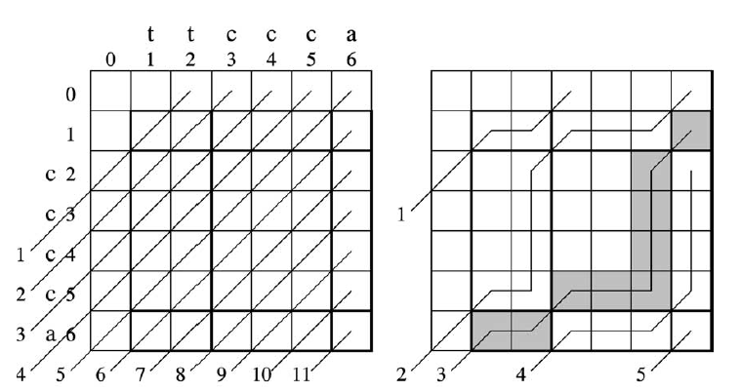
Parallelism
If the maximum number of units that can execute in parallel is 9,execution completes in only 5 steps, while the original LCS algorithm is 11 steps.

Slide 16
Thank you!!

