Slide 1
The Traveling Salesman Problem for lines in the plane
Håkan Jonsson
Information Processing Letters 82 (2002) 137–142
Presenter:Chang-Hao Huang
Date:Feb. 15, 2011

Slide 2
Abstract
We present an algorithm that computes the shortest route that intersects n lines in the plane in time polynomial in n; the time complexity is dominated by the time it takes to compute a shortest watchman route in a simple polygon of size n. We also present a simple O(n) time algorithm for computing a route that intersects the lines but which is guaranteed to have a length at most 2 times longer than the shortest route. 
√

Slide 3
Problem
Given a ( finite) set of lines in the plane, compute the shortest route that visits them.
We reduce the problem to the problem of computing a shortest watchman route in a simple polygon.

Slide 4
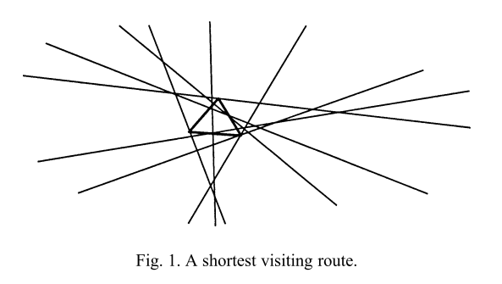

Slide 5
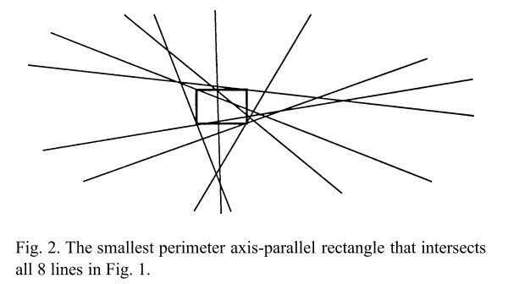

Slide 6
Terminology and notation(1/2)
L denotes the set of target lines while n denotes the size of L
two points in a simple polygon are visible to each other if the line segment between the points does not intersect the exterior of the polygon.
A watchman route is a route such that each point in the interior of the polygon is visible from at least one point along the route.

Slide 7
Terminology and notation(2/2)
Vopt denotes the shortest possible route.
Crossing is a point where two target lines intersect
Fragment is a maximal subset of a target line that does not contain a crossing.
Angle of reflection is the angle formed at a point of reflection by either the incoming or the outgoing edge of Vopt and the target line.

Slide 8
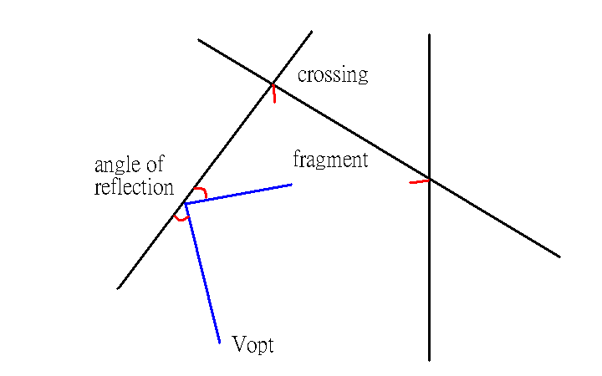

Slide 9
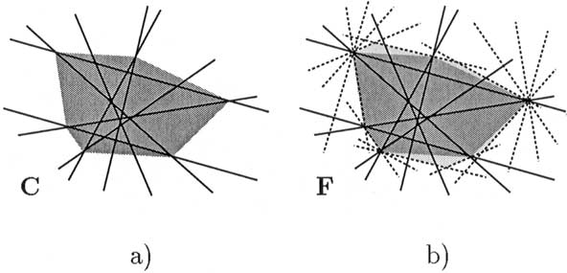
The convex hull C of all crossing
The polygon F (shaded and containing the even darker shaded hull C).

Slide 10
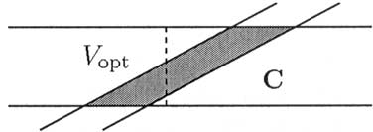
Fig. 5. Vopt is not always contained in C.

Slide 11
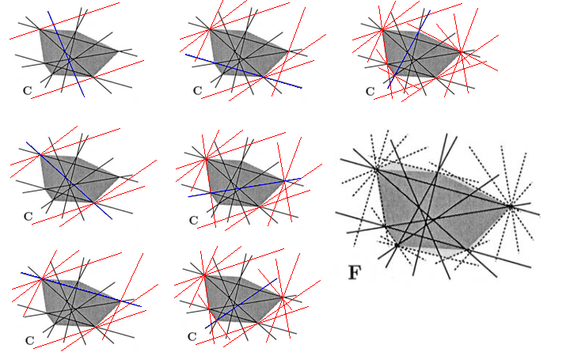
1
4
7
2
5
3
6

Slide 12
Lemma 2.1 (The reflection principle). The angles of reflection are equal at a point of reflection that lies in a fragment.
Lemma 2.2. Let vi denote a vertex of Vopt and assume without loss of generality that Vopt is located so that it makes a perfect reflection on the horizontal line through vi. Then vi lies either in a horizontal target line (on which Vopt makes a perfect reflection) or at a crossing between two target lines with negative and positive slope, respectively

Slide 13
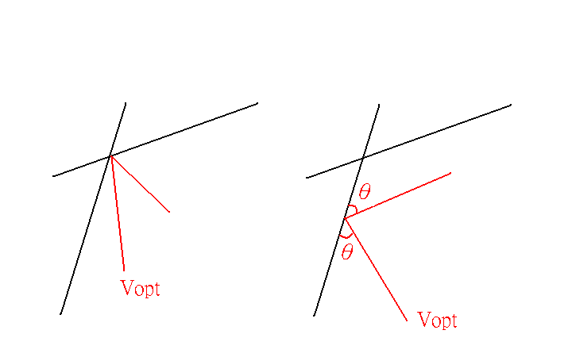

Slide 14
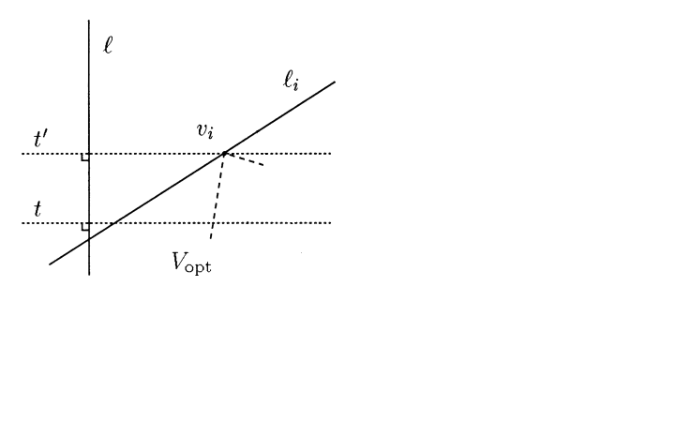
Lemma 2.3. Vopt is contained in F.

Slide 15
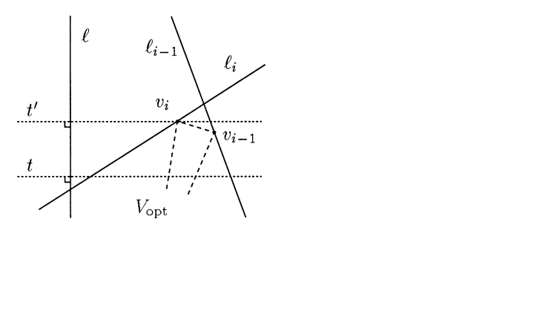
Lemma 2.3. Vopt is contained in F.

Slide 16
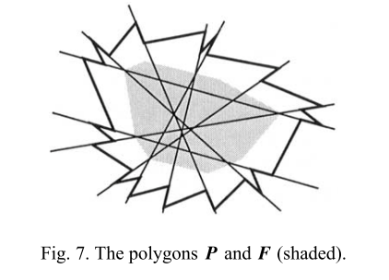
The polygon P

Slide 17
Lemma 2.4. A shortest watchman route in P is a shortest visiting route for L in the plane.

Slide 18
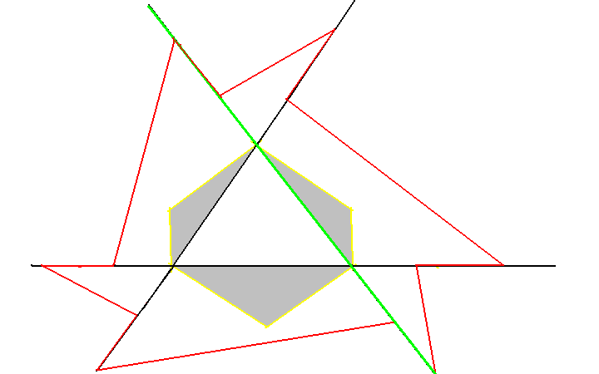
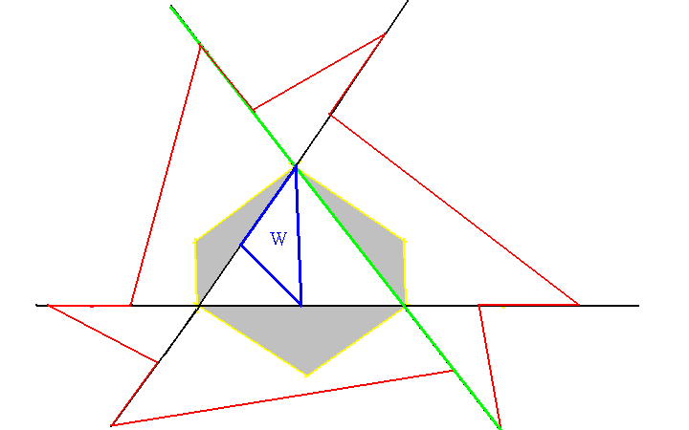
A watchman route in P is a visiting route for L

Slide 19
A visiting route in P is a watchman route in P
Let W denote a route that intersects the two chords Ci and Cj that extend into P from the reflex vertices that bounds a sawtooth.

Slide 20
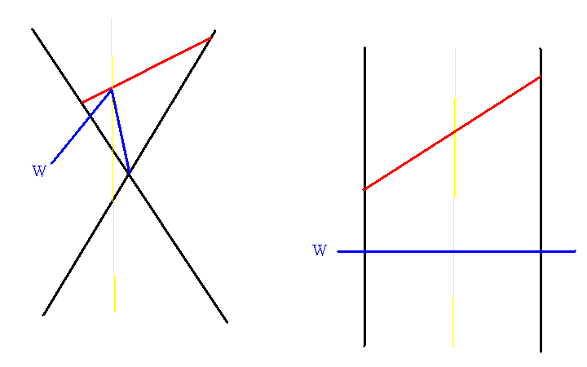
P
P

Slide 21
The polygon P

Slide 22
Computing Vopt
A shortest watchman route in a simple polygon can be computed in O(n ) time.
5

Slide 23
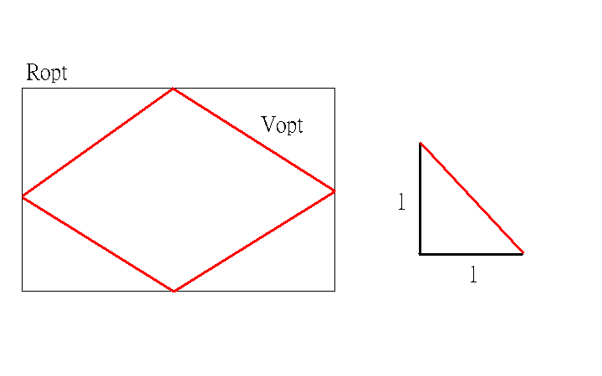
A linear time approximation
Lemma 3.1. Ropt (shortest perimeter axis-parallel rectangle)is a visiting route for L at most √ times as long as Vopt.
2
√
2

Slide 24
-
+
Lemma 3.2. The target lines in L and L intersect the diagonals [( x , y ), ( x , y )] and [( x , y ), ( x , y )]
Minimize 2(x – x ) + 2(y – y ) subject to
by + ax ≧ -c and -by - ax ≧ -c
for all ax+by+c = 0 ∈ L
-by - ax ≧ c and by + ax ≧ c
for all ax+by+c = 0 ∈ L
and
x – x ≧0 & y – y ≧0
-
-
+
+
-
+
+
-
+
-
+
-
+
-
-
+
+
-
-
+
+
-
+
-
+
-

Slide 25
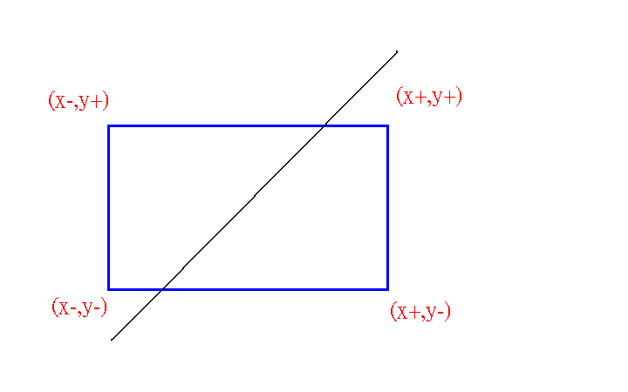

Slide 26
The program is formulated using 2n+2 constraints and 4 variables, the solution to a linear program in a fixed number of variables can be found in time linear in the number of constraints
Theorem 2. A visiting route for n lines in the plane, such that the length of the route is at most √ times longer than a shortest visiting route for the lines, can be computed in O(n) time.
2

Slide 27
Thanks for your listening!

