Slide 1
A prototype genetic algorithm-enhanced rough set-based rule induction system
Li-Pheng Khoo, Lian-Yin Zhai
Computers in Industry Volume 46(2001), p.p. 95-106
Presenter: Siao-ming Jhou
Date: March 1, 2011

Slide 2
Abstract(1/2)
The ability to learn from empirical data or the observation of a real world and accurately predict future instances is an important feature expected in human. It allows knowledge to be gained by experience and decision rules induced from empirical data. One of the major obstacles in performing rule induction from empirical data is the inconsistency of information about a problem domain. Rough set theory provides a novel way of dealing with vagueness and uncertainty.

Slide 3
Abstract(2/2)
When coupled with genetic algorithms, a rule induction engine that is able to induce probable rules from inconsistent information can possibly be developed. This paper presents an integrated approach that combines rough set theory, genetic algorithms and Boolean algebra, for inductive learning. Using such an approach, a prototype system (RClass-Plus) that discovers rules from inconsistent empirical data, has been developed. The system was validated using the data obtained from a case study. The results of the validation are presented.

Slide 4
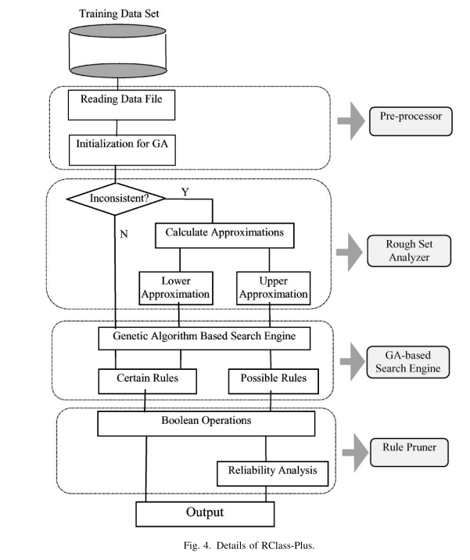

Slide 5
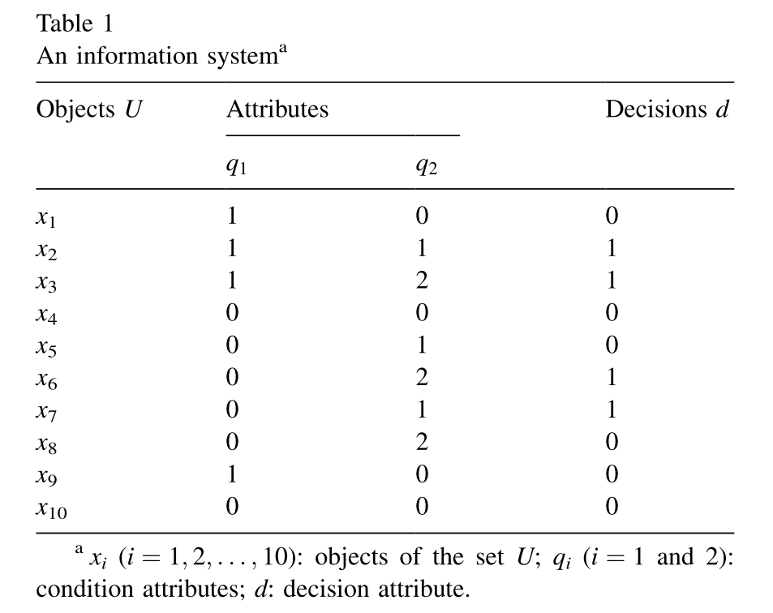
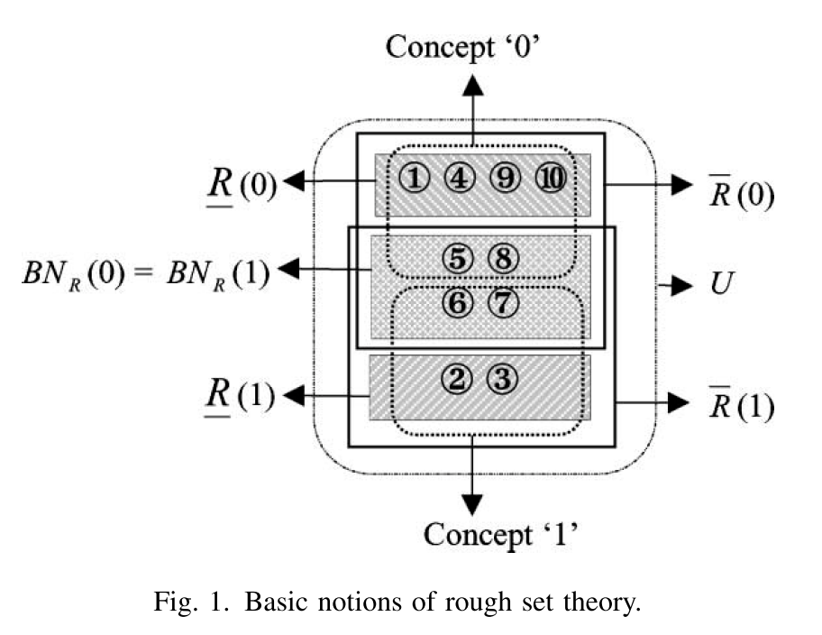
Rough Set

Slide 6
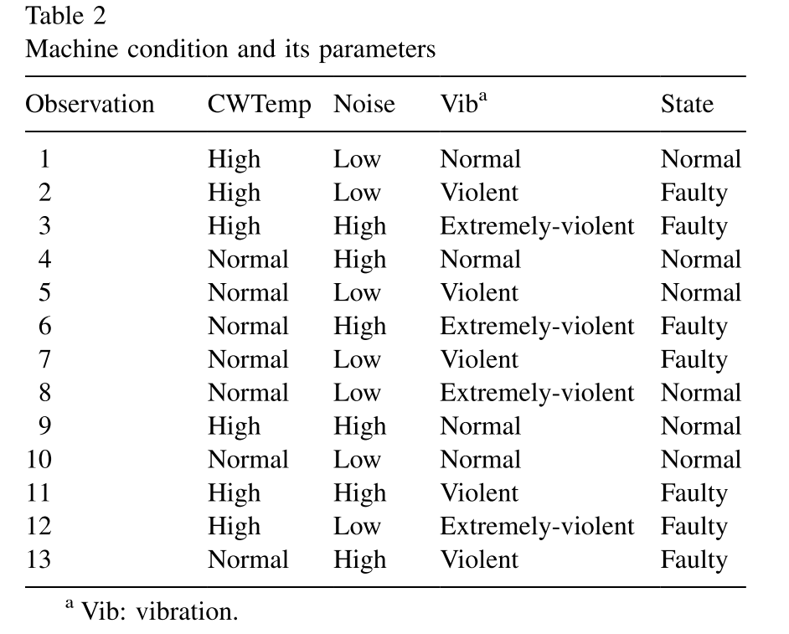
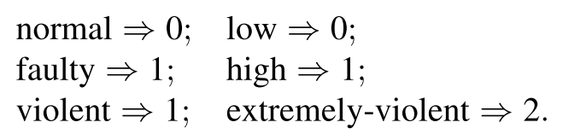
Input data

Slide 7
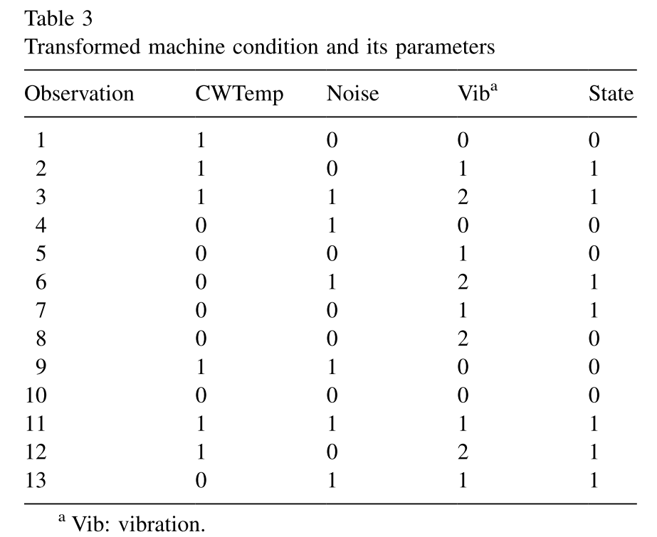



Slide 8


Slide 9
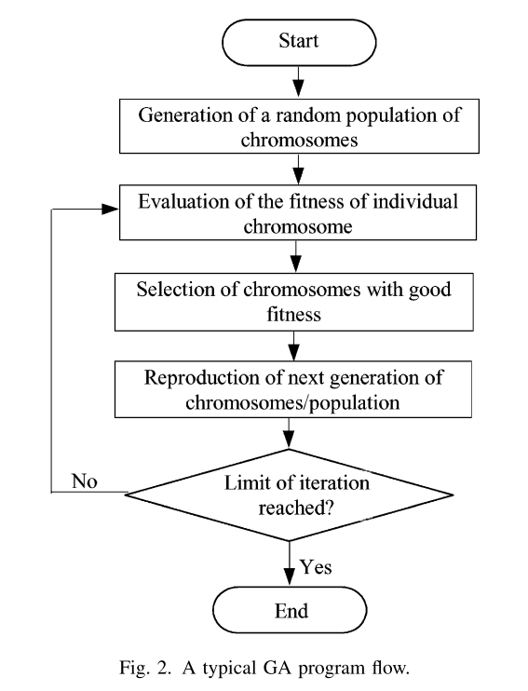
GA

Slide 10
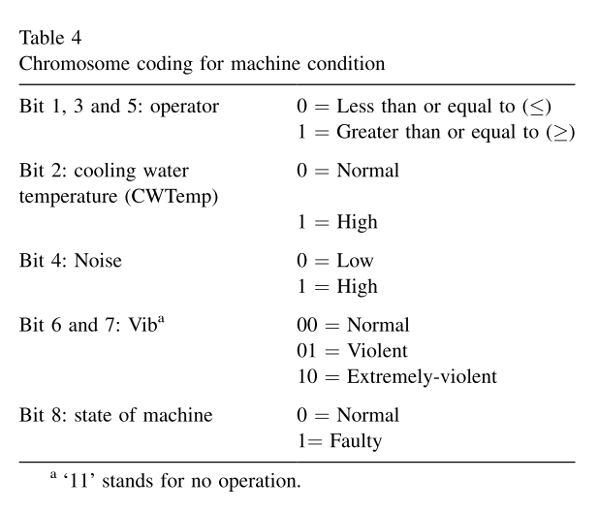
if (CWTemp ≧high) and
(Noise ≧low) and (Vib ≧violent) then the state of the machine is faulty
1
1
1
0
1
0
1
1

Slide 12
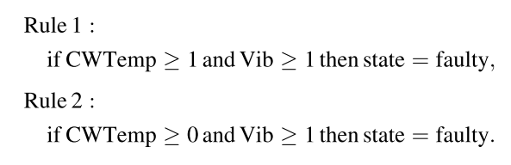

Slide 13
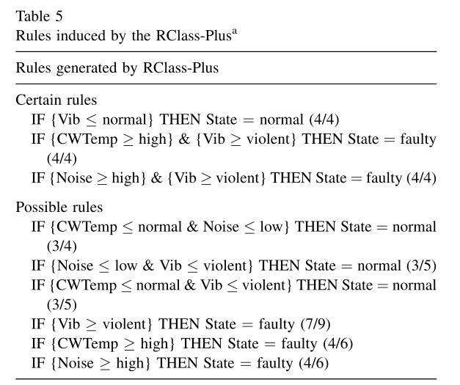

Slide 14
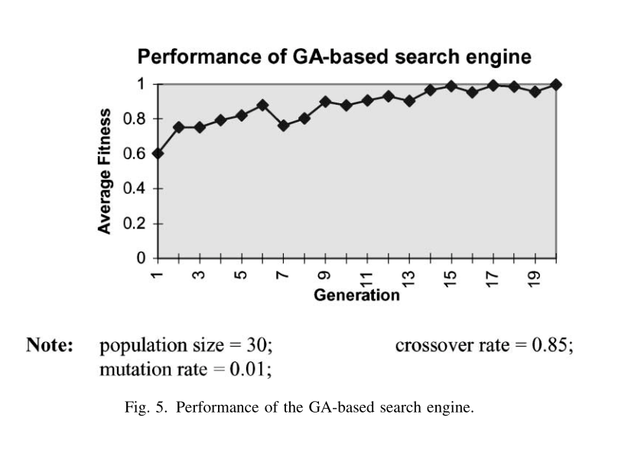
Result

Slide 15
Thank you

