Slide 1
A hybrid model based on rough sets theory and genetic algorithms for stock price forecasting
Ching-Hsue Cheng(鄭景裕), Tai-Liang Chen(陳泰良), Liang-Ying Wei (魏良穎)
Information Sciences, vol. 180 (2010), pp. 1610-1629
Presenter: Hung-Hsin Chen
Date: Mar. 15, 2011

Slide 2
Abstract (1/3)
In the stock market, technical analysis is a useful method for predicting stock prices. Although, professional stock analysts and fund managers usually make subjective judgments, based on objective technical indicators, it is difficult for non-professionals to apply this forecasting technique because there are too many complex technical indicators to be considered. Moreover, two drawbacks have been found in many of the past forecasting models: (1) statistical assumptions about variables are required for time series models, such as the autoregressive moving average model (ARMA) and the autoregressive conditional heteroscedasticity (ARCH), to produce forecasting models of mathematical equations, and these are not easily understood by stock investors; and (2) the rules mined from some artificial intelligence (AI) algorithms, such as neural networks (NN), are not easily realized.

Slide 3
Abstract (2/3)
In order to overcome these drawbacks, this paper proposes a hybrid forecasting model, using multi-technical indicators to predict stock price trends. Further, it includes four proposed procedures in the hybrid model to provide efficient rules for forecasting, which are evolved from the extracted rules with high support value, by using the toolset based on rough sets theory (RST): (1) select the essential technical indicators, which are highly related to the future stock price, from the popular indicators based on a correlation matrix; (2) use the cumulative probability distribution approach (CPDA) and minimize the entropy principle approach (MEPA) to partition technical indicator value and daily price fluctuation into linguistic values, based on the characteristics of the data distribution;

Slide 4
Abstract (3/3)
(3) employ a RST algorithm to extract linguistic rules from the linguistic technical indicator dataset; and (4) utilize genetic algorithms (GAs) to refine the extracted rules to get better forecasting accuracy and stock return. The effectiveness of the proposed model is verified with two types of performance evaluations, accuracy and stock return, and by using a six-year period of the TAIEX (Taiwan Stock Exchange Capitalization Weighted Stock Index) as the experiment dataset. The experimental results show that the proposed model is superior to the two listed forecasting models (RST and GAs) in terms of accuracy, and the stock return evaluations have revealed that the profits produced by the proposed model are higher than the three listed models (Buy-and-Hold, RST and GAs).

Slide 5
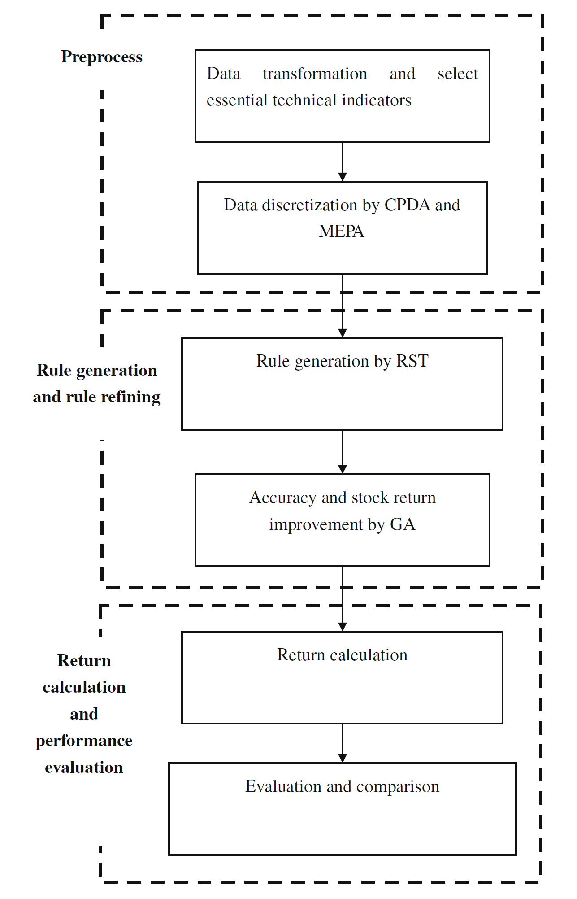
Framework
Hybrid model:
Selecting tech. indicators using correlation matrix
Using CPDA and MEPA to discretize data
Applying RST to produce rule from tech. indicators
GA to refine extracted rules
Testing model on:
TSMC (台積電, 2330), 1999/06/23~2000/5/11
TAIEX (台灣加權指數), 2000/01/04~2005/12/30

Slide 6
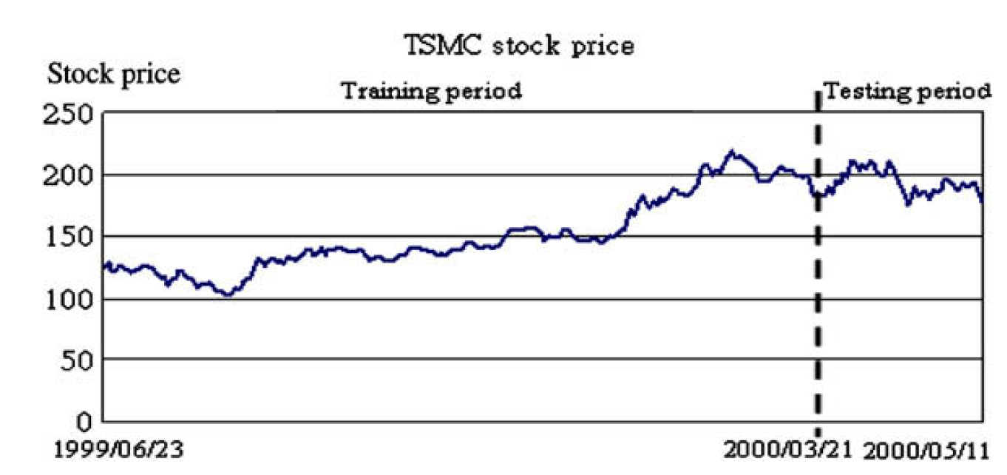
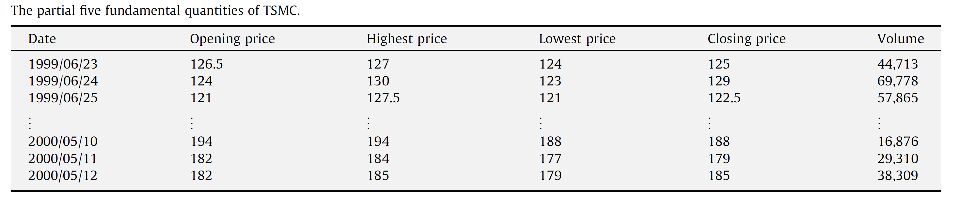

Slide 7
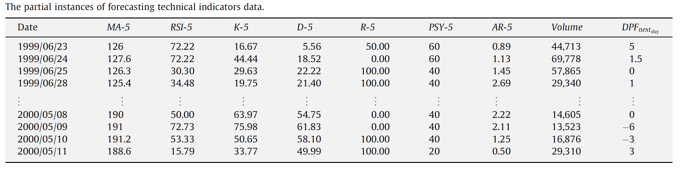
MA: simple moving average
RSI = (100 / (1+RS)) , RS)=n日內平均上漲點數 / n內日平均下跌點數
RSV=(本日收盤價-n日內最低價)/ (n日內最高價-n日內最低價) * 100.0
%K(t) = 2/3* %K(t-1) + 1/3 * RSV
%D(t) = 2/3 %D(t-1)＋ 1/3 * %K(t)
%R = (n日內最高價-本日收盤價-)/ (n日內最高價-n日內最低價) * 100.0
PSY(n) = (n日內的上漲天數/ n ) *100
AR(n) = (日內最高價－n日內開盤價之總和)/ (n日內開盤價－n日內最低價之總和)

Slide 8
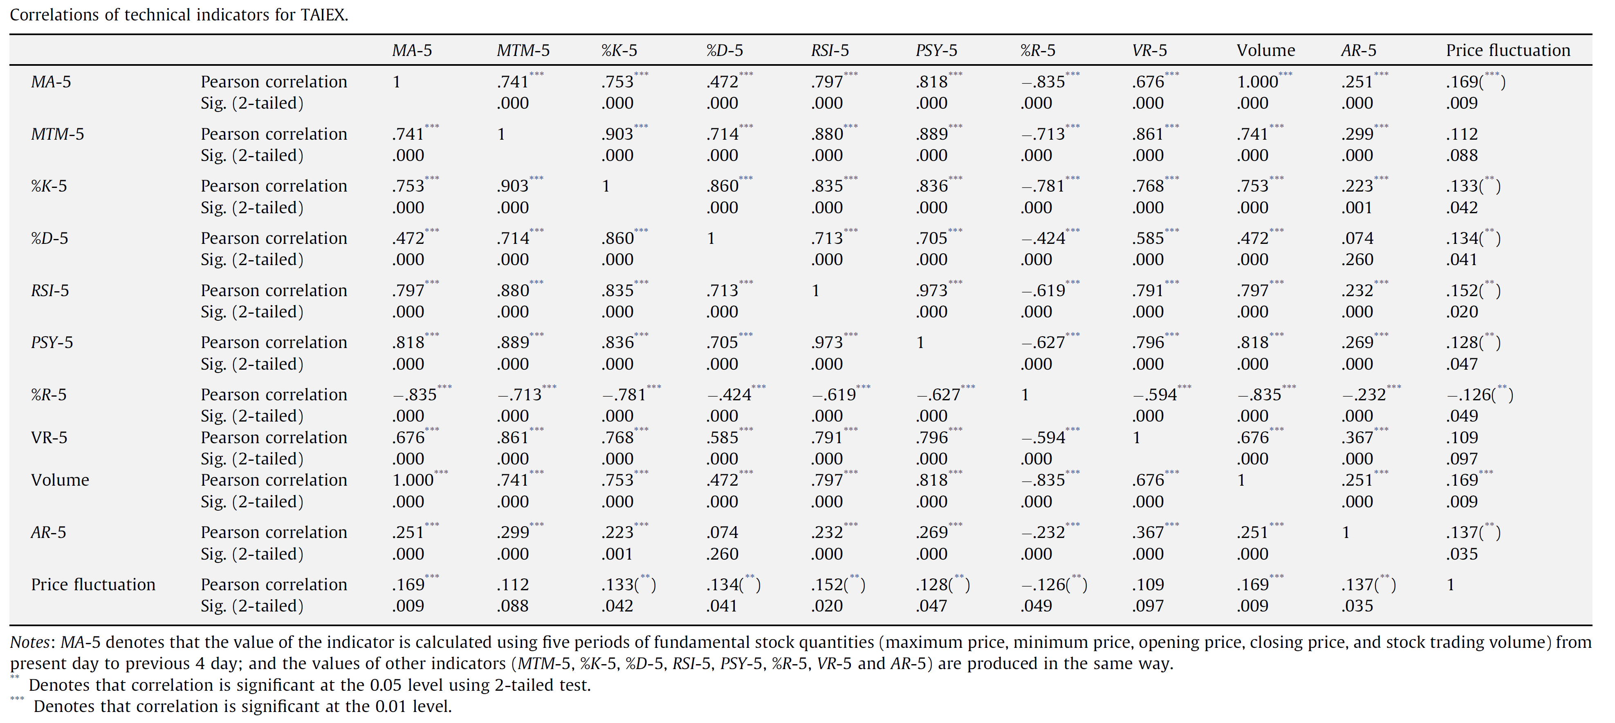
Selecting indicators using correlation matrix

Slide 9
Pearson correlation coefficient: Γ
Two-tail tests (p <0.05)
H₀(null hypothesis): Γ=0
H₁ (alternative hypothesis) Γ != 0
N: 資料筆數

Slide 10

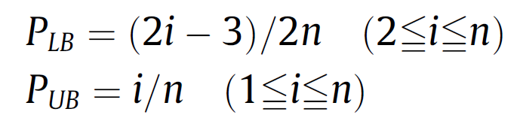
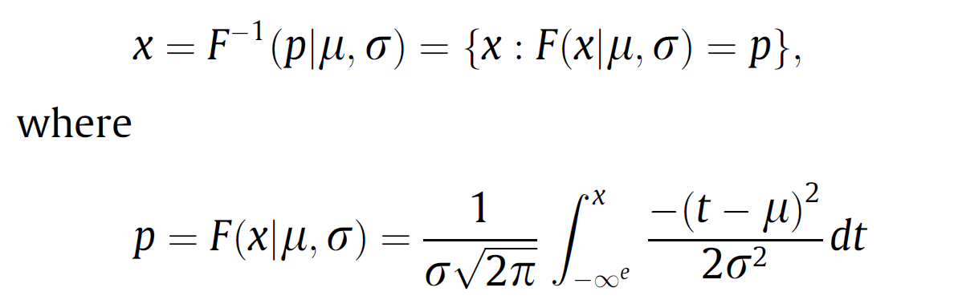
CPDA (cumulative probability distribution approach)
Using CPDA to discretize decision features (assume normal distribution)
(range of data)
D_{min}: minimum in historical data
D_{max}: maximum in historical data
σ: standard deviation of the yearly data
i: the order of the linguistic values

Slide 11
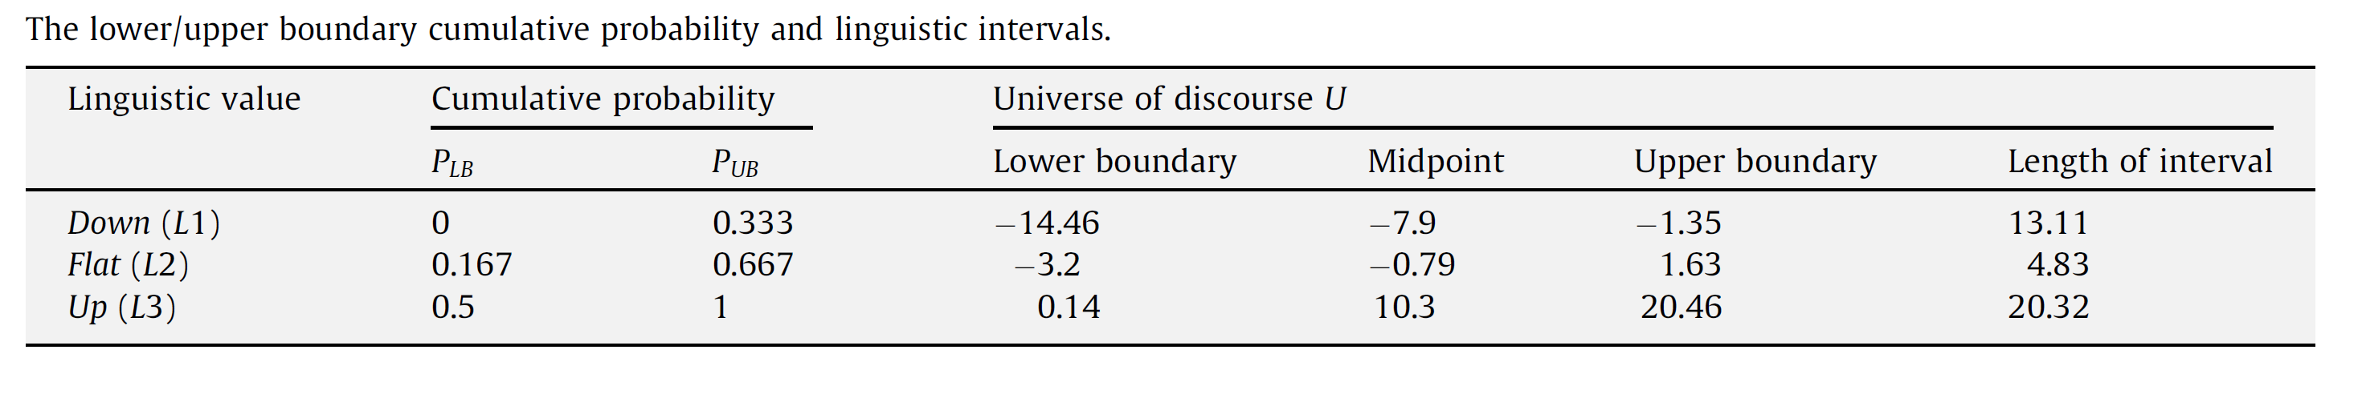
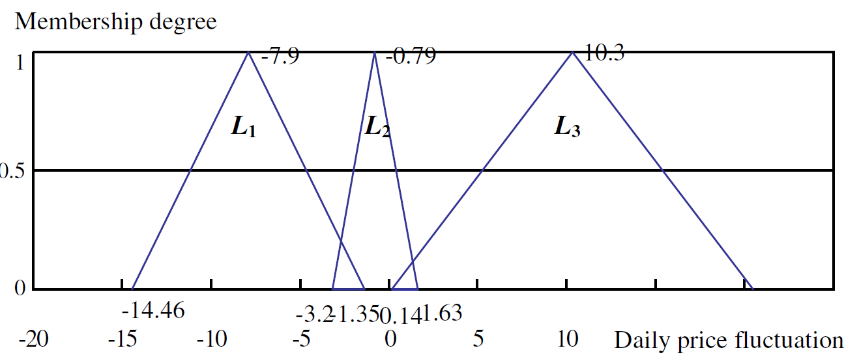
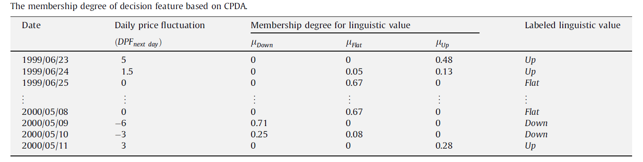
TSMC decision feautre依CDF所對應之x得出的membership function

Slide 12
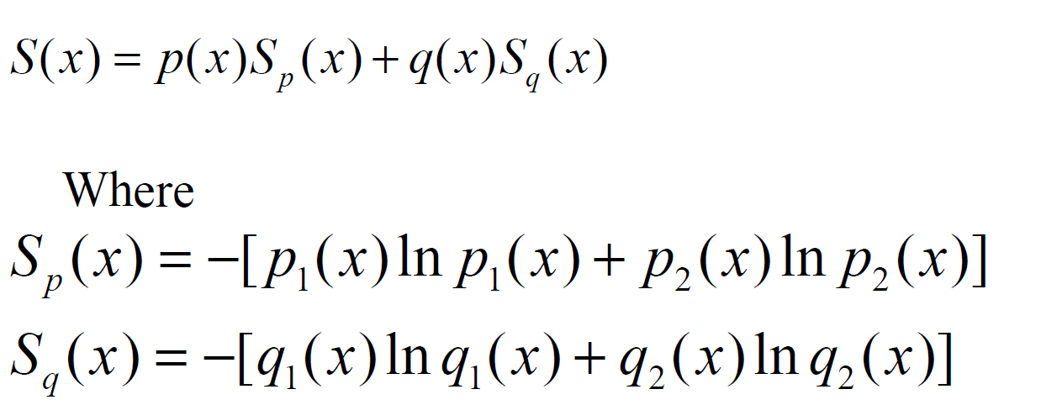

MEPA (minimize entropy principle approach)
Using MEPA to discretize condition features

Slide 13
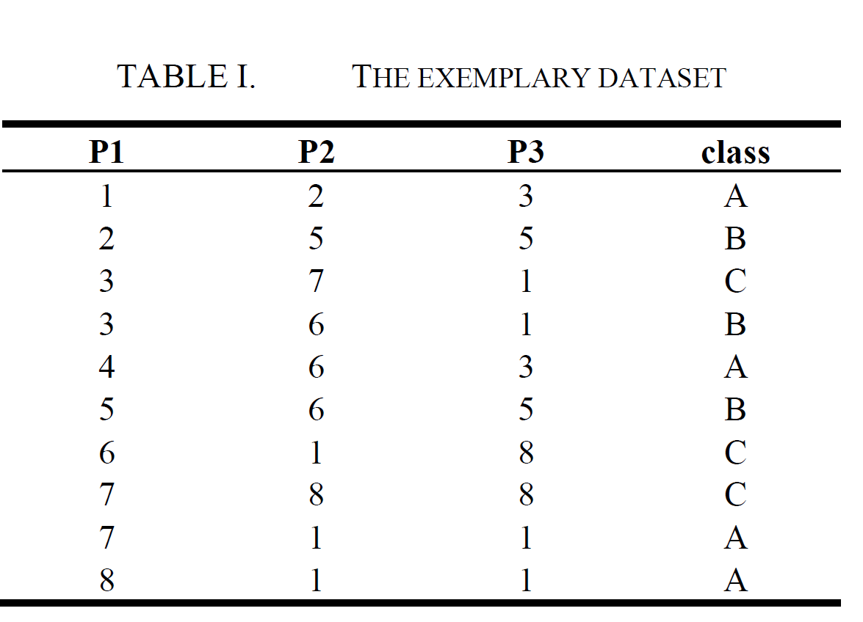
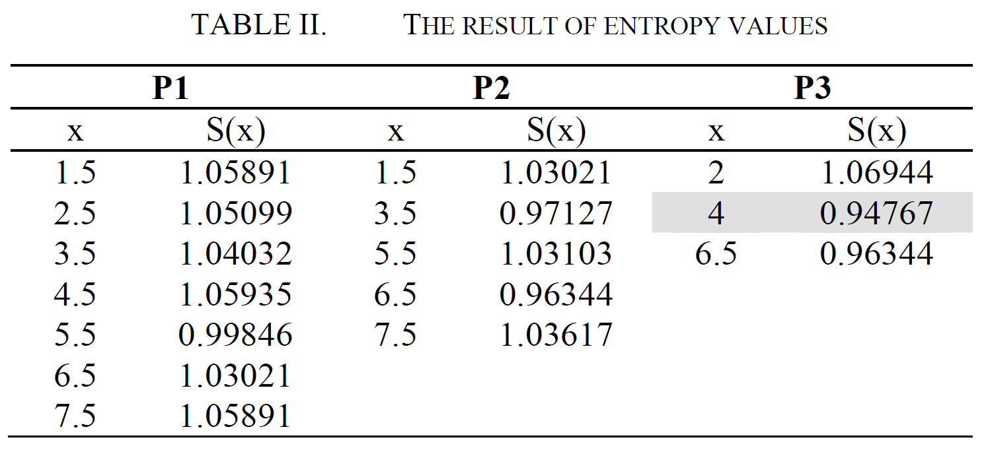
[Chen et. al., Feature Selection based on Minimize Entropy Principle, ICEIE 2010]
Example:
Step 1: computer the entropy

Slide 14
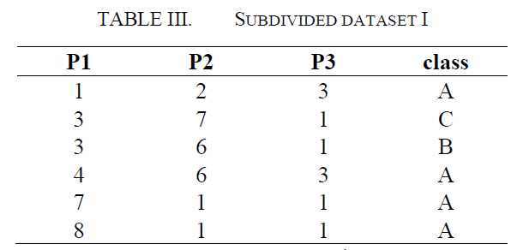
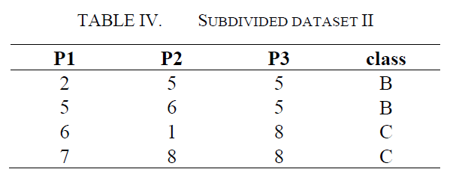
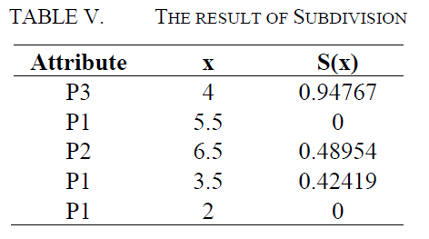
Step2 : subdivide the dataset until the stopping condition

Slide 15
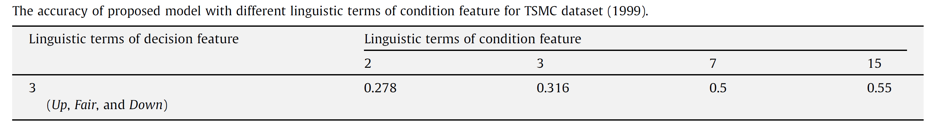
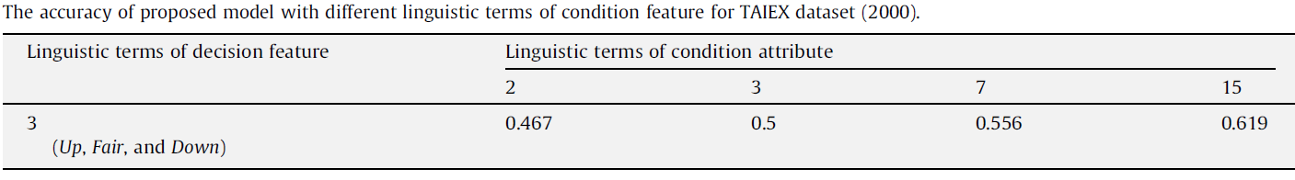

Slide 16
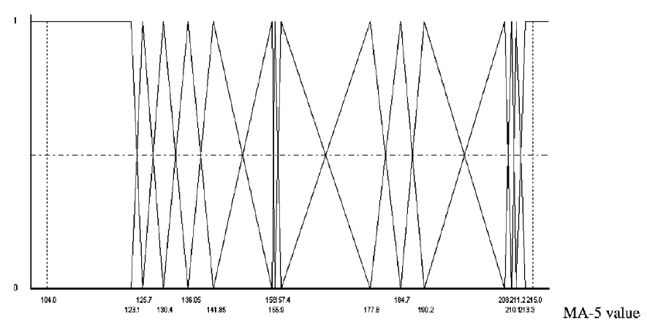
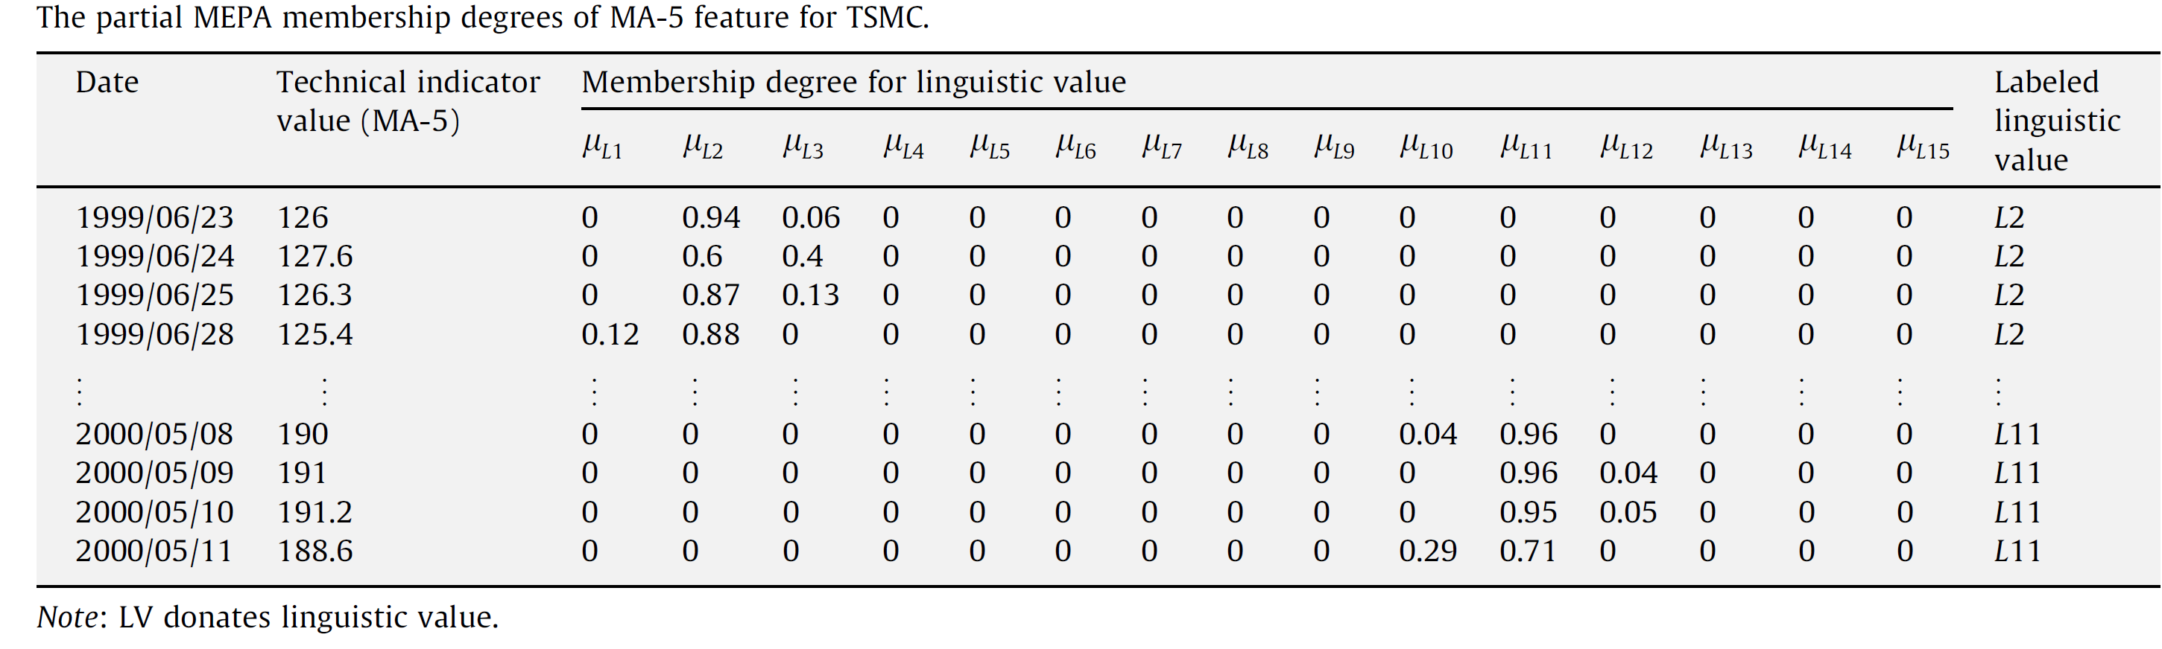

Slide 17
RST (rough set theory)
Using RST to generate decision rule from dataset
Example:
U | a₁ | a₂ | a₃ | d
x₁ | 2 | 1 | 3 | 1
x₂ | 3 | 2 | 1 | 2
x₃ | 2 | 1 | 3 | 1
x₄ | 2 | 2 | 3 | 2
x₅ | 1 | 1 | 4 | 3
x₆ | 1 | 1 | 2 | 3
x₇ | 3 | 2 | 1 | 2
x₈ | 1 | 1 | 4 | 3
x₉ | 2 | 1 | 3 | 1
x₁₀ | 3 | 2 | 1 | 2

Slide 18
Discernibility matrix:
須使用何種attributes來區分不同的sets
 | 1 | 2 | 3 | 4 | 5 | 6 | 7 | 8 | 9 | 10
1 | -
2 | a₁,a₂,a₃ | -
3 | - | a₁,a₂,a₃ | -
4 | a₂ | - | a₂ | -
5 | a₁,a₃ | a₁,a₂,a₃ | a₁,a₃ | a₁,a₂,a₃ | -
6 | a₁,a₃ | a₁,a₂,a₃ | a₁,a₃ | a₁,a₂,a₃ | - | -
7 | a₁,a₂,a₃ | - | a₁,a₂,a₃ | - | a₁,a₂,a₃ | a₁,a₂,a₃ | -
8 | a₁,a₃ | a₁,a₂,a₃ | a₁,a₃ | a₁,a₂,a₃ | - | - | a₁,a₂,a₃ | -
9 | - | a₁,a₂,a₃ | - | a₂ | a₁,a₃ | a₁,a₃ | a₁,a₂,a₃ | a₁,a₃ | -
10 | a₁,a₂,a₃ | - | a₁,a₂,a₃ | - | a₁,a₂,a₃ | a₁,a₂,a₃ | - | a₁,a₂,a₃ | a₁,a₂,a₃ | -

Slide 19
f_{A}(D)=(a₁+a₂+a₃)a₂(a₁+a₃) (a₁+a₃) (a₁+a₂+a₃) (a₁+a₃) (a₁+a₂+a₃) (a₁+a₂+a₃) (a₁+a₂+a₃) (a₁+a₂+a₃)a₂(a₁+a₃) (a₁+a₃) (a₁+a₂+a₃) (a₁+a₃) (a₁+a₂+a₃) (a₁+a₂+a₃) (a₁+a₂+a₃) (a₁+a₂+a₃) a₂(a₁+a₃) (a₁+a₂+a₃) (a₁+a₃) (a₁+a₂+a₃) (a₁+a₂+a₃) (a₁+a₃) (a₁+a₂+a₃) (a₁+a₂+a₃) (a₁+a₂+a₃) (a₁+a₃) (a₁+a₂+a₃) (a₁+a₂+a₃) = a₂(a₁+a₃) = a₁a₂ + a₂a₃
D-reducts = {a₁, a₂} and {a₂, a₃}
D-core = {a₂}
U | a₁ | a₂ | d
x₁ | 2 | 1 | 1
x₂ | 3 | 2 | 2
x₃ | 2 | 1 | 1
x₄ | 2 | 2 | 2
x₅ | 1 | 1 | 3
x₆ | 1 | 1 | 3
x₇ | 3 | 2 | 2
x₈ | 1 | 1 | 3
x₉ | 2 | 1 | 1
x₁₀ | 3 | 2 | 2
U | a₂ | a₃ | d
x₁ | 1 | 3 | 1
x₂ | 2 | 1 | 2
x₃ | 1 | 3 | 1
x₄ | 2 | 3 | 2
x₅ | 1 | 4 | 3
x₆ | 1 | 2 | 3
x₇ | 2 | 1 | 2
x₈ | 1 | 4 | 3
x₉ | 1 | 3 | 1
x₁₀ | 2 | 1 | 2

Slide 20
f₁(D) = (a₁+a₂)a₂a₁a₁(a₁+a₂)a₁(a₁+a₂) = a₁a₂
in the same way:
f₂(D) = a₁+ a₂
f₃(D) = a₁a₂
f₄(D) = a₂
f₅(D) = a₁
f₆(D) = a₁
f₇(D) = a₁+a₂
f₈(D) = a₁
f₉(D) = a₁a₂
f₁₀(D) = a₁ + a₂
U | a₁ | a₂ | d
x₁ | 2 | 1 | 1
x₂ | * | 2 | 2
x₃ | 2 | 1 | 1
x₄ | * | 2 | 2
x₅ | 1 | * | 3
x₆ | 1 | * | 3
x₇ | * | 2 | 2
x₈ | 1 | * | 3
x₉ | 2 | 1 | 1
x₁₀ | * | 2 | 2
Decision rule:
a₁ =2, a₂=1 => d=1
a₂ = 2 => d=2
a₁ =1 => d=3

Slide 21
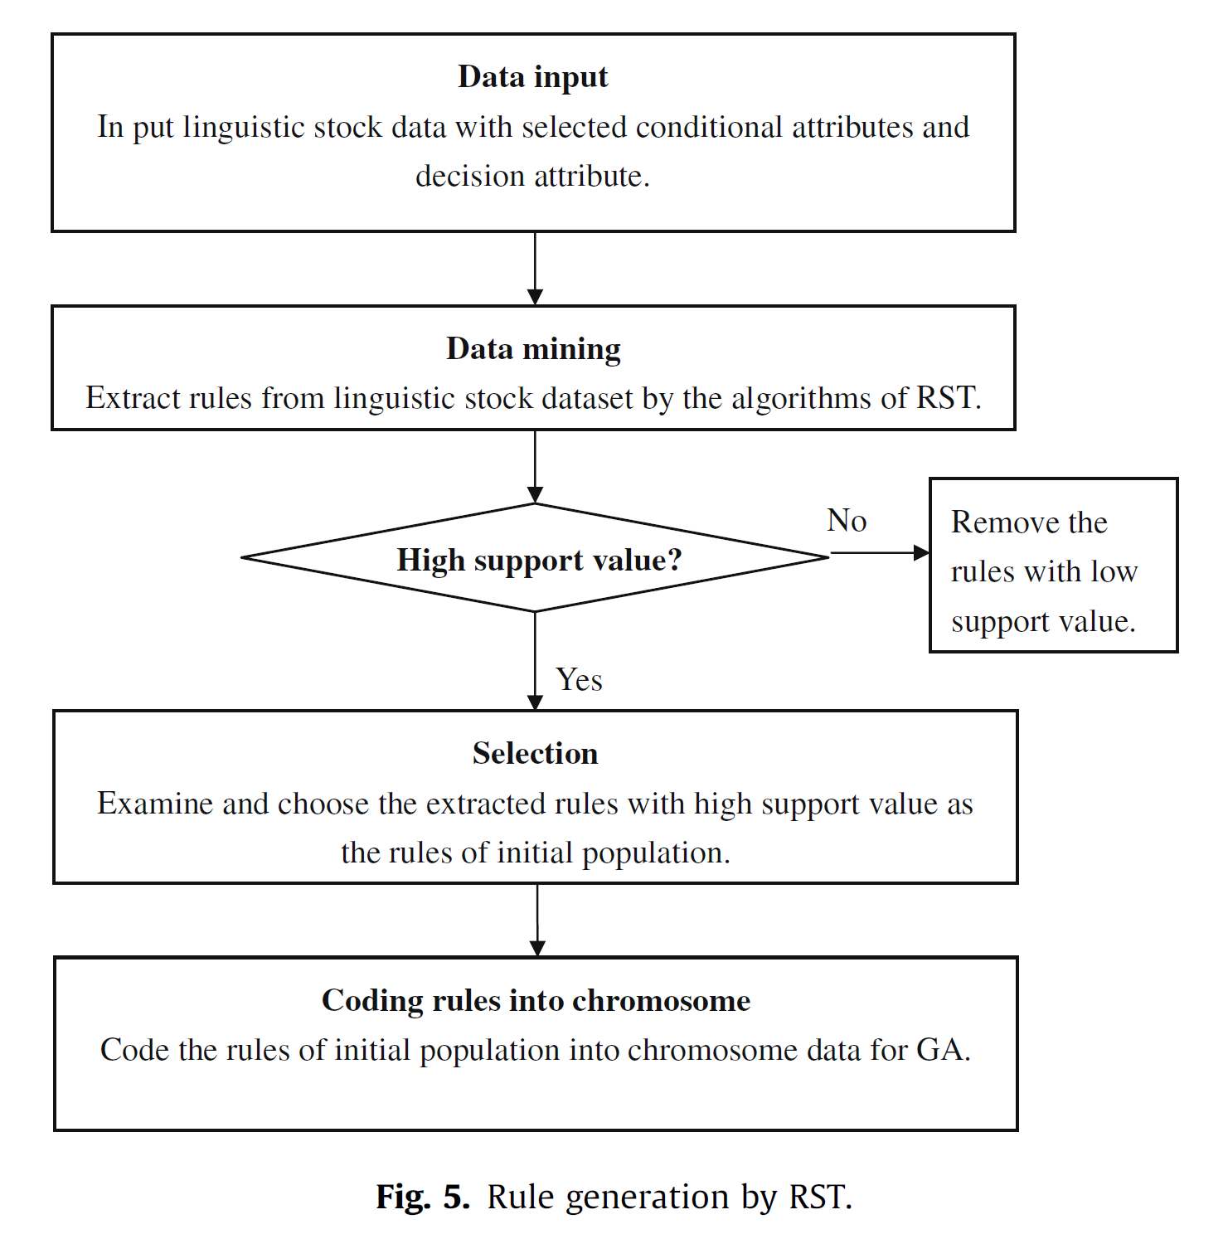
Rule generated by RST

Slide 22
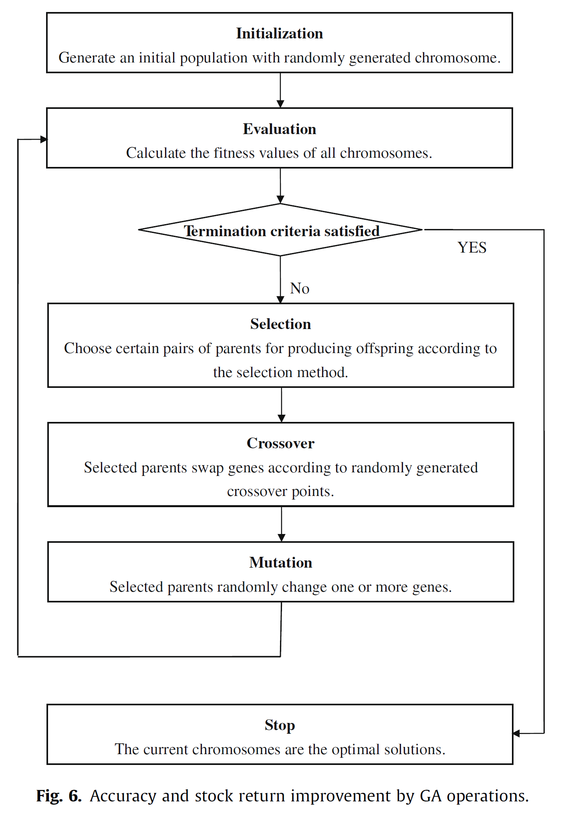
Accuracy and return improvement by GA

Slide 23
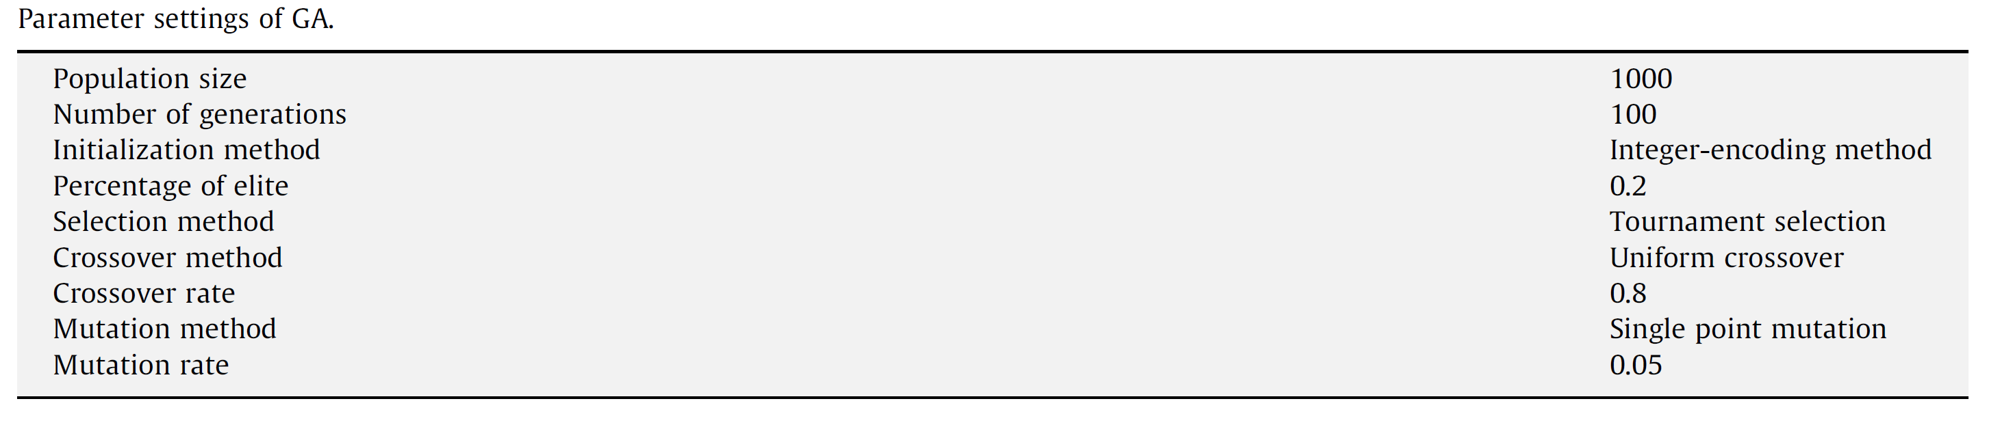
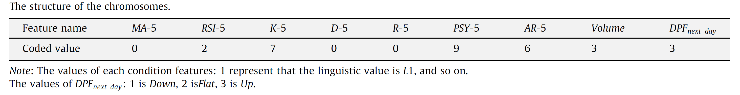
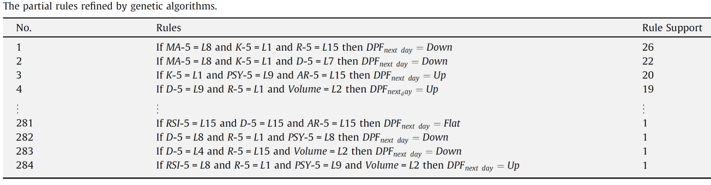

Slide 24
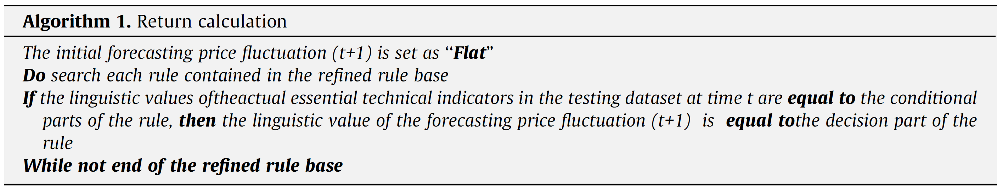
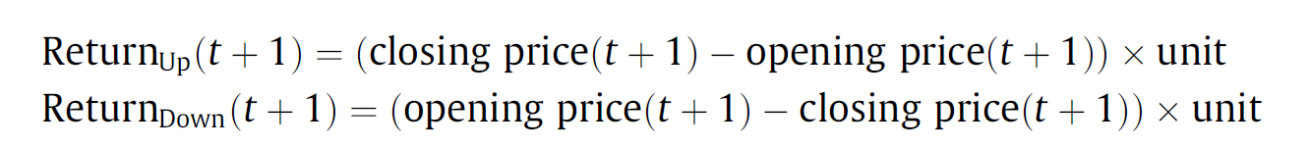
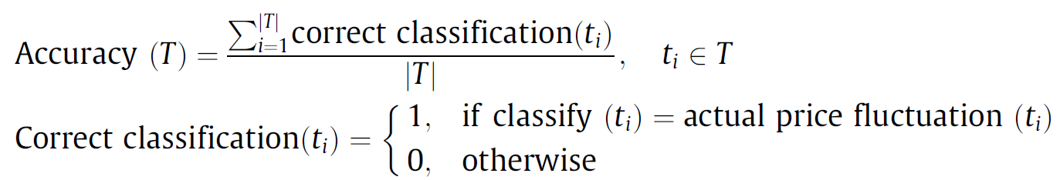
Buy on open and sell on close when the prediction is Up
Sell on open and buy on close when the prediction is Down
No transaction when the prediction is Flat

Slide 25
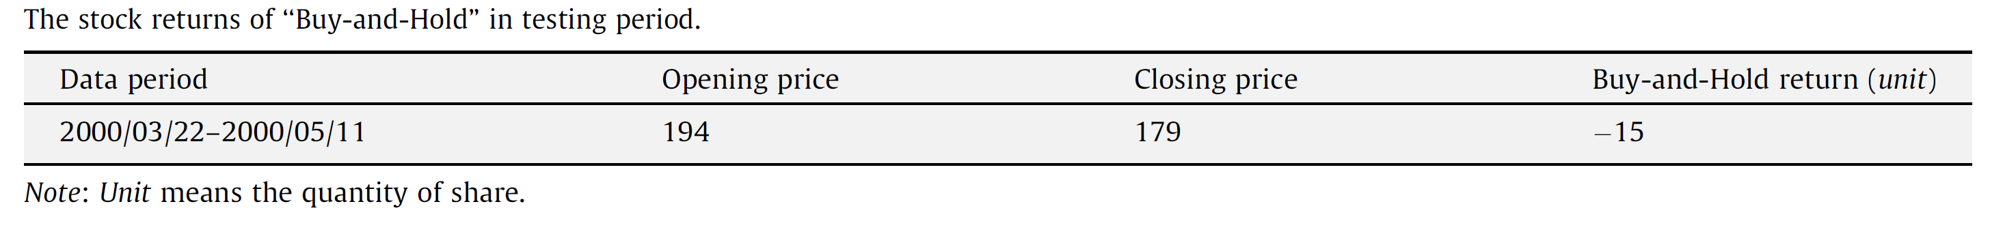
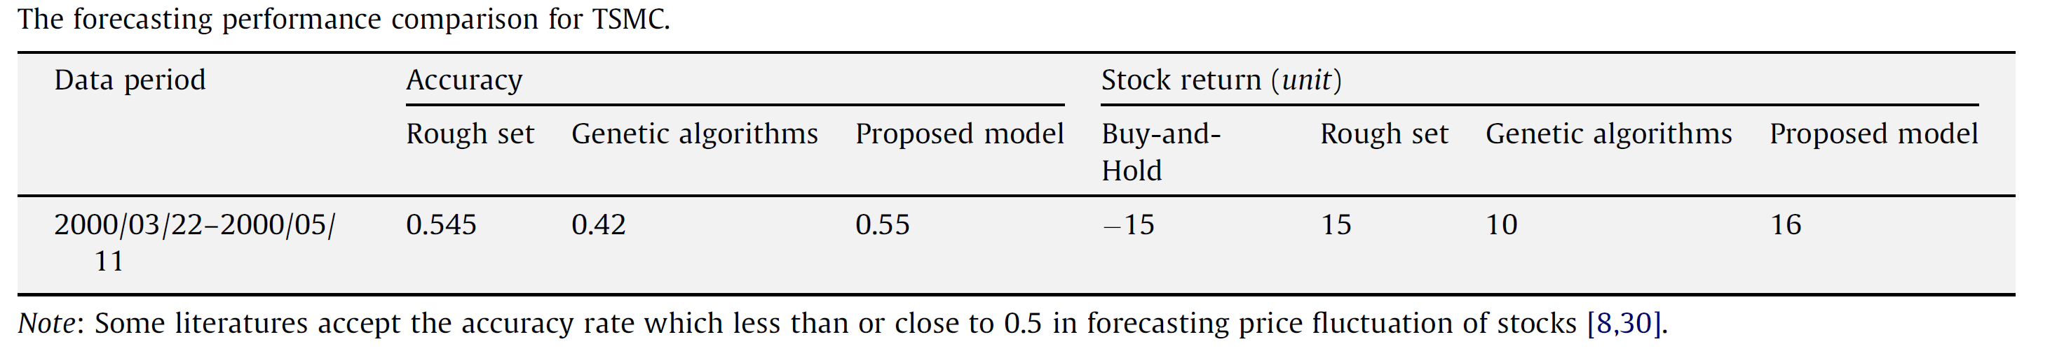

Slide 26
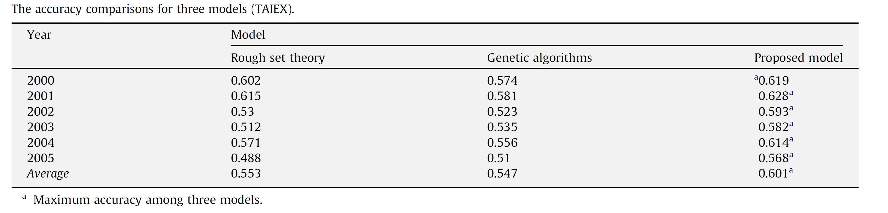
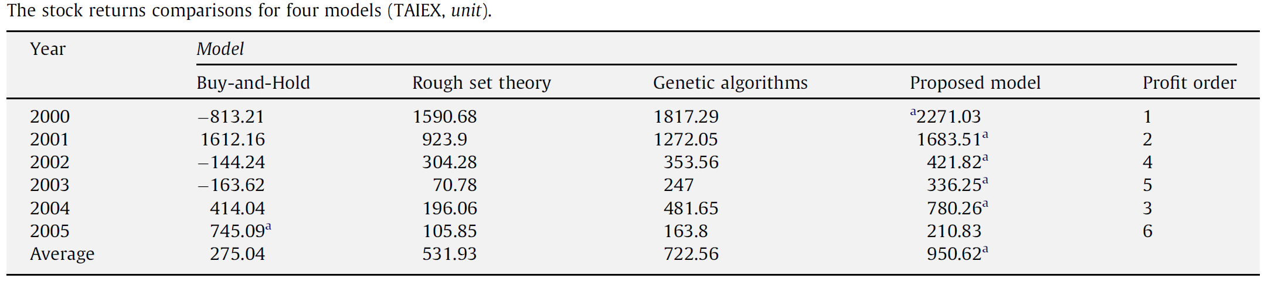
TAIEX: 2000/1/4~2005/12/30
Training : January ~ October (each year)
Testing: November, December (each year)

Slide 27
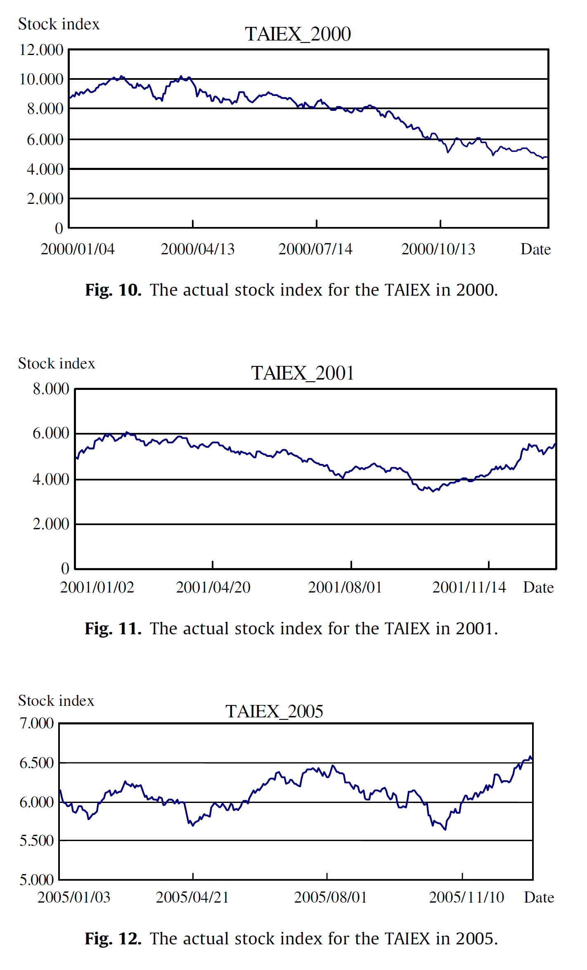

Slide 28
Conclusion
The proposed produces a positive stock return, whether the market is bullish or bearish.
Performing outstandingly when stock market is in a nearly bull market or bear market
The RST, GA, and the proposed perform their worst when there are many violent fluctuations occurring in the market.

Slide 29
Thank you!!

