Slide 1
A Novel Topic Selection Algorithm Based On Word Distribution
International Journal of Innovative Computing, Information and Control Volume 6, Number 4, April 2010
Chun-Wei Tsai, Ko-Wei Huang, Heng-Yao Hsu, Ming-Chao Chiang, and Chu-Sing Yang
Presenter: Chen Yun-shiun
Date:2011/5/3

Slide 2
Abstract (1)
Over the past decade, more and more users of the Internet rely on the search engines to help them find the information they need.However, the information they find depends, to a large extent, on the ranking mechanism if the search engines they use. Not surprisingly, it generally consist of a large amount of information that is completely irrelevant. To help users of the Internet find the information they are looking for quickly, an efficient algorithm for building the summaries of a collection of documents found by a search engine in response to a user query, called DiSco (Distribution Scoring), is proposed.

Slide 3
Abstract (2)
The main idea in the design of DiSco is to balance the rate of coverage and overlap in the selection of topic words for document summarization, especially when the datasets are large. Moreover, several measure methods such as coverage, overlap, and the computation time are employed in evaluating the performance of the proposed algorithm. All our simulation results indicate that the proposed algorithm outperforms all the state-of-the-art algorithms evaluated in terms of not only the quality of the summarizations but also the computation time.

Slide 4
Subsumption
Sanderson’s algorithm
Subsumption first chooses single words or phases, which occur in at least two documents, to be the candidates. If a term pair satisfies the condition P(x|y)≧0.8 and P(y|x)＜1, x is said to subsume y. By finding the set of such term pairs, topic hierarchies in the document collection were formed.

Slide 5
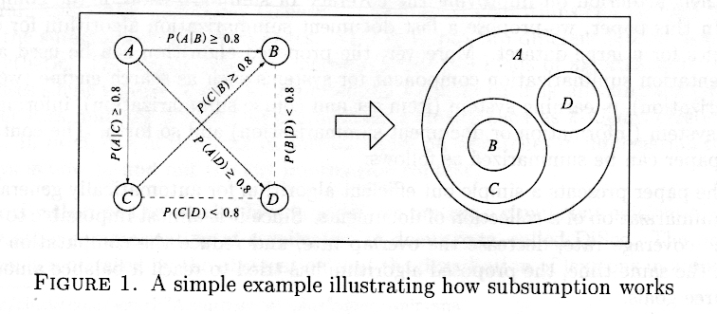
Subsumption

Slide 6
DSP
Lawrie’s Algorithm
Dominating Set Problem
First, the conditional probabilities Px(A|B) of all term pairs are calculated where A denotes a candidate topic term, B a vocabulary term, and x the number if common terms betwenn A and B. The graph model is created after the calculation is done. In the graph, vertices denote both candidate topic and vocabulary terms, and edges denote Px(A|B). Terms with the most dominating power and highest coverage were chosen as topics. Recomputing was done once for each level to generate hierachies.

Slide 7
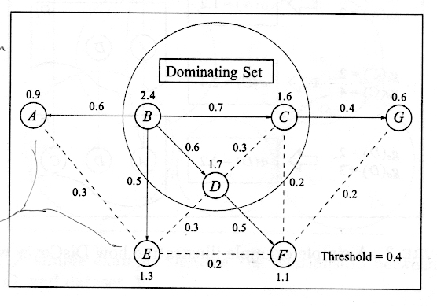
DSP

Slide 8
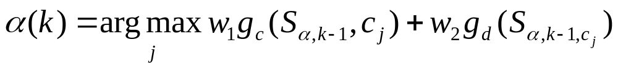
DisCover
Kummamuru’s Algorithm
Use Document Coverage,Compactness, and Sibling Node Distinctiveness – to develop the DisCover algorithm. The objective function was defined as

Slide 9
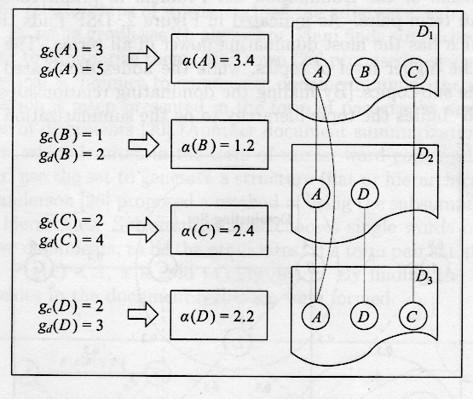
DisCover

Slide 10
Problem definition
Given a classified set of brief introductions or descriptions X= { x1,x2,…,xn } returned by a meta-search engine in response to a given query Q or from a document set, find a set topic words U included by X that is subject to maximize the coverage while at the same time minimizing the overlap.

Slide 11







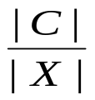






Problem definition
are covered documents.
X
are chosen topics.
Coverage:

Slide 12
DisCo Algorithm
Assume that the beginning and the end part are more important than the middle part
Use the parameter z to adjust the sizes of the beginning ,middle, end part
Assume that terms in a document are normally distributed with mean μ and standard variation σ

Slide 13
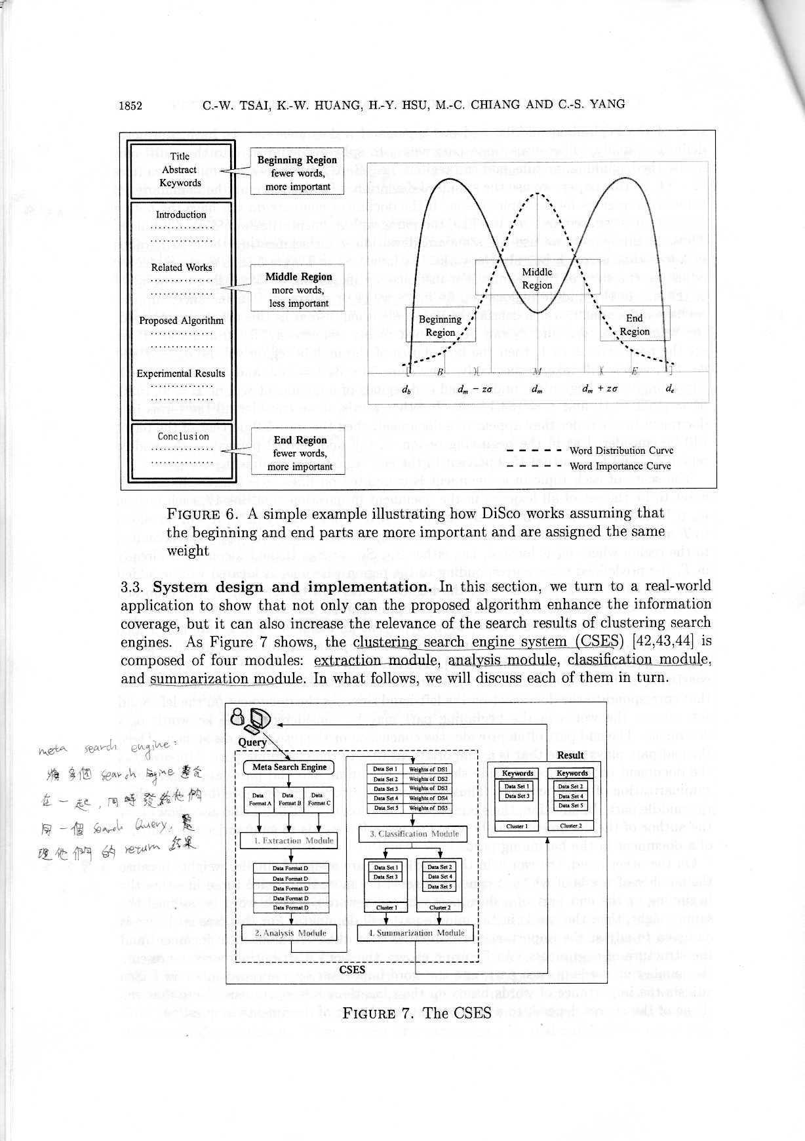
DisCo Algorithm

Slide 14








DiSco Algorithm
1 Algorithm DiSco
2 {
3 Use a stopword list to clean up the data
4 Perform stemming using Porter’s stemmer
5 Let T=0
6 For each group {
7 Select candidate topics
8 Compute the indices and locations of candidate topics
9 For each document {
10 /* the split process */
11 Split the document into three regions:
12 /* beginning region */
13 /* middle region */
14 /* middle region */
15 /* the score computation process */
16 Let W be the set of all lexicons in this document
17 If is new
18 add it to T
19 Let if where α = B, M, or E
20 Else
21 Let if where α = B, M, or E
22
23 If , then goto 17
24 }
25 }
26 Select the top T topics by scores
27 }

Slide 15
DiSco Algorithm
Clean up data(Stopwordlist)
Perform stemming(Porter’s stemming)
Result
YES
All groups finish?
NO
Select candidate topic and their and score
YES
All documents finish?
NO
Split the document into three regions
Compute the topic scores terms by terms

Slide 16
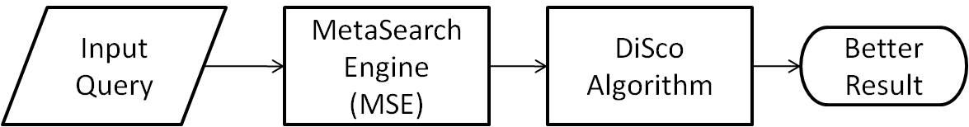
Goal and real-world application
The final goal is to refine the search result of mse by using the proposed algorithm.
  less overlapping documents
  summarized results

Slide 17
System design and implementation

Slide 18
System design and implementation
Clustering Search Engine System (CSES)
  Extraction module
    Delete useless information regions - use stopword
    Extracts data from different search engines and converts them into a uniform format.
  Analysis module
    Use Vector Space Model (VSM)
    Identify the similarities between web pages
  Classification module
    Inpute the similarities between the search results and the entries in the taxonomy tree extracted from the yahoo directory
    Output a set of classified web pages
  Summarization module
    Assign to each group of the web pages a set of keywords

Slide 19
The proving experiments
Hardware
  3.40GHz Intel PentinumD machine
  1GB memory
Software
  Windows XP
  Programs written in Java and compiled using Java1.5.0_09-n01

Slide 20
The proving experiments
Data Sets
  Google Trends
    retrived from the web and prepossed to remove the HTML tags and redundant information
    use the top 100, 200, 300 abstracts return by Google for each top 10 query
  Reuters-21578
    benchmark for text categorization
    Use the top 100,200,300 documents of the top 10 groups

Slide 21
The proving experiments
Group1
Group2
Group3
Document Set
Simulation
……...
Group10
10 groups contain the same number of documents.
The number of documents of each group are 100, 200,or 300 depending on the experiment.
The number of all documents are 1000, 2000, or 3000.

Slide 22
Empirical analysis
Pc : coverage of topics
  the average number of documents covered by the topics selected
Po : overlap of topics
  the average number of documents overlapped (appearing in two or more documnets) by the toppic selected
PT : computaion time in milliseconds

Slide 23
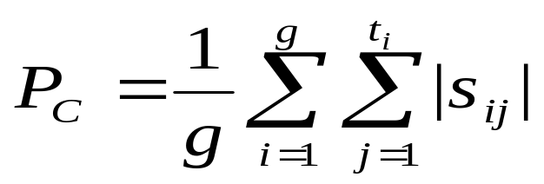
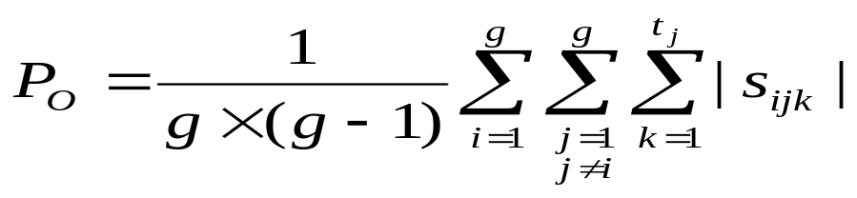
Empirical Analysis
g: the number of cluster
ti : the number of topics int cluster i
|sij|: the number of documents in cluster i
with topic j
|sijk|: the number of documents in both
cluster i and cluster j with topic k

Slide 24
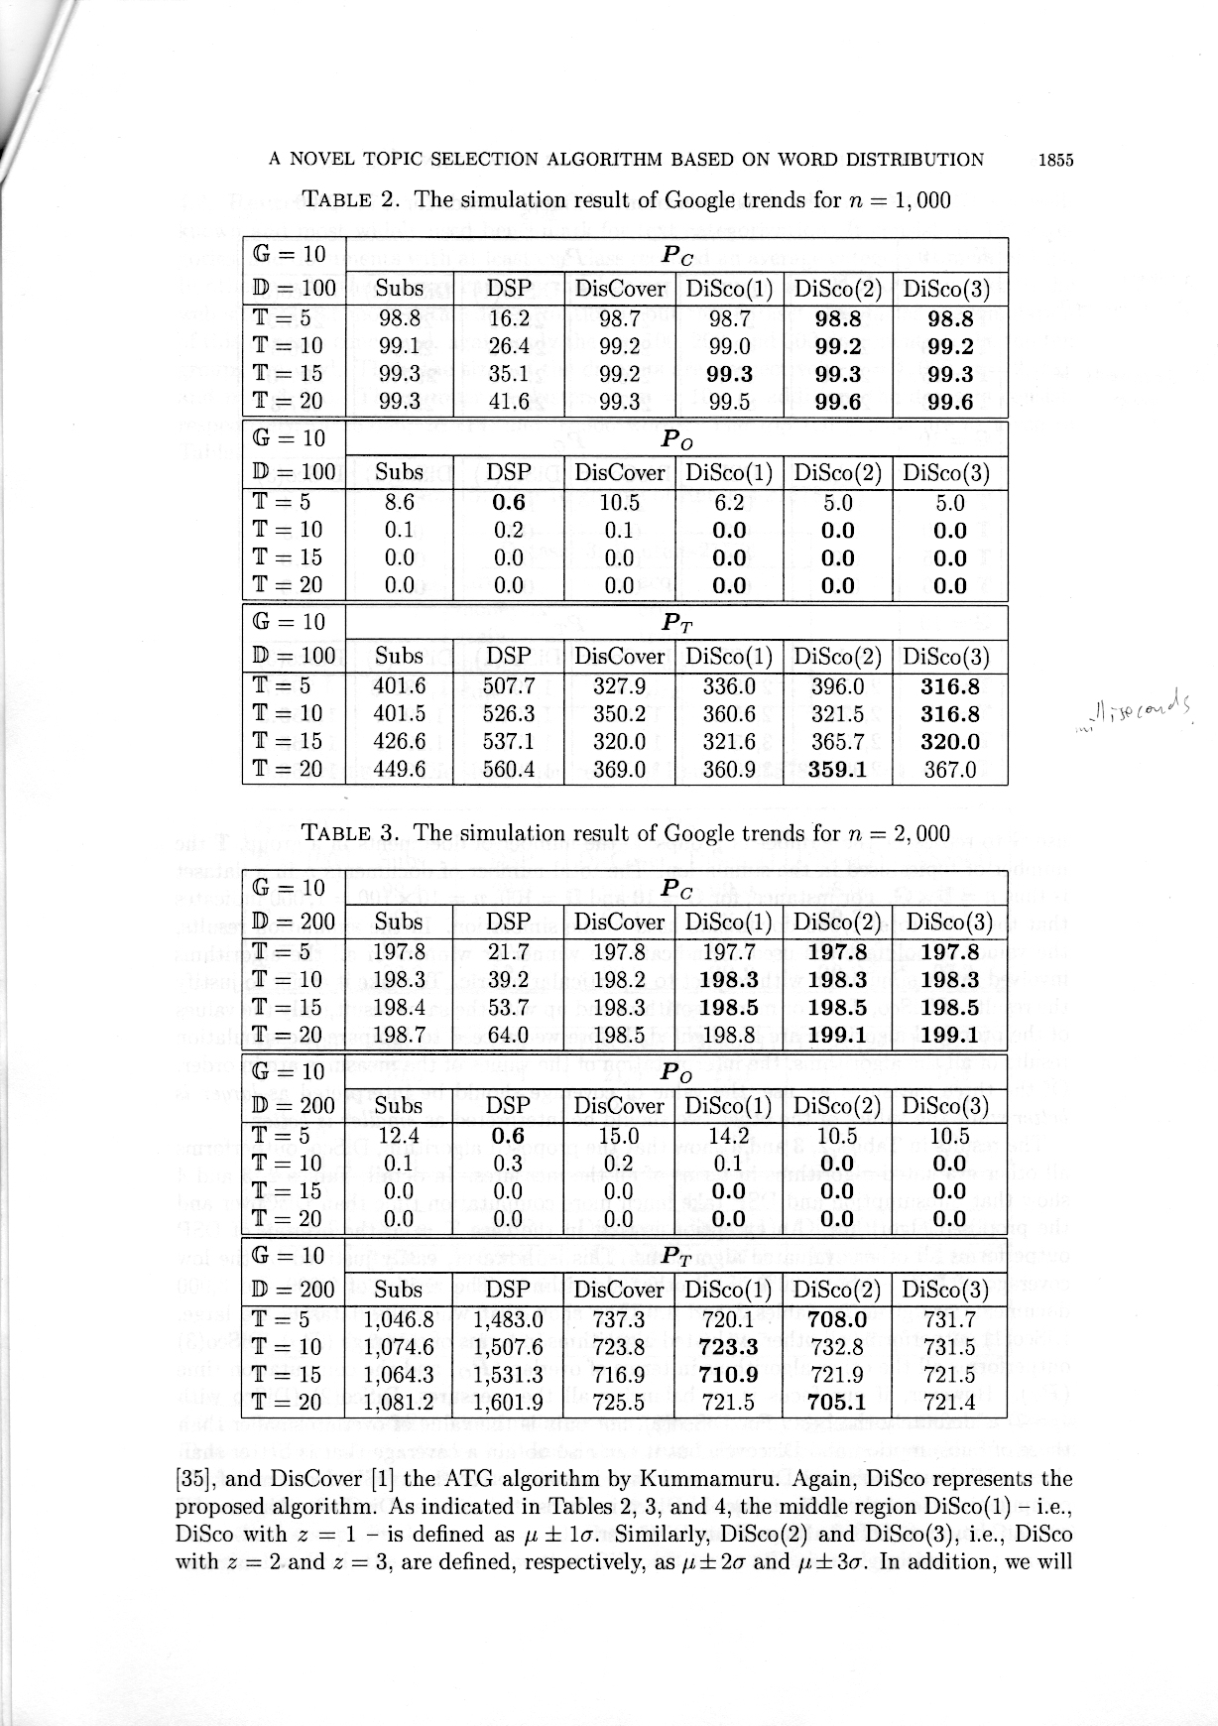
Experiment Result (1)

Slide 25
Experiment Result (1)

Slide 26
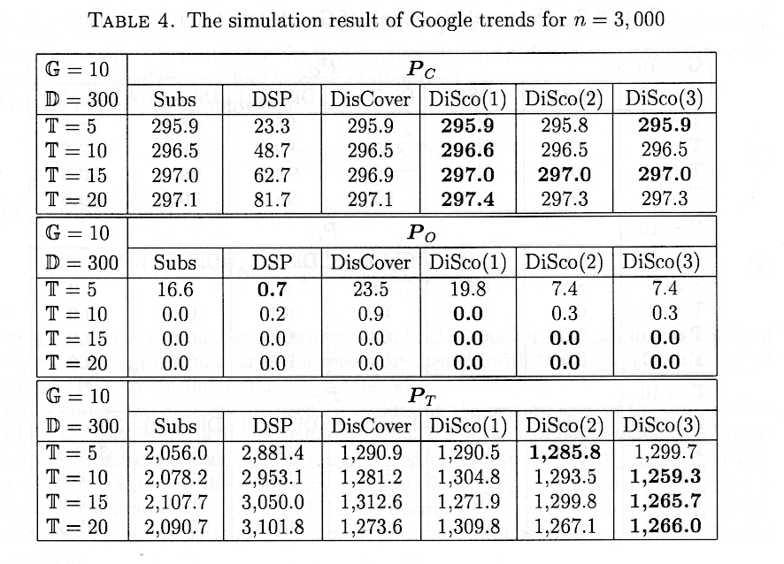
Experiment Result (1)

Slide 27
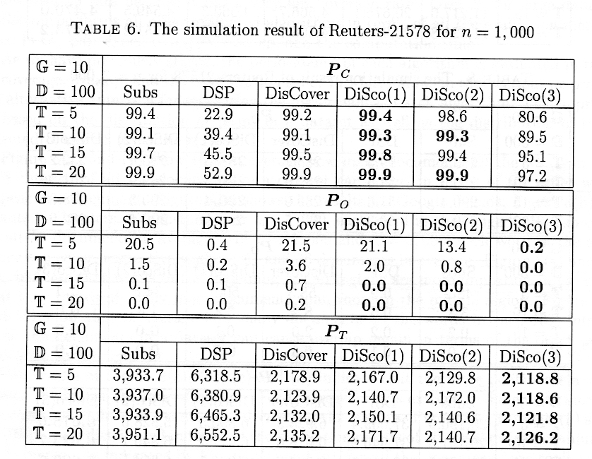
Experiment Result (1)

Slide 28
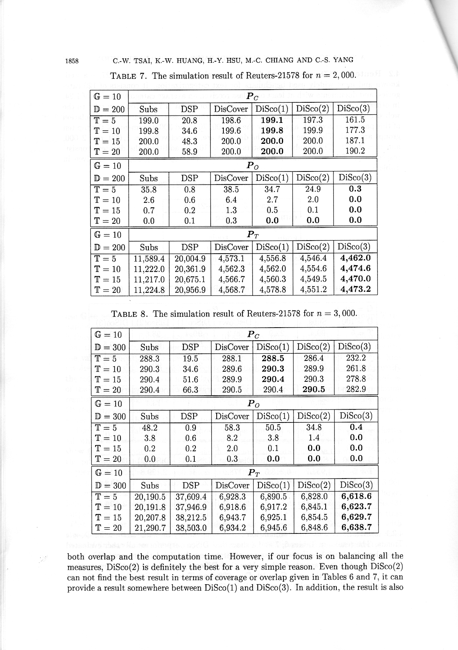
Experiment Result (1)

Slide 29
Experiment Result (1)

Slide 30
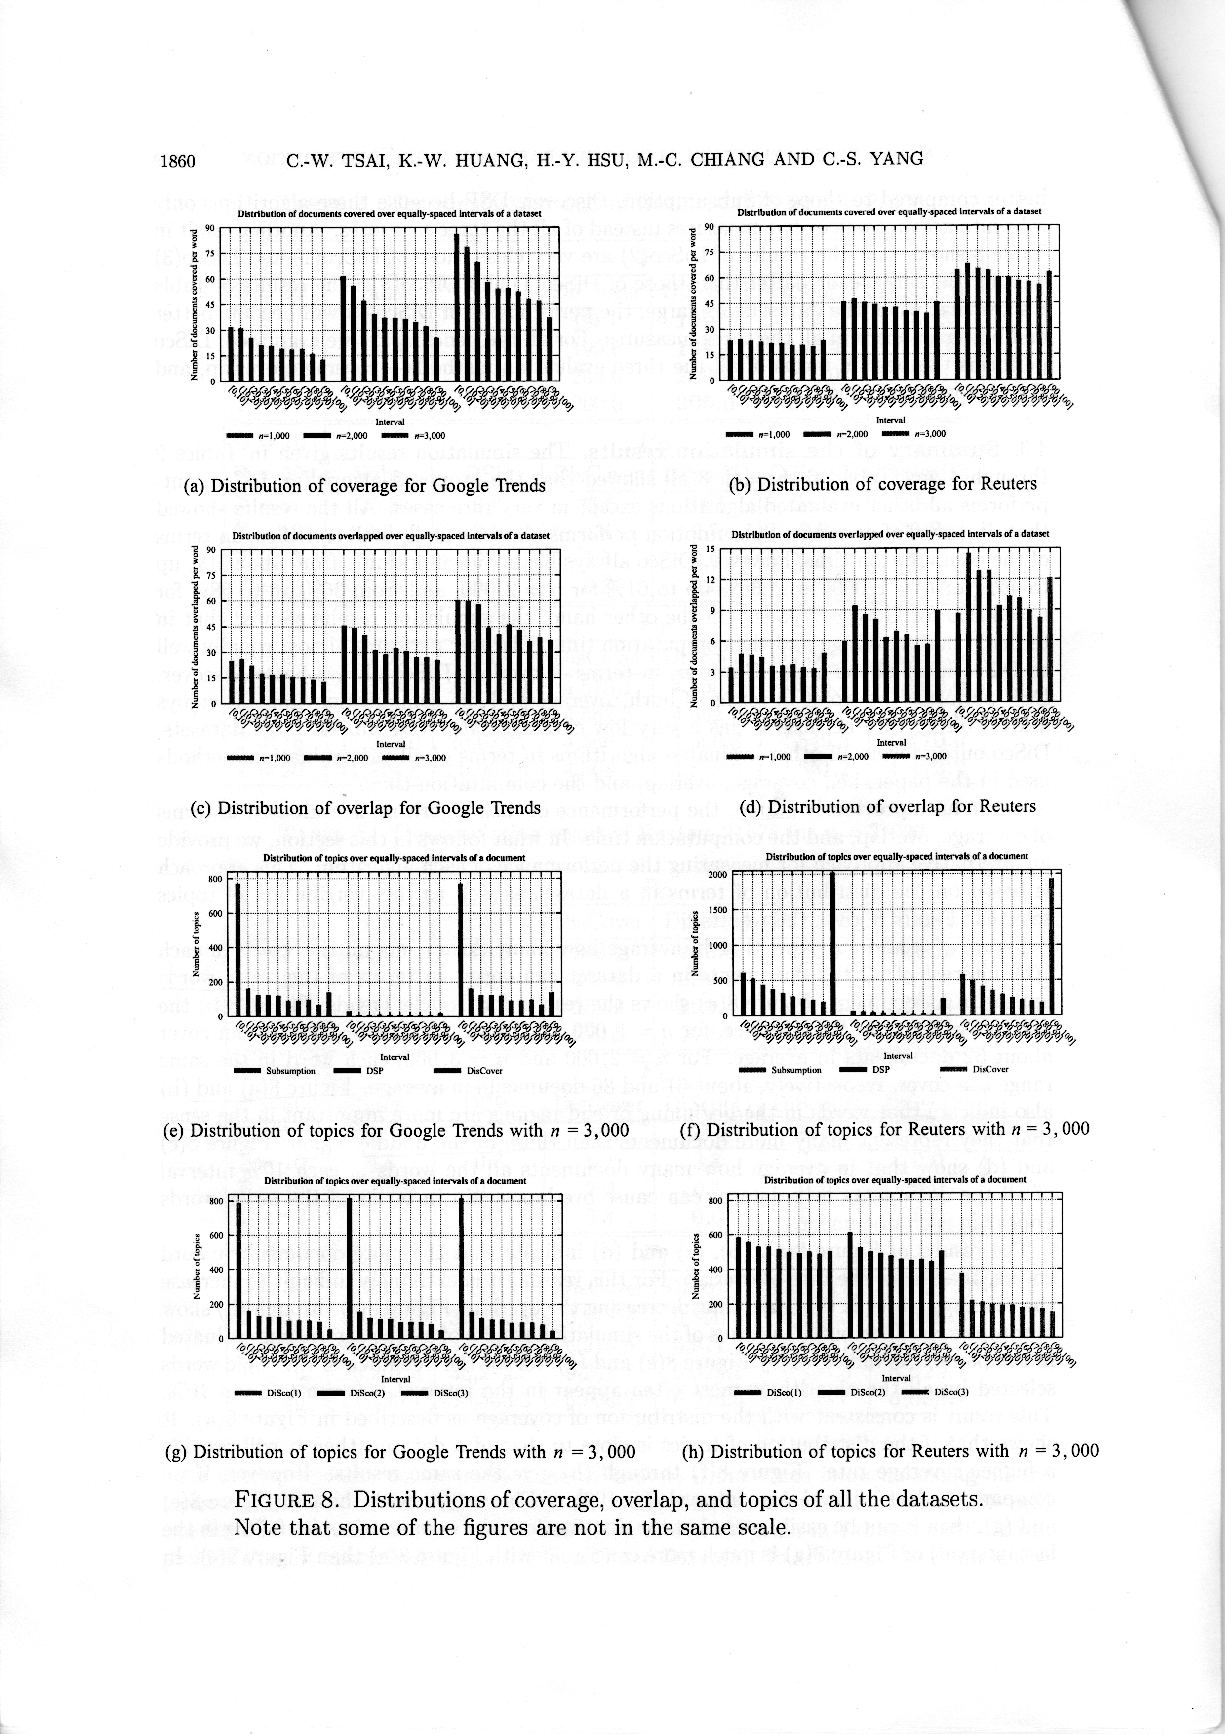
Distributions of coverage and overlap

Slide 31
Distribution of topics

Slide 32
Conclusion
The thesis, the beginning and the ending parts are more important, is correct.
The proposed algorithm outperform the other state-of-the-art algorithm in terms of coverage, overlap rate, and computation time.

Slide 33
Thank you!!!

