Slide 1
The Bayesian Hierarchical Classifier and Its Application to Short Vegetation[植被] Using
Multifrequency Polarimetric[測定偏振的] SAR
Yanni Kouskoulas, Fawwaz T. Ulaby, and Leland E. Pierce
IEEE TRANSACTIONS ON GEOSCIENCE[地球科學 ] AND REMOTE SENSING[遙測], VOL. 42, NO. 2, FEBRUARY 2004

Slide 2
Abstract
Given an image of a scene comprised of a number of distinct terrain[地域] classes, the optimum Bayesian classifier (OBC) provides the highest possible classification accuracy of the imaged scene, provided we have a priori knowledge of the probability density function (pdf) of the sensor’s output for each terrain class. If the imaging sensor consists of multiple channels, application of OBC requires knowledge of the joint pdf of the observations made by all the channels.

Slide 3
Abstract
In practice, the volume of data needed in order to generate an accurate multidimensional pdf far exceeds the size of available datasets. The data-size requirement may be relaxed by assuming the pdfs to be Gaussian in form, but such an assumption leads to suboptimum classification performance. This paper addresses the data size issue by 1) taking advantage of the maximum-entropy density estimation (MEDE) technique introduced in a companion paper and 2) using marginal pdfs in a hierarchical approach.

Slide 4
Abstract
Using multidate synthetic aperture radar [合成孔徑雷達] observations, it was shown that the Bayesian hierarchical classifier introduced in this paper can classify short vegetation classes with an accuracy of 93%, without retraining, compared with an accuracy of 84% for the maximum-likelihood estimator (with Gaussian assumption) and only 74% with ISODATA.

Slide 5

Bayes theorem
P(h): prior probability of hypothesis h, may reflect any background knowledge that h holds
P(D): prior probability of training data D is observed
P(D|h): the probability of observing D given that h holds
P(h|D): posterior probability that h holds after observing D
Tom M. Mitchell, "Machine Learning"

Slide 6
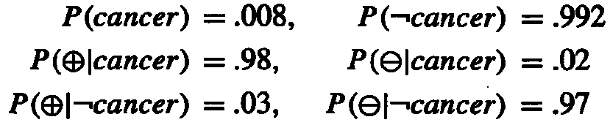
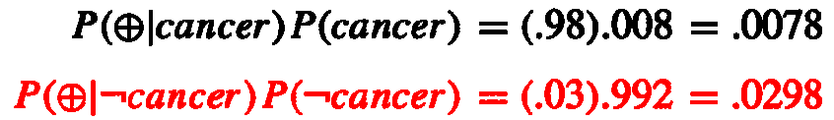
Bayes theorem example
P(cancer): the probability of the entire population that have cancer
P(⊕): the probability of laboratory test that shows positive outcome
Question: suppose we observe a person whose laboratory test is positive, should we diagnose him as have cancer or not?
Tom M. Mitchell, "Machine Learning"

Slide 7
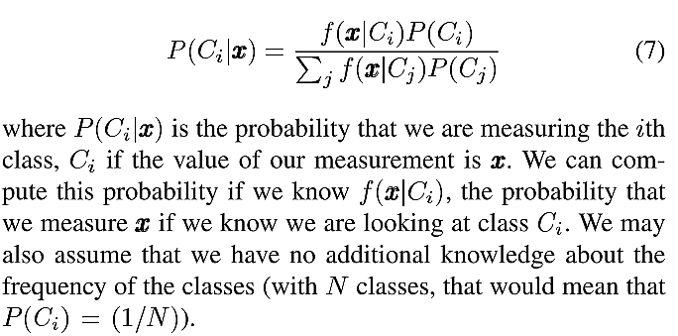
The optimum Bayesian classifier

Slide 8

The optimum Bayesian classifier
 | X1 | X2
C1 | 5/16 | 2/16
C2 | 2/16 | 7/16
P(C1)=7/16
P(C2)=9/16
P(X1)=7/16
P(X2)=9/16
P(X1|C1)=5/16/(7/16)=5/7
P(C1|X1)=5/16/(7/16)=5/7
P(X2|C1)=2/16/(7/16)=2/7
P(C2|X1)=2/16/(2/16)=2/7
P(X1|C2)=2/16/(9/16)=2/9
P(C1|X2)=5/16/(9/16)=5/9
P(X2|C2)=7/16/(9/16)=7/9
P(C2|X2)=2/16/(9/16)=2/9

Slide 9
Synthetic aperture radar (SAR)
Synthetic-aperture radar (SAR) is a form of radar whose defining characteristic is its use of relative motion between an antenna and its target region to provide distinctive long-term coherent-signal variations that are exploited to obtain finer spatial resolution than is possible with conventional beam-scanning means.
http://en.wikipedia.org/wiki/Synthetic_aperture_radar

Slide 10
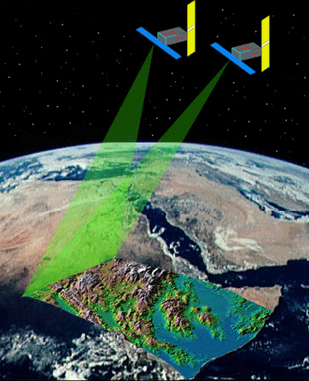
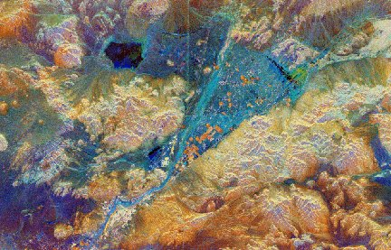
Synthetic aperture radar (SAR)
www.stanford.edu/group/ radar/radarbeams.jpeg
http://www.centennialofflight.gov/essay/Dictionary/SAR/DI175G1.jpg

Slide 11
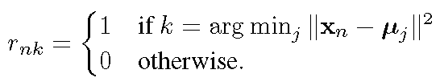

K-means
用以上方法疊代
  n:資料編號，k: cluster編號
M. Bishop, “Pattern Recognition and Machine Learning”

Slide 12
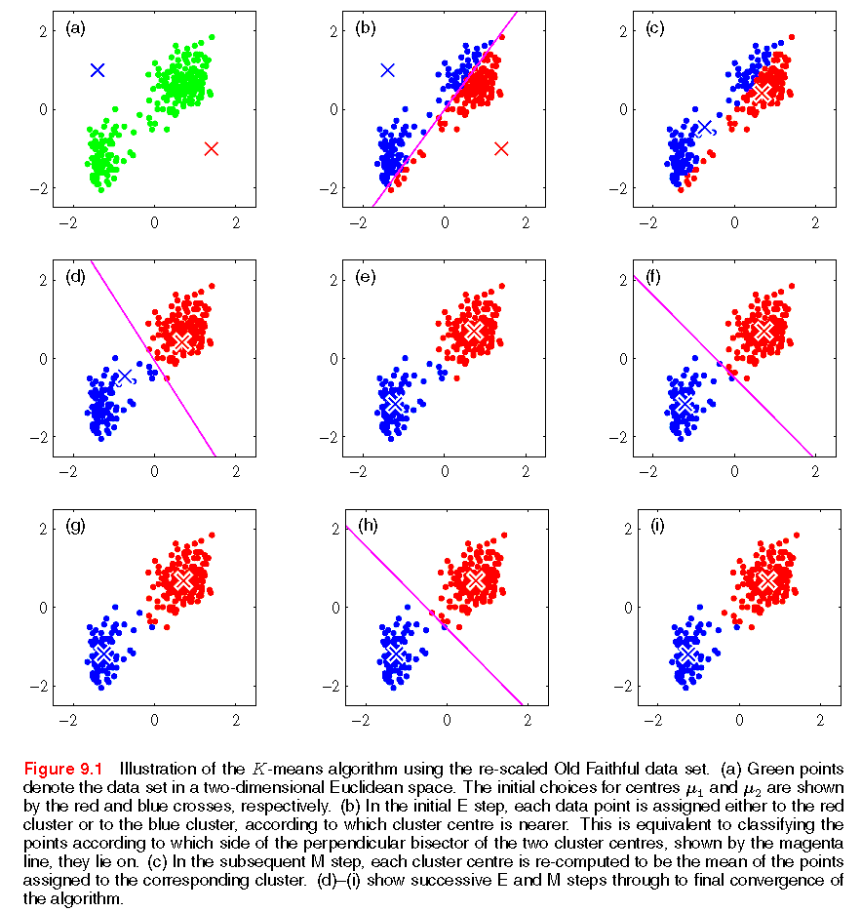
K-means
M. Bishop, “Pattern Recognition and Machine Learning”

Slide 13
ISODATA
Iterative Self-Organizing Data Analysis Techniques
類似K means方法，但多了Merge與Split步驟：
  Cluster間如果太近則合併
  相同Cluster如果太大則分開

Slide 14
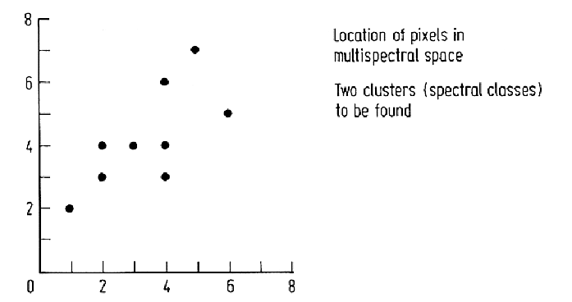
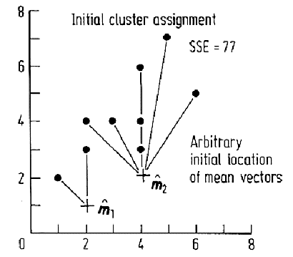
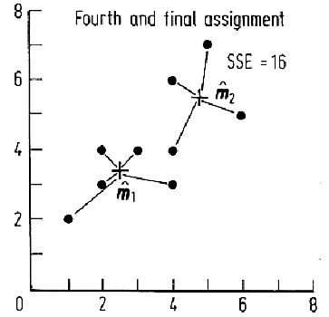
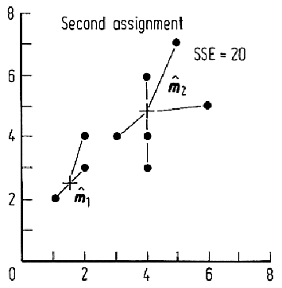
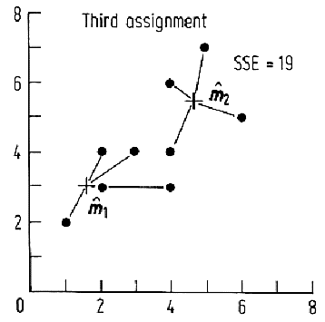
John A. Richards, “Remote Sensing Digital Image Analysis”

Slide 15
Hierarchical classifier
The hierarchical classifier uses sequential decision rules based on training data, with each decision rule involving two of the available features at a time.
針對每一類別
  以one vs. others把資料分成二類
  針對每一特徵組合
    針對某特徵組合找決策邊界
    把others資料刪除

Slide 16
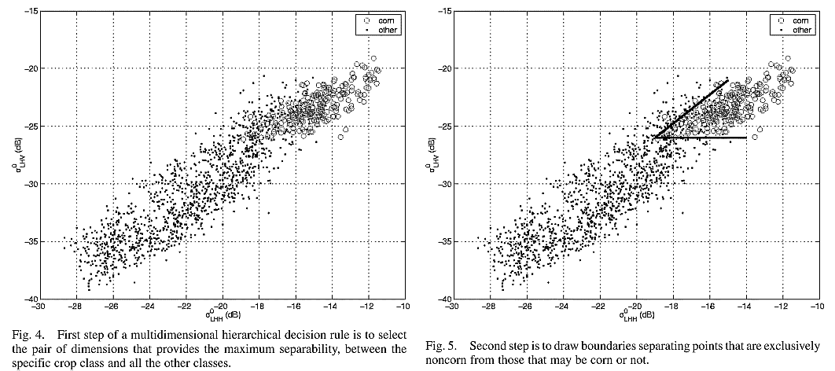
Hierarchical classifier

Slide 17
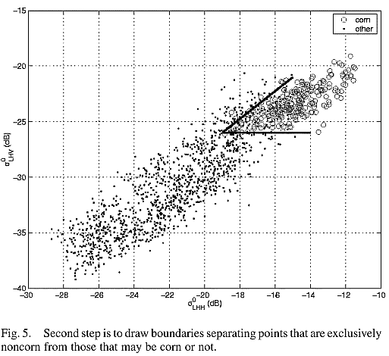
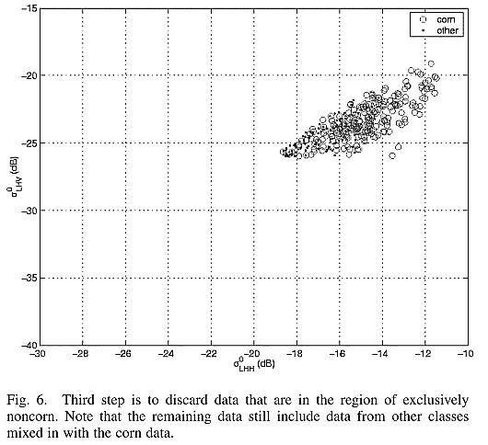
Hierarchical classifier

Slide 18
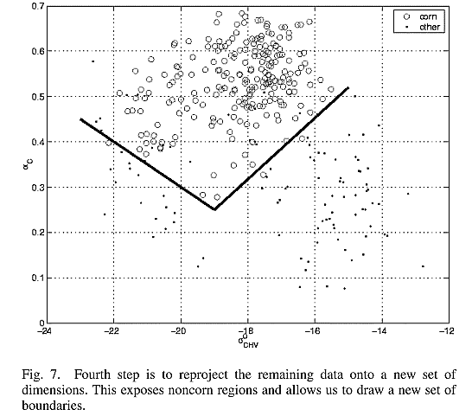
Hierarchical classifier

Slide 19
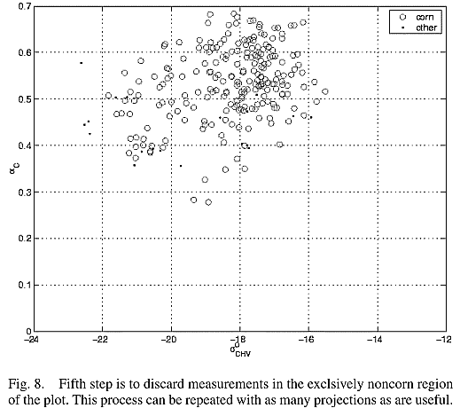
Hierarchical classifier

Slide 20
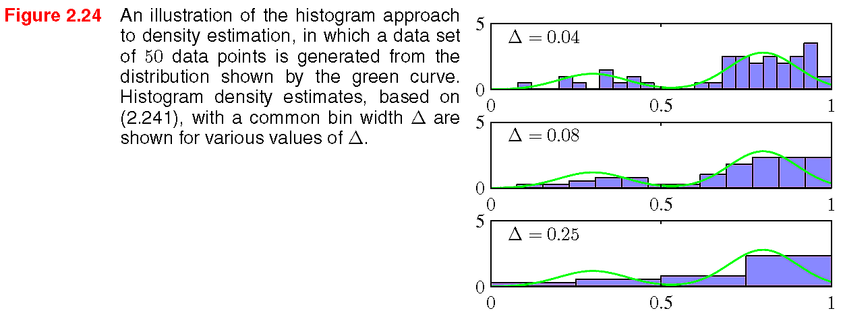
Density estimation
The best results are obtained for some intermediate value of Δ (middle figure). In principle, a histogram density model is also dependent on the choice of edge location for the bins, though this is typically much less significant than the value of Δ.
Another major limitation of the histogram approach is its scaling with dimensionality.
假設每一特徵切10等份，10個特徵便有10^10個bins，資料在這樣的空間便很稀疏。
M. Bishop, “Pattern Recognition and Machine Learning”

Slide 21
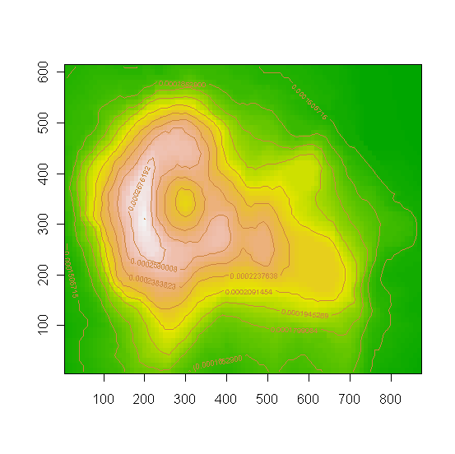
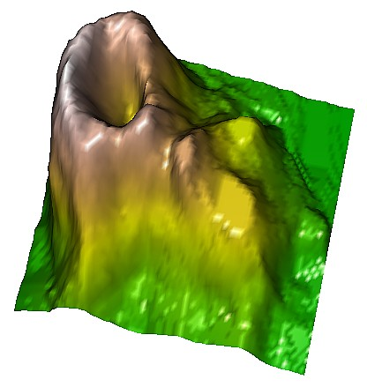
Maximum-Entropy Density Estimation
(MEDE)
A density estimation methopd involves maximum entropy and Legendre discomposition technique.
Notes:
data(volcano)
volcano=volcano/sum(volcano)
Max_v=max(volcano)
Min_v=min(volcano)
x <- 10*(1:nrow(volcano))
y <- 10*(1:ncol(volcano))
image(x, y, volcano,
col = terrain.colors(100),
axes = FALSE,
xlab = "", ylab = "")
contour(x, y, volcano,
levels = seq(Min_v, Max_v, by=(Max_v-Min_v)/10),
add = TRUE,
col = "peru")
axis(1, at = seq(100, 800, by = 100))
axis(2, at = seq(100, 600, by = 100))
box()
X11()
persp(x, y, volcano, theta = 30, phi = 30, expand = 0.5, col = "lightblue",
shade=.5,
xlab = "X", ylab = "Y", zlab = "Z")
library(rgl)
z=list(x=x,y=y,z=volcano)
open3d()
surface3d((z$x - min(z$x)) / diff(range(z$x)),
(z$y - min(z$y)) / diff(range(z$y)),
(z$z - min(z$z)) / diff(range(z$z)),
color = terrain.colors(256)[
1 + round(254 * (z$z - min(z$z)) / diff(range(z$z)))
])

Slide 22
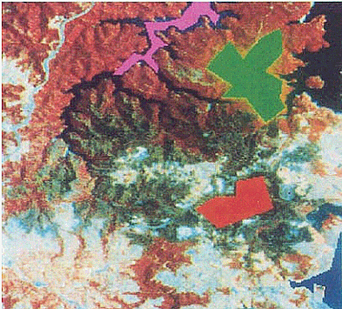
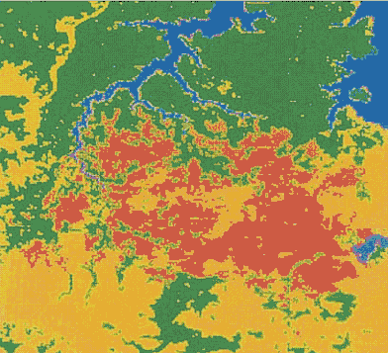
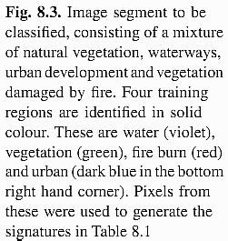
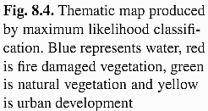
問題定義
訓練資料
預測結果
John A. Richards, “Remote Sensing Digital Image Analysis”

Slide 23
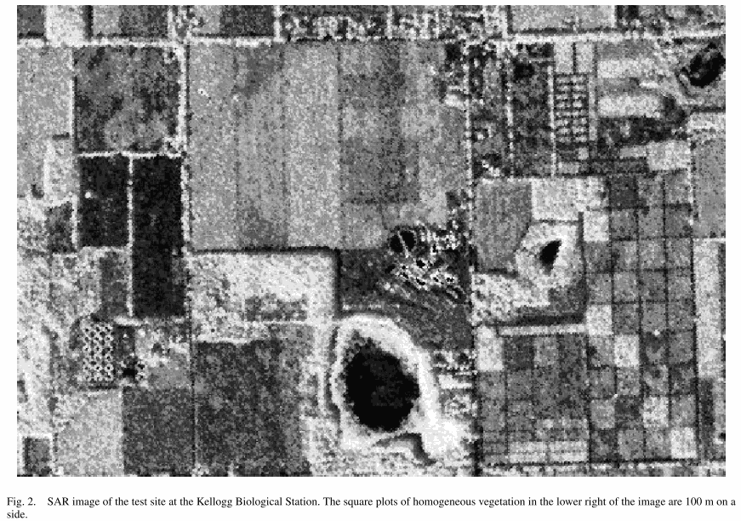
Data

Slide 24
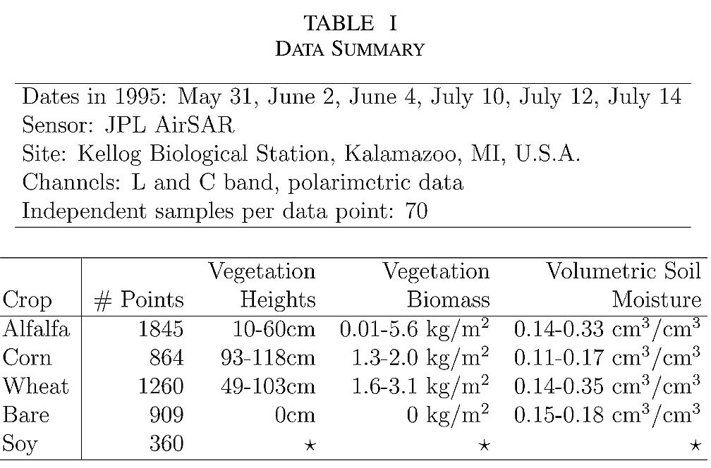
Data
計兩種頻道
類別
資料數

Slide 25
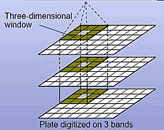
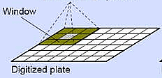
Single vs. multi band image
對某些用途，可每3x3像素取統計量當特徵，假設N個統計量
假設原影像有3個Bands，那3x3像素有3xN特徵描述
http://dame.dsf.unina.it/images/multi-band.jpg

Slide 26
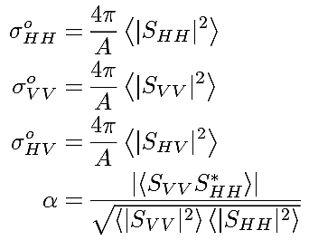
Features
每一頻道(L or C)包含以下四特徵：
由於有兩頻道，故計8特徵

Slide 27
Bayesian Hierarchical Classifier
P(Ci|x)為觀察到x後，估算x屬於Ci機率
要獲得P(Ci|x)，需先計算P(Ci)與f(x|Ci)
  只要統計類別與數量關係即可獲P(Ci)
  f(x|Ci)需靠density estimation
本文作者提出8特徵分3/3/2利用MEDE找density estimation

Slide 28
Bayesian Hierarchical Classifier
本文作者提出8特徵分3/3/2利用MEDE找每一類別density estimation
8特徵分3/3/2有多種排列組合算density estimation，以下為決定方法：
  以窮舉法找最佳C⁸₃排列組合
  以窮舉法找最佳C⁵₃排列組合
  C²₂排列組合

Slide 29
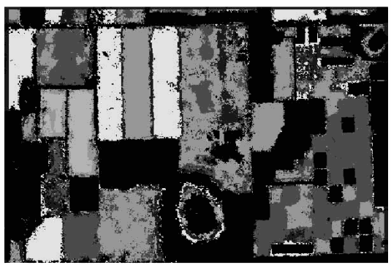
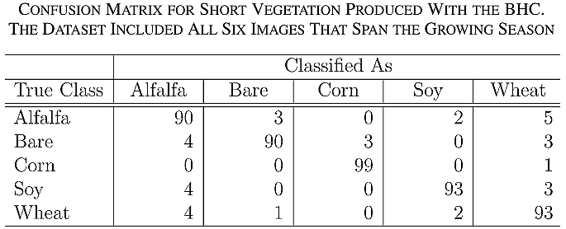
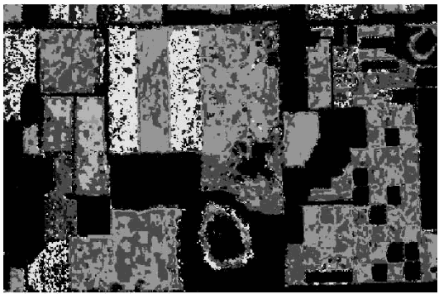
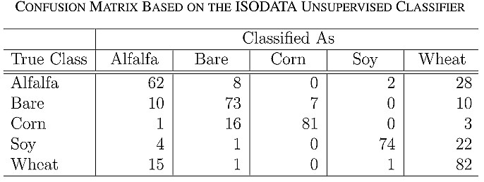
Results

