Slide 1
Next-generation sequencing: applications beyond genomes
‥
‥
Samuel Marguerat, Brian T. Wilhelm and Jurg Bahler
Presenter:Chang-Hao Huang
Date:Mar. 29, 2011

Slide 2
Abstact(1/2)
The development of DNA sequencing more than 30 years ago has profoundly impacted biological research. In the last couple of years, remarkable technological innovations have emerged that allow the direct and cost-effective sequencing of complex samples at unprecedented scale and speed. These next-generation technologies make it feasible to sequence not only static genomes, but also entire transcriptomes expressed under different conditions. These and other powerful applications of next-generation sequencing are rapidly revolutionizing the way genomic studies are carried out.

Slide 3
Abstact(2/2)
Below, we provide a snapshot of these exciting new approaches to understanding the properties and functions of genomes. Given that sequencing-based assays may increasingly supersede microarray-based assays, we also compare and contrast data obtained from these distinct approaches.

Slide 4
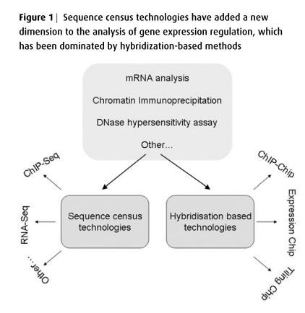

Slide 5
Complex DNA or RNA samples are directly sequenced to determine their content.
With reference genomes available, short sequence reads are sufficient to map their locations (except for repeated regions), and once mapped, millions of sequence hits are simply counted to determine their genomic distribution

Slide 6
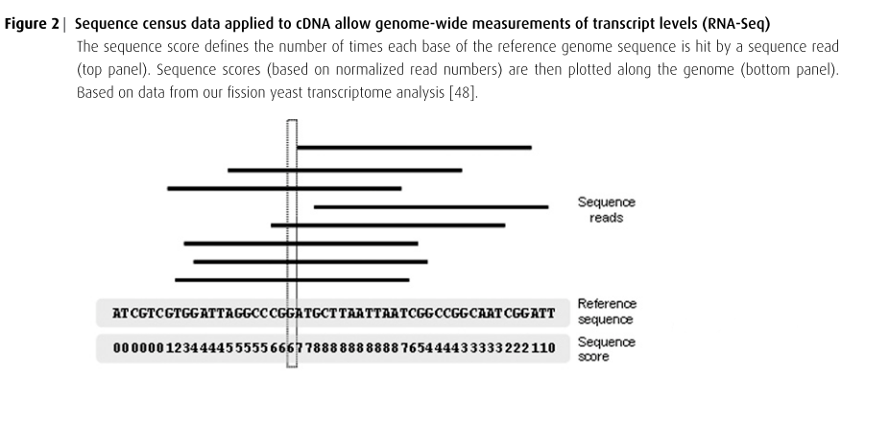

Slide 7
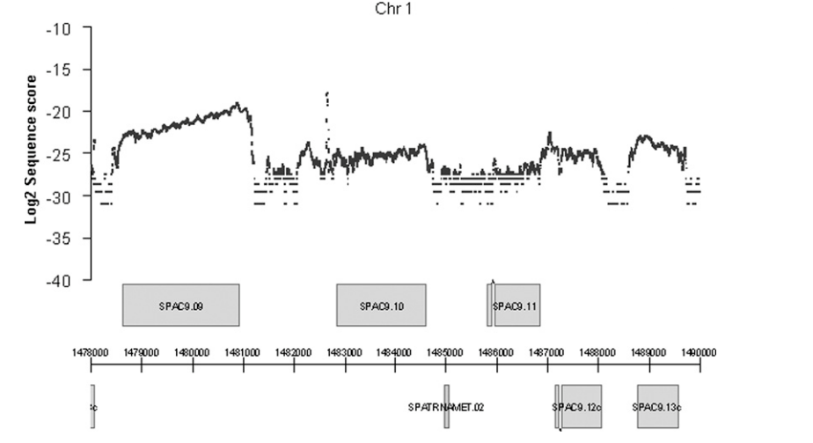

Slide 8
Scores provide accurate measurements of relative RNA levels.
We can estimate the relative abundance of given transcripts by counting the number of times they are hit by sequence reads.

Slide 9
ChIP-on-chip :
Globally mapping the in vivo binding sites of various DNA-binding proteins across genomes.
ChIP-Seq :
Directly sequencing this DNA to analyse the protein-binding sites at high resolution.

Slide 10
Global analysis of gene expression relies largely on hybridization-based platforms such as microarrays.
1. determining relative expression levels
2. changes in gene expression between different biological conditions

Slide 11
Hybridization data consist of continuous signals, sequence census data are made of absolute numbers of reads

Slide 12
Microarray data are affected by the dynamic range of the scanner, sequence data have a linear dynamic range only limited by the sequencing depth.

Slide 13
Conclusion
Sequence census methods such as ChIP-Seq and RNA-Seq are becoming powerful and quantitative approaches to analyse the structures and functions of both genomes and transcriptomes at maximal resolution.

