Slide 1
A fast algorithm for finding the positions of all squares in a run-length encoded string
J. J. Liu(劉嘉傑), G. S. Huang(黃光璿) and Y. L. Wang(王有禮)
Theoretical Computer Science, Vol. 410, pp.3942-3948, 2009
Presenter：Chiou-Ting Tseng
Date: May. 17, 2011

Slide 2
Abstract
Squares are strings of the form ww where w is any nonempty string. Main and Lorentz proposed an O(n log n)-time algorithm for finding the positions of all squares in a string of length n. Based on their result, we show how to find the positions of all squares in a run-length encoded string in time O(N log N) where N is the number of runs in this string, provided that we do not explicitly compute at all “trivial squares” occurring within runs. The algorithm is optimal and its time complexity is independent of the length of the original uncompressed string.

Slide 3
Square
An immediately repeated nonempty string
aa
abab
xyzxyz

Slide 4
Optimality
We remark that the total number of occurrences of squares in a^{n} is Θ(n²), which indicates that an O(n²)-time algorithm is optimal if one needs to enumerate one occurrence at a time.
aaaaaa → 5 * aa + 3 * aaaa + 1 * aaaaaa

Slide 5
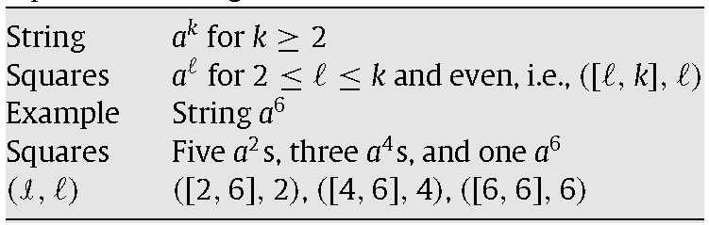
Related Squares

Slide 6
Main and Lorentz's Idea
Divide and Conquer
Suppose that a string x is divided into two nonempty strings u and v. If ww is a square of x, then clearly either ww occurs in u or in v, or as the concatenation of a suffix of u and a prefix of v.
square(uv) = square(u) ∪ square(v) ∪ cross(u, v) for u, v nonempty
square(y)=∅ if |y|≤1:

Slide 7
Main and Lorentz's Idea
LP(v, j): the length of the longest substring of v that starts at position j (for 2 ≤ j ≤ |v|) and matches a prefix of v;
LS(u, v, j): the length of the longest substring of v that ends at position j (for 1 ≤ j ≤ |v|) and matches a suffix of u.

Slide 8
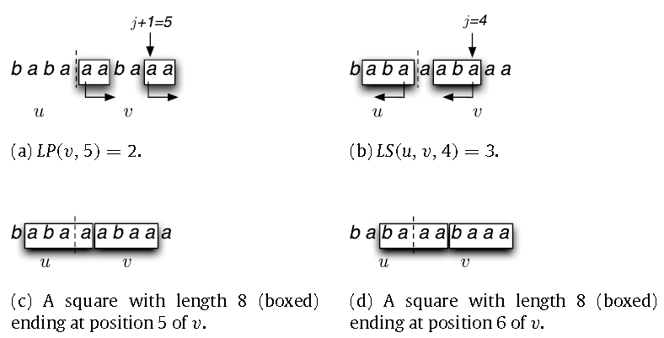
Example

Slide 9
Lemma 1
Let j and k be integers with 1 ≤ j ≤ |v|and j ≤ k < 2j. There is a square of length 2j in uv ending at position k of v if and only if 2j – LS(u, v, j) ≤ k ≤ j + LP(v, j + 1).
LS(u, v, j) + LP(v, j + 1) ≥ j
k + LS(u, v, j) ≥ 2j

Slide 10
Run Length Encoded Version
aabbbabbbbb → (a, 2)(b, 3)(a, 1)(b, 5)
Main and Lorentz's algorithm cannot be applied directly to find all squares inside σ(x) because some squares are missing by using their algorithm.
A square of x either occurs entirely within a run or overlaps with at least two consecutive runs (in the latter case in fact it has to span at least four runs).

Slide 11
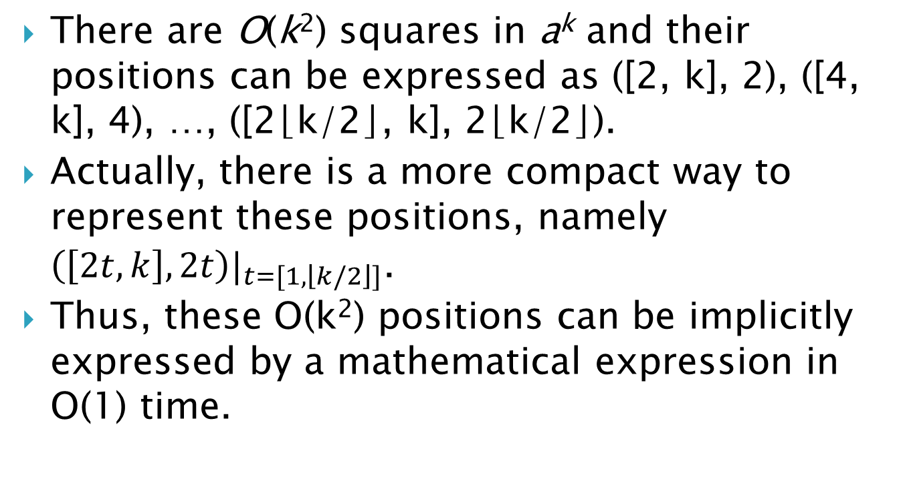
Compact Representation
There are O(k²) squares in a^{k} and their positions can be expressed as ([2, k], 2), ([4, k], 4), …, ([2⌊k/2⌋, k], 2⌊k/2⌋).
Actually, there is a more compact way to represent these positions, namely ${\left(\left[2t, k\right], 2t\right)|}_{t=[1, \left\lfloor k/2\right\rfloor ]}$.
Thus, these O(k²) positions can be implicitly expressed by a mathematical expression in O(1) time.

Slide 12
Divide and Conquer
D1: X = UV and neither U nor V is empty.
D2: The squares can be further divided into three cases:
Case A: centered at the junction of u and v;
Case B: centered at v;
Case C: centered at u.

Slide 13
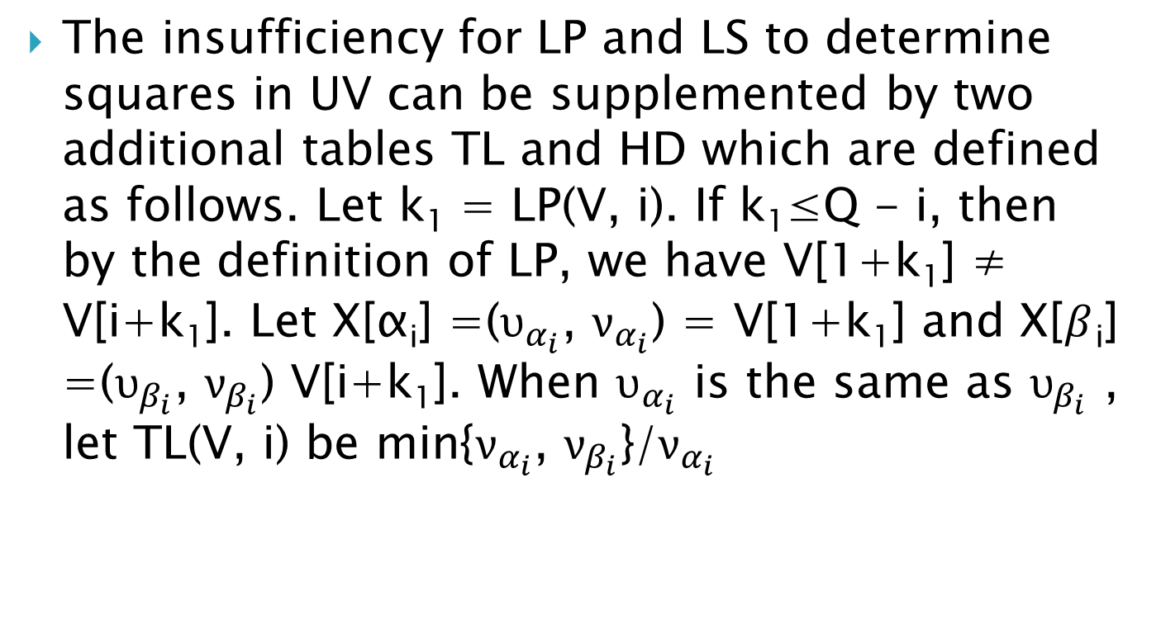
Algorithm
The insufficiency for LP and LS to determine squares in UV can be supplemented by two additional tables TL and HD which are defined as follows. Let k₁ = LP(V, i). If k₁≤Q - i, then by the definition of LP, we have V[1+k₁] ≠ V[i+k₁]. Let X[α_{i}] =($υ_{α_{i}}$, $ν_{α_{i}}$) = V[1+k₁] and X[$β$_{i}] =($υ_{β_{i}}$, $ν_{β_{i}}$) V[i+k₁]. When $υ_{α_{i}}$ is the same as $υ_{β_{i}}$ , let TL(V, i) be min{$ν_{α_{i}}$, $ν_{β_{i}}$}/$ν_{α_{i}}$

Slide 14
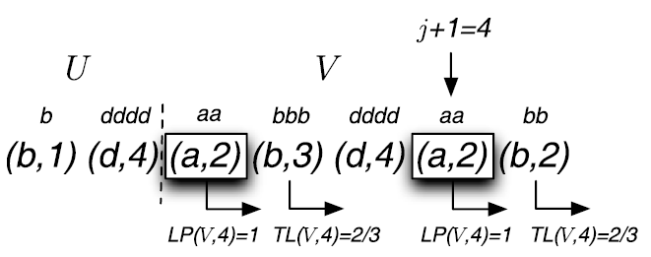
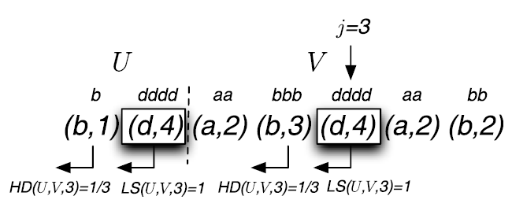
Example

Slide 15
Decision Equation – Case B
A square ww is divided into A₁B₁A₂B₂ where A₁ is a suffix of u, B₁ is a prefix of v, A₁ = A2, and B₁ = B₂. j is the end point of A2.
LS(U, V, j) + HD(U, V, j) + LP(V, j+1) + TL(V, j+1) ≥ j
LS(U, V, j) + HD(U, V, j) >0 and LP(V, j+1) + TL(V, j+1) > 0
j=3, 1 + 1/3 + 1 + 2/3 = 3 ≥ 3
bddddabbbddddabb

Slide 16
Decision Equation – Case C
Similar to case B

Slide 17
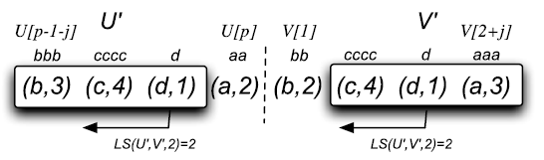
Case A (Junction)
Let U’=U-U[P] and V’=V-V[1]. There is a square centered at the boundary of u and v if and only if there exists j with 0 ≤ j ≤ min[P – 2, Q – 2] such that
LS(U’, V’, j) = j
u_{P-1-j} =υ₁, u_{p}=υ_{2+j}, ν₁ ≤ μ_{P-1-j} and μ₂ ≤ ν_{2+j}

Slide 18
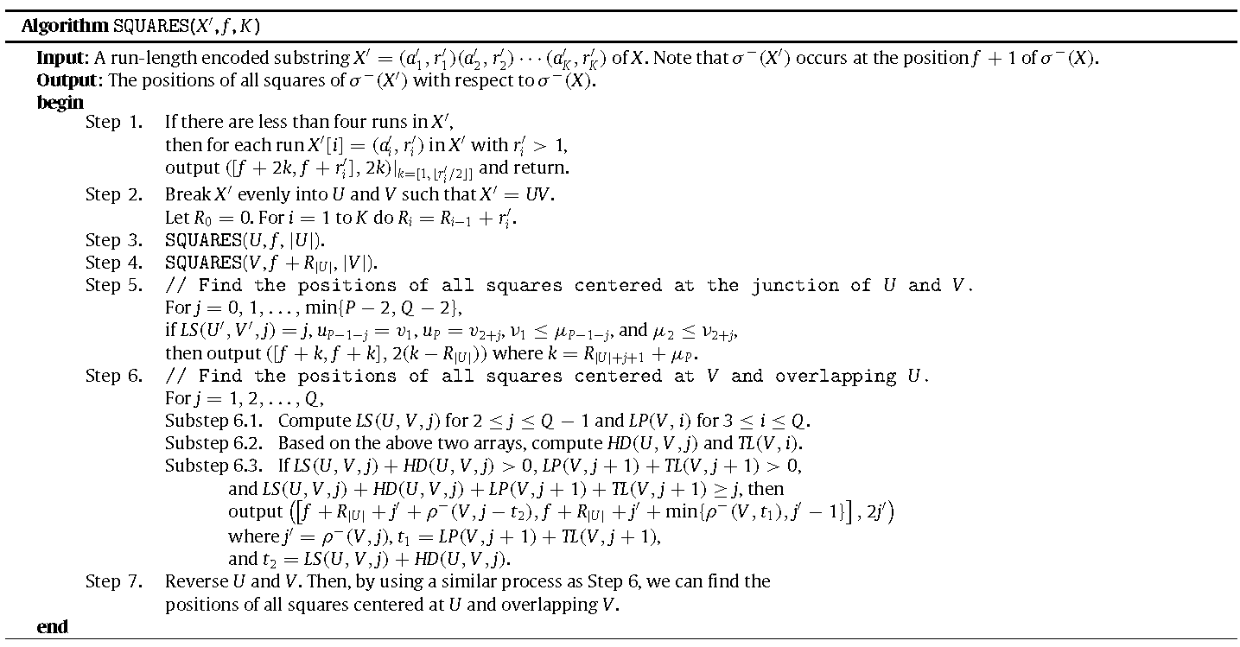

Slide 19
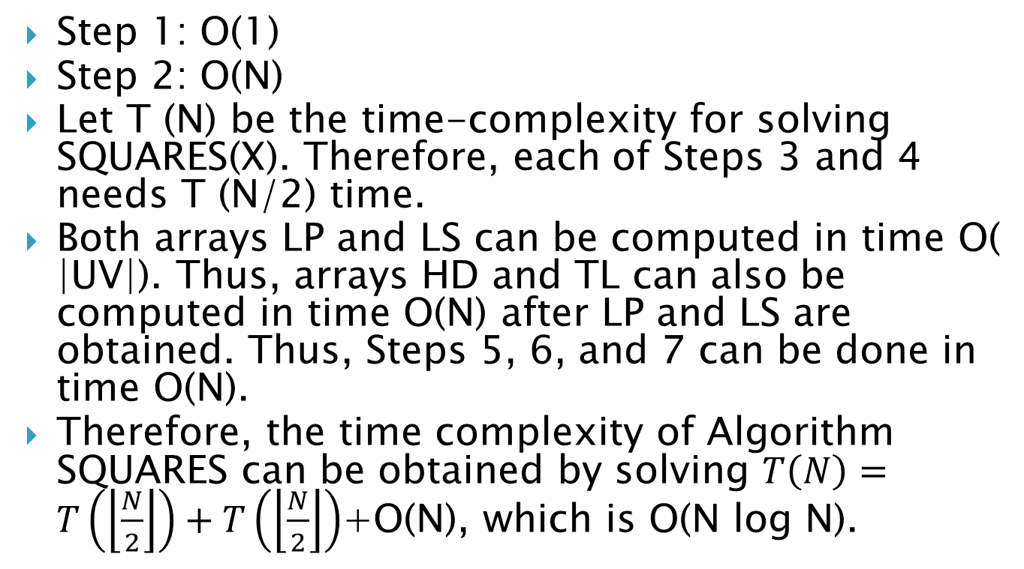
Time Complexity
Step 1: O(1)
Step 2: O(N)
Let T (N) be the time-complexity for solving SQUARES(X). Therefore, each of Steps 3 and 4 needs T (N/2) time.
Both arrays LP and LS can be computed in time O( |UV|). Thus, arrays HD and TL can also be computed in time O(N) after LP and LS are obtained. Thus, Steps 5, 6, and 7 can be done in time O(N).
Therefore, the time complexity of Algorithm SQUARES can be obtained by solving $T\left(N\right)=T\left(\left\lfloor \frac{N}{2}\right\rfloor \right)+T\left(\left\lfloor \frac{N}{2}\right\rfloor \right)$+O(N), which is O(N log N).

