Slide 1
Next-generation sequencing: applications beyond genomes
Samuel Marguerat, Brian T. Wilhelm and Jürg Bähler
Presenter: Chang-Hao Huang
Date: May 29, 2011

Slide 2
Abstact(1/2)
The development of DNA sequencing more than 30 years ago has profoundly impacted biological research. In the last couple of years, remarkable technological innovations have emerged that allow the direct and cost-effective sequencing of complex samples at unprecedented scale and speed. These next-generation technologies make it feasible to sequence not only static genomes, but also entire transcriptomes expressed under different conditions. These and other powerful applications of next-generation sequencing are rapidly revolutionizing the way genomic studies are carried out.

Slide 3
Abstact(2/2)
Below, we provide a snapshot of these exciting new approaches to understanding the properties and functions of genomes. Given that sequencing-based assays may increasingly supersede microarray-based assays, we also compare and contrast data obtained from these distinct approaches.

Slide 4
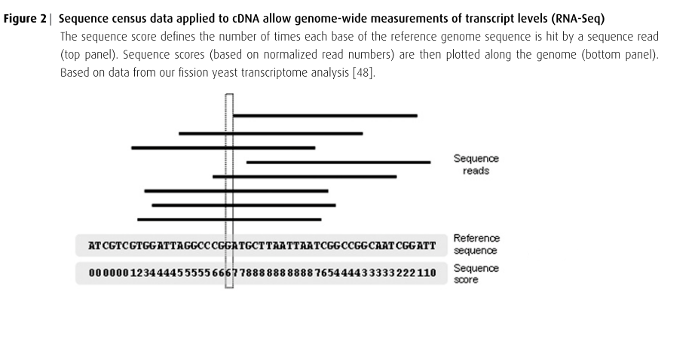

Slide 5
Sequenced using Solexa reversible-terminator chemistry on the Illumina Genome Analyser(sequencing-by-synthesis ).
Sequence reads were mapped to the reference genome using BLAT(BLAST-Like Alignment Tool).

Slide 6
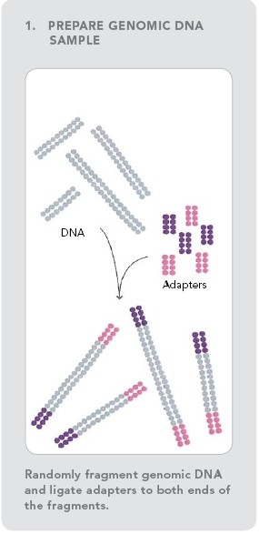
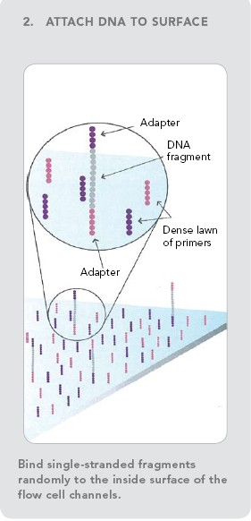
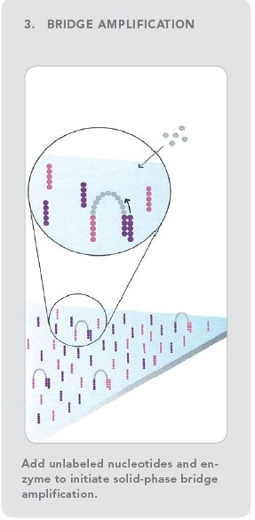

Slide 7
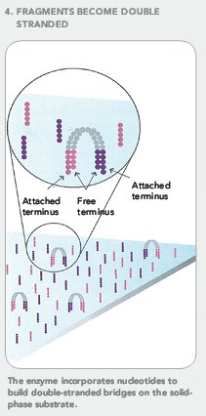
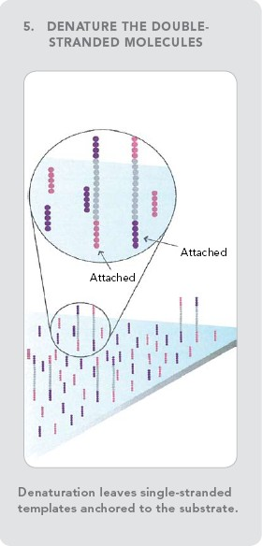
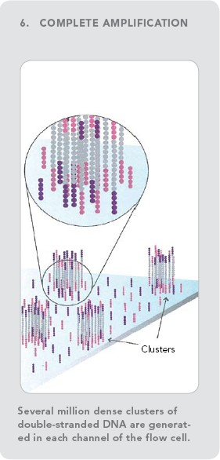

Slide 8
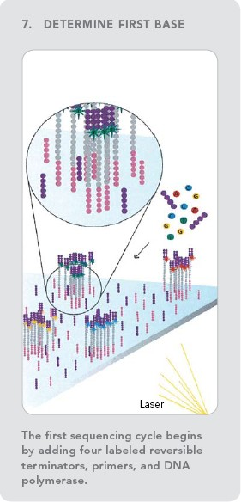
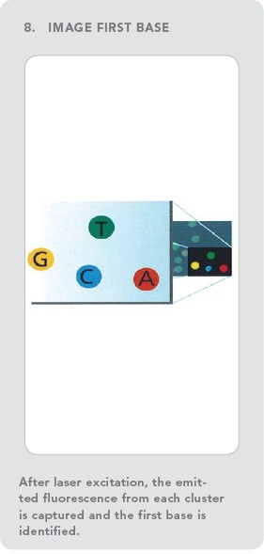
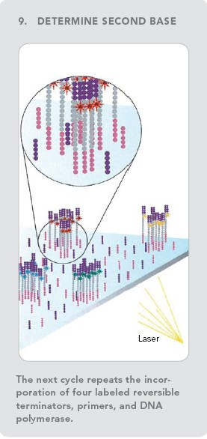

Slide 9
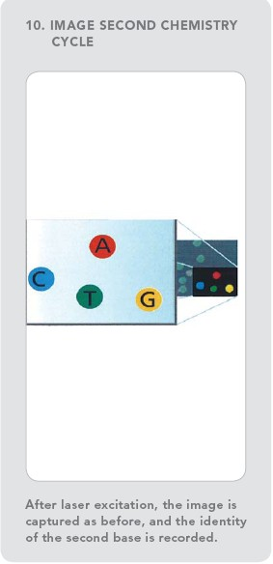
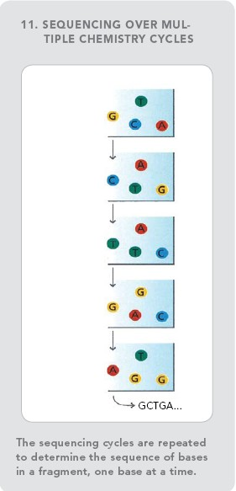
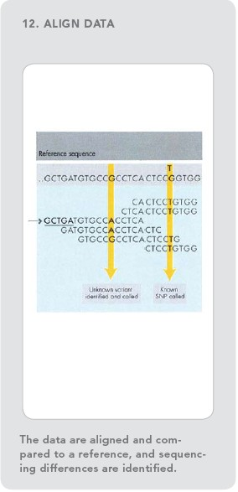

Slide 10
http://www.youtube.com/watch?v=HtuUFUnYB9Y
http://www.youtube.com/watch?v=77r5p8IBwJk

