Slide 1
DIALIGN: Finding local similarities by multiple sequence alignment
Burkhard Morgenstern, Kornelie Frech, Andreas Dress, Thomas Werner
BIOINFORMATICS Vol15 no.3 1999 Pages211-218
報告者：何文娟
日期：2015/01/28

Slide 2
Abstract(1/2)
Motivation: DIALIGN is a new method for pairwise as well as multiple alignment of nucleic acid and protein sequences. While standard alignment programs rely on comparing single residues and imposing gap penalties, DIALIGN constructs alignments by comparing whole segments of the sequences. No gap penalty is employed. This point of view is especially adequate if sequences are not globally related, but share only local similarities, as is the case in genomic DNA sequences and in many protein families.

Slide 3
Abstract(2/2)
Results: Using four different data sets, we show that DIALIGN is able correctly to align conserved motifs in protein sequences. Alignments produced by DIALIGN are compared systematically to the results of five other alignment programs.

Slide 4
Sequence Alignment
Gap= -2, Mismatch=-1, Match = 1
S₁ = A T C G A T C
S₂ = T T C G T T
→
A T C G A T C A T C G A T C −
T T C G T T − T T C G − T − T
Score = 0 Score = -3

Slide 5
Needleman-Wunsch Algorithm (1/2)
Sc[i-1,j]+gap
max Sc[i,j-1]+gap if i ≠ j
Sc[i,j]= Sc[i-1,j-1]+mismatch
Sc[i-1,j-1]+match if i = j

Slide 6
Needleman-Wunsch Algorithm (2/2)
 |  | G | C | A | T | G | C | U
 | 0 | -1 | -2 | -3 | -4 | -5 | -6 | -7
G | -1 | 1 | 0 | -1 | -2 | -3 | -4 | -5
A | -2 | 0 | 0 | 1 | 0 | -1 | -2 | -3
T | -3 | -1 | -1 | 0 | 2 | 1 | 0 | -1
T | -4 | -2 | -2 | -1 | 1 | 1 | 0 | -1
A | -5 | -3 | -3 | -1 | 0 | 0 | 0 | -1
C | -6 | -4 | -2 | -2 | -1 | -1 | 1 | 0
A | -7 | -5 | -3 | -1 | -2 | -2 | 0 | 0
Best Alignments
G-ATTACA
GCATG-CU
G-ATTACA
GCA-TGCU
G-ATTACA
GCAT-GCU

Slide 7
Algorithm(1/10)
Step1. Compute all optimal pairwise alignment
Step2. Incorporate the diagonals into alignments and sort them
Weight scores
Degree of overlap
Step3. Use greedy manner
Step4. Introduce gaps into the sequences

Slide 8
Algorithm(2/10)
Y I A F L F A W D D
L A C F I F G S
S W E D F M F A E D

Slide 9
Algorithm(3/10)
Y I A F L F A W D D
L A C F I F G S
L A C F I F G S
S W E D F M F A E D
Y I A F L F A W D D
S W E D F M F A E D
1
I A
D₁
L A
F L F
D₂
F I F
F I F
D₄
F M F
2
W D D
D₃
W E D
FLFAWD
D₅
FMFAED
3

Slide 10
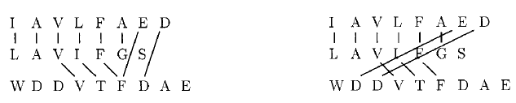
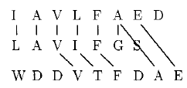
Collections Of Diagonals
Non-consistent
Consistent

Slide 11
Algorithm(5/10)
M₁= ｛D₁,D₂,D₃,D₄ ,D₅｝ D₂→ D₄→ D₃→ D₁→ D₅
Y I A F L F A W D D
L A C F I F G S
S W E D F M F A E D
 | D₁ | D₂ | D₃ | D₄ | D₅
Weight | 0.2 | 2.6 | 4.7 | 2.2 | 0.1
Overlap weight | 0.2 | 5.3 | 4.7 | 4.9 | 0.1
F L F
D₂
F I F

Slide 12
Algorithm(6/10)
M₁= ｛D₁,D₂,D₃,D₄ ,D₅｝ D₂→ D₄→ D₃→ D₁→ D₅
Y I A F L F A W D D
L A C F I F G S
S W E D F M F A E D
 | D₁ | D₂ | D₃ | D₄ | D₅
Weight | 0.2 | 2.6 | 4.7 | 2.2 | 0.1
Overlap weight | 0.2 | 5.3 | 4.7 | 4.9 | 0.1
F I F
D₄
F M F

Slide 13
Algorithm(7/10)
M₁= ｛D₁,D₂,D₃,D₄ ,D₅｝ D₂→ D₄→ D₃→ D₁→ D₅
Y I A F L F A W D D
L A C F I F G S
S W E D F M F A E D
 | D₁ | D₂ | D₃ | D₄ | D₅
Weight | 0.2 | 2.6 | 4.7 | 2.2 | 0.1
Overlap weight | 0.2 | 5.3 | 4.7 | 4.9 | 0.1
W D D
D₃
W E D
Non-consistent

Slide 14
Algorithm(8/10)
M₁= ｛D₁,D₂,D₃,D₄ ,D₅｝ D₂→ D₄→ D₃→ D₁→ D₅
Y I A F L F A W D D
L A C F I F G S
S W E D F M F A E D
 | D₁ | D₂ | D₃ | D₄ | D₅
Weight | 0.2 | 2.6 | 4.7 | 2.2 | 0.1
Overlap weight | 0.2 | 5.3 | 4.7 | 4.9 | 0.1
I A
D₁
L A
M₂= ｛ D₁, D₂, D₄｝

Slide 15
Algorithm(9/10)
M₁= ｛D₁,D₂,D₃,D₄ ,D₅｝ D₂→ D₄→ D₃→ D₁→ D₅
Y I A F L F A W D D
L A C F I F G S
S W E D F M F A E D
 | D₁ | D₂ | D₃ | D₄ | D₅
Weight | 0.2 | 2.6 | 4.7 | 2.2 | 0.1
Overlap weight | 0.2 | 5.3 | 4.7 | 4.9 | 0.1
FLFAWD
D₅
FMFAED

Slide 16
Algorithm(10/10)
Y I A F L F A W D D
L A C F I F G S
S W E D F M F A E D
− − − − Y I A − F L F − − A W D D
− − − − − L A C F I F G S
S W E D − − − − F M F − − A E D

Slide 17
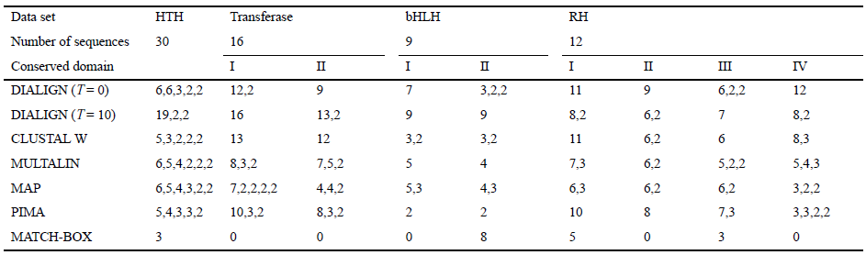
Results(1/2)

Slide 18
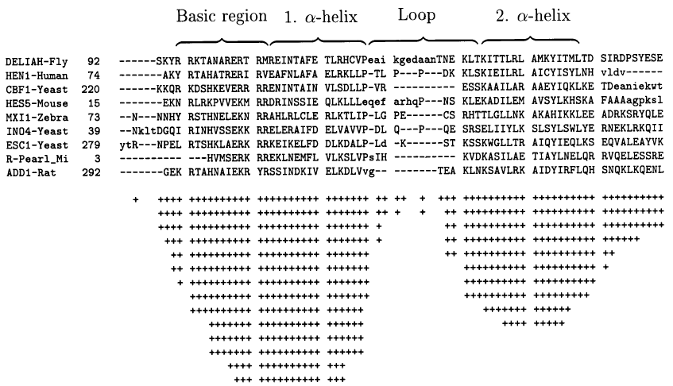
Results(2/2)

