Slide 1
Re-Use Dynamic Programming for Sequence Alignment: An Algorithmic Toolkit
Maxime Crochemore, Gad M. Landau, Michal Ziv-Ukelson
String Algorithmics, pp. 19-59 (2005)
Presenter: Tzu-Chiang Hsu (徐子強)
2015/01/28

Slide 2
Abstract (1/2)
The problem of comparing two sequences S and T to determine their similarity is one of the fundamental problems in pattern matching. In this manuscript we will be primarily concerned with sequences as our objects and with various string comparison metrics. Our goal is to survey a methodology for utilizing repetitions in sequences in order to speed up the comparison process.

Slide 3
Abstract (2/2)
Within this framework we consider various methods of parsing the sequences in order to frame their repetitions, and present a toolkit of various solutions whose time complexity depends both on the chosen parsing method as well as on the string-comparison metric used for the alignment.

Slide 4
On the Common Substring
Alignment Problem, Journal
of Algorithms, 2001
Lempel–Ziv
Compression
① {
Encoding O(n²)
Alignment O(n)
② {
Encoding O(n|Y|)
Alignment O(n)
A Sub-quadratic Sequence Alignment Algorithm for
Unrestricted Scoring Matrices, SIAM J. COMPUT., 2003
① + LZ O(hn²/log n) Time and Space
② + LZ O(hn²/log n) Time, O(h²n²/(log n)²) Space

Slide 5
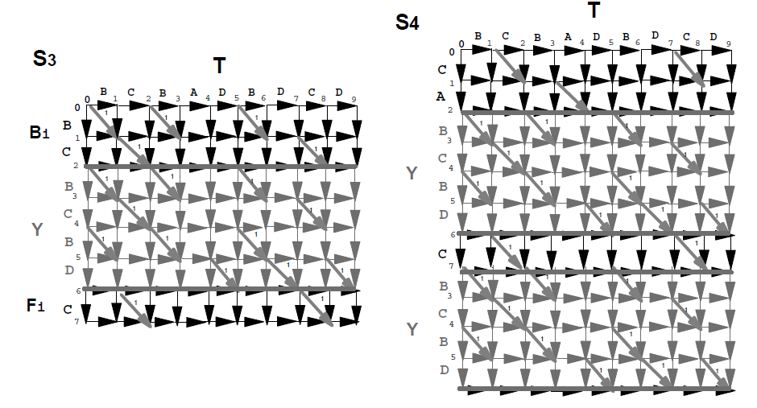

Slide 6
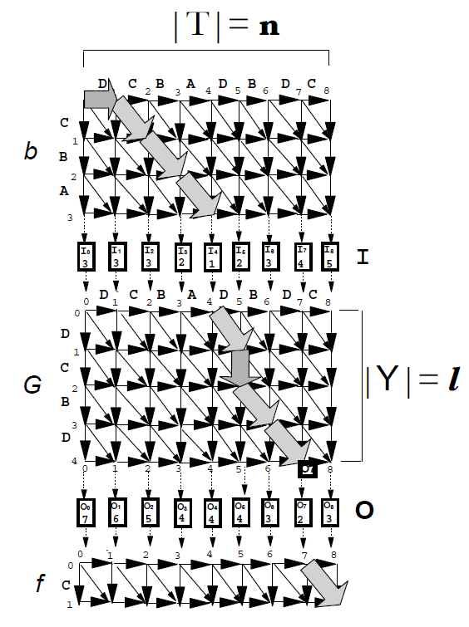

Slide 7
a
c
g
0
-1
-1
-1
-2
-3
a
1
-1
-1
-1
-1
1
0
-1
g
-2
0
0
1

Slide 8
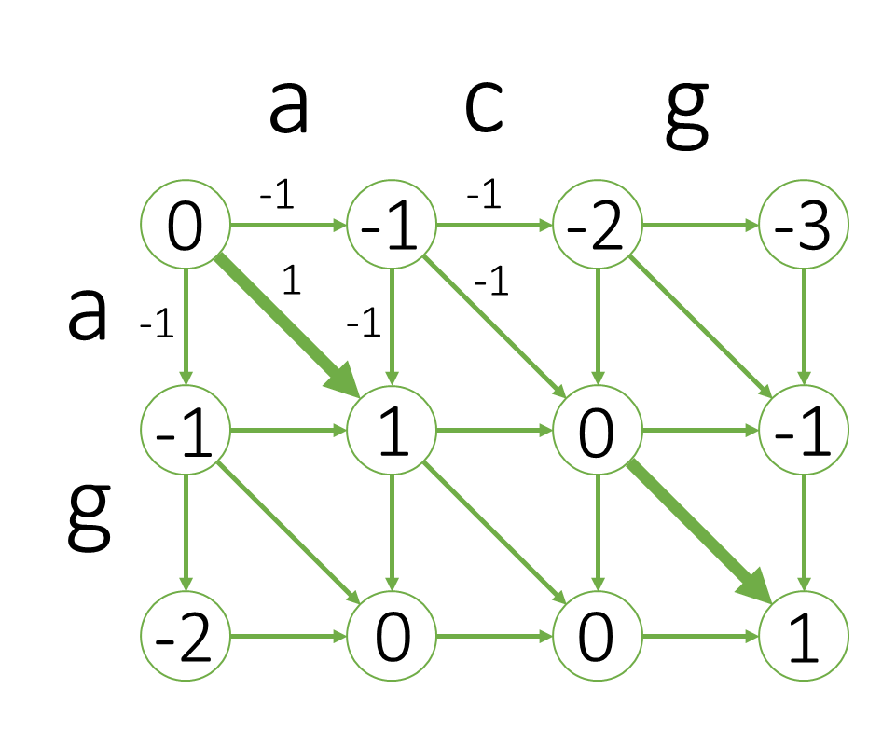
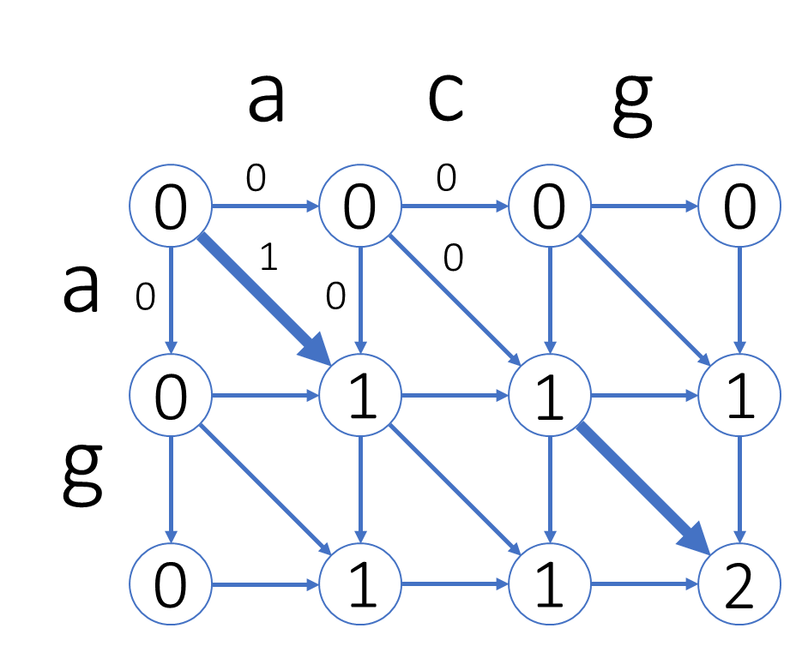
左(i, j) + max(i, j) = 2 * 右(i, j)

Slide 9
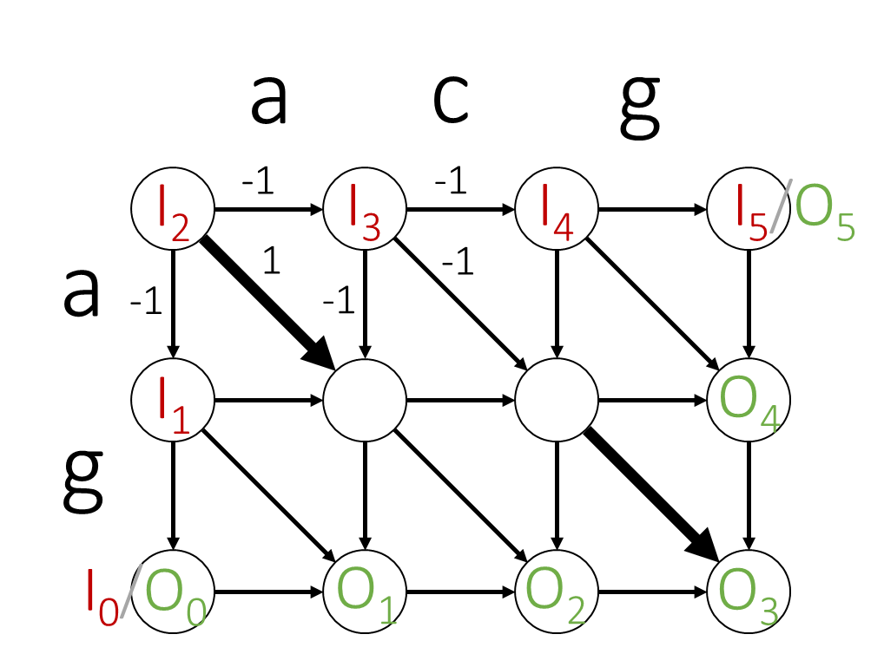

Slide 10
DIST
 |  |  |  | 0 | 1 | 2 | 3 | 4 | 5
 |  |  | 0 | 0 | -1 | -2 | -3 | ∆ | ∆
 |  |  | 1 | -1 | -1 | -2 | -1 | -3 | ∆
 |  |  | 2 | -2 | 0 | 0 | 1 | -1 | -3
 |  |  | 3 | ∆ | -2 | -2 | 0 | -2 | -2
 |  |  | 4 | ∆ | ∆ | -2 | 0 | -1 | -1
 |  |  | 5 | ∆ | ∆ | ∆ | -2 | -1 | 0

Slide 11
 |  |  |  | 0 | 1 | 2 | 3 | 4 | 5
 |  | I₀ = 1 | 0 | 0 | -1 | -2 | -3 | ∆ | ∆
 |  | I₁ = 2 | 1 | -1 | -1 | -2 | -1 | -3 | ∆
 |  | I₂ = 3 | 2 | -2 | 0 | 0 | 1 | -1 | -3
 |  | I₃ = 2 | 3 | ∆ | -2 | -2 | 0 | -2 | -2
 |  | I₄ = 1 | 4 | ∆ | ∆ | -2 | 0 | -1 | -1
 |  | I₅ = 3 | 5 | ∆ | ∆ | ∆ | -2 | -1 | 0
DIST

Slide 12
 |  |  |  | 0 | 1 | 2 | 3 | 4 | 5
 |  | I₀ = 1 | 0 | 0+1 | -1+1 | -2+1 | -3+1 | ∆ | ∆
 |  | I₁ = 2 | 1 | -1+2 | -1+2 | -2+2 | -1+2 | -3+2 | ∆
 |  | I₂ = 3 | 2 | -2+3 | 0+3 | 0+3 | 1+3 | -1+3 | -3+3
 |  | I₃ = 2 | 3 | ∆ | -2+2 | -2+2 | 0+2 | -2+2 | -2+2
 |  | I₄ = 1 | 4 | ∆ | ∆ | -2+1 | 0+1 | -1+1 | -1+1
 |  | I₅ = 3 | 5 | ∆ | ∆ | ∆ | -2+3 | -1+3 | 0+3

Slide 13
 |  |  |  | 0 | 1 | 2 | 3 | 4 | 5
 |  | I₀ = 1 | 0 | 1 | 0 | -1 | -2 | -∞ | -∞
 |  | I₁ = 2 | 1 | 1 | 1 | 0 | 1 | -1 | -∞
 |  | I₂ = 3 | 2 | 1 | 3 | 3 | 4 | 2 | 0
 |  | I₃ = 2 | 3 | -12 | 0 | 0 | 2 | 0 | 0
 |  | I₄ = 1 | 4 | -13 | -13 | -1 | 1 | 0 | 0
 |  | I₅ = 3 | 5 | -14 | -14 | -14 | 1 | 2 | 3
 |  |  |  | 1 | 3 | 3 | 4 | 2 | 3
 |  |  |  | O₀ | O₁ | O₂ | O₃ | O₄ | O₅

Slide 14
1 | 0 | -1 | -2 | -∞ | -∞
1 | 1 | 0 | 1 | -1 | -∞
1 | 3 | 3 | 4 | 2 | 0
-12 | 0 | 0 | 2 | 0 | 0
-13 | -13 | -1 | 1 | 0 | 0
-14 | -14 | -14 | 1 | 2 | 3
Concave Total Monotonicity

Slide 15
1 | 0 | -1 | -2 | -∞ | -∞
1 | 1 | 0 | 1 | -1 | -∞
1 | 3 | 3 | 4 | 2 | 0
-12 | 0 | 0 | 2 | 0 | 0
-13 | -13 | -1 | 1 | 0 | 0
-14 | -14 | -14 | 1 | 2 | 3
左上≦左下 → 右上≦右下

Slide 16
1 | 0 | -1 | -2 | -∞ | -∞
1 | 1 | 0 | 1 | -1 | -∞
1 | 3 | 3 | 4 | 2 | 0
-12 | 0 | 0 | 2 | 0 | 0
-13 | -13 | -1 | 1 | 0 | 0
-14 | -14 | -14 | 1 | 2 | 3
1 | 3 | 3 | 4 | 2 | 3
SMWAK O(# of columns),
Geometric Applications of a
Matrix-Searching Algorithm,
Algorithmica, 1987

Slide 17
Incremental String Comparison,
SIAM J. COMPUT., 1998
O(n|Y|)
DIST
 | I₀ = 1 | 0 | -1 | -2 | -3 | ∆ | ∆
 | I₁ = 2 | -1 | -1 | -2 | -1 | -3 | ∆
 | I₂ = 3 | -2 | 0 | 0 | 1 | -1 | -3
 | I₃ = 2 | ∆ | -2 | -2 | 0 | -2 | -2
 | I₄ = 1 | ∆ | ∆ | -2 | 0 | -1 | -1
 | I₅ = 3 | ∆ | ∆ | ∆ | -2 | -1 | 0
 |  | O₀= 1 | O₁= 3 | O₂= 3 | O₃= 4 | O₄= 2 | O₅= 3

Slide 18
ABAABCABCB
1 A 2 B 3 C
Lempel-Ziv Compression

Slide 19
ABAABCABCB
1 A 2 B 3 C

Slide 20
ABAABCABCB
1 A 2 B 3 C 4 AB

Slide 21
ABAABCABCB
1 A 2 B 3 C 4 AB
1 2 1 4 3 7 2

Slide 22
ABAABCABCB
1 A 2 B 3 C 4 AB 5 BA
1 2 1 4 3 7 2

Slide 23
ABAABCABCB
1 A 2 B 3 C 4 AB 5 BA
1 2 1 4 3 7 2

Slide 24
ABAABCABCB
1 A 2 B 3 C 4 AB 5 BA
6 AA
1 2 1 4 3 7 2

Slide 25
ABAABCABCB
1 A 2 B 3 C 4 AB 5 BA
6 AA
1 2 1 4 3 7 2

Slide 26
ABAABCABCB
1 A 2 B 3 C 4 AB 5 BA
6 AA
1 2 1 4 3 7 2

Slide 27
ABAABCABCB
1 A 2 B 3 C 4 AB 5 BA
6 AA 7 ABC
1 2 1 4 3 7 2

Slide 28
ABAABCABCB
1 A 2 B 3 C 4 AB 5 BA
6 AA 7 ABC
1 2 1 4 3 7 2

Slide 29
ABAABCABCB
1 A 2 B 3 C 4 AB 5 BA
6 AA 7 ABC 8 CA
1 2 1 4 3 7 2

Slide 30
ABAABCABCB
1 A 2 B 3 C 4 AB 5 BA
6 AA 7 ABC 8 CA
1 2 1 4 3 7 2

Slide 31
ABAABCABCB
1 A 2 B 3 C 4 AB 5 BA
6 AA 7 ABC 8 CA
1 2 1 4 3 7 2

Slide 32
ABAABCABCB
1 A 2 B 3 C 4 AB 5 BA
6 AA 7 ABC 8 CA
1 2 1 4 3 7 2

Slide 33
ABAABCABCB
1 A 2 B 3 C 4 AB 5 BA
6 AA 7 ABC 8 CA 9 ABCB
1 2 1 4 3 7 2

Slide 34
ABAABCABCB
1 A 2 B 3 C 4 AB 5 BA
6 AA 7 ABC 8 CA 9 ABCB
1 2 1 4 3 7 2

Slide 35
ABAABCABCB
1 A 2 B 3 C 4 AB 5 BA
6 AA 7 ABC 8 CA 9 ABCB
1 2 1 4 3 7 2

Slide 36
ABAABCABCB
1 A 2 B 3 C 4 AB 5 BA
6 AA 7 ABC 8 CA 9 ABCB
1 2 1 4 3 7 2

Slide 37
ABAABCABCB
1 A 2 B 3 C 4 AB 5 BA
6 AA 7 ABC 8 CA 9 ABCB
1 2 1 4 3 7 2

Slide 38
ABAABCABCB
1 A 2 B 3 C 4 AB 5 BA
6 AA 7 ABC 8 CA 9 ABCB
O(n / log n) distinct phrases

Slide 39
ABAABCABCB
0
C
B
A
1 A 2 B 3 C 4 AB 5 BA
3
2
1
A
A
B
A
8
5
4
6
6 AA 7 ABC 8 CA 9 ABCB
C
7
9
B

Slide 40
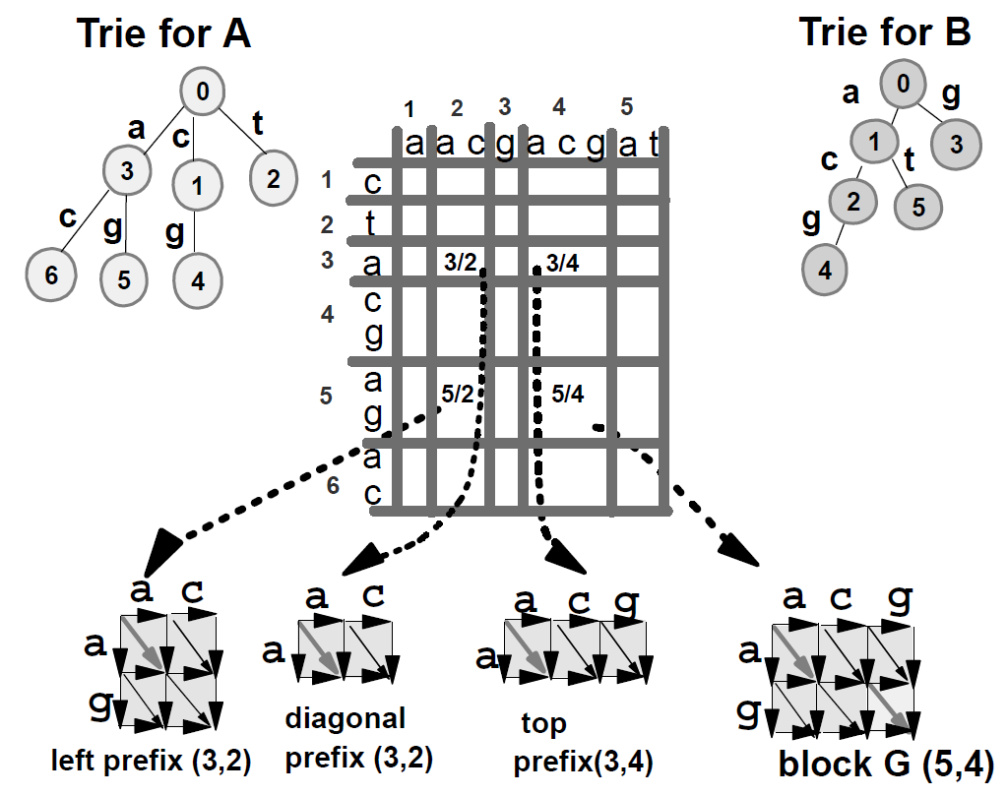

Slide 41
DIST
 |  |  |  | 0 | 1 | 2 | 3 | 4 | 5
 |  |  | 0 | 0 | -1 | -2 | -3 | ∆ | ∆
 |  |  | 1 | -1 | -1 | -2 | -1 | -3 | ∆
 |  |  | 2 | -2 | 0 | 0 | 1 | -1 | -3
 |  |  | 3 | ∆ | -2 | -2 | 0 | -2 | -2
 |  |  | 4 | ∆ | ∆ | -2 | 0 | -1 | -1
 |  |  | 5 | ∆ | ∆ | ∆ | -2 | -1 | 0

Slide 43
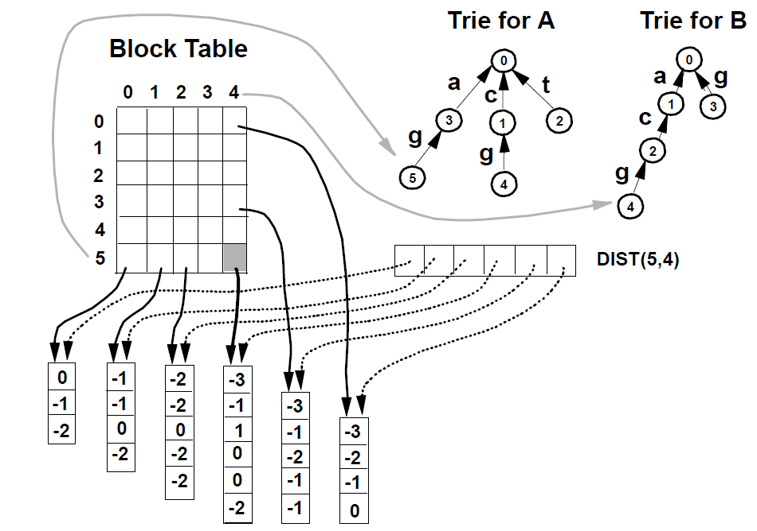
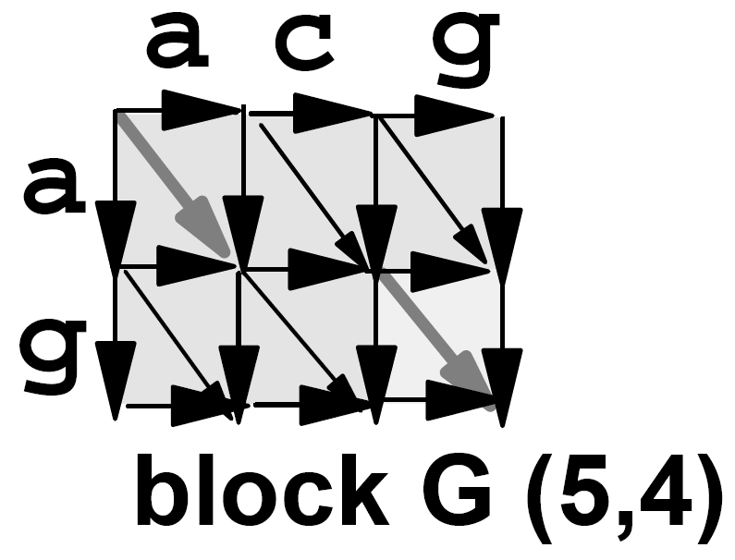

Slide 44
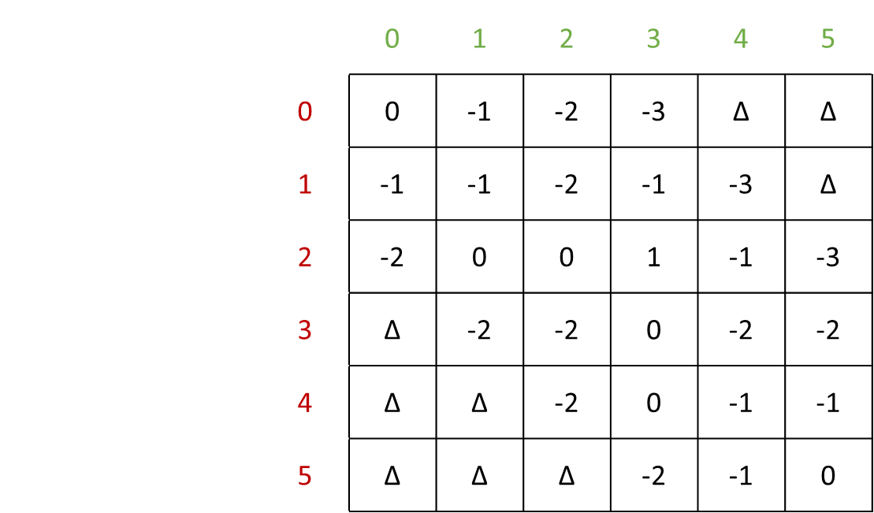
DIST

Slide 45
BlockTable(5, 4)
I₂
I₃
I₄
I₅
0
1
2
3
4
5
-3
-1
1
0
0
-2
I₁
I₀

Slide 46
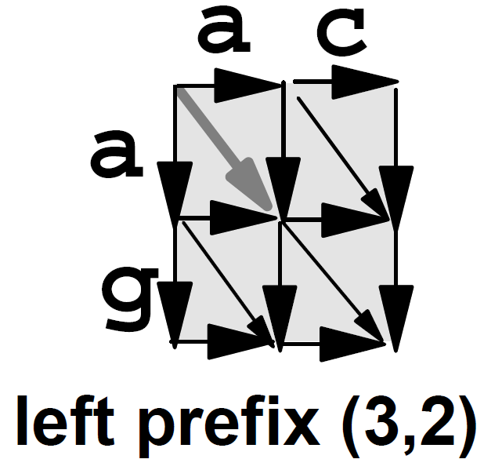
BlockTable(5, 2)
I₂
I₃
I₄
0
1
2
3
4
-2
-2
0
-2
-2
I₁
I₀
(5,

Slide 47
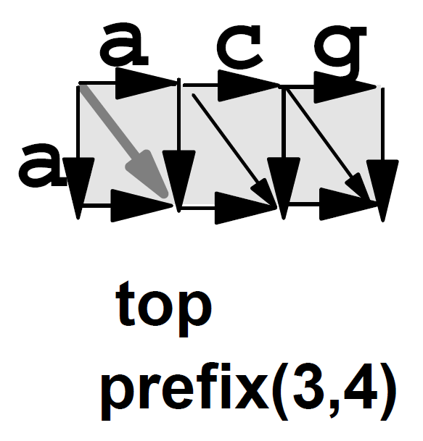
I₁
I₂
I₃
I₄
BlockTable(3, 4)
0
1
2
3
4
-3
-1
-2
-1
-1
I₀

Slide 49
╳

Slide 50
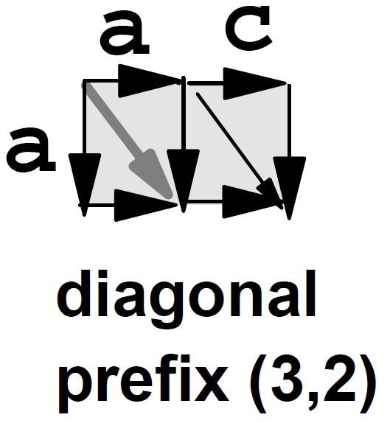
-2
0
-1
-1
-3
-1
-2
-1
-1
I₀
-2
-2
0
-2
-2
-3
-1
1
0
0
-2
I₁
I₀

Slide 51
 | left prefix | diagonal prefix | top prefix | G
0 | -2-1 | ∆ | ∆ | -3
1 | -2-1 | -2+1 | -3-1 | -1
2 | 0-1 | 0+1 | -1-1 | 1
3 | -2-1 | -1+1 | -2-1 | 0
4 | -2-1 | -1+1 | -1-1 | 0
5 | ∆ | ∆ | -3-1 | -2

Slide 53
 | a | a | c | g | a | c | g | a
c
t
a
c
g
a
g
a
O(hn²/log n) Time and Space, 0 < h ≦ 1

Slide 54
 | a | a | c | g | a | c | g | a
c
t
a
c
g
a
g
a
O(hn²/log n) Time and Space, 0 < h ≦ 1

Slide 55
On the Common Substring
Alignment Problem, Journal
of Algorithms, 2001
Lempel–Ziv
Compression
① {
Encoding O(n²)
Alignment O(n)
② {
Encoding O(n|Y|)
Alignment O(n)
A Sub-quadratic Sequence Alignment Algorithm for
Unrestricted Scoring Matrices, SIAM J. COMPUT., 2003
① + LZ O(hn²/log n) Time and Space
② + LZ O(hn²/log n) Time, O(h²n²/(log n)²) Space

Slide 56
DIST
DELTA
 |  |  |  | 0 | 1 | 2 | 3 | 4 | 5
 |  |  | 0 | 0 | -1 | -2 | -3 | ∆ | ∆
 |  |  | 1 | -1 | -1 | -2 | -1 | -3 | ∆
 |  |  | 2 | -2 | 0 | 0 | 1 | -1 | -3
 |  |  | 3 | ∆ | -2 | -2 | 0 | -2 | -2
 |  |  | 4 | ∆ | ∆ | -2 | 0 | -1 | -1
 |  |  | 5 | ∆ | ∆ | ∆ | -2 | -1 | 0
 |  |  |  | 0 | 1 | 2 | 3 | 4 | 5
 |  |  | 0 | ∆ | -1 | -1 | -1 | ∆ | ∆
 |  |  | 1 | ∆ | 0 | -1 | 1 | -2 | ∆
 |  |  | 2 | ∆ | 2 | 0 | 1 | -2 | -2
 |  |  | 3 | ∆ | ∆ | 0 | 2 | -2 | 0
 |  |  | 4 | ∆ | ∆ | ∆ | 2 | -1 | 0
 |  |  | 5 | ∆ | ∆ | ∆ | ∆ | 1 | 1
BorderlinePoints
 |  |  |  | 0 | 1 | 2 | 3 | 4 | 5
 |  |  | 1 | ∆ | 0 | 1 | 0 | 3 | 2
 |  |  | 2 | ∆ | 1 | ∆ | 0 | 4 | 2
 |  |  | 3 | ∆ | 1 | ∆ | 2 | 4 | 4

Slide 57
BorderlinePoints O(Ψn) Space, Ψ: const.
All Highest Scoring Path In Weighted Grid Graphs and Their
Application To Finding Approximate Repeats In Strings,
SIAM J. COMPUT., 1998
On the Common Substring
Alignment Problem, Journal
of Algorithms, 2001
② {
Encoding O(n|Y|)
Alignment O(n)
Incremental Tree Set Union Algorithm,
A Linear Time Algorithm for a Special Case of Disjoint Set Union,
J. Comput. Syetem Sci., 1985

Slide 58
O(hn²/log n) Time, O(h²n²/(log n)²) Space

