Slide 1
A Decision-Theoretic Generalization of On-Line Learning and an Application to Boosting
Yoav Freund and Robert E. Schapire
journal of computer and system sciences, Vol. 55, pp. 119-139, 1997
Reported by Chiou-Yi Hor
2015-03-16

Slide 2
Gödel Prize
哥德爾獎是以著名的邏輯學家庫爾特·哥德爾命名的獎項，由歐洲理論計算機協會（European Association for Theoretical Computer Science，簡稱EATCS）與美國計算機協會（Association of Computing Machinery，簡稱ACM）的ACM SIGACT（Special Interest Group on Algorithms and Computation Theory）共同頒發。這個獎項是獎勵給在理論計算機科學領域中優秀論文的作者。
http://en.wikipedia.org/wiki/G%C3%B6del_Prize

Slide 3
Abstract - 1
In the first part of the paper we consider the problem of dynamically apportioning resources among a set of options in a worst-case on-line framework. The model we study can be interpreted as a broad, abstract extension of the well-studied on-line prediction model to a general decision-theoretic setting. We show that the multiplicative weight- update Littlestone-Warmuth rule can be adapted to this model, yielding bounds that are slightly weaker in some cases, but applicable to a considerably more general class of learning problems. We show how the resulting learning algorithm can be applied to a variety of problems, including gambling, multiple-outcome prediction, repeated games, and prediction of points in R^n .

Slide 4
Abstract - 2
In the second part of the paper we apply the multiplicative weight-update technique to derive a new boosting algorithm. This boosting algorithm does not require any prior knowledge about the performance of the weak learning algorithm. We also study generalizations of the new boosting algorithm to the problem of learning functions whose range, rather than being binary, is an arbitrary finite set or a bounded segment of the real line.

Slide 5
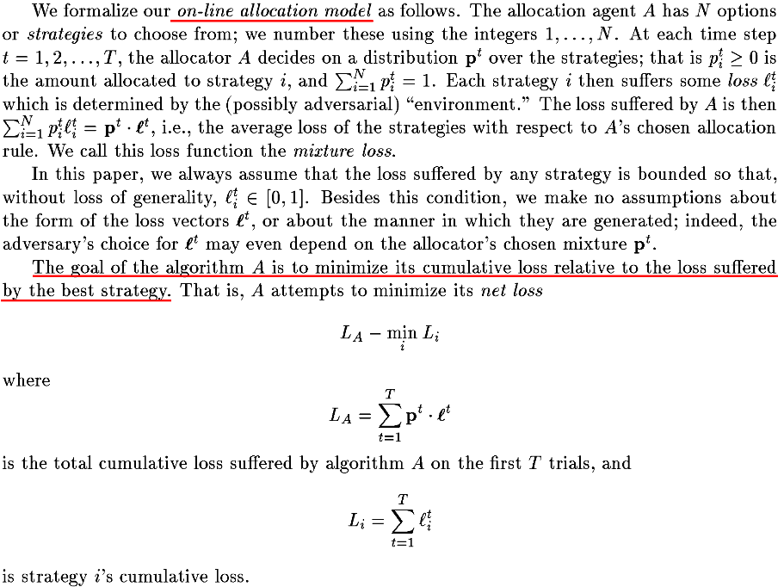
On-line allocation model

Slide 6
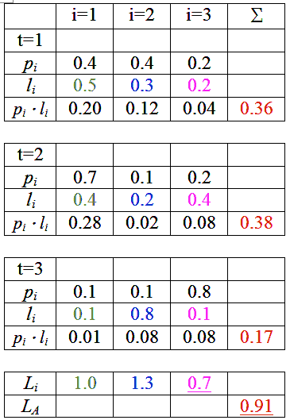
調整p^{t}_{i}使得L_{A}與最小之L_{i}差距越小越好
假設
t=1時(甚麼都看不到)，(剛好)選i=3，
t=2時，選i=3(發現t=1,i=3時有最小Loss)，
t=3時，選i=2 (發現t=2,i=2時有最小Loss) ，
則總Loss為1.8

Slide 7
Majority vote
Assume we have three independent but weak (better than randomly guessing) classifiers, each achieves a classification rate of 60%. The final output is obtained by a majority voting scheme.
The probability to make mistakes is:
  0.6*0.4*0.4 = 9.6%
  0.4*0.6*0.4 = 9.6%
  0.4*0.4*0.6 = 9.6%
  0.4*0.4*0.4 = 6.4%
The overall classification rate is: 1-3*9.6%-6.4% = 64.8%.
The analysis about majority vote can be obtained from
Ofer Matan, On Voting Ensembles of Classifiers, In Proceedings of AAAI-96 workshop on Integrating Multiple Learned Models

Slide 8
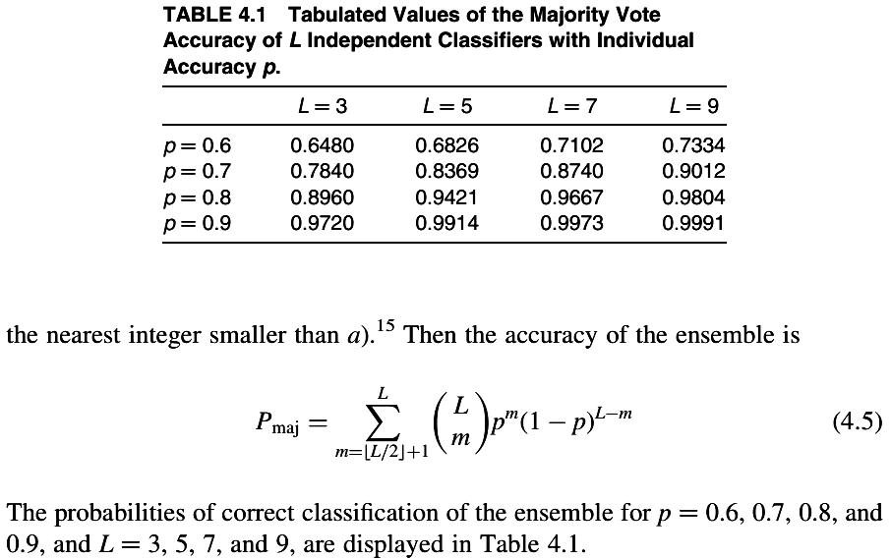
Majority vote
Ludmila I. Kuncheva, "Combining Pattern Classifiers: Methods and Algorithms"
http://www.ccas.ru/voron/download/books/machlearn/kuncheva04combining.pdf

Slide 9
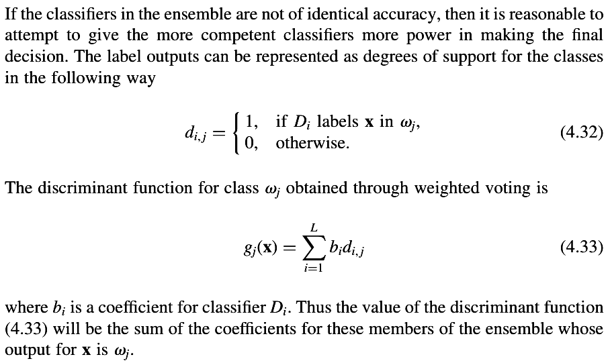
Weighted majority vote
Ludmila I. Kuncheva, "Combining Pattern Classifiers: Methods and Algorithms"
http://www.ccas.ru/voron/download/books/machlearn/kuncheva04combining.pdf

Slide 10
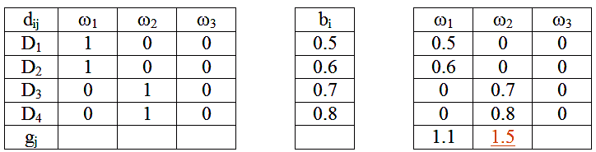
Weighted majority vote
A 3-class and 4-classifier example:

Slide 11
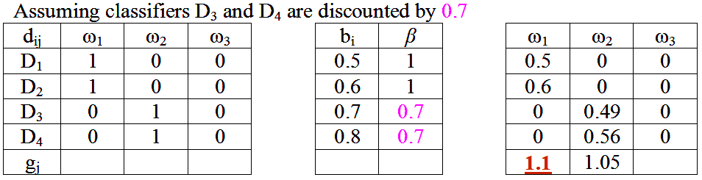
Littlestone-Warmuth rule for the weighted majority algorithm (WMA)
The compound algorithm collects weighted votes from all the algorithms in the pool. If the compound algorithm makes a mistake, the algorithms in the pool that contributed to the wrong predicting will be discounted by a certain ratioβ where 0<β<1.
http://en.wikipedia.org/wiki/Weighted_Majority_Algorithm

Slide 12
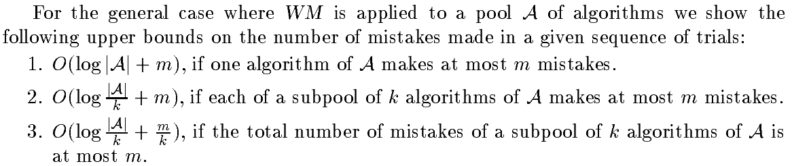
Littlestone-Warmuth rule for the weighted majority algorithm (WMA)
It can be shown that the upper bounds on the number of mistakes made in a given sequence of predictions from a pool of algorithms A is O(log|A|+m) if one algorithm in Xi makes at most m mistakes.
Littlestoneet al., "The Weighted Majority Algorithm"

Slide 13
Littlestone-Warmuth rule for the weighted majority algorithm (WMA)
The final performances of the compound algorithm is bounded by a function of the performance of the specialist (best performing algorithm) in the pool.
Littlestoneet al., "The Weighted Majority Algorithm"

Slide 14
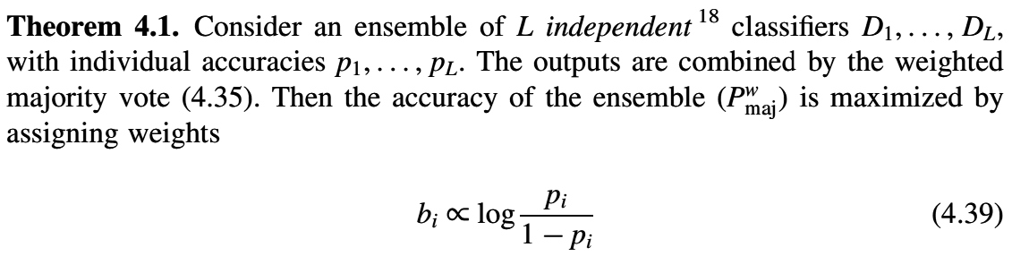
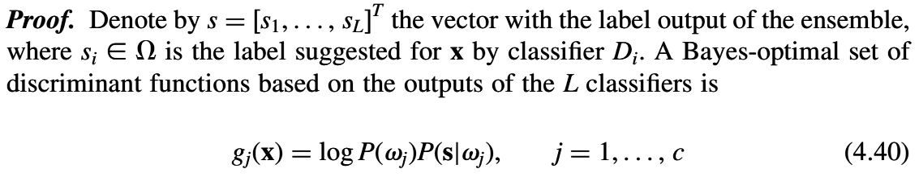
Weight settings for WMA
Ludmila I. Kuncheva, "Combining Pattern Classifiers: Methods and Algorithms"
http://www.ccas.ru/voron/download/books/machlearn/kuncheva04combining.pdf

Slide 15
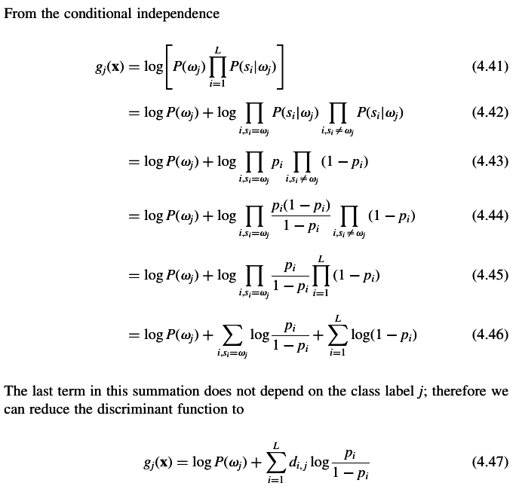
Ludmila I. Kuncheva, "Combining Pattern Classifiers: Methods and Algorithms"
http://www.ccas.ru/voron/download/books/machlearn/kuncheva04combining.pdf

Slide 16
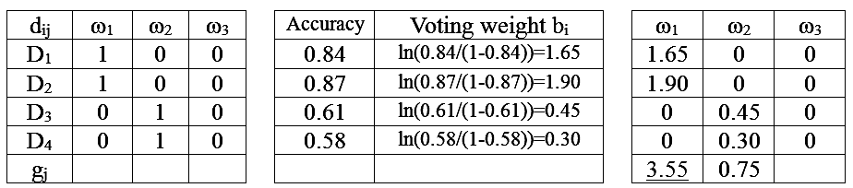
Example for WMA

Slide 17
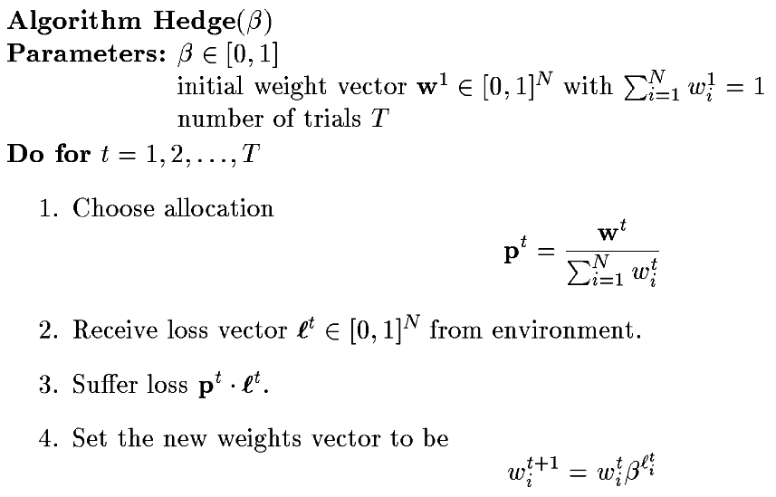
Hedge algorithm
將hypothesis之權重進行正規化
以正規化後權重與對應Loss進行加權平均
根據hypothesis的loss對其權重進行更新，若hypothesis的loss越大，其接下來的權重將越小

Slide 18
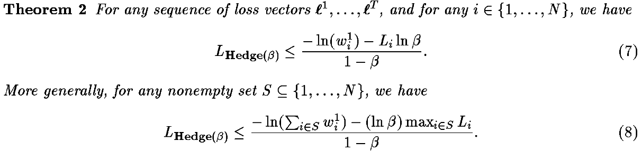

Hedge algorithm for the on-line allocation problem
The simpler bound (7) holds for all i and states that Hedge(β) does not perform "too much worse" than the best strategy i for the sequence. ∵0<β<1, ∴ln(β)<0 and –Li/(1-β)*ln(β)>0
If each weight is set equally so that w¹_{i} =1/N, then this bound becomes

Slide 19
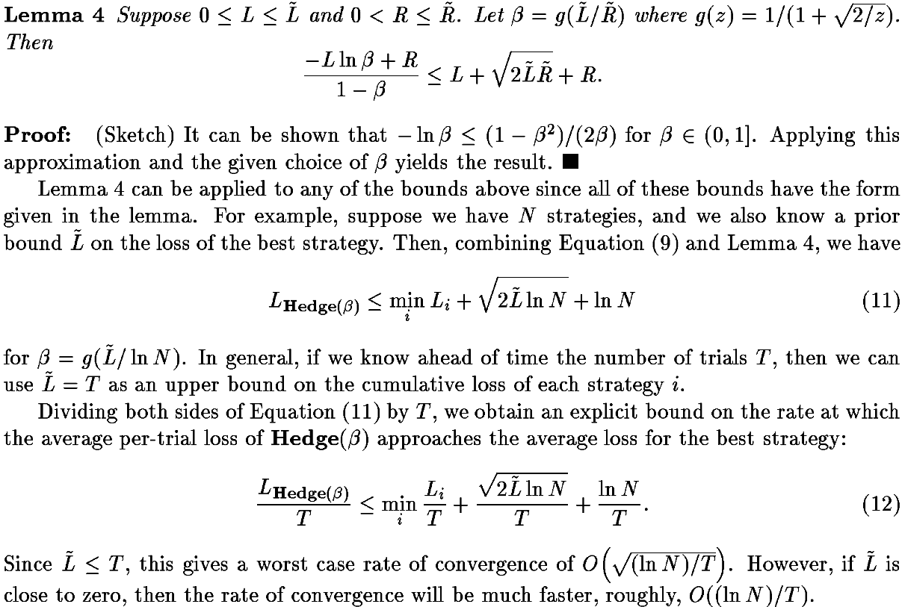
選擇合適的β，則Loss如 (11)

Slide 20
Weak and strong learner
A weak learner is defined to be a classifier which is only slightly correlated with the true classification (it can label examples better than random guessing).
A strong learner is a classifier that is arbitrarily well-correlated with the true classification.
http://en.wikipedia.org/wiki/Boosting_(machine_learning)

Slide 21
Boosting algorithm
A family of machine learning algorithms which convert weak learners to strong ones.
Limitations for previous algorithms like WMA
  Needs prior knowledge about the (least accurate) weak learners
  Not focus on data instances that are difficult to learn (the data distribution is not altered)
  Not takes advantage of hypotheses computed by weak learners whose errors are significantly smaller than the presumed worst-case bias of ½-γ, where γ>0. (β is a constant not a function of error)
The authors propose AdaBoost (adaptive boosting)!

Slide 22
AdaBoost variants
AdaBoost: for binary classification
AdaBoost.M1: for multi-class classification with hard loss {0,1}
AdaBoost.M2: for multi-class classification with soft pseudo-loss
AdaBoost.R: for regression

Slide 23
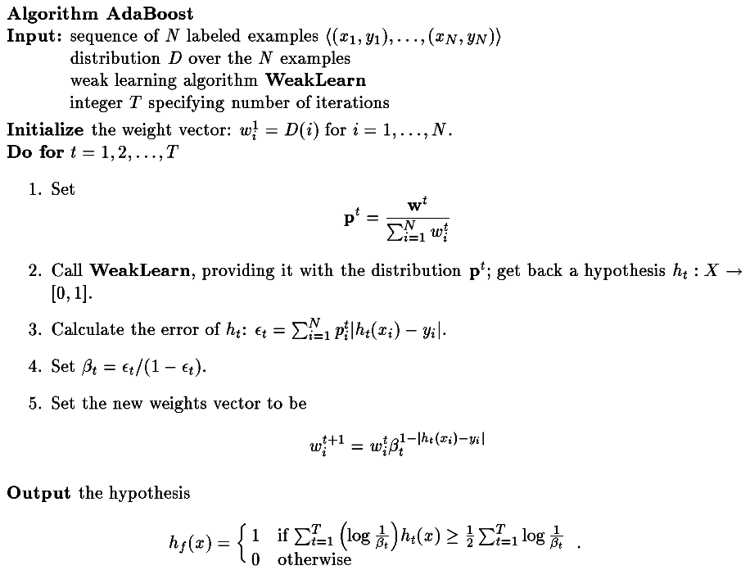
分類器輸出值越接近1，表示越可能是類別1
當分類錯誤時，絕對值為1
當分類正確時，絕對值為0
計算hypothesis的權重
每一資料i均對應一權重。當分類正確時，權重下降。
把所有hypothesis的輸出進行加權平均，權重為-log(β)

Slide 24


Train classifier1
h₁
classified , weight ↓
test
unclassified
Training Data
-log(β₁)
Testing Data
-log(β₂)
Train classifier2
h₂
Final classifier
h_{f}
…
Σ
-log(β_{T})
The final classifier is the weighted combination of D1, D2, ...
Output

Slide 25
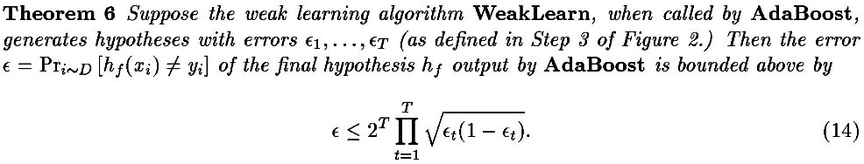
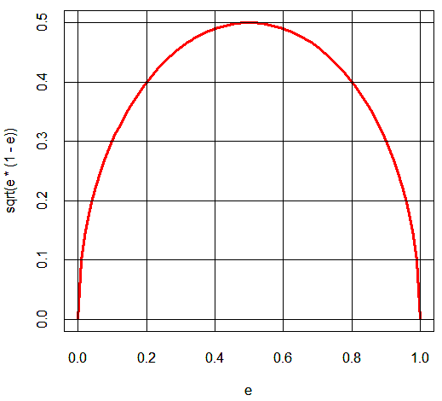

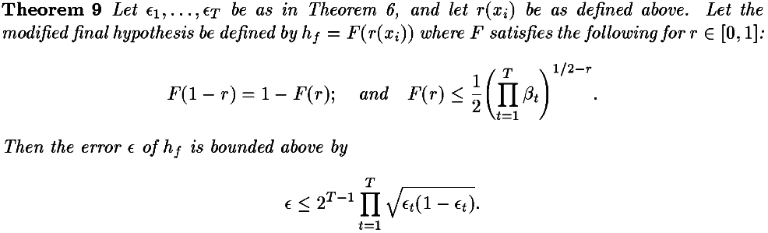
Error bound for AdaBoost

Slide 26
VC (Vapnik Chernovenkis) Dimension
The VC dimension of the class {f(x, a)} is defined to be the largest number of points (in some configuration) that can be shattered[打碎, 粉碎, 使散開] by members of {f(x, a)}.
The Vapnik Chernovenkis dimension is a way of measuring the complexity of a class of functions by assessing how wiggly[扭動的; 蠕動的; 左右搖擺的] its members can be.
One can use the VC dimension in constructing an estimate of in-sample prediction error.
Taken from the textbook: The elements of statistical learning
http://web.stanford.edu/~hastie/local.ftp/Springer/OLD/ESLII_print4.pdf

Slide 27
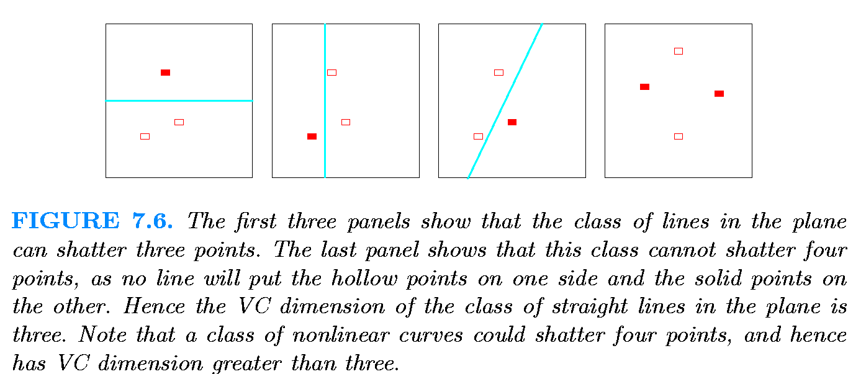
VC Dimension
In general, a linear indicator function in p dimensions has VC dimension p + 1, which is also the number of free parameters.
Taken from the textbook: The elements of statistical learning
http://web.stanford.edu/~hastie/local.ftp/Springer/OLD/ESLII_print4.pdf

Slide 28
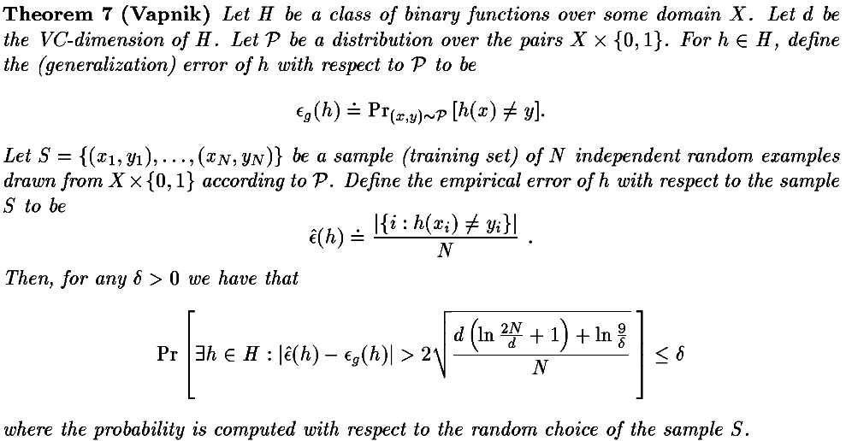
VC Dimension and generalization error
The generalization error of a machine learning model is a function that measures how well a learning machine generalizes to unseen data.

Slide 29
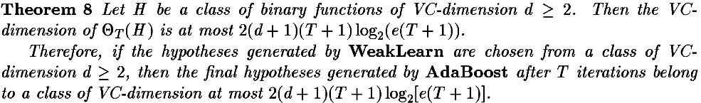
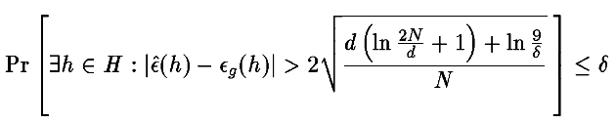
VC Dimension for AdaBoost

Slide 30
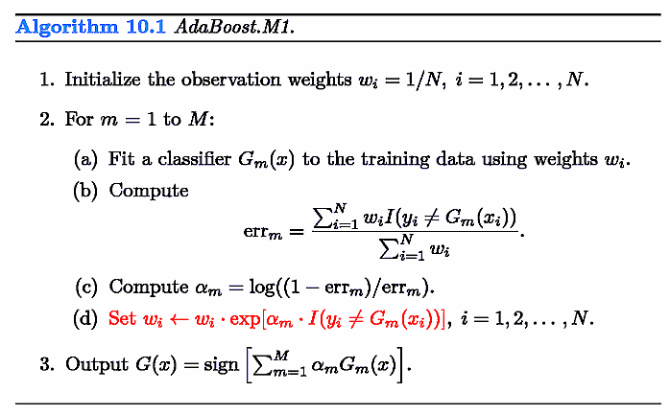
AdaBoost
觀察某一訓練資料在AdaBoost訓練時出現狀況
第一輪0個，第一輪錯
第二輪2個，第二輪錯
第三輪6個，第三輪錯
第四輪11個，第四輪對
第五輪4個，第五輪錯
第六輪6個，第六輪錯
第七輪10個，第七輪對
第八輪8個，第八輪對
第九輪3個，第九輪錯
當某資料被分類錯誤時，其在下一輪加入訓練的次數會增加
Taken from the textbook: The elements of statistical learning
http://web.stanford.edu/~hastie/local.ftp/Springer/OLD/ESLII_print4.pdf
Notes:
x <- cbind(rep(seq(0,10,.2),each=51),rep(seq(0,10,.2),51))
cl <- apply(x,1,function(x) if((x[1]-x[2])>=0) "C1" else "C2")
col <- rep("blue",dim(x)[1])
col[which(cl=="C1")] <- "red"
plot(x,type='p',xlab="x1",ylab="x2",col=col,main="Original data")
x<-data.frame(x1=x[,1],x2=x[,2],class=cl)
ad <- adaboost.M1(class~.,x,mfinal=10)
for(i in 1:length(ad$trees)){
pred <- predict(ad$trees[[i]],x,type="class")
col <- rep("blue",dim(x)[1])
col[which(pred=="C1")] <- "red"
str <- sprintf("Classifier %i output, error: %f, weight: %f",
i,sum(pred!=x[,3])/dim(x)[1],ad$weights[i])
print(str)
x11()
plot(x[,1:2],type='p',xlab="x1",ylab="x2",col=col,main=str)
}
pred <- predict(ad,x)$class
col <- rep("blue",dim(x)[1])
col[which(pred=="C1")] <- "red"
str <- sprintf("Classifier 1~%i output, error: %f",
length(ad$trees),sum(pred!=x[,3])/dim(x)[1])
print(str)
x11()
plot(x[,1:2],type='p',xlab="x1",ylab="x2",col=col,main=str)

Slide 31
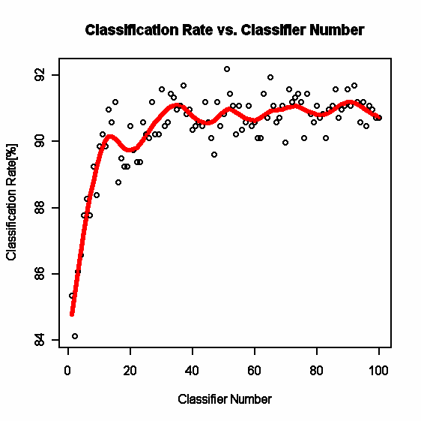
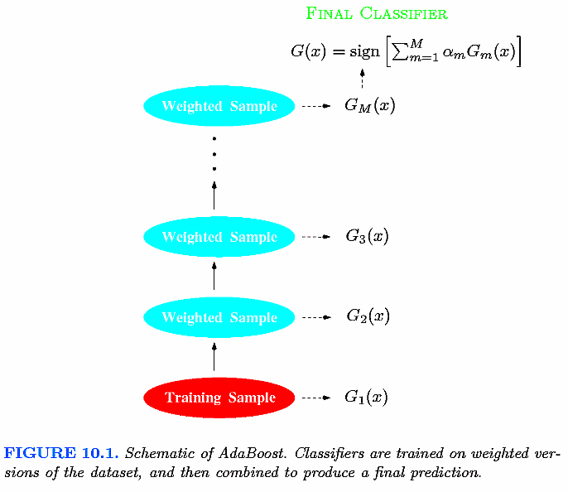
Adaboost
Taken from the textbook: The elements of statistical learning
http://web.stanford.edu/~hastie/local.ftp/Springer/OLD/ESLII_print4.pdf

Slide 32
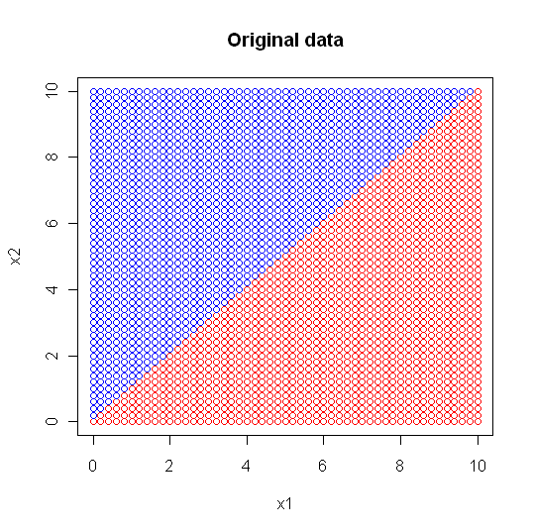
Adaboost
"Classifier 1 output, error: 0.132257, weight: 0.940575"
"Classifier 2 output, error: 0.217993, weight: 0.638700"
"Classifier 3 output, error: 0.129950, weight: 0.950700"
"Classifier 4 output, error: 0.129950, weight: 0.950700"
"Classifier 5 output, error: 0.190311, weight: 0.723994"
"Classifier 6 output, error: 0.259516, weight: 0.524244"
"Classifier 7 output, error: 0.348328, weight: 0.313199"
"Classifier 8 output, error: 0.328335, weight: 0.357862"
"Classifier 9 output, error: 0.384083, weight: 0.236127"
"Classifier 10 output, error: 0.209919, weight: 0.662706"
Notes:
[1] "Classifier 1 output, error: 0.132257, weight: 0.940575"
[1] "Classifier 2 output, error: 0.217993, weight: 0.638700"
[1] "Classifier 3 output, error: 0.129950, weight: 0.950700"
[1] "Classifier 4 output, error: 0.129950, weight: 0.950700"
[1] "Classifier 5 output, error: 0.190311, weight: 0.723994"
[1] "Classifier 6 output, error: 0.259516, weight: 0.524244"
[1] "Classifier 7 output, error: 0.348328, weight: 0.313199"
[1] "Classifier 8 output, error: 0.328335, weight: 0.357862"
[1] "Classifier 9 output, error: 0.384083, weight: 0.236127"
[1] "Classifier 10 output, error: 0.209919, weight: 0.662706"

Slide 33
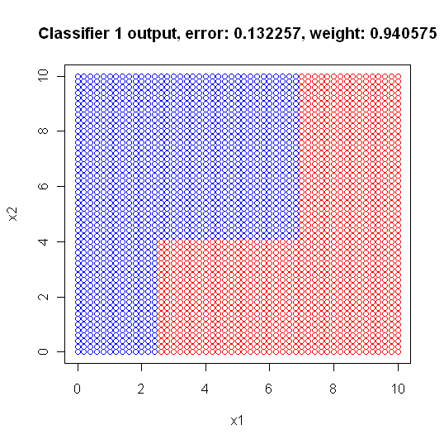
Adaboost
1) root 2601 1300 C1 (0.50019223 0.49980777)
2) x2< 4.1 1041 187 C1 (0.82036503 0.17963497)
4) x1>=2.5 801 30 C1 (0.96254682 0.03745318) *
5) x1< 2.5 240 83 C2 (0.34583333 0.65416667) *
3) x2>=4.1 1560 447 C2 (0.28653846 0.71346154)
6) x1>=6.9 495 130 C1 (0.73737374 0.26262626) *
7) x1< 6.9 1065 82 C2 (0.07699531 0.92300469) *
"

Slide 34
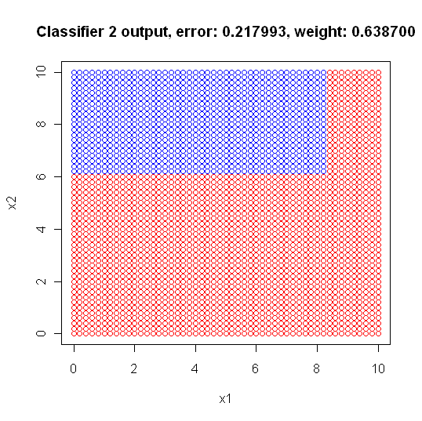
Adaboost
1) root 2601 1276 C1 (0.50941945 0.49058055)
2) x2< 6.1 1557 405 C1 (0.73988439 0.26011561) *
3) x2>=6.1 1044 173 C2 (0.16570881 0.83429119)
6) x1>=8.3 188 75 C1 (0.60106383 0.39893617) *
7) x1< 8.3 856 60 C2 (0.07009346 0.92990654) *

Slide 35
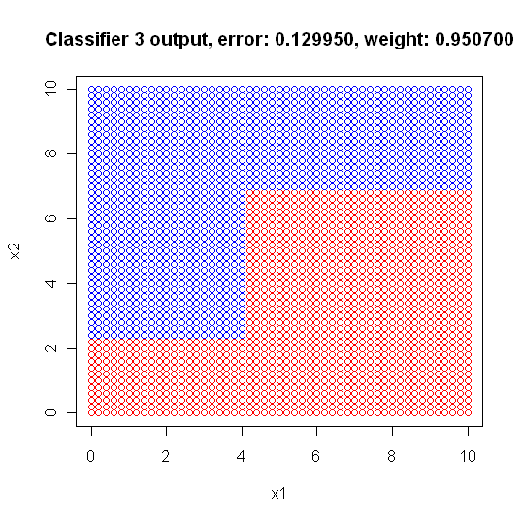
Adaboost
1) root 2601 1181 C2 (0.45405613 0.54594387)
2) x1>=4.1 1461 516 C1 (0.64681725 0.35318275)
4) x2< 6.9 936 83 C1 (0.91132479 0.08867521) *
5) x2>=6.9 525 92 C2 (0.17523810 0.82476190) *
3) x1< 4.1 1140 236 C2 (0.20701754 0.79298246)
6) x2< 2.3 286 81 C1 (0.71678322 0.28321678) *
7) x2>=2.3 854 31 C2 (0.03629977 0.96370023) *

Slide 36
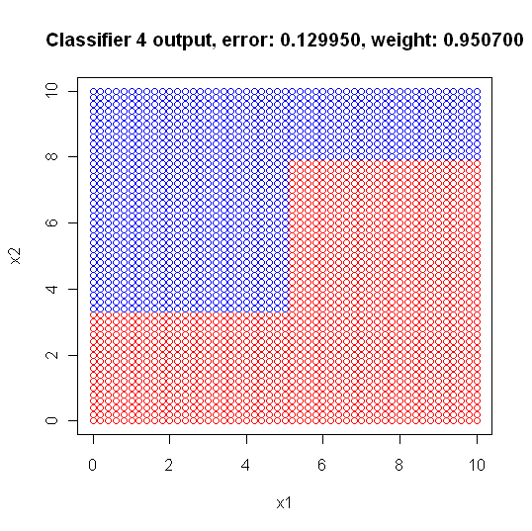
Adaboost
1) root 2601 1185 C2 (0.45559400 0.54440600)
2) x1>=5.1 1207 359 C1 (0.70256835 0.29743165)
4) x2< 7.9 840 97 C1 (0.88452381 0.11547619) *
5) x2>=7.9 367 105 C2 (0.28610354 0.71389646) *
3) x1< 5.1 1394 337 C2 (0.24175036 0.75824964)
6) x2< 3.3 557 254 C1 (0.54398564 0.45601436) *
7) x2>=3.3 837 34 C2 (0.04062127 0.95937873) *

Slide 37
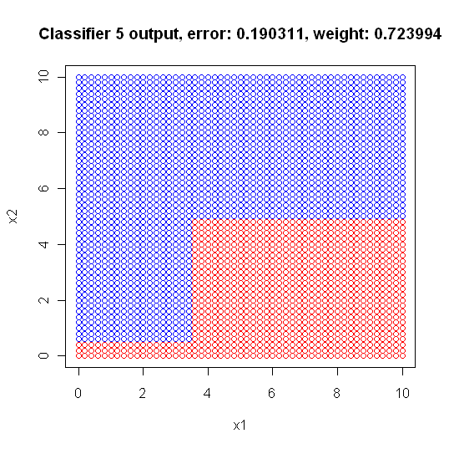
Adaboost
1) root 2601 1085 C2 (0.41714725 0.58285275)
2) x1>=3.5 1518 574 C1 (0.62187088 0.37812912)
4) x2< 4.9 496 26 C1 (0.94758065 0.05241935) *
5) x2>=4.9 1022 474 C2 (0.46379648 0.53620352) *
3) x1< 3.5 1083 141 C2 (0.13019391 0.86980609)
6) x2< 0.5 68 21 C1 (0.69117647 0.30882353) *
7) x2>=0.5 1015 94 C2 (0.09261084 0.90738916) *

Slide 38
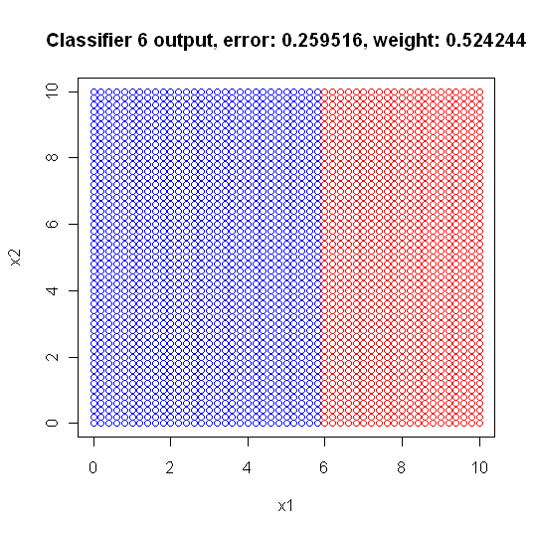
Adaboost
1) root 2601 1268 C1 (0.5124952 0.4875048)
2) x1>=5.9 1105 206 C1 (0.8135747 0.1864253) *
3) x1< 5.9 1496 434 C2 (0.2901070 0.7098930) *

Slide 39
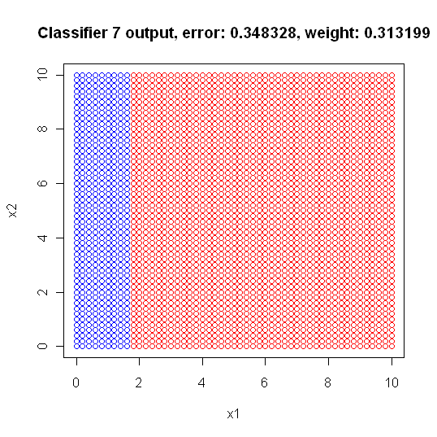
Adaboost
1) root 2601 1240 C1 (0.5232603 0.4767397)
2) x1>=1.7 2067 787 C1 (0.6192550 0.3807450) *
3) x1< 1.7 534 81 C2 (0.1516854 0.8483146) *

Slide 40
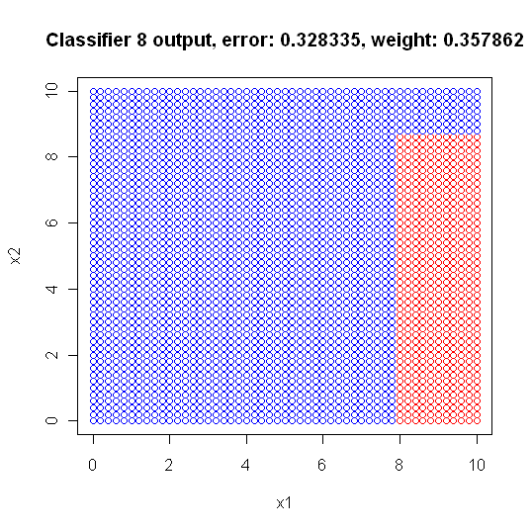
Adaboost
1) root 2601 1254 C2 (0.48212226 0.51787774)
2) x1>=7.9 619 141 C1 (0.77221325 0.22778675)
4) x2< 8.7 391 13 C1 (0.96675192 0.03324808) *
5) x2>=8.7 228 100 C2 (0.43859649 0.56140351) *
3) x1< 7.9 1982 776 C2 (0.39152371 0.60847629) *

Slide 41
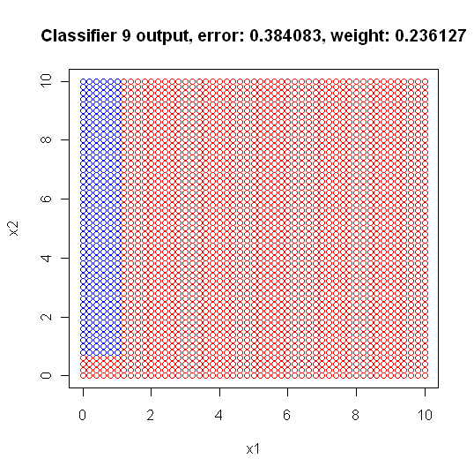
Adaboost
1) root 2601 1144 C1 (0.56016917 0.43983083)
2) x1>=1.1 2296 892 C1 (0.61149826 0.38850174) *
3) x1< 1.1 305 53 C2 (0.17377049 0.82622951)
6) x2< 0.7 63 23 C1 (0.63492063 0.36507937) *
7) x2>=0.7 242 13 C2 (0.05371901 0.94628099) *

Slide 42
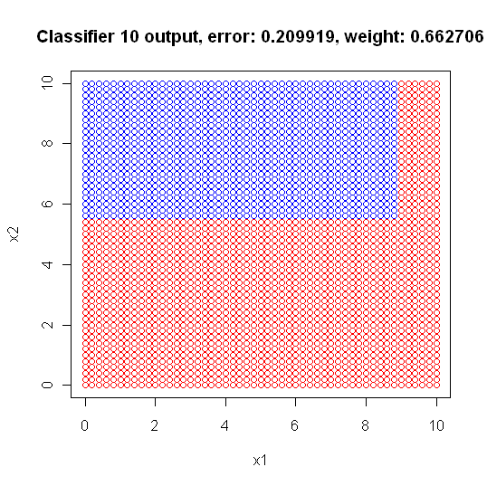
Adaboost
1) root 2601 1253 C1 (0.5182622 0.4817378)
2) x1>=8.9 335 35 C1 (0.8955224 0.1044776) *
3) x1< 8.9 2266 1048 C2 (0.4624890 0.5375110)
6) x2< 5.5 1302 503 C1 (0.6136713 0.3863287) *
7) x2>=5.5 964 249 C2 (0.2582988 0.7417012) *

Slide 43
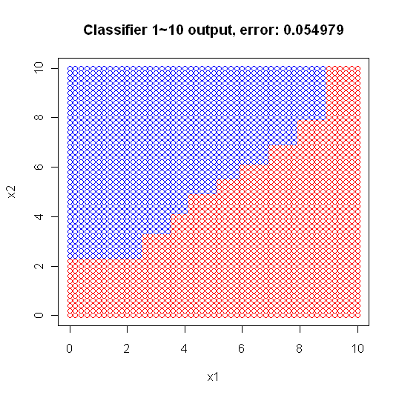
Adaboost - how to classify
input (6.6,6.6)
Classifier 1 output C2, weight: 0.940575
Classifier 2 output C2, weight: 0.638700
Classifier 3 output C1, weight: 0.950700
Classifier 4 output C1, weight: 0.950700
Classifier 5 output C2, weight: 0.723994
Classifier 6 output C1, weight: 0.524244
Classifier 7 output C1, weight: 0.313199
Classifier 8 output C2, weight: 0.357862
Classifier 9 output C1, weight: 0.236127
Classifier 10 output C2, weight: 0.662706
---------------------------------------------
C2:0.940575+0.638700+0.723994+0.357862+0.662706
=3.323837
C1:0.950700+0.950700+0.524244+0.313199+0.236127
2.97497
➔C2

Slide 44
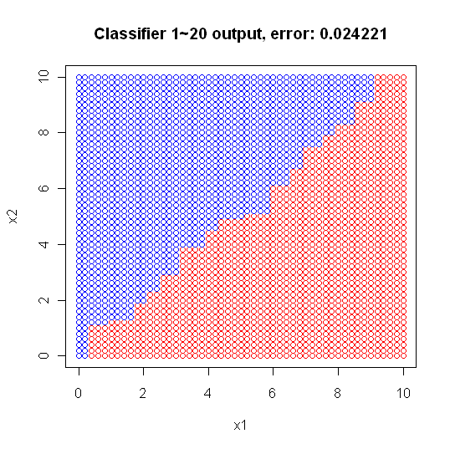
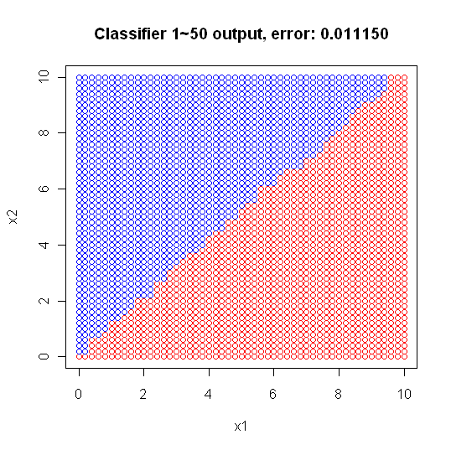
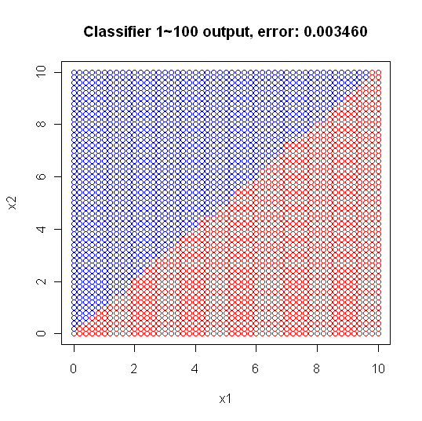
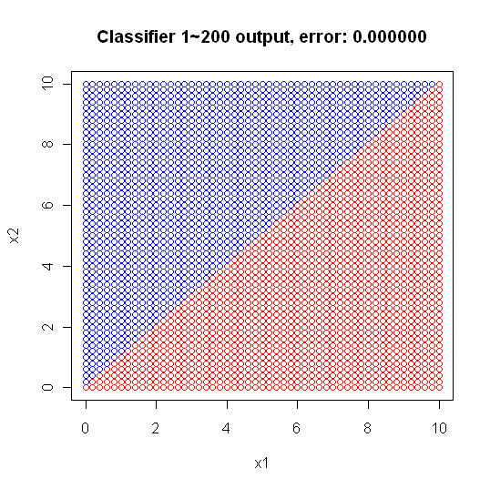
Adaboost

Slide 45
AdaBoost for multi-class problems
y={1,2,…,k}
In the binary case (k=2), a random guess will be correct with probability ½.
When k>2, the probability of a correct random prediction is only 1/k<½. Thus, our requirement that the accuracy of the weak hypothesis be greater than ½ is significantly stronger than simply requiring that the weak hypothesis perform better than random guessing.

Slide 46
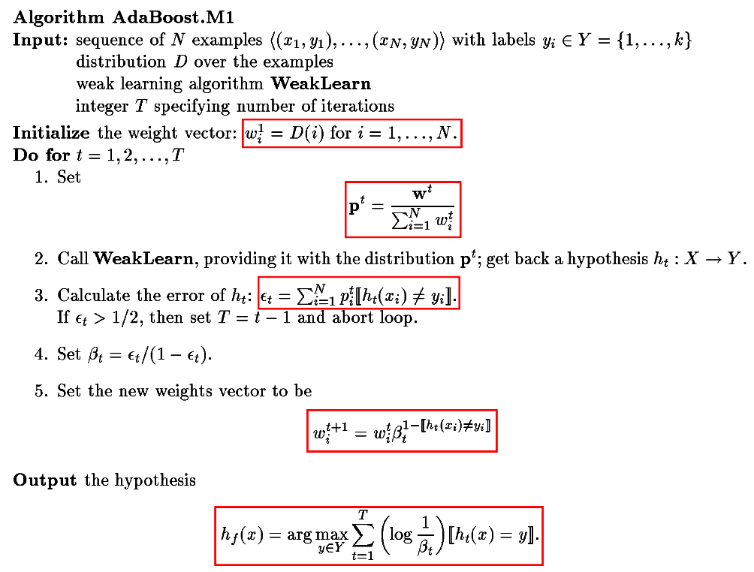
每一資料i均對應一權重
當分類錯誤時，值為1
當分類正確時，值為0
計算hypothesis的權重
每一資料i均對應一權重。當分類正確時，權重下降。
把所有hypothesis的輸出y的信心值進行加權平均，權重為 -log(β)

Slide 47
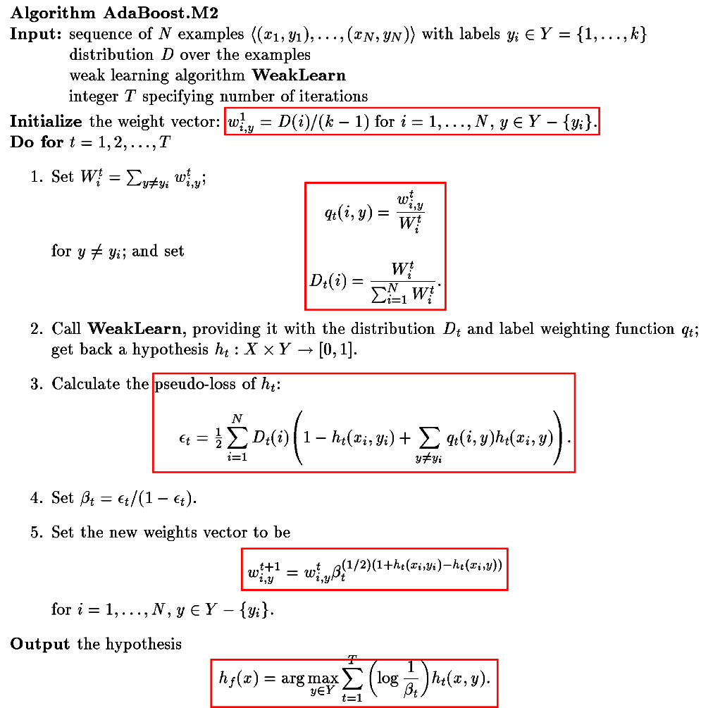
每一資料i均對應(k-1)個權重
當分類錯誤時，值變大，而非為1或0
每一資料i均對應(k-1)個權重。當分類正確時，權重下降。
把所有輸出y的hypothesis的信心值進行加權平均，權重為-log(β)

Slide 48
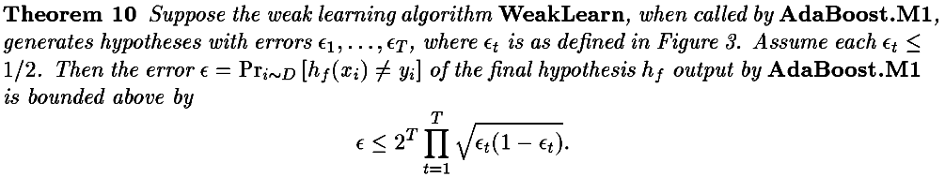
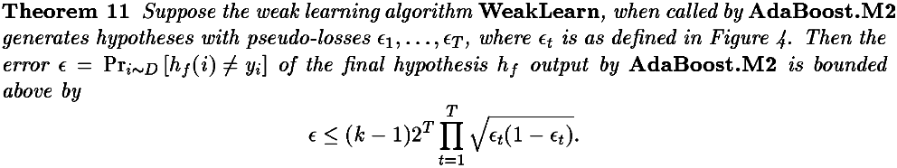
Error bound for AdaBoost.M
It may often be significantly easier to find weak hypotheses with small pseudo-loss rather than hypotheses whose prediction error is small. On the other hand, the theoretical bound for boosting using the prediction error (Theorem 10) is stronger than the bound for ploss (Theorem 11). Empirical tests [12] have shown that pseudo-loss is generally more successful when the weak learners use very restricted hypotheses.

Slide 49
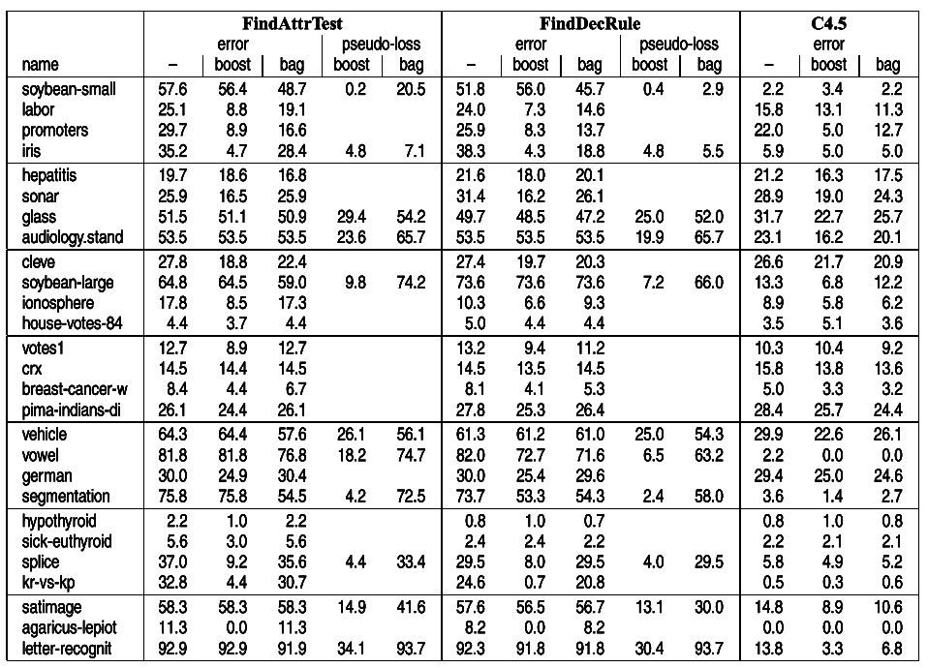
Weak learner1
Weak learner2
AdaBoost.M2
AdaBoost.M1
Yoav Freund et al., “Experiments with a New Boosting Algorithm”

Slide 50
AdaBoost for regression
For each example (x_{i} , y_{i} ) in the training set, we define a continuum[連續, 閉聯集, 連續統] of examples indexed by pairs (i, y) for all y∈[0, 1]: the associated instance is x'_{i,y} =(xi , y), and the label is y'_{i,y} = [[y≧y_{i}]]. (Recall that [[π]] is 1 if predicate π holds and 0 otherwise.). Each instance (x_{i} , y_{i} ) is mapped to an infinite set of binary questions, one for each y∈Y, and each of the form: ‘‘Is the correct label y_{i} bigger or smaller than y?’’

Slide 51
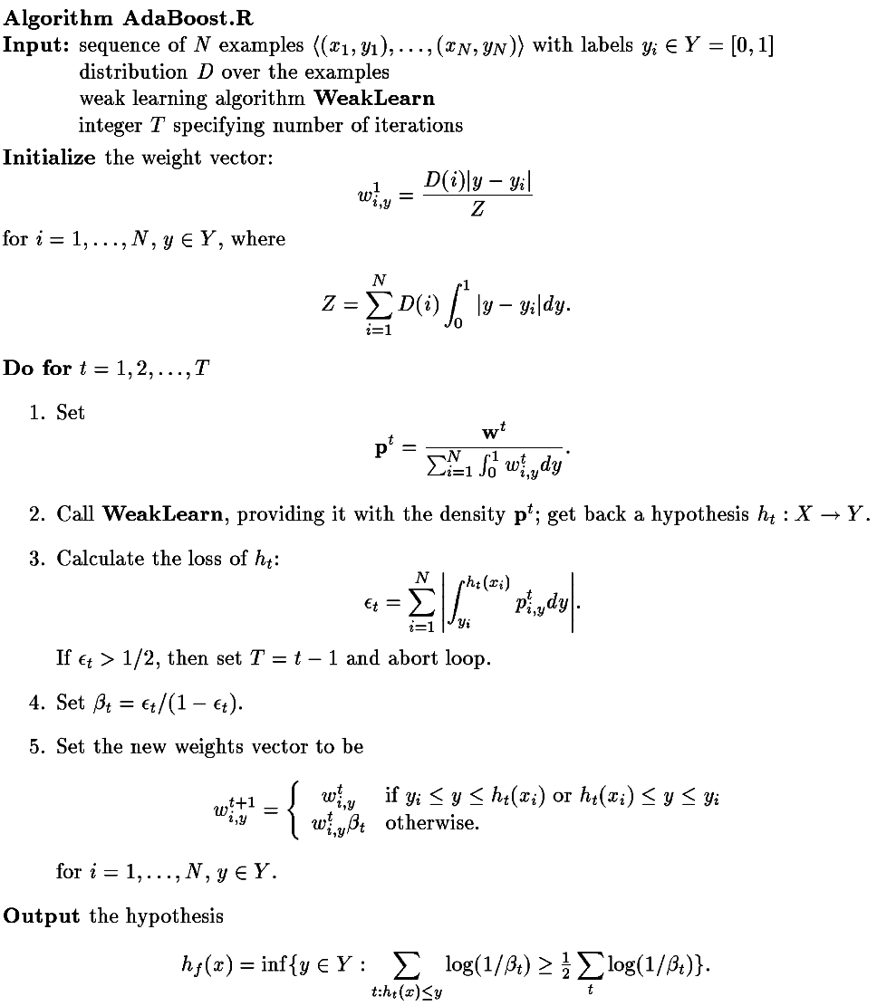
每一資料i均對應|Y|個權重。
計算迴歸誤差
每一資料i均對應|Y|個權重。當h(x_{i})輸出介於某限定範圍內時，權重下降。
把所有輸出y的hypothesis的信心值進行加權平均，以最小y(Inf)當成輸出

Slide 52
Boosting strong classifiers
It depends of the learning dataset to succeed.
The required time and resource for training base classifiers may be the primary motivation for boosting.
http://stats.stackexchange.com/questions/23388/in-boosting-why-are-the-learners-weak
http://stackoverflow.com/questions/17519969/effects-of-boosting-with-strong-classifier`

Slide 53
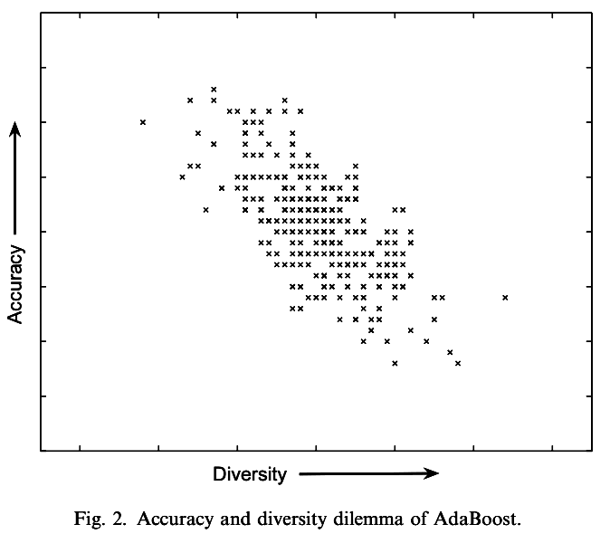
Accuracy/diversity dilemma of AdaBoost
Diversity is known to be an important factor affecting the generalization performance of Ensemble methods, which means that the errors made by different component classifiers should be uncorrelated. The more accurate the two component classifiers become, the less they can disagree with each other.
Xuchun Li et al., “AdaBoost with SVM-based component classifiers”
http://web.eecs.utk.edu/~leparker/Courses/CS425-528-fall10/Handouts/AdaboostSVM(Journal).pdf
Notes:
This diagram is a scatter-plot where each point corresponds to a component classifier. The x coordinate value of a point is the diversity value of the corresponding component classifier while the y coordinate value is the accuracy value of the corresponding component classifier. From this Figure, it can be observed that, if the component classifiers are too accurate, it is difficult to find very diverse ones, and combining these accurate but non-diverse classifiers often leads to very limited improvement (Wind- eatt, 2005). On the other hand, if the component classifiers are too inaccurate, although we can find diverse ones, the combination result may be worse than that of combining both more accurate and diverse component classifiers. This is because if the combination result is dominated by too many inaccurate component classifiers, it will be wrong most of the time, leading to poor classification result. Hence, how could we maximize the diversity under the condition of obtaining a fairly good component classifier accuracy in AdaBoost.
In AdaBoostSVM, the obtained RBFSVM component classifiers are mostly moderately accurate, which gives chances to select more diverse component classifiers. As aforementioned, through adjustment of the sigma value, a set of RBFSVM component classifiers with different learning abilities is obtained. This provides an opportunity of selecting more diverse component classifiers from this set to deal with the accuracy/diversity dilemma. Hence, we proposed a Diverse AdaBoostSVM approach (Table 3), and it is hoped to further improve the generalization performance of AdaBoostSVM.

Slide 54
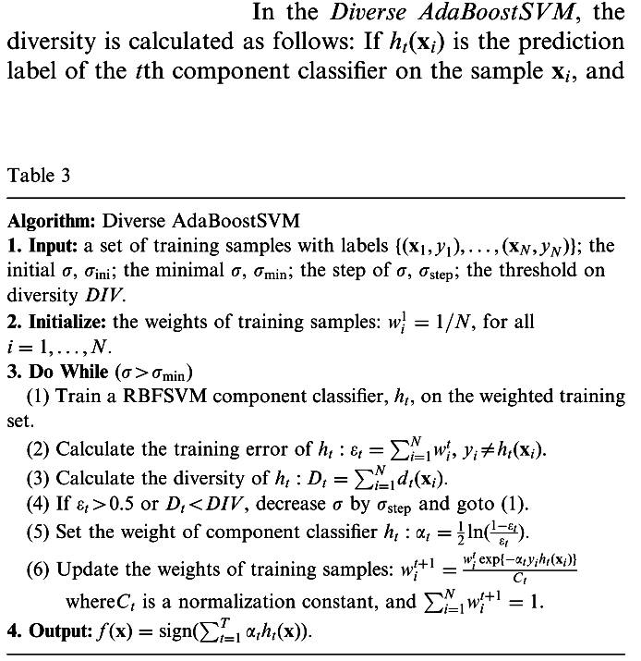
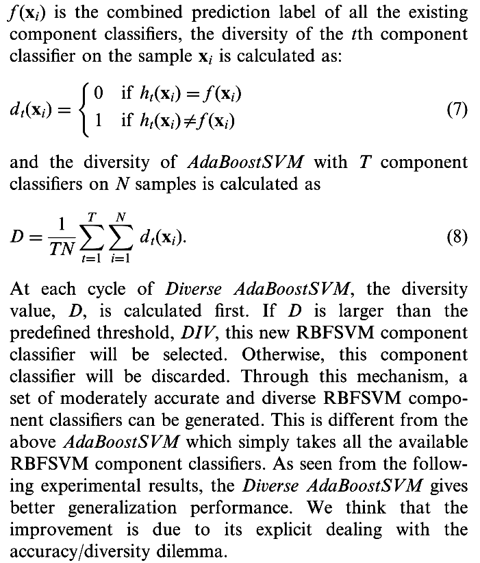
Diversity and AdaBoostSVM
Xuchun Li et al., “AdaBoost with SVM-based component classifiers”
http://web.eecs.utk.edu/~leparker/Courses/CS425-528-fall10/Handouts/AdaboostSVM(Journal).pdf
Notes:
This diagram is a scatter-plot where each point corresponds to a component classifier. The x coordinate value of a point is the diversity value of the corresponding component classifier while the y coordinate value is the accuracy value of the corresponding component classifier. From this Figure, it can be observed that, if the component classifiers are too accurate, it is difficult to find very diverse ones, and combining these accurate but non-diverse classifiers often leads to very limited improvement (Wind- eatt, 2005). On the other hand, if the component classifiers are too inaccurate, although we can find diverse ones, the combination result may be worse than that of combining both more accurate and diverse component classifiers. This is because if the combination result is dominated by too many inaccurate component classifiers, it will be wrong most of the time, leading to poor classification result. Hence, how could we maximize the diversity under the condition of obtaining a fairly good component classifier accuracy in AdaBoost.
In AdaBoostSVM, the obtained RBFSVM component classifiers are mostly moderately accurate, which gives chances to select more diverse component classifiers. As aforementioned, through adjustment of the sigma value, a set of RBFSVM component classifiers with different learning abilities is obtained. This provides an opportunity of selecting more diverse component classifiers from this set to deal with the accuracy/diversity dilemma. Hence, we proposed a Diverse AdaBoostSVM approach (Table 3), and it is hoped to further improve the generalization performance of AdaBoostSVM.

Slide 55



Diversity and AdaBoostSVM
1.h_{t}(x_{i}) is the prediction label of the t’th component classiﬁer on the sample x_{i}
2.f(x_{i}) is the combined prediction label of all the existing component classiﬁers
3.d_{t}(x_{i}) is the diversity of the t’th component classiﬁer on the sample x_{i}
4.D is the diversity of AdaBoostSVM with T component classiﬁers on N samples
Xuchun Li et al., “AdaBoost with SVM-based component classifiers”
http://web.eecs.utk.edu/~leparker/Courses/CS425-528-fall10/Handouts/AdaboostSVM(Journal).pdf
Notes:
This diagram is a scatter-plot where each point corresponds to a component classifier. The x coordinate value of a point is the diversity value of the corresponding component classifier while the y coordinate value is the accuracy value of the corresponding component classifier. From this Figure, it can be observed that, if the component classifiers are too accurate, it is difficult to find very diverse ones, and combining these accurate but non-diverse classifiers often leads to very limited improvement (Wind- eatt, 2005). On the other hand, if the component classifiers are too inaccurate, although we can find diverse ones, the combination result may be worse than that of combining both more accurate and diverse component classifiers. This is because if the combination result is dominated by too many inaccurate component classifiers, it will be wrong most of the time, leading to poor classification result. Hence, how could we maximize the diversity under the condition of obtaining a fairly good component classifier accuracy in AdaBoost.
In AdaBoostSVM, the obtained RBFSVM component classifiers are mostly moderately accurate, which gives chances to select more diverse component classifiers. As aforementioned, through adjustment of the sigma value, a set of RBFSVM component classifiers with different learning abilities is obtained. This provides an opportunity of selecting more diverse component classifiers from this set to deal with the accuracy/diversity dilemma. Hence, we proposed a Diverse AdaBoostSVM approach (Table 3), and it is hoped to further improve the generalization performance of AdaBoostSVM.

Slide 56

比較AB_{DT}與AB_{SVM}，可知boosting可用在strong(效果不顯著)與weak learner上，且最終效能與base learner有關
比較AB_{SVM-s}與SVM/AB_{SVM}，可知由於前者base classifier的diversity小，因此最終效果反而變差
Xuchun Li et al., “AdaBoost with SVM-based component classifiers”
http://web.eecs.utk.edu/~leparker/Courses/CS425-528-fall10/Handouts/AdaboostSVM(Journal).pdf

Slide 57

Xuchun Li et al., “AdaBoost with SVM-based component classifiers”
http://web.eecs.utk.edu/~leparker/Courses/CS425-528-fall10/Handouts/AdaboostSVM(Journal).pdf

Slide 58

Other diversity measure
The measures of diversity is symmetrical(nonaffected) with respect to swapping the 0 and the 1.
Ludmila I. Kuncheva et al., “Measures of Diversity in Classifier Ensembles and Their Relationship with the Ensemble Accuracy”

