Slide 1
Computing similarity of run-length encoded strings with affine gap penalty
Jin Wook Kim, Amihood Amir, Gad M. Landau, Kunsoo Park
Theoretical Computer Science
Volume 395, Issues 2–3, 1 May 2008, Pages 268–282
Presenter: Huang-Ting Chan
Date:2015/3/23

Slide 2
Abstract
The problem of computing the similarity of two run-length encoded strings has been studied for various scoring metrics. Many algorithms have been developed for the longest common subsequence metric and some algorithms for the Levenshtein distance metric and the weighted edit distance metric. In this paper we consider similarity based on the affine gap penalty metric which is a more general and rather complicated scoring metric than the weighted edit distance.

Slide 3
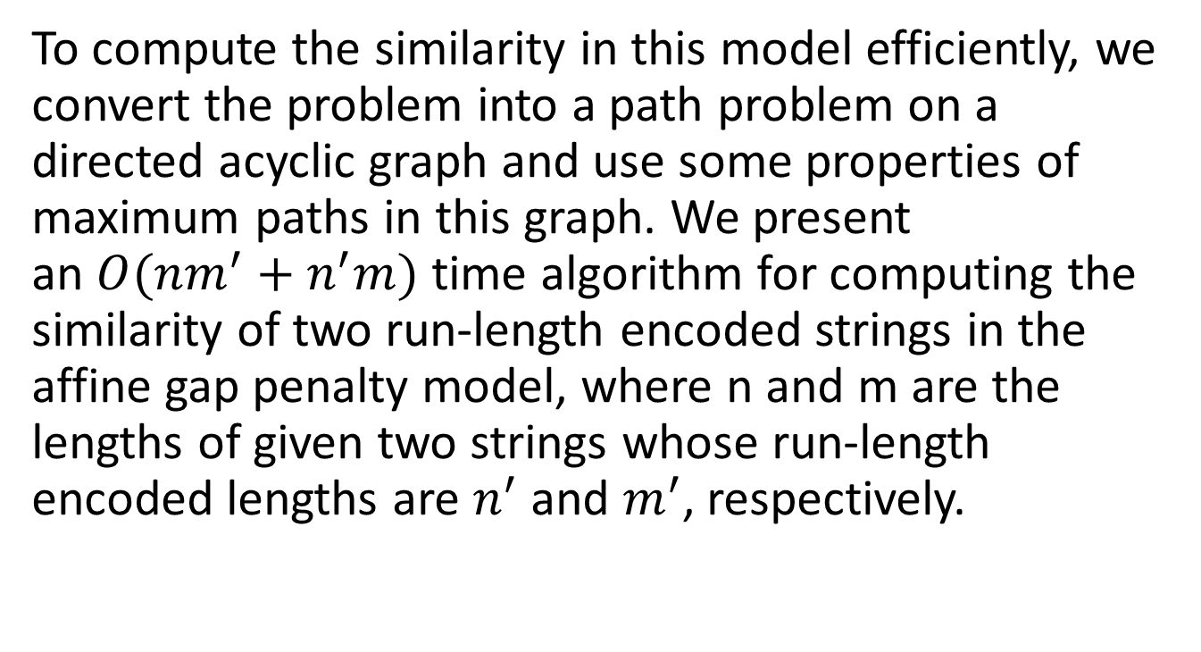
To compute the similarity in this model efficiently, we convert the problem into a path problem on a directed acyclic graph and use some properties of maximum paths in this graph. We present an $O(nm^{′}+n^{′}m)$ time algorithm for computing the similarity of two run-length encoded strings in the affine gap penalty model, where n and m are the lengths of given two strings whose run-length encoded lengths are $n^{′}$ and $m^{′}$, respectively.

Slide 4
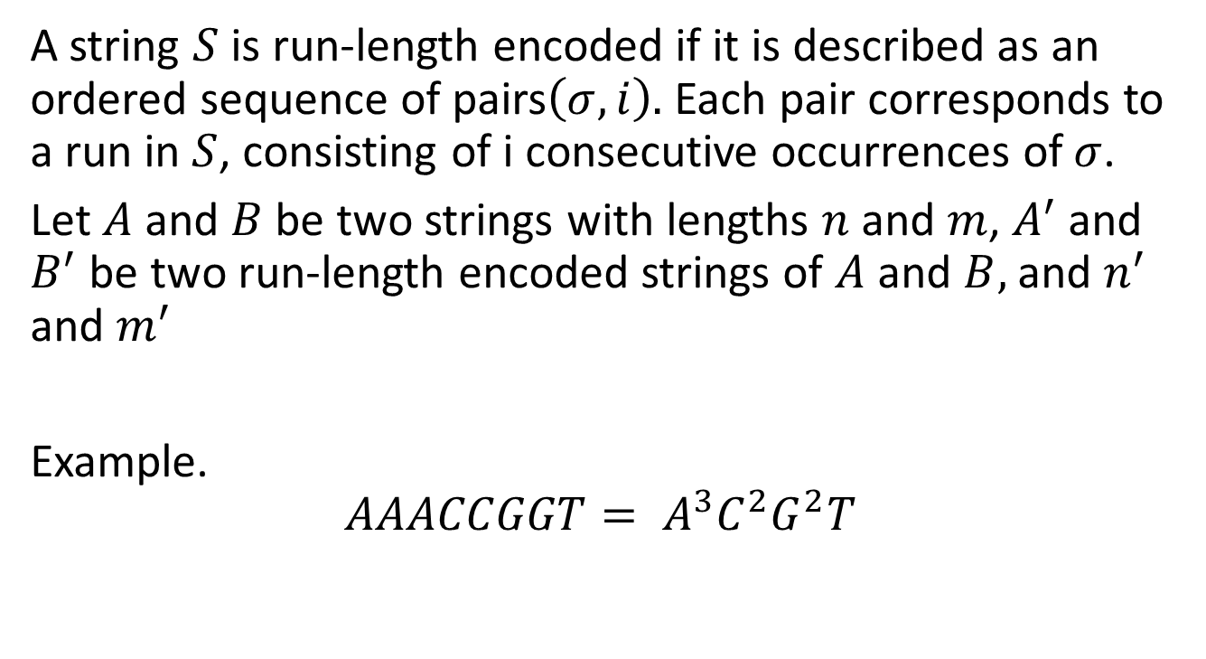
Introduction
A string $S$ is run-length encoded if it is described as an ordered sequence of pairs$\left(σ,i\right).$ Each pair corresponds to a run in $S$, consisting of i consecutive occurrences of$σ$.
Let $A$ and $B$ be two strings with lengths $n$ and $m$, $A^{′}$ and $B^{′}$ be two run-length encoded strings of $A$ and $B,$ and $n^{′}$ and $m^{′}$
Example.
$$AAACCGGT= A^{3}C^{2}G^{2}T$$

Slide 5
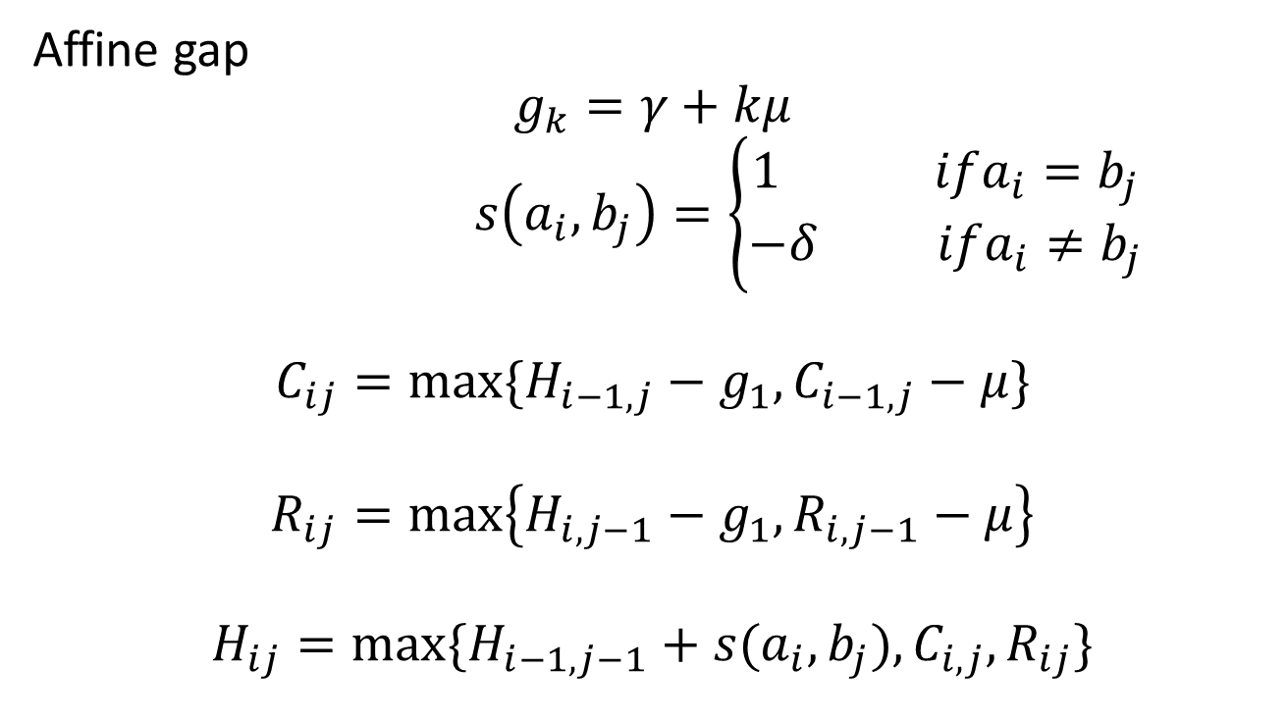
Affine gap
$$g_{k}=γ+kμ$$
$s\left(a_{i},b_{j}\right)=\left\{\begin{aligned}1 ifa_{i}=b_{j} \\ −δ ifa_{i}≠b_{j}\end{aligned}\right.$
$$C_{ij}=max⁡\{H_{i−1,j}−g_{1},C_{i−1,j}−μ\}$$
$$R_{ij}=\max\left\{H_{i,j−1}−g_{1},R_{i,j−1}−μ\right\}$$
$$H_{ij}=max⁡\{H_{i−1,j−1}+s(a_{i},b_{j}),C_{i,j},R_{ij}\}$$

Slide 6
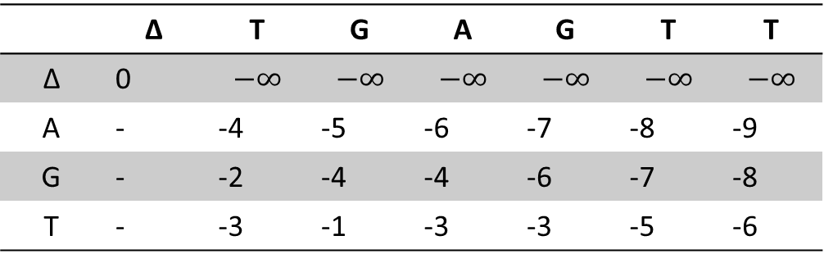
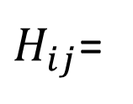
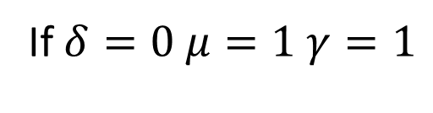
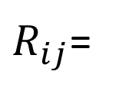
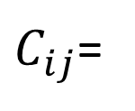
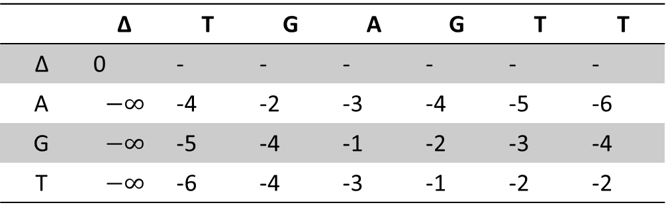
If $δ=0 μ=1 γ=1$
 | ∆ | T | G | A | G | T | T
∆ | 0 | $$−∞$$ | $$−∞$$ | $$−∞$$ | $$−∞$$ | $$−∞$$ | $$−∞$$
A | - | -4 | -5 | -6 | -7 | -8 | -9
G | - | -2 | -4 | -4 | -6 | -7 | -8
T | - | -3 | -1 | -3 | -3 | -5 | -6
$C_{ij}$=
 | ∆ | T | G | A | G | T | T
∆ | 0 | - | - | - | - | - | -
A | $$−∞$$ | -4 | -2 | -3 | -4 | -5 | -6
G | $$−∞$$ | -5 | -4 | -1 | -2 | -3 | -4
T | $$−∞$$ | -6 | -4 | -3 | -1 | -2 | -2
$R_{ij}$=
 | ∆ | T | G | A | G | T | T
∆ | 0 | -2 | -3 | -4 | -5 | -6 | -7
A | -2 | 0 | -2 | -2 | -4 | -5 | -6
G | -3 | -2 | 1 | -1 | -1 | -3 | -4
T | -4 | -2 | -1 | 1 | -1 | 0 | -2
$H_{ij}$=

Slide 7
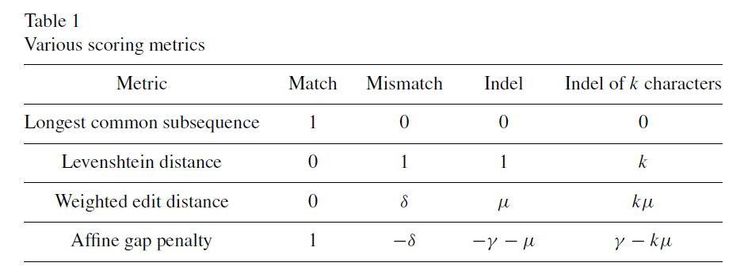

Slide 8
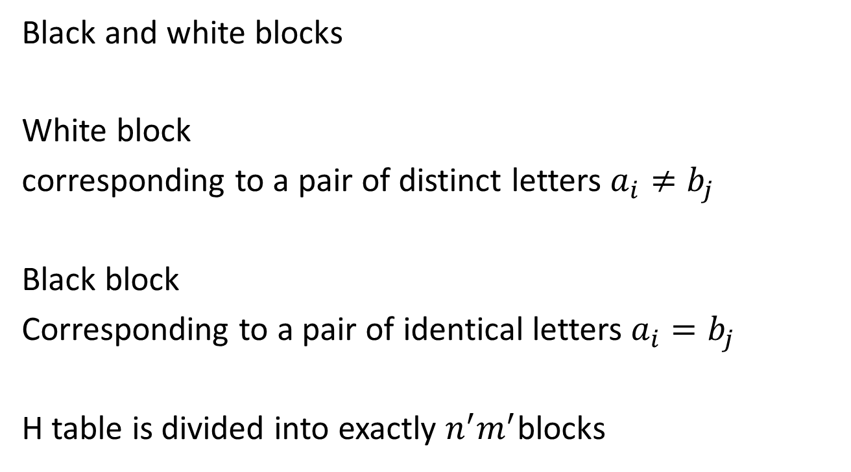
Black and white blocks
White block
corresponding to a pair of distinct letters $a_{i}{≠b}_{j}$
Black block
Corresponding to a pair of identical letters $a_{i}{=b}_{j}$
H table is divided into exactly $n^{′}m^{′}$blocks

Slide 9
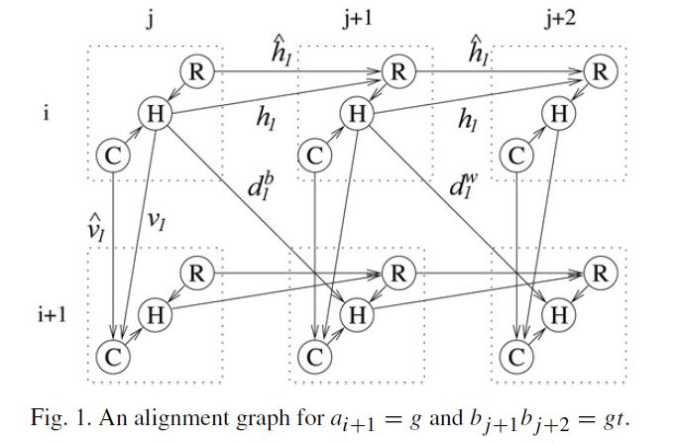
Dependency of elements

Slide 10
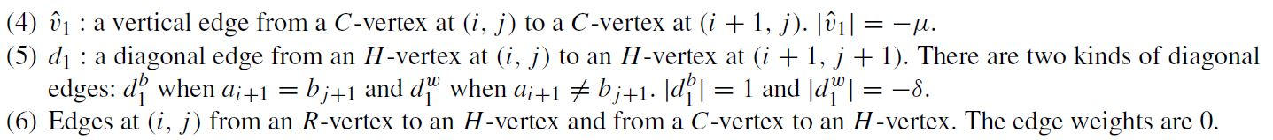

Slide 11


Slide 12
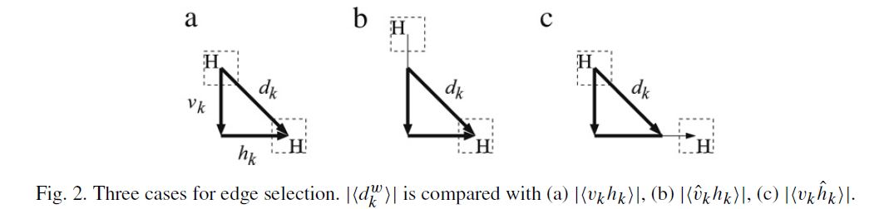

Slide 13
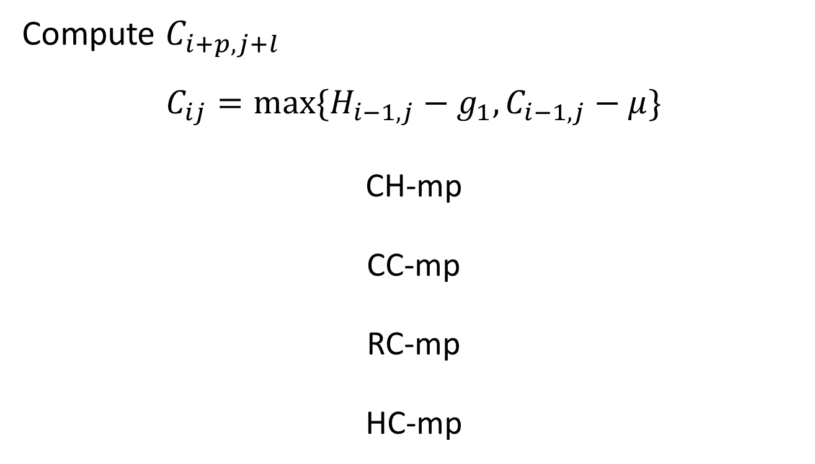
Algorithm – white blocks
Compute $C_{i+p,j+l}$
$$C_{ij}=max⁡\{H_{i−1,j}−g_{1},C_{i−1,j}−μ\}$$
CH-mp
CC-mp
RC-mp
HC-mp

Slide 14
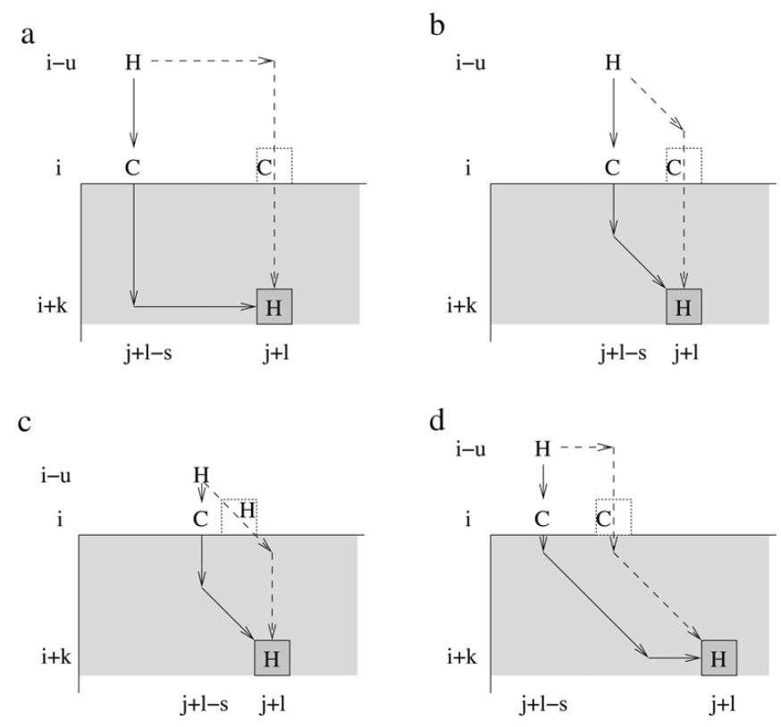
Algorithm- white blocks CH-mp

Slide 15
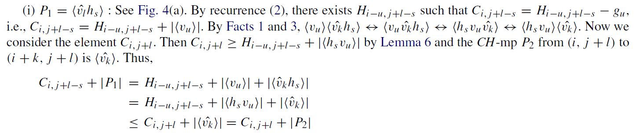
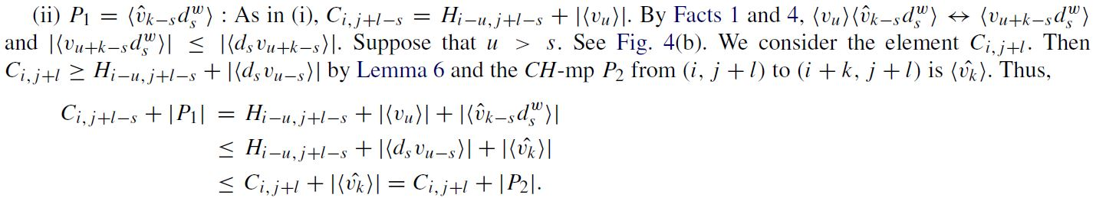
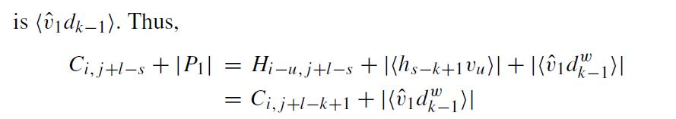

Slide 16
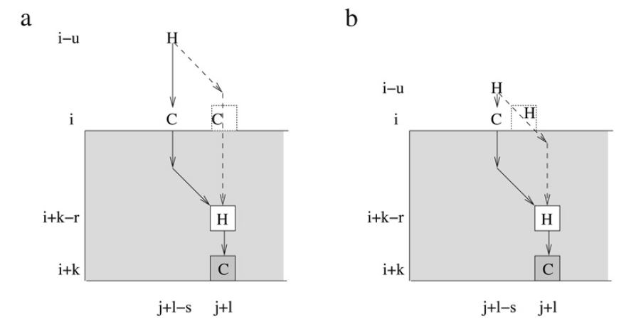
Algorithm- white blocks CC-mp

Slide 18
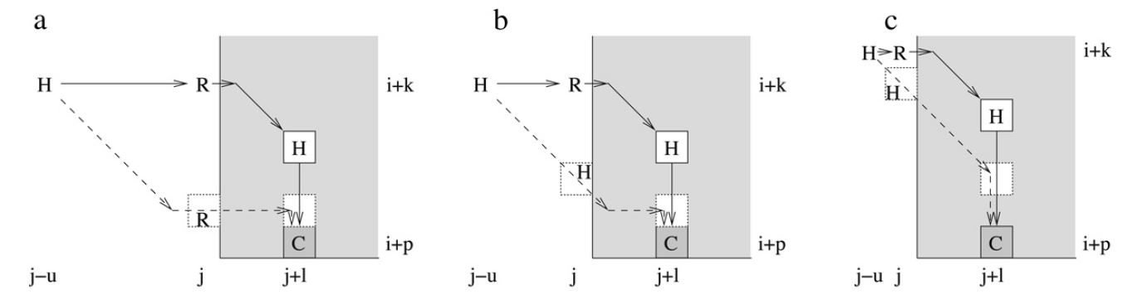

Algorithm- white blocks RC-mp

Slide 19
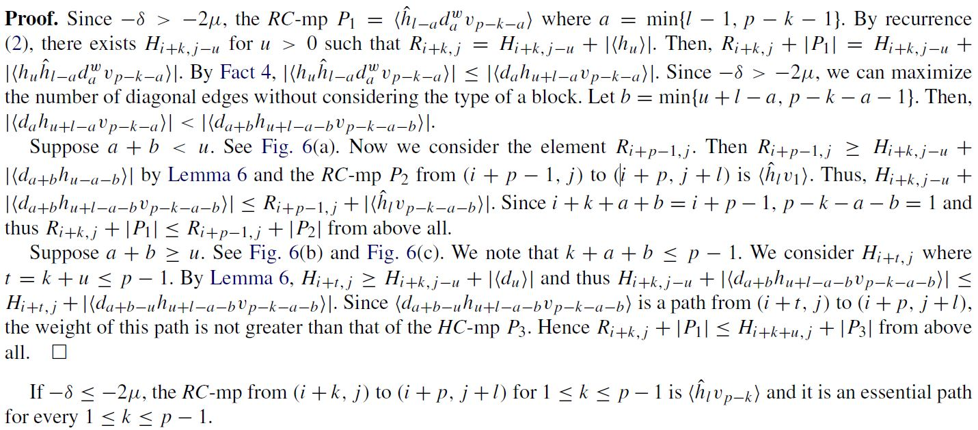

Slide 20
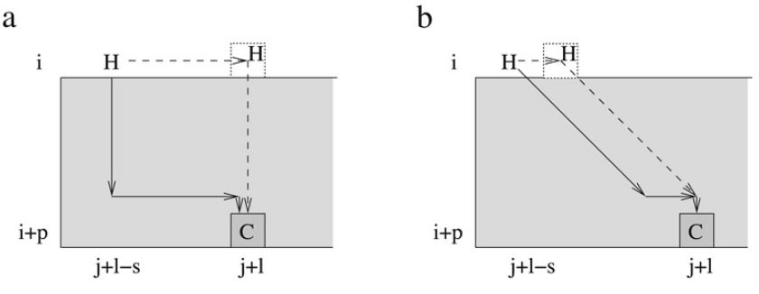
Algorithm- white blocks HC-mp

Slide 21
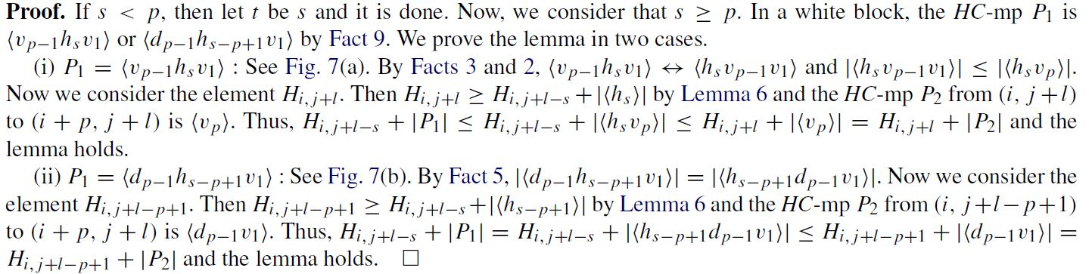

Slide 22
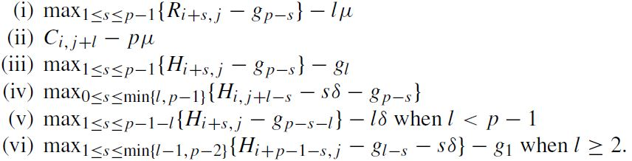

Compute $C_{i+p,j+l}$

Slide 23
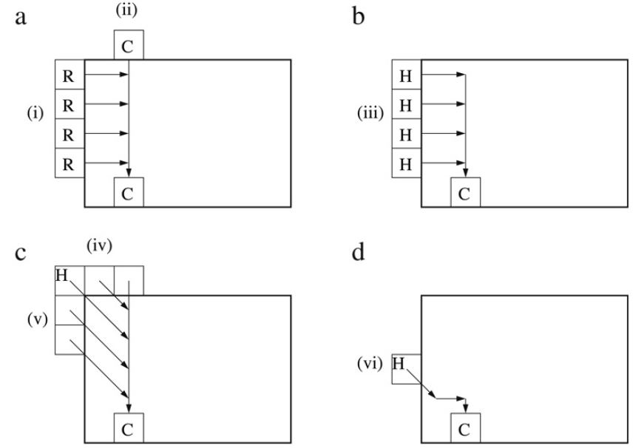

Slide 24


Algorithm- white block
Compute $R_{i+p,j+l}$

Slide 25

Algorithm- white block
Compute $H_{i+p,j+l}$
$$C_{i+p,j+l}$$
$$R_{i+p,j+l}$$
$$H_{i+p−1,j+l−1}$$
RH-mp
CH-mp
HH-mp

Slide 26
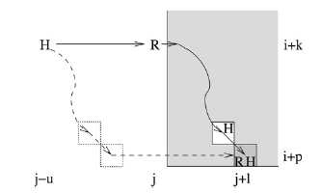

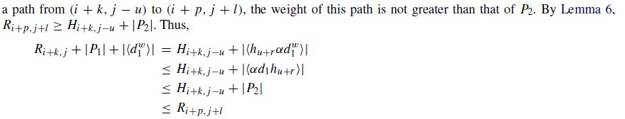
Algorithm- white block RH-mp

Slide 27
Algorithm- white block CH-mp
Similar to the RH-mp

Slide 28
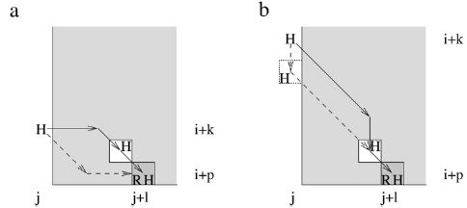
Algorithm- white block HH-mp

Slide 29
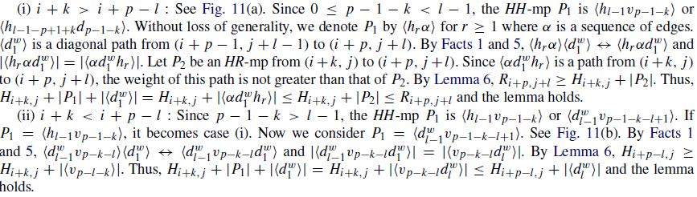

Slide 30

Compute $H_{i+p,j+l}$
$$R_{i+p,j+l}$$
$$C_{i+p,j+l}$$
$$H_{i+p−l,j}−lδ$$
$$H_{i,j+l−p}−pδ$$

Slide 31
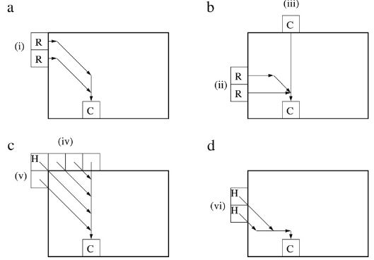
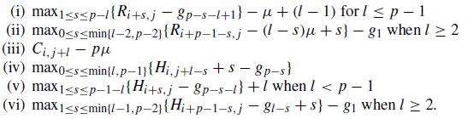
Algorithm- black block
Compute $C_{i+p,j+l}$

Slide 32
Algorithm- black block
Compute $R_{i+p,j+l}$

Slide 33

Algorithm- black block
Compute $H_{i+p,j+l}$
$$C_{i+p,j+l}$$
$$R_{i+p,j+l}$$
$$H_{i+p−1,j+l−1}$$
RH-mp
CH-mp

Slide 34
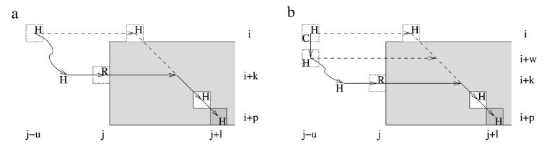
Algorithm- black blocks RH-mp

Slide 35
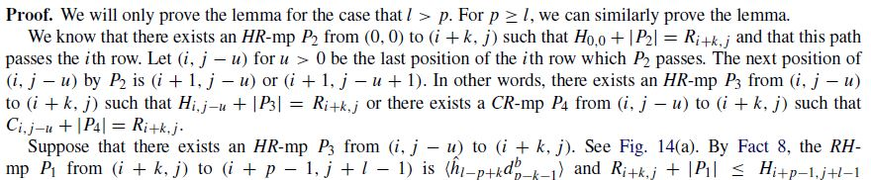
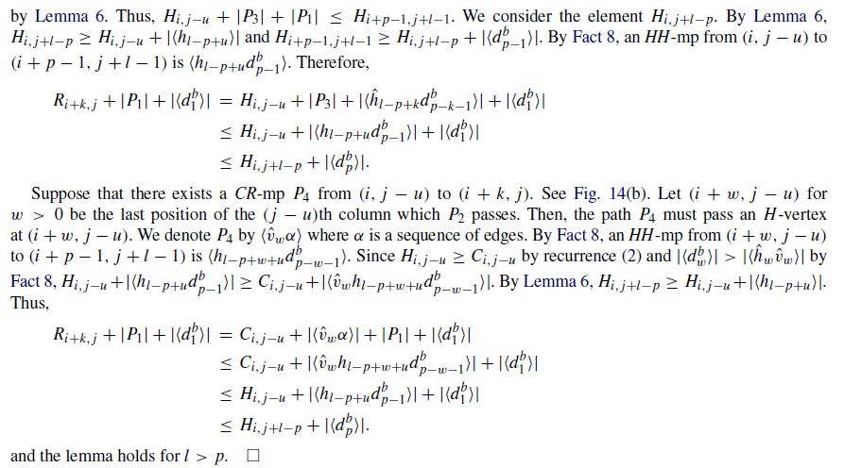

Slide 36

Compute $H_{i+p,j+l}$
$$R_{i+p,j+l}$$
$$C_{i+p,j+l}$$
$$H_{i+p−l,j}+l$$
$$H_{i,j+l−p}+p$$

Slide 37
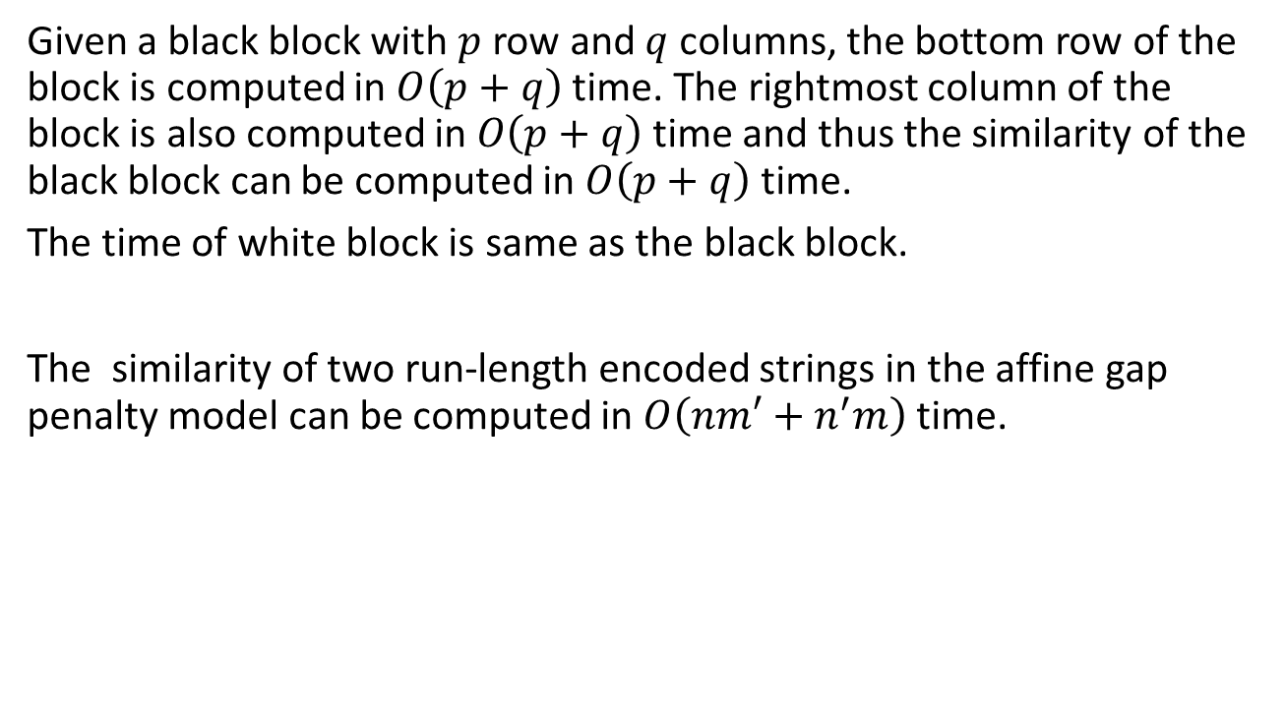
Conclusion
Given a black block with $p$ row and $q$ columns, the bottom row of the block is computed in $O\left(p+q\right)$ time. The rightmost column of the block is also computed in $O\left(p+q\right)$ time and thus the similarity of the black block can be computed in $O\left(p+q\right)$ time.
The time of white block is same as the black block.
The similarity of two run-length encoded strings in the affine gap penalty model can be computed in $O\left(nm′+n^{′}m\right)$time.

