Slide 1
New Efficient Algorithms for LCS and Constrained LCS Problem
Costas S. Iliopoulos and
M. Sohel Rahman
Information Processing Letters 106 (2008) 13–18
Presenter:De-Sheng Chan
2015/05/05

Slide 2
Abstract
In this paper, we study the classic and well-studied longest common subsequence (LCS) problem and a recent variant of it, namely the constrained LCS (CLCS) problem. In the CLCS problem, the computed LCS must also be a supersequence of a third given string. In this paper, we first present an efficient algorithm for the traditional LCS problem that runs in O(Rloglogn + n) time, where R is the total number of ordered pairs of positions at which the two strings match and n is the length of the two given strings. Then, using this algorithm, we devise an algorithm for the CLCS problem having time complexity O(pRloglogn + n) in the worst case, where p is the length of the third string.

Slide 3
LCS
X = TCCACA
Y = ACCAAG
LCS(X, Y) = CCAA, whose length is 4.
|X| = |Y| = n = 6

Slide 4
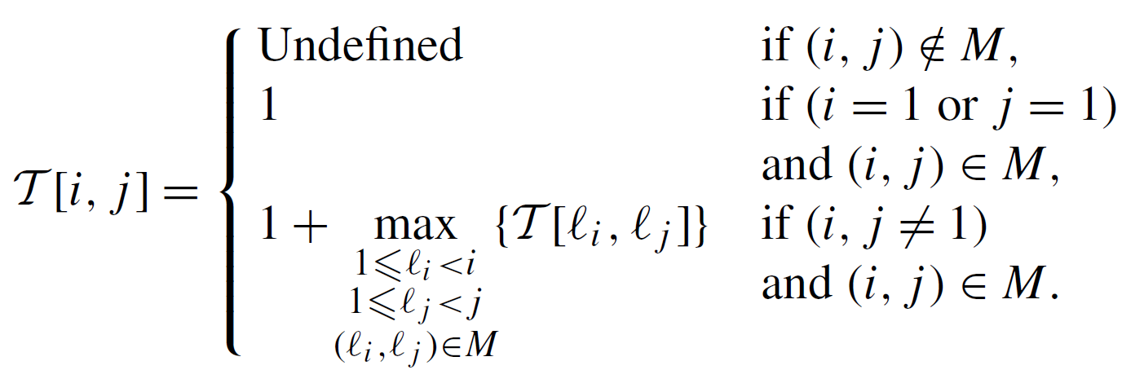
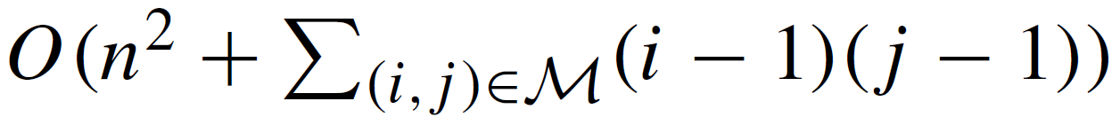
LCS
 |  | A | C | C | A | A | G
 | 0 | 1 | 2 | 3 | 4 | 5 | 6
T | 1
C | 2 |  | 1 | 1
C | 3 |  | 1 | 2
A | 4 | 1 |  |  | 3
C | 5
A | 6
O(n²)
M.S. Rahman, C.S. Iliopoulos, Algorithms for computing variants
of the longest common subsequence problem.

Slide 5
LCS
X = TCCACA
Y = ACCAAG
|X| = |Y| = n = 6
L_{X}[A] = {4, 6}
L_{X}[C] = {2, 3, 5}
L_{X}[G] = {}
L_{X}[T] = {1}
L_{Y}[A] = {1, 4, 5}
L_{Y}[C] = {2, 3}
L_{Y}[G] = {6}
L_{Y}[T] = {}
|M| = R
O(n + R)

Slide 6
 |  | A | C | C | A | A | G
 | 0 | 1 | 2 | 3 | 4 | 5 | 6
T | 1
C | 2
C | 3
A | 4
C | 5
A | 6
 |  | A | C | C | A | A | G
 | 0 | 1 | 2 | 3 | 4 | 5 | 6
T | 1
C | 2 |  | A | B
C | 3 |  | C | D
A | 4 | E |  |  | F | G
C | 5 |  | H | I
A | 6 | J |  |  | K | L
H
0 | 0 | 0 | 0 | 0 | 0
H₁
0 | 0 | 0 | 0 | 0 | 0
H₂
0 | 0 | 0 | 0 | 0 | 0
H₃
0 | A | B | 0 | 0 | 0
H₆
E | H | I | F | G | 0

Slide 7
LCS
 |  | A | C | C | A | A | G
 | 0 | 1 | 2 | 3 | 4 | 5 | 6
T | 1
C | 2 |  | 1
C | 3
A | 4
C | 5
A | 6
H₁
0 | 0 | 0 | 0 | 0 | 0
H₂
0 | 1 | 0 | 0 | 0 | 0
RMAX(Range Maxima Query Problem) : O(n) pre-processing time
and O(1) time per query.

Slide 8
LCS
 |  | A | C | C | A | A | G
 | 0 | 1 | 2 | 3 | 4 | 5 | 6
T | 1
C | 2 |  | 1 | 1
C | 3
A | 4
C | 5
A | 6
H₁
0 | 0 | 0 | 0 | 0 | 0
H₂
0 | 1 | 1 | 0 | 0 | 0
RMAX(Range Maxima Query Problem) : O(n) pre-processing time
and O(1) time per query.

Slide 9
LCS
 |  | A | C | C | A | A | G
 | 0 | 1 | 2 | 3 | 4 | 5 | 6
T | 1
C | 2 |  | 1 | 1
C | 3 |  | 1
A | 4
C | 5
A | 6
H₂
0 | 1 | 1 | 0 | 0 | 0
H₃
0 | 1 | 1 | 0 | 0 | 0

Slide 10
LCS
 |  | A | C | C | A | A | G
 | 0 | 1 | 2 | 3 | 4 | 5 | 6
T | 1
C | 2 |  | 1 | 1
C | 3 |  | 1 | 2
A | 4 | 1 |  |  | 3 | 3
C | 5 |  | 2 | 2
A | 6 | 1 |  |  | 3 | 4
H₆
1 | 2 | 2 | 3 | 3 | 0
H₇
1 | 2 | 2 | 3 | 4 | 0
O(n²)

Slide 11
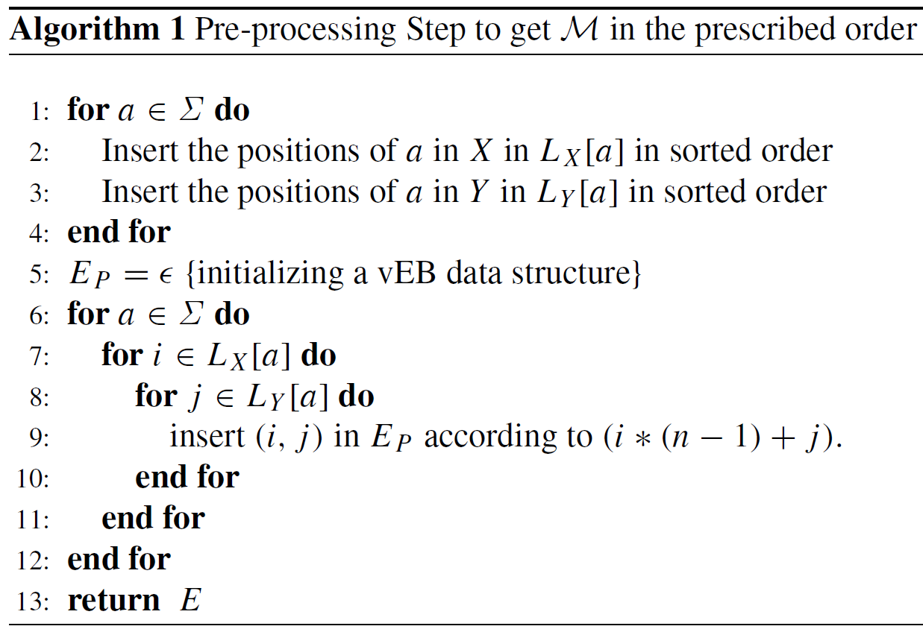
A New Algorithm for Problem LCS
Van Emde Boas that allows us
to maintain a sorted list of
integers in the range [1..n]
in O(loglogn) time
per insertion and deletion.

Slide 12
A New Algorithm for Problem LCS
X = TCCACA
Y = ACCAAG
L_{X}[A] = {4, 6}
L_{X}[C] = {2, 3, 5}
L_{X}[G] = {}
L_{X}[T] = {1}
L_{Y}[A] = {1, 4, 5}
L_{Y}[C] = {2, 3}
L_{Y}[G] = {6}
L_{Y}[T] = {}
i*(n-1)+j
21
(4,1)
24
(4,4)
25
(4,5)

Slide 13
A New Algorithm for Problem LCS
L_{X}[A] = {4, 6}
L_{X}[C] = {2, 3, 5}
L_{X}[G] = {}
L_{X}[T] = {1}
L_{Y}[A] = {1, 4, 5}
L_{Y}[C] = {2, 3}
L_{Y}[G] = {6}
L_{Y}[T] = {}
12
(2,2)
13
(2,3)
17
(3,2)
18
(3,3)
21
(4,1)
24
(4,4)
25
(4,5)
27
(5,2)
28
(5,3)
31
(6,1)
34
(6,4)
35
(6,5)
In row-by-row manner. O(Rloglogn + n)

Slide 14
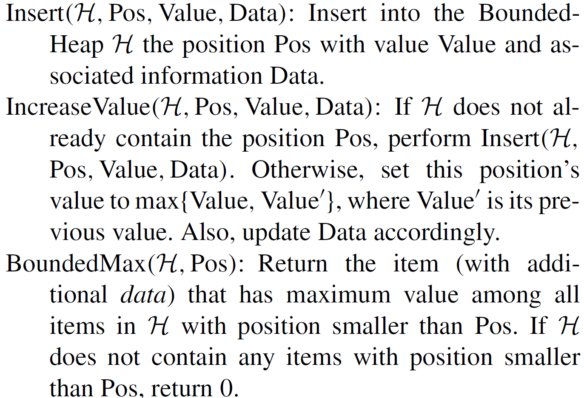
BoundHeap
That supports the following operations:
O(loglogn)

Slide 15
A New Algorithm for Problem LCS
 |  | A | C | C | A | A | G
 | 0 | 1 | 2 | 3 | 4 | 5 | 6
T | 1
C | 2 |  | 1
C | 3
A | 4
C | 5
A | 6
H₁
0 | 0 | 0 | 0 | 0 | 0
H₂
0 | 1 | 0 | 0 | 0 | 0

Slide 16
A New Algorithm for Problem LCS
 |  | A | C | C | A | A | G
 | 0 | 1 | 2 | 3 | 4 | 5 | 6
T | 1
C | 2 |  | 1 | 1
C | 3
A | 4
C | 5
A | 6
H₁
0 | 0 | 0 | 0 | 0 | 0
H₂
0 | 1 | 1 | 0 | 0 | 0

Slide 17
A New Algorithm for Problem LCS
 |  | A | C | C | A | A | G
 | 0 | 1 | 2 | 3 | 4 | 5 | 6
T | 1
C | 2 |  | 1 | 1
C | 3 |  | 1
A | 4
C | 5
A | 6
H₂
0 | 1 | 1 | 0 | 0 | 0
H₃
0 | 1 | 1 | 0 | 0 | 0

Slide 18
A New Algorithm for Problem LCS
 |  | A | C | C | A | A | G
 | 0 | 1 | 2 | 3 | 4 | 5 | 6
T | 1
C | 2 |  | 1 | 1
C | 3 |  | 1 | 2
A | 4
C | 5
A | 6
H₂
0 | 1 | 1 | 0 | 0 | 0
H₃
0 | 1 | 2 | 0 | 0 | 0

Slide 19
A New Algorithm for Problem LCS
 |  | A | C | C | A | A | G
 | 0 | 1 | 2 | 3 | 4 | 5 | 6
T | 1
C | 2 |  | 1 | 1
C | 3 |  | 1 | 2
A | 4 | 1 |  |  | 3 | 3
C | 5 |  | 2 | 2
A | 6 | 1 |  |  | 3 | 4
H₅
1 | 2 | 2 | 3 | 3 | 0
H₆
1 | 2 | 2 | 3 | 4 | 0

Slide 20
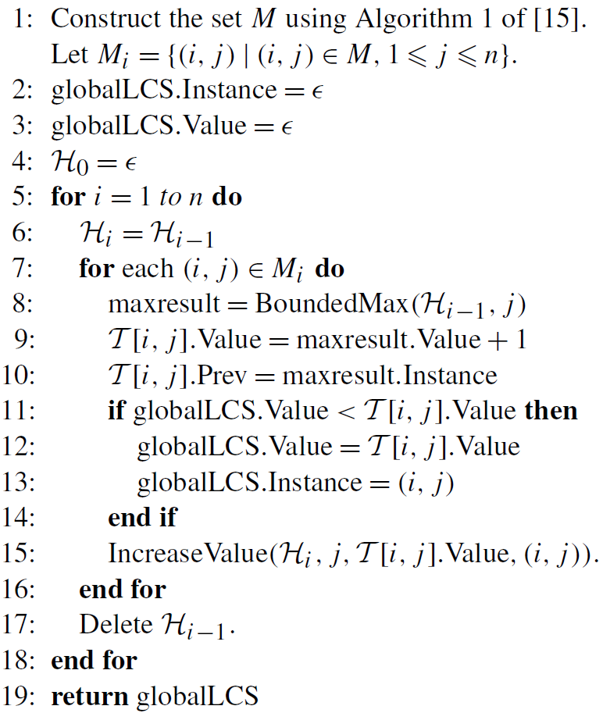
A New Algorithm for Problem LCS
In total, the running time
is O(Rloglogn + n), and
the space requirement is
Θ(max{R, n})

Slide 21
CLCS problem
X = TCCACA
Y = ACCAAG
Z = AC
CLCS(X, Y, Z) = ACA

Slide 22
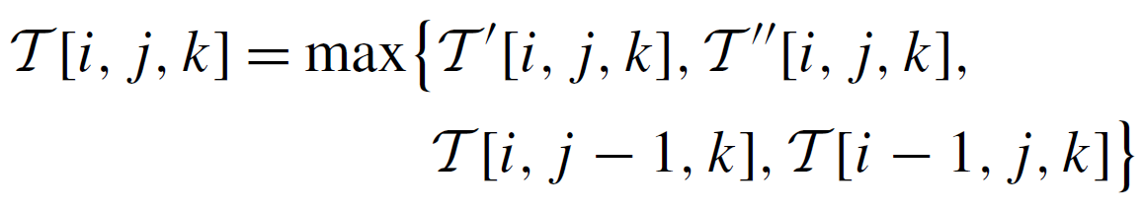
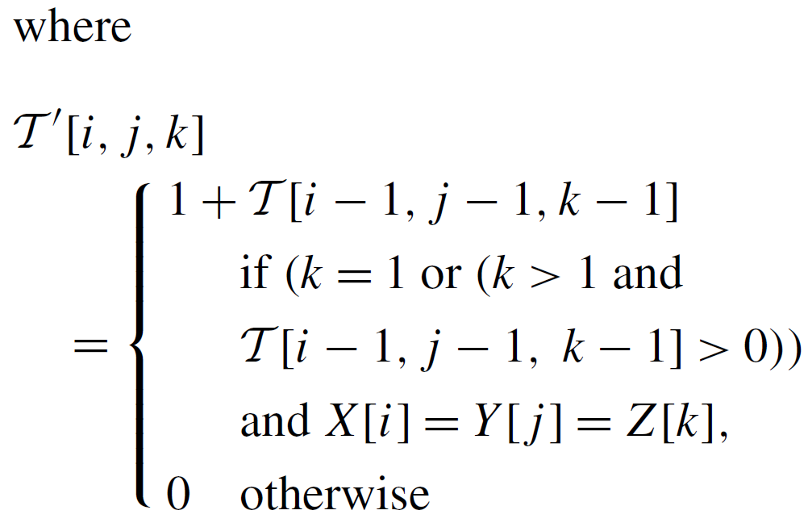
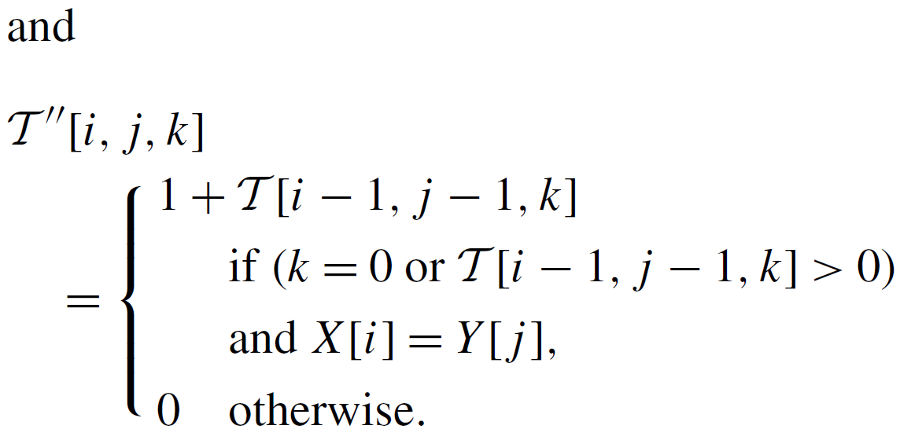
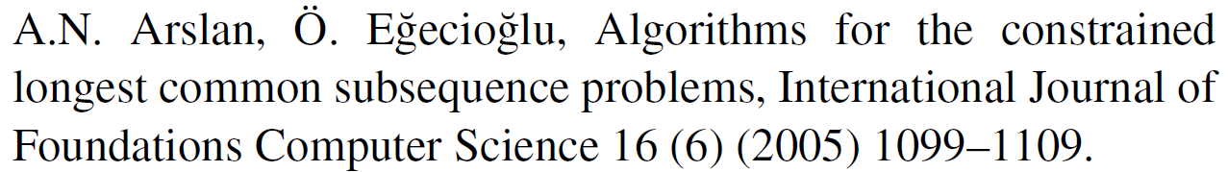
CLCS Algorithm
O(pn²)

Slide 23
CLCS Algorithm
X = TCCACA
Y = ACCAAG
Z = AC
 |  | 1 | 2 | 3 | 4 | 5 | 6
 | 0 | 0 | 0 | 0 | 0 | 0 | 0
1 | 0 | 0 | 0 | 0 | 0 | 0 | 0
2 | 0 | 0 | 1 | 1 | 1 | 1 | 1
3 | 0 | 0 | 1 | 2 | 2 | 2 | 2
4 | 0 | 1 | 1 | 2 | 3 | 3 | 3
5 | 0 | 1 | 2 | 2 | 3 | 3 | 3
6 | 0 | 1 | 2 | 2 | 3 | 4 | 4
 |  | 1 | 2 | 3 | 4 | 5 | 6
 | 0 | 0 | 0 | 0 | 0 | 0 | 0
1 | 0 | 0 | 0 | 0 | 0 | 0 | 0
2 | 0 | 0 | 0 | 0 | 0 | 0 | 0
3 | 0 | 0 | 0 | 0 | 0 | 0 | 0
4 | 0 | 1 | 1 | 1 | 3 | 3 | 3
5 | 0 | 1 | 2 | 2 | 3 | 3 | 3
6 | 0 | 1 | 2 | 2 | 3 | 4 | 4
 |  | 1 | 2 | 3 | 4 | 5 | 6
 | 0 | 0 | 0 | 0 | 0 | 0 | 0
1 | 0 | 0 | 0 | 0 | 0 | 0 | 0
2 | 0 | 0 | 0 | 0 | 0 | 0 | 0
3 | 0 | 0 | 0 | 0 | 0 | 0 | 0
4 | 0 | 0 | 0 | 0 | 0 | 0 | 0
5 | 0 | 0 | 2 | 2 | 2 | 2 | 2
6 | 0 | 0 | 2 | 2 | 3 | 3 | 3
K = 0
K = 1
K = 2

Slide 24
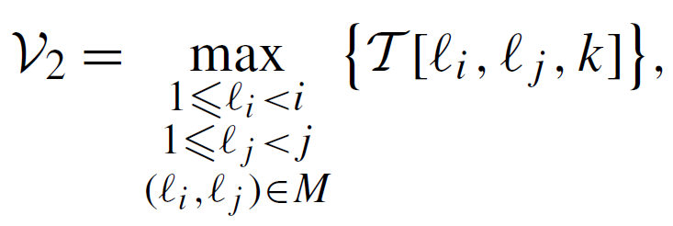
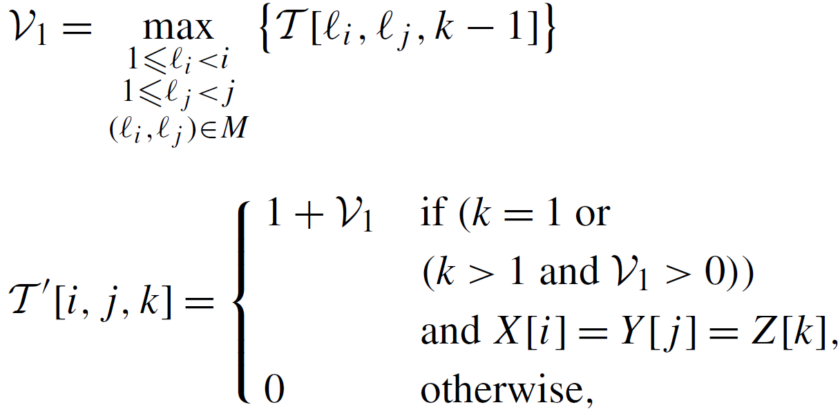
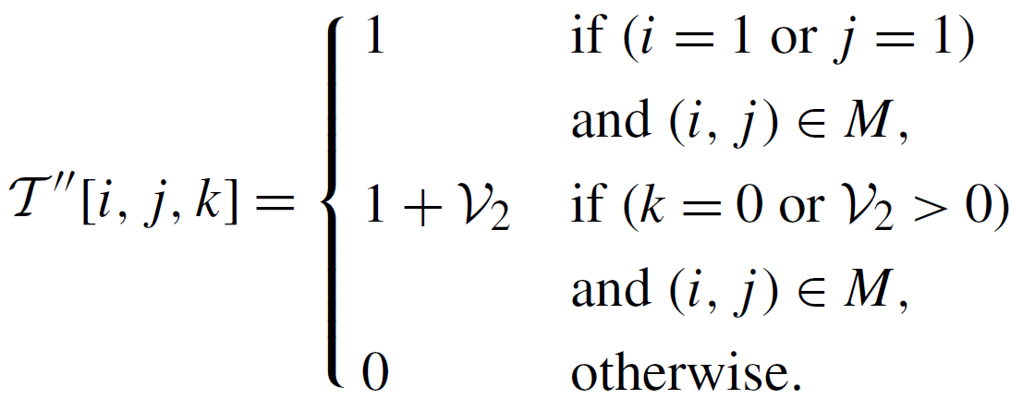
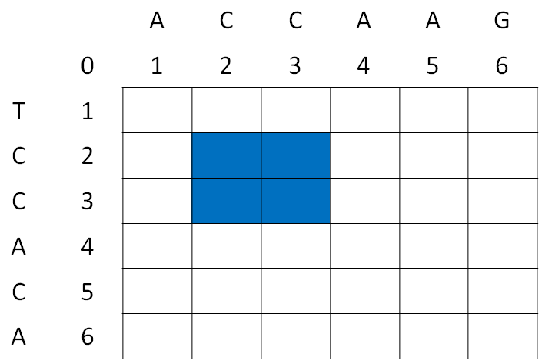
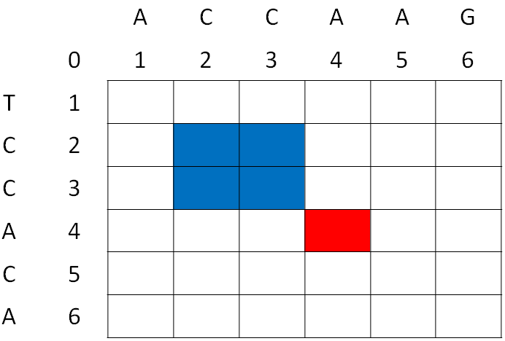
A New Algorithm for Problem CLCS
K
K-1

Slide 25
A New Algorithm for Problem CLCS
L_{X}[A] = {4, 6}
L_{X}[C] = {2, 3, 5}
L_{X}[G] = {}
L_{X}[T] = {1}
L_{Y}[A] = {1, 4, 5}
L_{Y}[C] = {2, 3}
L_{Y}[G] = {6}
L_{Y}[T] = {}
12
(2,2)
13
(2,3)
17
(3,2)
18
(3,3)
21
(4,1)
24
(4,4)
25
(4,5)
27
(5,2)
28
(5,3)
31
(6,1)
34
(6,4)
35
(6,5)
In row-by-row manner. O(Rloglogn + n)

Slide 26
A New Algorithm for Problem CLCS
Z = AC,
 |  | A | C | C | A | A | G
 | 0 | 1 | 2 | 3 | 4 | 5 | 6
T | 1
C | 2 |  | 1
C | 3
A | 4
C | 5
A | 6
K = 0
0 | 0 | 0 | 0 | 0 | 0
0 | 1 | 0 | 0 | 0 | 0

Slide 27
A New Algorithm for Problem CLCS
Z = AC,
 |  | A | C | C | A | A | G
 | 0 | 1 | 2 | 3 | 4 | 5 | 6
T | 1
C | 2 |  | 1 | 1
C | 3
A | 4
C | 5
A | 6
K = 0
0 | 0 | 0 | 0 | 0 | 0
0 | 1 | 1 | 0 | 0 | 0

Slide 28
A New Algorithm for Problem CLCS
Z = AC,
 |  | A | C | C | A | A | G
 | 0 | 1 | 2 | 3 | 4 | 5 | 6
T | 1
C | 2 |  | 1 | 1
C | 3
A | 4
C | 5
A | 6
 |  | A | C | C | A | A | G
 | 0 | 1 | 2 | 3 | 4 | 5 | 6
T | 1
C | 2 |  | 0
C | 3
A | 4
C | 5
A | 6
K = 0
K = 1
0 | 0 | 0 | 0 | 0 | 0
0 | 0 | 0 | 0 | 0 | 0
0 | 1 | 1 | 0 | 0 | 0
0 | 0 | 0 | 0 | 0 | 0

Slide 29
A New Algorithm for Problem CLCS
Z = AC,
 |  | A | C | C | A | A | G
 | 0 | 1 | 2 | 3 | 4 | 5 | 6
T | 1
C | 2 |  | 1 | 1
C | 3
A | 4
C | 5
A | 6
 |  | A | C | C | A | A | G
 | 0 | 1 | 2 | 3 | 4 | 5 | 6
T | 1
C | 2 |  | 0 | 0
C | 3
A | 4
C | 5
A | 6
K = 0
K = 1
0 | 0 | 0 | 0 | 0 | 0
0 | 0 | 0 | 0 | 0 | 0
0 | 1 | 1 | 0 | 0 | 0
0 | 0 | 0 | 0 | 0 | 0

Slide 30
A New Algorithm for Problem CLCS
Z = AC,
 |  | A | C | C | A | A | G
 | 0 | 1 | 2 | 3 | 4 | 5 | 6
T | 1
C | 2 |  | 0 | 0
C | 3
A | 4
C | 5
A | 6
 |  | A | C | C | A | A | G
 | 0 | 1 | 2 | 3 | 4 | 5 | 6
T | 1
C | 2 |  | 0
C | 3
A | 4
C | 5
A | 6
K = 1
K = 2
0 | 0 | 0 | 0 | 0 | 0
0 | 0 | 0 | 0 | 0 | 0
0 | 0 | 0 | 0 | 0 | 0
0 | 0 | 0 | 0 | 0 | 0

Slide 31
A New Algorithm for Problem CLCS
Z = AC,
 |  | A | C | C | A | A | G
 | 0 | 1 | 2 | 3 | 4 | 5 | 6
T | 1
C | 2 |  | 0 | 0
C | 3
A | 4
C | 5
A | 6
 |  | A | C | C | A | A | G
 | 0 | 1 | 2 | 3 | 4 | 5 | 6
T | 1
C | 2 |  | 0 | 0
C | 3
A | 4
C | 5
A | 6
K = 1
K = 2
0 | 0 | 0 | 0 | 0 | 0
0 | 0 | 0 | 0 | 0 | 0
0 | 0 | 0 | 0 | 0 | 0
0 | 0 | 0 | 0 | 0 | 0

Slide 32
A New Algorithm for Problem CLCS
Z = AC,
 |  | A | C | C | A | A | G
 | 0 | 1 | 2 | 3 | 4 | 5 | 6
T | 1
C | 2 |  | 1 | 1
C | 3 |  | 1
A | 4
C | 5
A | 6
K = 0
0 | 1 | 1 | 0 | 0 | 0
0 | 1 | 1 | 0 | 0 | 0

Slide 33
A New Algorithm for Problem CLCS
Z = AC,
 |  | A | C | C | A | A | G
 | 0 | 1 | 2 | 3 | 4 | 5 | 6
T | 1
C | 2 |  | 1 | 1
C | 3 |  | 1 | 2
A | 4
C | 5
A | 6
K = 0
0 | 1 | 1 | 0 | 0 | 0
0 | 1 | 2 | 0 | 0 | 0

Slide 34
A New Algorithm for Problem CLCS
 |  | A | C | C | A | A | G
 | 0 | 1 | 2 | 3 | 4 | 5 | 6
T | 1
C | 2 |  | 0 | 0
C | 3 |  | 0 | 0
A | 4 | 1 |  |  | 3 | 3
C | 5 |  | 2 | 2
A | 6 | 1 |  |  | 3 | 4
 |  | A | C | C | A | A | G
 | 0 | 1 | 2 | 3 | 4 | 5 | 6
T | 1
C | 2 |  | 0 | 0
C | 3 |  | 0 | 0
A | 4 | 0 |  |  | 0 | 0
C | 5 |  | 2 | 2
A | 6 | 0 |  |  | 3 | 3
K = 1
K = 2
1 | 2 | 2 | 3 | 3 | 0
0 | 2 | 2 | 0 | 0 | 0
34

Slide 35
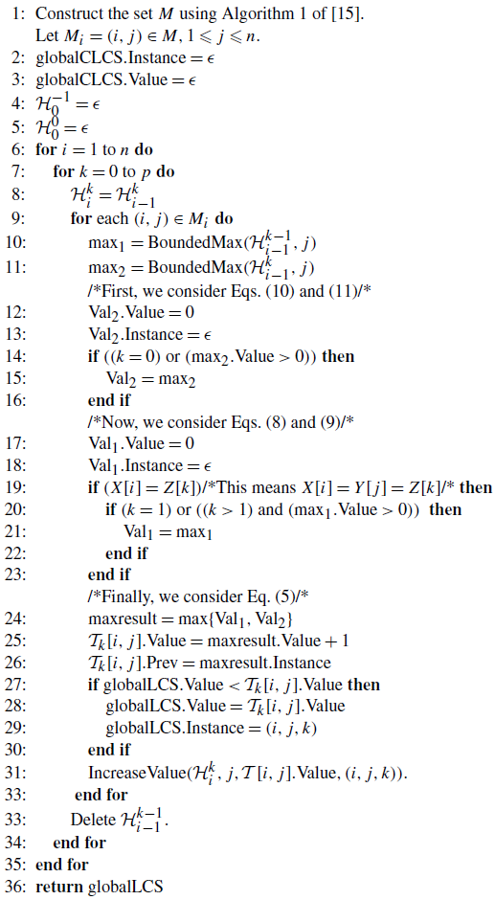
A New Algorithm for Problem CLCS
In total, the running time
is O(pRloglogn + n), and
the space requirement is
Θ(max{R, n})
|Z| = p

Slide 36
Conclusion
 | R∼n | R = n²
LCS | O(nloglogn) | O(n²loglogn)
CLCS | O(pnloglogn) | O(pn²loglogn)

Slide 37
Thanks for listening

