Slide 1
Fast Pattern Matching in Strings
Donald E. Knuth, James H. Morris, Jr., and Vaughan R. Pratt
SIAM Journal on Computing
Volume 6, Issues 2, 1977, Pages 323-350
Presenter: Huang-Ting Chan
Date:2015/5/12

Slide 2
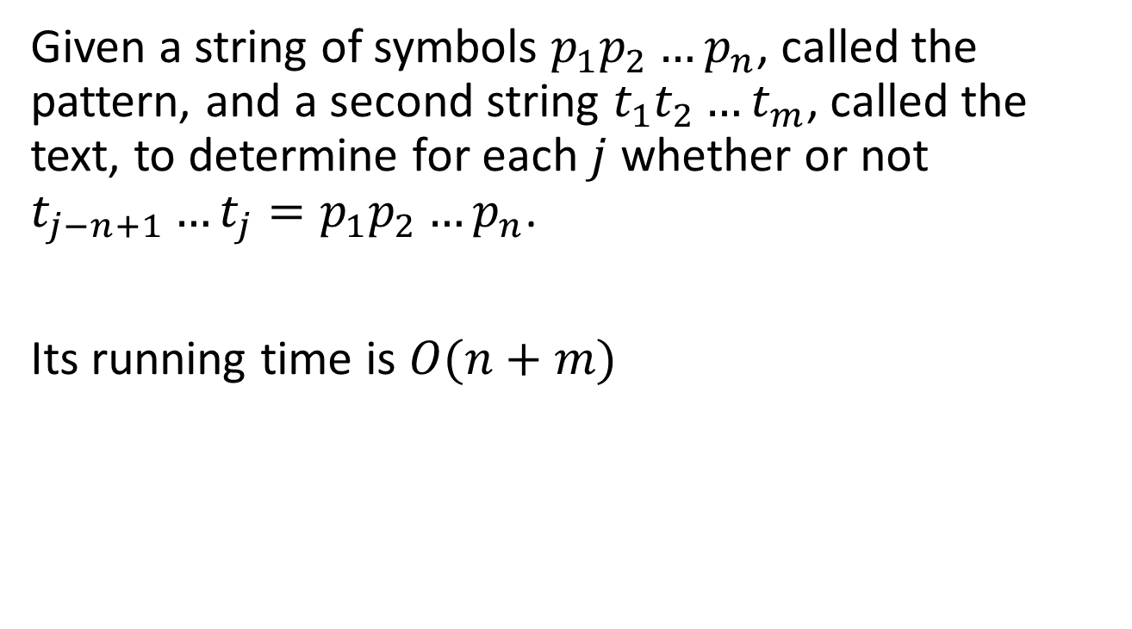
The problem
Given a string of symbols $p_{1}p_{2}…p_{n}$, called the pattern, and a second string $t_{1}t_{2}…t_{m}$, called the text, to determine for each $j$ whether or not $t_{j−n+1}…t_{j}=p_{1}p_{2}…p_{n}$.
Its running time is $O(n+m)$
aabzabzabcz
||||||
abzabc

Slide 3
Example
Text: aabzabzabcz
Pattern: abzabc
aabzabzabcz
|||||X
abzabc

Slide 4
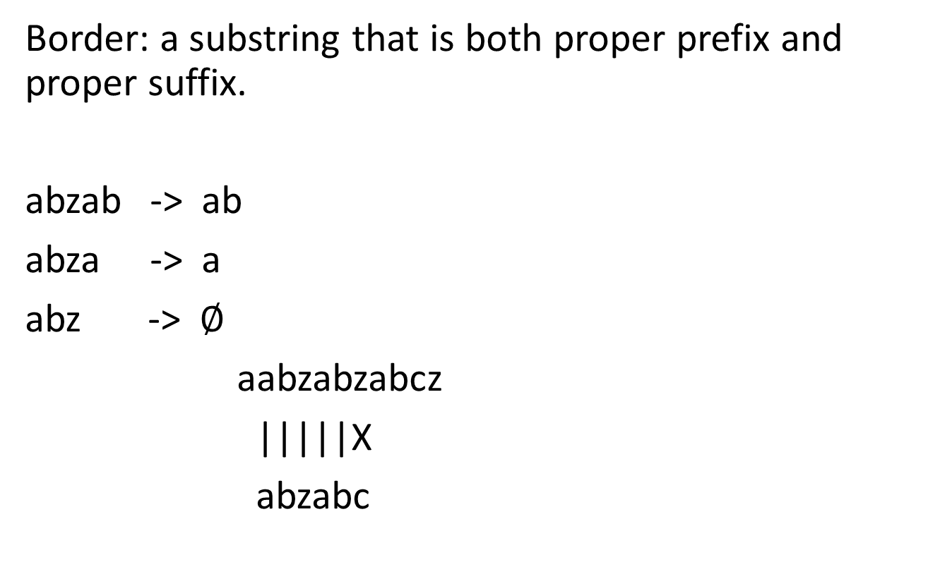
KMP algorithm
Border: a substring that is both proper prefix and proper suffix.
abzab -> ab
abza -> a
abz -> $∅$
aabzabzabcz
|||||X
abzabc
aabzabzabcz
||||||
abzabc

Slide 5
Text: abzaabzab
Pattern: abzab
abzaabzab abzaabzab abzaabzab
||||X |X |||||
abzab ab abzab

Slide 6
Two dimensional pattern matching
R.S. Bird
Information Processing Letters
Volume 6, Issues 5, October 1977, Pages 168-170
Presenter: Huang-Ting Chan
Date:2015/5/12

Slide 7
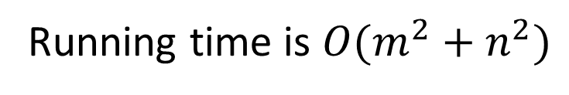

The problem
Given a pattern which is two-dimensional array of symbols $p_{ij},1≤i,j≤n,$ and the text is a second array $t_{ij}, 1≤i,j≤m.$ In this case the problem is to determine where, if anywhere, the pattern occurs as a subarray of the text.
Running time is $O(m^{2}+n^{2})$
A | B | C
A | A | C
B | A | B
C | B | A
A | C
A | B

Slide 8
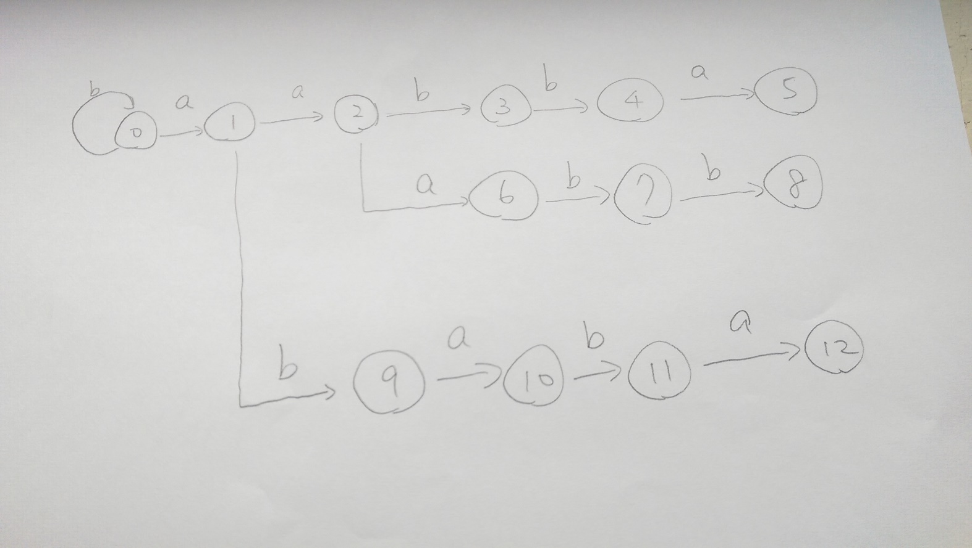
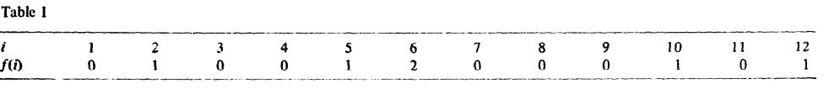
Row-matching
Pattern
a | a | b | b | a
a | a | a | b | b
a | b | a | b | a
a | a | b | b | a

Slide 9
Column-matching
a | a | b | b | a
a | a | a | b | b
a | b | a | b | a
a | a | b | b | a
1
2
3
1

Slide 10
A | B | C
A | A | C
B | A | B
C | B | A
A | C
A | B
 | 2
 |  | 1
 |  | 2

Slide 11
The theory and computation of evolutionary distances: Pattern recognition
Peter H Sellers
Journal of Algorithms
Volume 1, Issues 4, December 1980, Pages 359-373
Presenter: Huang-Ting Chan
Date:2015/5/12

Slide 12
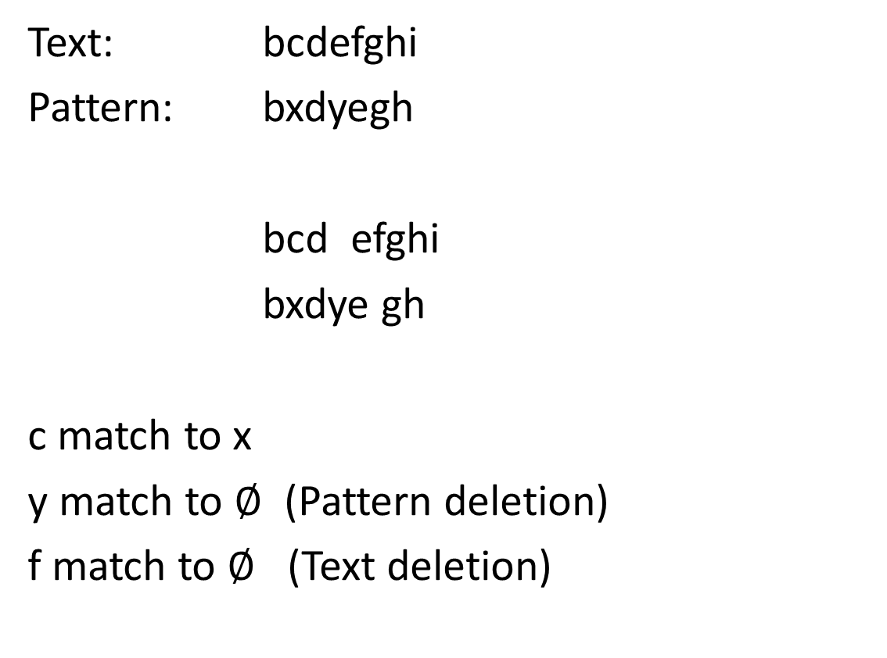
The problem
Text: bcdefghi
Pattern: bxdyegh
bcd efghi
bxdye gh
c match to x
y match to $∅$ (Pattern deletion)
f match to $∅$ (Text deletion)

Slide 13
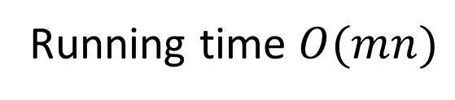
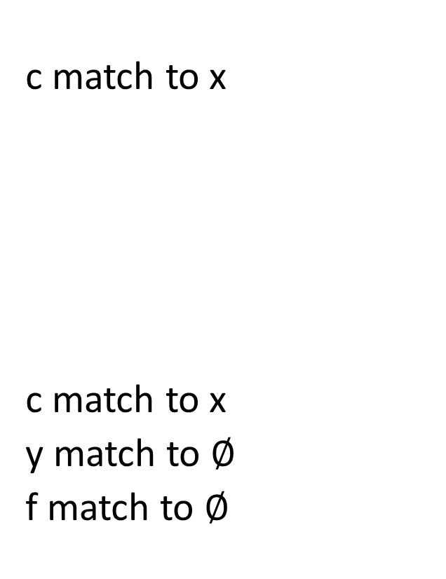
The problem
c match to x
c match to x
y match to $∅$
f match to $∅$
String matching with k mismatch
Find all occurrences of the
pattern in the text with at most
k mismatch
String matching with k differences
Find all occurrences of the
pattern in the text with at most
k differences
Running time $O(mn)$

Slide 14
Efficient two-dimensional pattern matching in the presence of errors
Kamala Krithivasan and R. Sitalakshmi
Information Sciences
Volume 43, Issue 3, December 1987, Pages 169–184
Presenter: Huang-Ting Chan
Date:2015/5/12

Slide 15

The problem
Find out whether pattern(an $n_{1}×n_{2}$ array) occurs as a subarray of text(an $m_{1}×m_{2}$ array) with at most k mismatches.
A | B | C
A | A | C
B | A | B
C | B | A
A | C
C | B
Running time $O(kn_{1}n_{2}logn_{2}+{n_{1}}^{2}n_{2}+kn_{1}m_{1}m_{2})$

Slide 16
The problem
Find out whether pattern(an $n_{1}×n_{2}$ array) occurs as a subarray of text(an $m_{1}×m_{2}$ array) with at most k mismatches.
K=1
A | B | C
A | A | C
B | A | B
C | B | A
A | C
C | B

Slide 17
The problem
Find out whether pattern(an $n_{1}×n_{2}$ array) occurs as a subarray of text(an $m_{1}×m_{2}$ array) with at most k mismatches.
K=2
A | B | C
A | A | C
B | A | B
C | B | A
A | C
C | B

Slide 18
Similarity in Two-Dimensional Strings
Ricardo A. Baeza-Yates
Lecture Notes in Computer Science
Volume 1449, 1998, pp 319-328
Presenter: Huang-Ting Chan
Date:2015/5/12

Slide 19
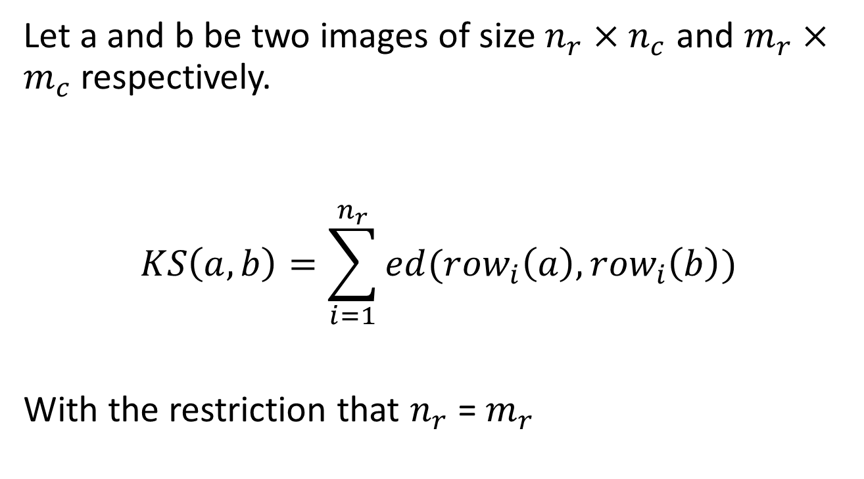
KS distance
Let a and b be two images of size $n_{r}×n_{c}$ and $m_{r}×m_{c}$ respectively.
$$KS\left(a,b\right)=\sum_{i=1}^{n_{r}}{ed({row}_{i}\left(a\right),{row}_{i}\left(b\right))}$$
With the restriction that $n_{r}$ = $m_{r}$

Slide 20
The pattern and a text subimage are compared from top to bottom and from left to right.
That is a sub-image can be enlarged by extending it the bottom or/and the right side.
Text occurrences must have the same shape of the pattern.
Otherwise, we may have occurrences that have at most k errors that don’t count unmatched characters on the boundaries.

Slide 21
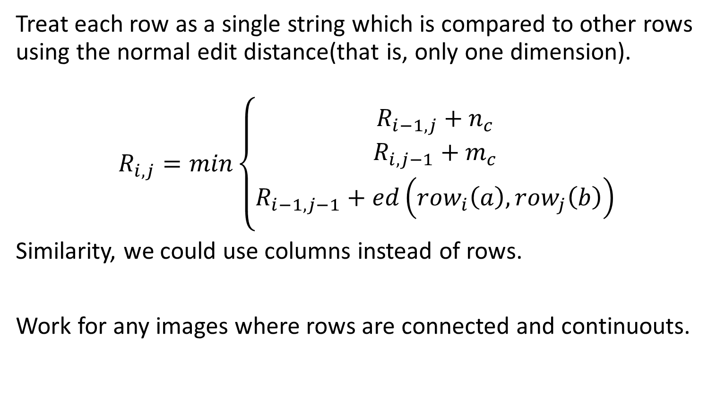
R distance
Treat each row as a single string which is compared to other rows using the normal edit distance(that is, only one dimension).
$$R_{i,j}=min\left\{\begin{aligned}R_{i−1,j}+n_{c} \\ R_{i,j−1}+m_{c} \\ R_{i−1,j−1}+ed\left({row}_{i}\left(a\right),{row}_{j}\left(b\right)\right)\end{aligned}\right.$$
Similarity, we could use columns instead of rows.
Work for any images where rows are connected and continuouts.

Slide 22
RC distance
Generalizing this idea to insertions and deletions at the same time in rows and/or columns is not as simple.
Suppose that we have two subimages that we want to compare. One alternative is to decompose the border of a subimage in rows or columns.

Slide 23
L distance
RC distance doesn’t handle cases where we want to change at the same time a row and a column.
We can also decompose the border of a subimage using L-shapes and we can have the same extensions as for rows or columns.
To compare two L-shapes we see them as two one-dimensional strings.

Slide 24
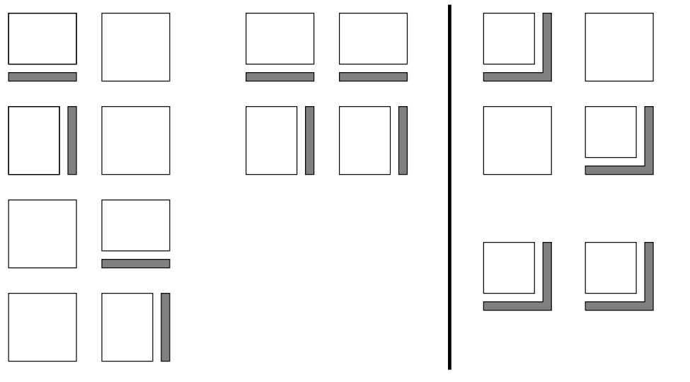

Slide 25
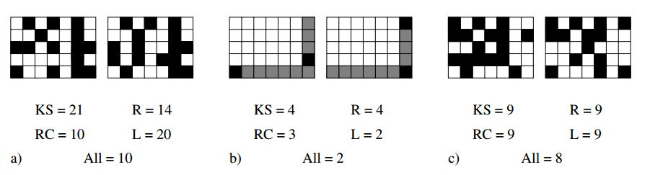

Slide 26
Neither of the new measures defined can handle scaling transformations nor rotations.
A more realistic distance can be defined using the following idea, which tries to define the largest common image of two images, which generalizes the concept of longest common subsequence of one-dimensional strings.

Slide 27
Generalized LCS
Amihood Amir, Tzvika Hartman, Oren Kapah, B. Riva Shalom, Dekel Tsur
Lecture Notes in Computer Science
Volume 4726, 2007, pp 50-61
Presenter: Huang-Ting Chan
Date:2015/5/12

Slide 28
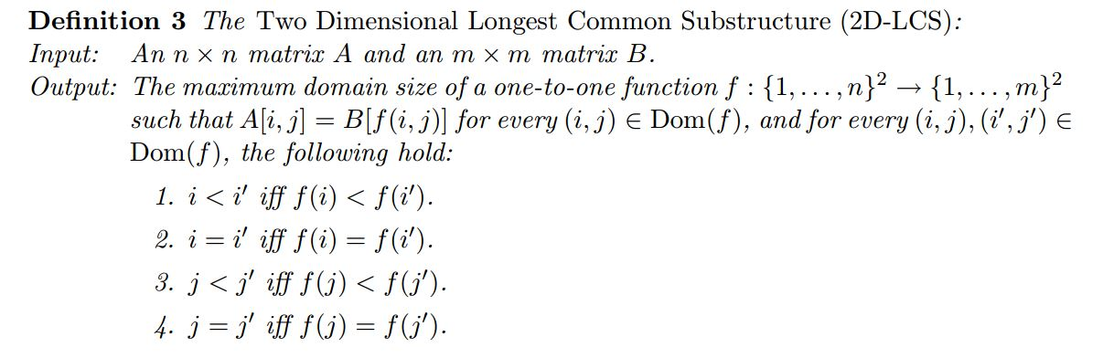
Definition
A | C | Z
B | D | Z
Z | Z | Z
A | X | C
B | X | D
X | X | X

Slide 29
Definition
A | C | Z
B | D | Z
Z | Z | Z
A | X | C
B | X | D
X | X | X

Slide 30
A | C | B
B | D | C
C | B | A
A | B | C
B | A | C
B | B | D

Slide 31
A | C | B
B | D | C
C | B | A
A | B | C
B | A | C
B | B | D
A | C | B
B | D | C
C | B | A
A | B | C
B | A | C
B | B | D

Slide 32
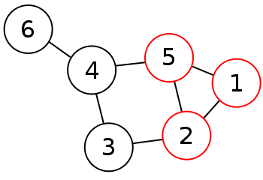
Proof
Prove the hardness of the problem by a reduction from the Clique problem.
A clique in a graph G is a complete subgraph of G; that is, it is a subset S of the vertices such that every two vertices in S are connected by an edge in G.
Clique problem:
Find whether or not there exist a clique
size of k

Slide 33
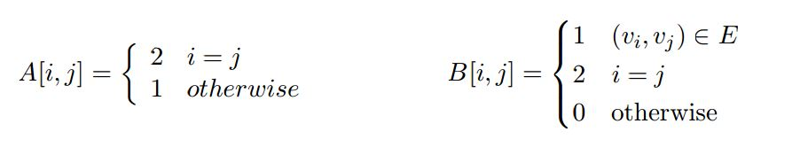

Definition
Given a graph $G=(V,E)$ with vertices $v_{1}v_{2}…v_{n}$ and an integer $K$, we construct two matrices.

Slide 34
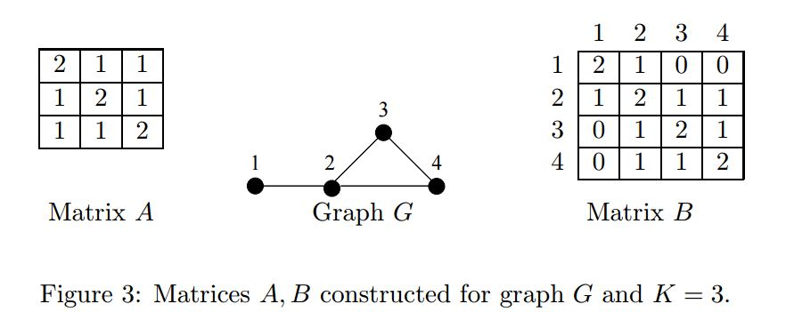

Slide 36
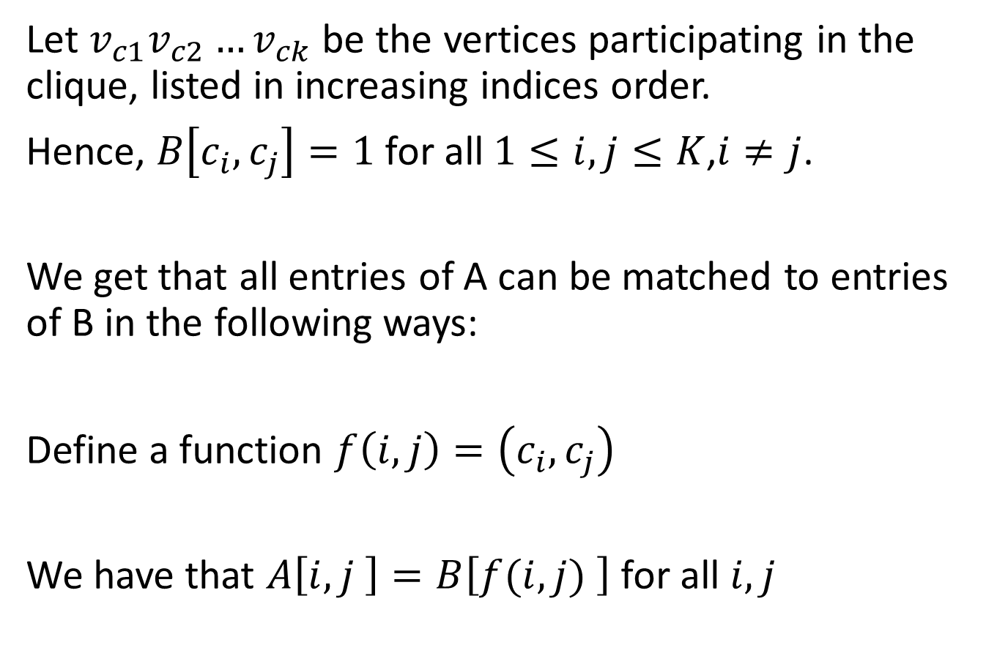
Suppose that G contains a clique of size k
Let $v_{c1}v_{c2}…v_{ck}$ be the vertices participating in the clique, listed in increasing indices order.
Hence, $B\left[c_{i},c_{j}\right]=1$ for all $1≤i,j≤K$,$i≠j$.
We get that all entries of A can be matched to entries of B in the following ways:
Define a function $f\left(i,j\right)=\left(c_{i},c_{j}\right)$
We have that $A\left[i,j \right]=B\left[f(i,j) \right]$ for all $i,j$

Slide 37
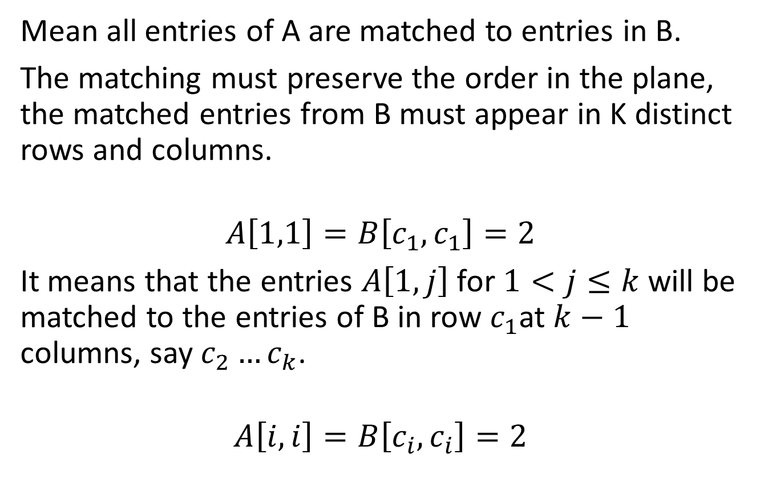

Suppose there is a common substructure between A and B of size $k^{2}$
Mean all entries of A are matched to entries in B.
The matching must preserve the order in the plane, the matched entries from B must appear in K distinct rows and columns.
$$A\left[1,1\right]=B\left[c_{1},c_{1}\right]=2$$
It means that the entries $A\left[1,j\right]$ for $1<j≤k$ will be matched to the entries of B in row $c_{1}$at $k−1$ columns, say $c_{2}…c_{k}$.
$$A\left[i,i\right]=B\left[c_{i},c_{i}\right]=2$$

