Slide 1
A Novel Parallel Scheme for Fast Similarity Search in Large Time Series
Yin Hong, Yang Shuqiang, Ma Shaodong, Liu Fei, Chen Zhikun,Communication,China (Volume:12 ,Issue: 2) P.129 – P.140,2015
Presenter: Wen-Chuan Ho
Date:2015/05/05

Slide 2
Abstract(1/2)
The similarity search is one of the fundamental components in time series data mining, e.g. clustering, classification, association rules mining. Many methods have been proposed to measure the similarity between time series, including Euclidean distance, Manhattan distance, and dynamic time warping (DTW). In contrast, DTW has been suggested to allow more robust similarity measure and be able to find the optimal alignment in time series.

Slide 3
Abstract(2/2)
However, due to its quadratic time and space complexity, DTW is not suitable for large time series datasets. Many improving algorithms have been proposed for DTW search in large databases, such as approximate search or exact indexed search. Unlike the previous modified algorithm, this paper presents a novel parallel scheme for fast similarity search based on DTW, which is called MRDTW (MapRedcuebased DTW). The experimental results show that our approach not only retained the original accuracy as DTW, but also greatly improved the efficiency of similarity measure in large time series.

Slide 4
Dynamic Time Warping(1/2)
C = {71,73,75,80,80,80,78,76,75}
Q = {69,69,73,75,79,80,79,78,76}
 | 71 | 73 | 75 | 80 | 80 | 80 | 78 | 76 | 75
69 | 2 | 4 | 6 | 11 | 11 | 11 | 9 | 7 | 6
69 | 2 | 4 | 6 | 11 | 11 | 11 | 9 | 7 | 6
73 | 2 | 0 | 2 | 7 | 7 | 7 | 5 | 3 | 2
75 | 4 | 2 | 0 | 5 | 5 | 5 | 3 | 1 | 0
79 | 8 | 6 | 4 | 1 | 1 | 1 | 1 | 3 | 4
80 | 9 | 7 | 5 | 0 | 0 | 0 | 2 | 4 | 5
79 | 8 | 6 | 4 | 1 | 1 | 1 | 1 | 3 | 4
78 | 7 | 5 | 3 | 2 | 2 | 2 | 0 | 2 | 3
76 | 5 | 3 | 1 | 4 | 4 | 4 | 2 | 0 | 1
 | 71 | 73 | 75 | 80 | 80 | 80 | 78 | 76 | 75
69 | 2 | 6 | 12 | 23 | 34 | 45 | 54 | 61 | 67
69 | 4 | 6 | 12 | 23 | 34 | 45 | 54 | 61 | 67
73 | 6 | 4 | 6 | 13 | 20 | 27 | 32 | 35 | 37
75 | 10 | 6 | 4 | 9 | 14 | 19 | 22 | 23 | 23
79 | 18 | 12 | 8 | 5 | 6 | 7 | 8 | 11 | 15
80 | 27 | 19 | 13 | 5 | 5 | 5 | 7 | 11 | 16
79 | 35 | 25 | 17 | 6 | 6 | 6 | 6 | 9 | 13
78 | 42 | 30 | 20 | 8 | 8 | 8 | 6 | 8 | 11
76 | 47 | 33 | 21 | 12 | 12 | 12 | 8 | 6 | 7

Slide 5
Dynamic Time Warping(2/2)
 | 71 | 73 | 75 | 80 | 80 | 80 | 78 | 76 | 75
69 | 2 | 6 | 12 | 23 | 34 | 45 | 54 | 61 | 67
69 | 4 | 6 | 12 | 23 | 34 | 45 | 54 | 61 | 67
73 | 6 | 4 | 6 | 13 | 20 | 27 | 32 | 35 | 37
75 | 10 | 6 | 4 | 9 | 14 | 19 | 22 | 23 | 23
79 | 18 | 12 | 8 | 5 | 6 | 7 | 8 | 11 | 15
80 | 27 | 19 | 13 | 5 | 5 | 5 | 7 | 11 | 16
79 | 35 | 25 | 17 | 6 | 6 | 6 | 6 | 9 | 13
78 | 42 | 30 | 20 | 8 | 8 | 8 | 6 | 8 | 11
76 | 47 | 33 | 21 | 12 | 12 | 12 | 8 | 6 | 7

Slide 6
Parallelization of DTW(1/6)
C = {71,73,75,80,80,80,78,76,75}
Q = {69,69,73,75,79,80,79,78,76}
S₁ = {71,73,75}, S₂ = {80,80,80}, S₃ = {78,76,75}

Slide 7
Parallelization of DTW(2/6)
 | 71 | 73 | 75
69 | 2 | 4 | 6
69 | 2 | 4 | 6
73 | 2 | 0 | 2
75 | 4 | 2 | 0
79 | 8 | 6 | 4
80 | 9 | 7 | 5
79 | 8 | 6 | 4
78 | 7 | 5 | 3
76 | 5 | 3 | 1
 | 71 | 73 | 75
69 | 2 | 6 | 12
69 | 4 | 6 | 12
73 | 6 | 4 | 6
75 | 10 | 6 | 4
79 | 18 | 12 | 8
80 | 27 | 19 | 13
79 | 35 | 25 | 17
78 | 42 | 30 | 20
76 | 47 | 33 | 21
Node 1
W₁ =
{(1,1),(1,2),(2,3),(3,4)}
{(1,1),(2,1),(3,1)}
{(1,1),(2,1),(3,2)}
{(1,1),(1,2),(2,3),(3,3)}

Slide 8
Parallelization of DTW(3/6)
 | 78 | 76 | 75
69 | 9 | 7 | 6
69 | 9 | 7 | 6
73 | 5 | 3 | 2
75 | 3 | 1 | 0
79 | 1 | 3 | 4
80 | 2 | 4 | 5
79 | 1 | 3 | 4
78 | 0 | 2 | 3
76 | 2 | 0 | 1
 | 78 | 76 | 75
69 | 9 | 16 | 22
69 | 18 | 16 | 22
73 | 23 | 19 | 18
75 | 26 | 20 | 18
79 | 27 | 23 | 22
80 | 29 | 27 | 27
79 | 30 | 30 | 31
78 | 30 | 32 | 33
76 | 32 | 32 | 33
Node 3
W₃ =
{(7,8),(8,9),(9,9}
{(7,7),(8,8),(9,9)}

Slide 9
Parallelization of DTW(4/6)
 | 80 | 80 | 80
69 | 11 | 11 | 11
69 | 11 | 11 | 11
73 | 7 | 7 | 7
75 | 5 | 5 | 5
79 | 1 | 1 | 1
80 | 0 | 0 | 0
79 | 1 | 1 | 1
78 | 2 | 2 | 2
76 | 4 | 4 | 4
 | 80 | 80 | 80
69 | 11 | 22 | 33
69 | 22 | 22 | 33
73 | 29 | 29 | 29
75 | 34 | 34 | 34
79 | 35 | 35 | 35
80 | 35 | 35 | 35
79 | 36 | 36 | 36
78 | 38 | 38 | 38
76 | 42 | 42 | 42
Node 2
W₂ =
{(4,7),(5,8),(6,9)}
{(4,6),(5,7),(6,8)}
{(4,5),(5,6),(6,7)}
{(4,4),(5,5),(6,6)}
{(4,3),(5,4),(6,5)}
{(4,2),(5,3),(6,4)}
{(4,1),(5,2),(6,3)}
{(4,1),(5,1),(6,2)}
{(4,1),(5,1),(6,1)}

Slide 10
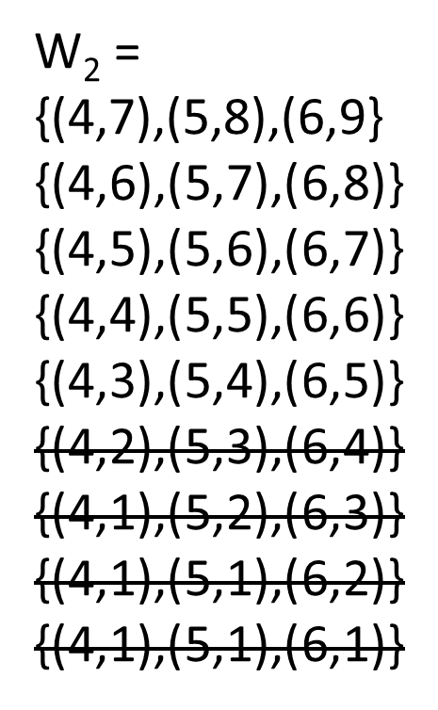
Parallelization of DTW(5/6)
 | 71 | 73 | 75
69 | 2 | 6 | 12
69 | 4 | 6 | 12
73 | 6 | 4 | 6
75 | 10 | 6 | 4
79 | 18 | 12 | 8
80 | 27 | 19 | 13
79 | 35 | 25 | 17
78 | 42 | 30 | 20
76 | 47 | 33 | 21
Node 1
 | 80 | 80 | 80
69 | 11 | 22 | 33
69 | 22 | 22 | 33
73 | 29 | 29 | 29
75 | 34 | 34 | 34
79 | 35 | 35 | 35
80 | 35 | 35 | 35
79 | 36 | 36 | 36
78 | 38 | 38 | 38
76 | 42 | 42 | 42
Node 2
 | 78 | 76 | 75
69 | 9 | 16 | 22
69 | 18 | 16 | 22
73 | 23 | 19 | 18
75 | 26 | 20 | 18
79 | 27 | 23 | 22
80 | 29 | 27 | 27
79 | 30 | 30 | 31
78 | 30 | 32 | 33
76 | 32 | 32 | 33
Node 3

Slide 11
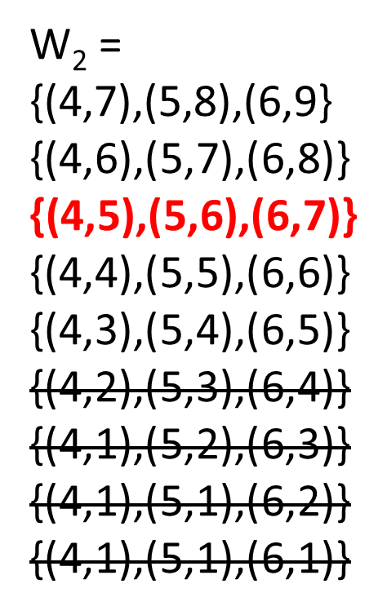
Parallelization of DTW(6/6)
 | 71 | 73 | 75
69 | 2 | 6 | 12
69 | 4 | 6 | 12
73 | 6 | 4 | 6
75 | 10 | 6 | 4
79 | 18 | 12 | 8
80 | 27 | 19 | 13
79 | 35 | 25 | 17
78 | 42 | 30 | 20
76 | 47 | 33 | 21
Node 1
 | 80 | 80 | 80
69 | 11 | 22 | 33
69 | 22 | 22 | 33
73 | 29 | 29 | 29
75 | 34 | 34 | 34
79 | 35 | 35 | 35
80 | 35 | 35 | 35
79 | 36 | 36 | 36
78 | 38 | 38 | 38
76 | 42 | 42 | 42
Node 2
 | 78 | 76 | 75
69 | 9 | 16 | 22
69 | 18 | 16 | 22
73 | 23 | 19 | 18
75 | 26 | 20 | 18
79 | 27 | 23 | 22
80 | 29 | 27 | 27
79 | 30 | 30 | 31
78 | 30 | 32 | 33
76 | 32 | 32 | 33
Node 3

Slide 12
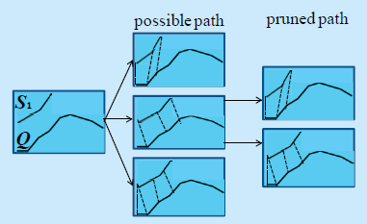
MapReduce-based DTW
Map: A function that transforms the input data into a set of key/value pairs and performs filtering and sorting. All the operations will be executed individually in different nodes

Slide 13
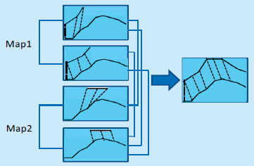
MapReduce-based DTW
Reduce: A function that merges together the results from the Map and integrates the results into a single value.

Slide 14
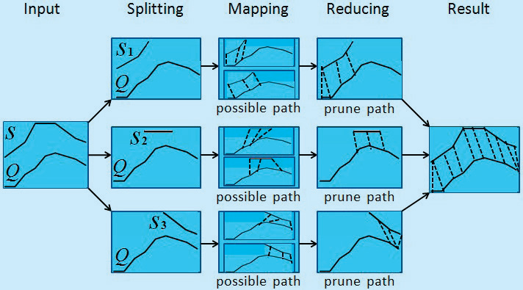
MapReduce-based DTW

Slide 15
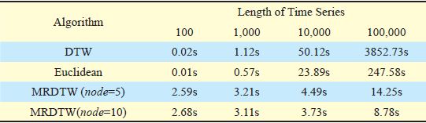
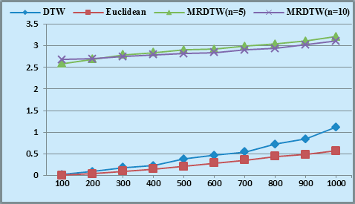
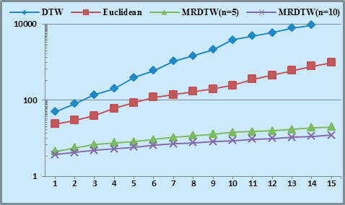
Efficiency of MRDTW
On small time series
On large time series

Slide 16
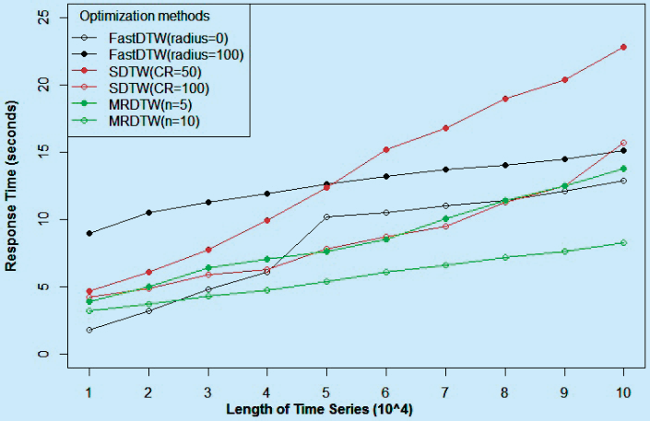
The experimental results

Slide 17
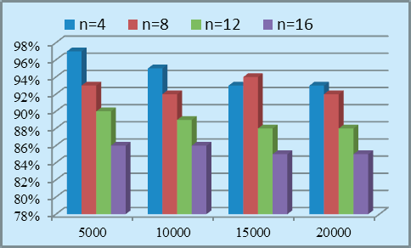
Accuracy of MRDTW

