Slide 1
Multiresolution Gray-Scale and Rotation Invariant Texture Classification with Local Binary Patterns
Timo Ojala, Matti PietikaÈ inen, Senior Member, IEEE, and Topi MaÈenpaÈa
IEEE TRANSACTIONS ON PATTERN ANALYSIS AND MACHINE INTELLIGENCE, VOL. 24, NO. 7, pp.971-988, JULY 2002.
Presenter: Tsai-Ming Sun
Date:2015/5/12

Slide 2
abstract
This paper presents a theoretically very simple, yet efficient, multiresolution approach to gray-scale and rotation invariant texture classification based on local binary patterns and nonparametric discrimination of sample and prototype distributions. The method is based on recognizing that certain local binary patterns, termed “uniform,” are fundamental properties of local image texture and their occurrence histogram is proven to be a very powerful texture feature. We derive a generalized gray-scale and rotation invariant operator presentation that allows for detecting the “uniform” patterns for any quantization of the angular space and for any spatial resolution and presents a method for combining multiple operators for multiresolution analysis. The proposed approach is very robust in terms of gray-scale variations since the operator is, by definition, invariant against any monotonic transformation of the gray scale. Another advantage is computational simplicity as the operator can be realized with a few operations in a small neighborhood and a lookup table.

Slide 3

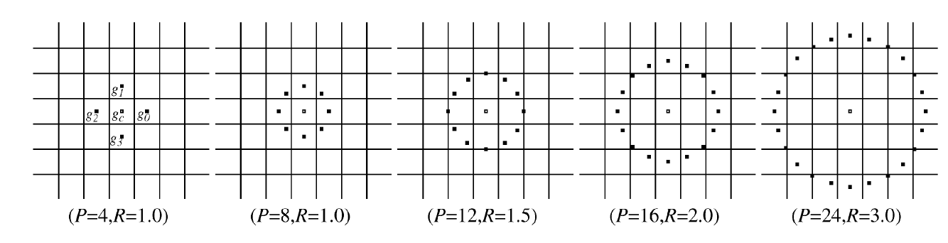
GRAY SCALE AND ROTATION INVARIANT LOCAL BINARY PATTERNS

Slide 4
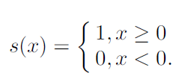
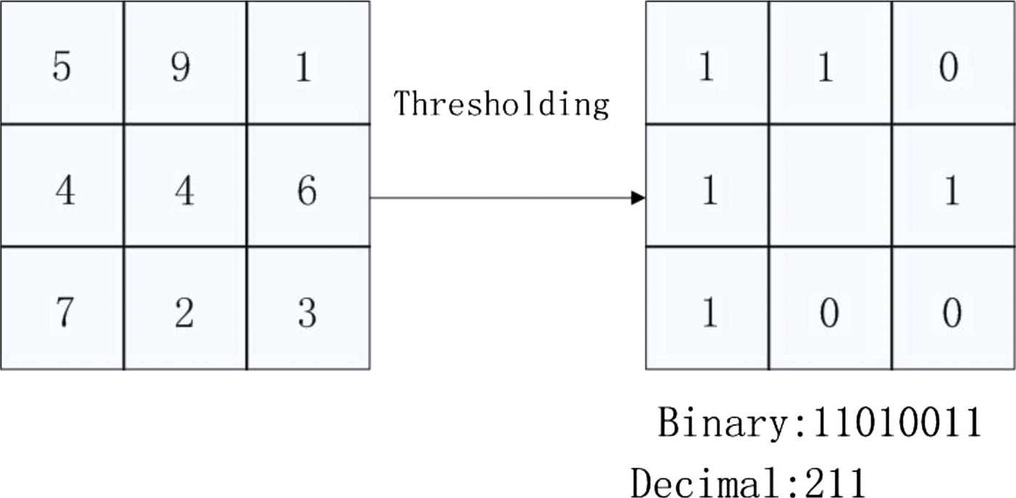
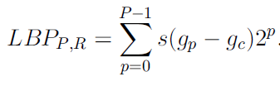

GRAY SCALE AND ROTATION INVARIANT LOCAL BINARY PATTERNS

Slide 5
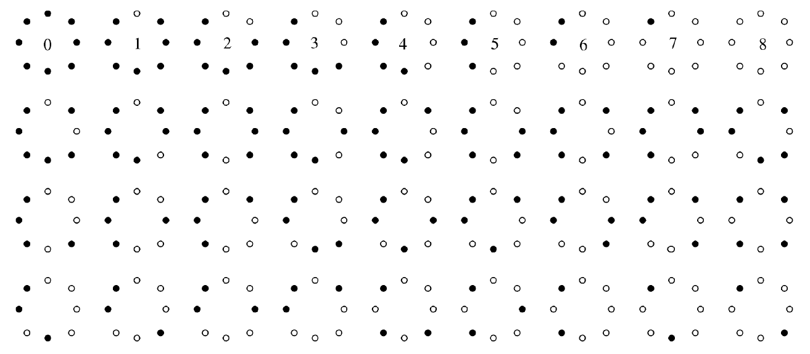
Achieving Rotation Invariance

Slide 6
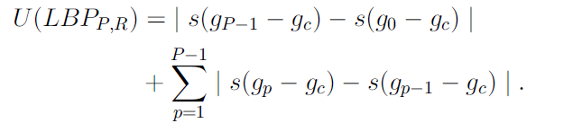
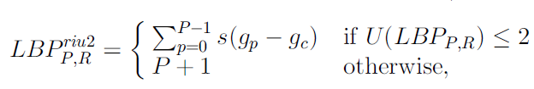
Achieving Rotation Invariance

Slide 7
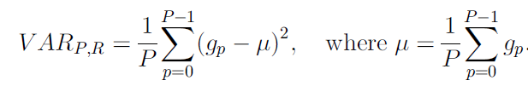
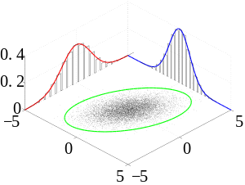
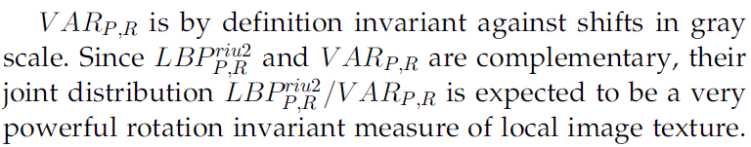
Rotation Invariant Variance Measures of the Contrast of Local Image Texture

Slide 8
