Slide 1
A fast pruned-extreme learning machine for classification problem
Hai-Jun Rong, Yew-Soon Ong, Ah-Hwee Tan, Zexuan Zhu
Division of Information Systems, School of Computer Engineering, Nanyang Technological University
Neurocomputing 2008, Volume 72, pp.359-366
Presenter : Yao-Chou Tsai
Date : 2015/5/18

Slide 2
Abstract(1/2)
Extreme learning machine (ELM) represents one of the recent successful approaches in machine learning, particularly for performing pattern classification. One key strength of ELM is the significantly low computational time required for training new classifiers since the weights of the hidden and output nodes are randomly chosen and analytically determined, respectively. In this paper, we address the architectural design of the ELM classifier network, since too few/many hidden nodes employed would lead to underfitting/overfitting issues in pattern classification. In particular, we describe the proposed pruned-ELM (P-ELM) algorithm as a systematic and automated approach for designing ELM classifier network.

Slide 3
Abstract(2/2)
P-ELM uses statistical methods to measure the relevance of hidden nodes. Beginning from an initial large number of hidden nodes, irrelevant nodes are then pruned by considering their relevance to the class labels. As a result, the architectural design of ELM network classifier can be automated. Empirical study of P-ELM on several commonly used classification benchmark problems and with diverse forms of hidden node functions show that the proposed approach leads to compact network classifiers that generate fast response and robust prediction accuracy on unseen data, comparing with traditional ELM and other popular machine learning approaches.

Slide 4
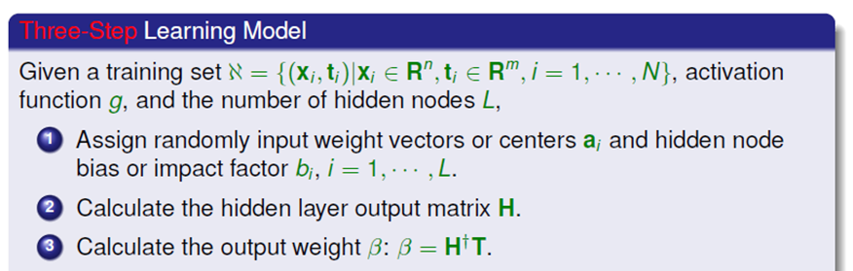
Extreme Learning Machine
The learning algorithm for SLFNs

Slide 5
Main ideas of Pruned-ELM
Identifying the degree of relevance between the hidden nodes and the class labels.
Remove the irrelevant or low relevant hidden nodes.
前置計算步驟與原始ELM相同。
使用統計方法來判斷關聯性。
An extreme large network also brings about longer prediction responses and unnecessary requirement for large memory as well.

Slide 6


Chi-squared (1/2)
Hypothesis Testing
兩個分類變數的關聯性分析
Formula
$A$是觀察變數，$E$ 是期望變數

Slide 7
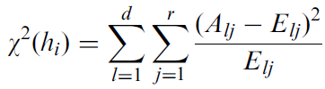
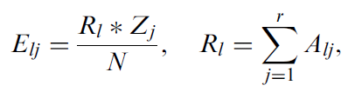


Chi-squared (2/2)
Association between the class labels and individual hidden node.
Class label 代表類別名稱
Main formula
$d$ is the number of discrete bins for individual hidden node $h_{i}$
$r$ is the number of class labels.
$A_{lj}$ represents the cardinality of bin $l$ and class label $j$.
$E_{lj}$ represents the expected cardinality of $A_{lj}$.

Slide 8
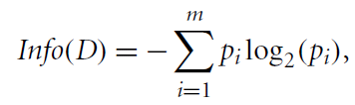
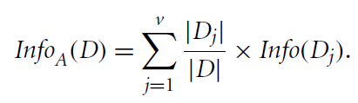

Information gain (1/2)
Comes from Information theory
Entropy of D

Slide 9


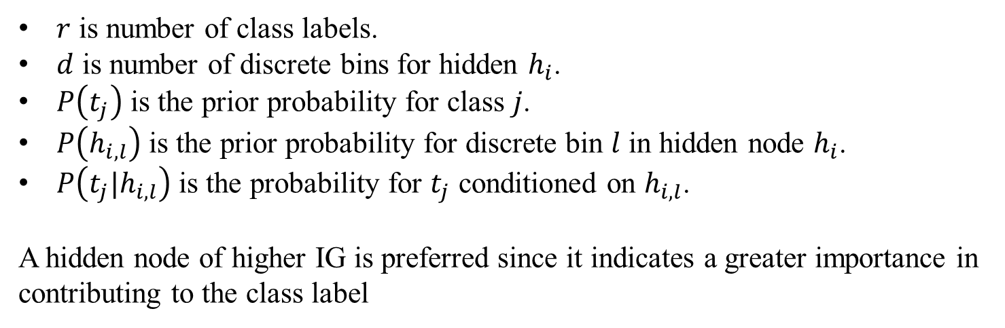
Information gain (2/2)
$r$ is number of class labels.
$d$ is number of discrete bins for hidden $h_{i}$.
$P\left(t_{j}\right)$ is the prior probability for class $j$.
$P\left(h_{i,l}\right)$ is the prior probability for discrete bin $l$ in hidden node $h_{i}$.
$P\left(t_{j}|h_{i,l}\right)$ is the probability for $t_{j}$ conditioned on $h_{i,l}$.
A hidden node of higher IG is preferred since it indicates a greater importance in contributing to the class label

Slide 10
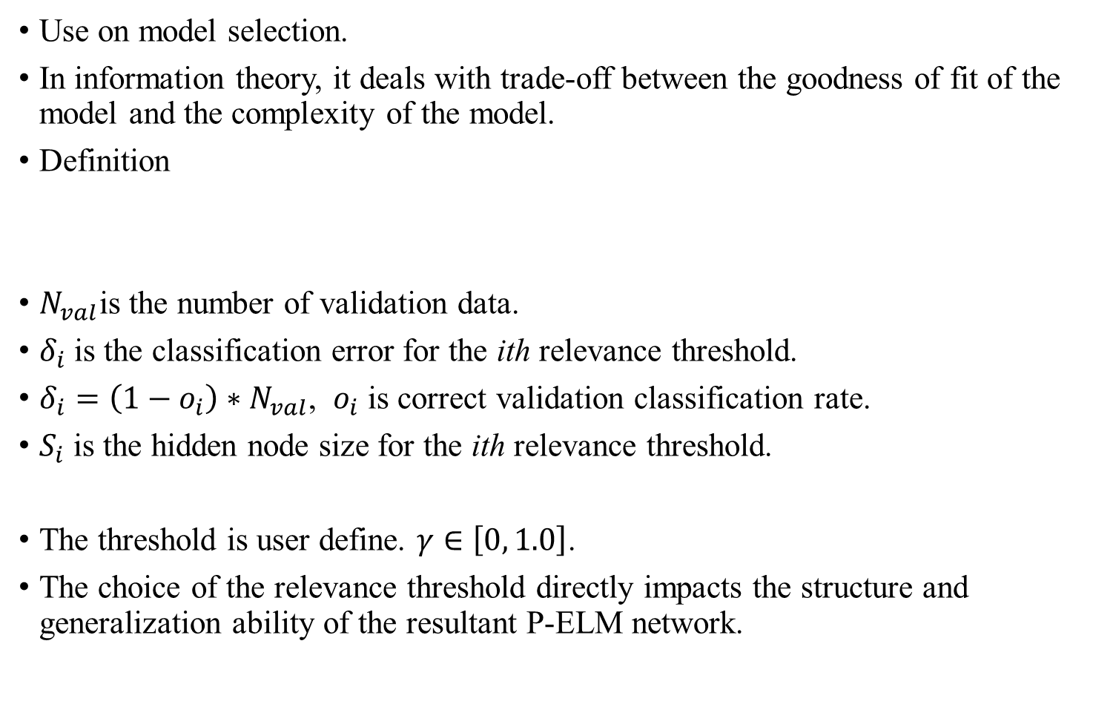
Akaike's Information Criterion
Use on model selection.
In information theory, it deals with trade-off between the goodness of fit of the model and the complexity of the model.
Definition
$N_{val}$is the number of validation data.
$δ_{i}$ is the classification error for the ith relevance threshold.
$δ_{i}=\left(1−o_{i}\right)∗N_{val}$, $o_{i}$ is correct validation classification rate.
$S_{i}$ is the hidden node size for the ith relevance threshold.
The threshold is user define. $γ∈\left[0, 1.0\right]$.
The choice of the relevance threshold directly impacts the structure and generalization ability of the resultant P-ELM network.

Slide 11
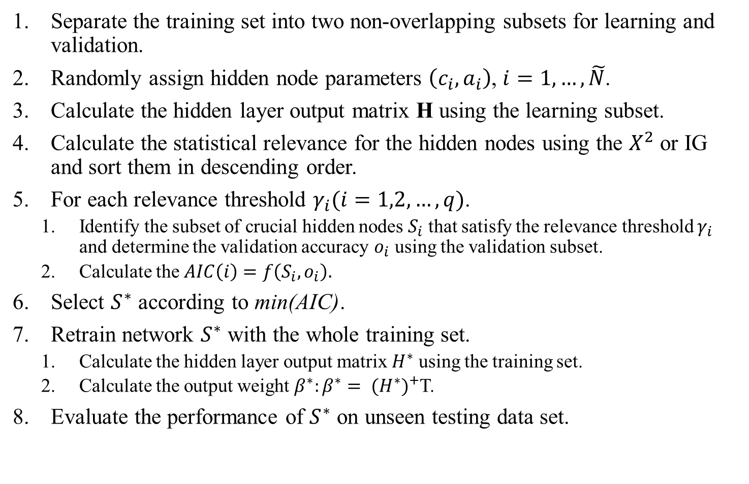
P-ELM algorithm
Separate the training set into two non-overlapping subsets for learning and validation.
Randomly assign hidden node parameters $\left(c_{i},a_{i}\right)$, $i=1, …, \tilde{N}$.
Calculate the hidden layer output matrix H using the learning subset.
Calculate the statistical relevance for the hidden nodes using the $X^{2}$ or IG and sort them in descending order.
For each relevance threshold $γ_{i}(i=1,2,…,q)$.
Identify the subset of crucial hidden nodes $S_{i}$ that satisfy the relevance threshold $γ_{i}$ and determine the validation accuracy $o_{i}$ using the validation subset.
Calculate the $AIC\left(i\right)=f\left(S_{i},o_{i}\right).$
Select $S^{∗}$ according to min(AIC).
Retrain network $S^{∗}$ with the whole training set.
Calculate the hidden layer output matrix $H^{∗}$ using the training set.
Calculate the output weight $β^{∗}:β^{∗}= ({H^{∗})}^{+}$T.
Evaluate the performance of $S^{∗}$ on unseen testing data set.

Slide 12
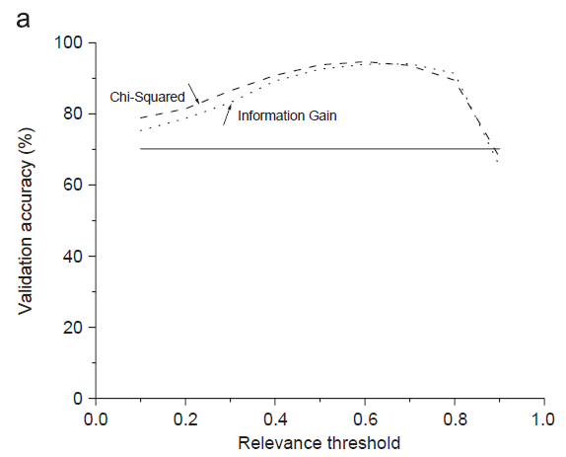
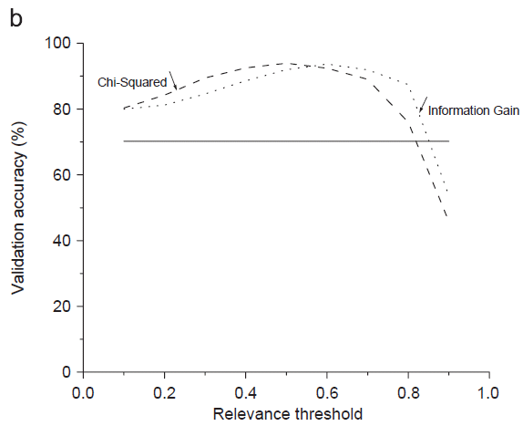
Experimental result(1/2)

Slide 13
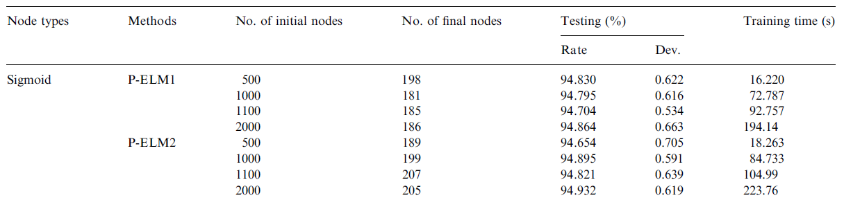
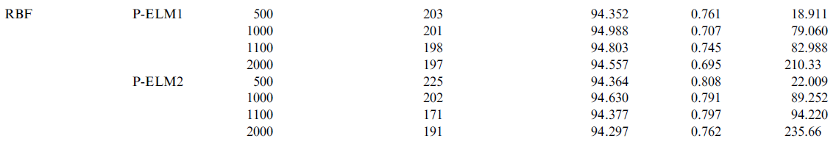
Experimental result(2/2)
Data source : Image segmentation. Training 1100, Testing 1210.

Slide 14
P.S.
OP-ELM: Theory, Experiments and a Toolbox
Aalto University, Finland
Applications of Machine Learning Group
http://research.ics.aalto.fi/eiml/software.shtml

