Slide 1
Synchronizing Dynamic Huﬀman Codes
Shmuel T. Klein, Elina Opalinsky, and Dana Shapira.
Discrete Applied Mathematics, Volume 358, 2024 : 23-32
Presenter: Pei-Chian Lee
Date: Sept. 24, 2024

Slide 2
Abstract
Traditional dynamic Huﬀman algorithms update the frequencies adaptively
after every character, according to the assumption that better compression can be
achieved when all previous characters are taken into account, justifying the slow processing time. This, however, turns the encoded ﬁle into an extremely vulnerable one in the case of even a single bit error. Since the above mentioned assumption is not necessarily true, we explore blockwise dynamic Huﬀman variants, where the Huﬀman tree is periodically, rather than constantly, updated. Experiments show that avoiding the updates at every character and choosing larger blocks does not hurt the compression performance, and may even improve it at times. Moreover, the new scheme seems to be more robust against single errors introduced in the encoded ﬁle.
Notes:
傳統動態huffman codes，是在編碼或解碼，會去對每個字元的頻率做更新。那本文作法是，在處理完一 個block的字元後，再去一起字元頻率去做更新，當未來有bit發生錯誤時，可以讓huffman解碼快速恢復正常解碼，且壓縮效率也會更好

Slide 3
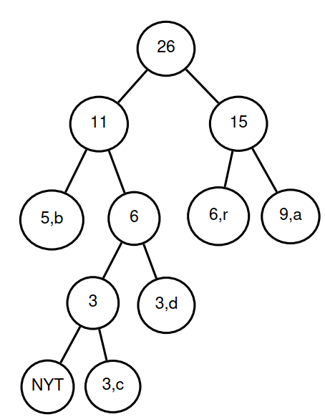
the difficulty of Vitter's algorithm
…101111…
1
0
Notes:
3a

Slide 4
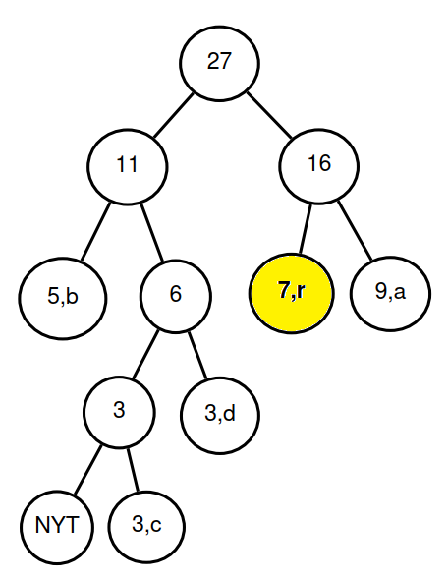
the difficulty of Vitter's algorithm
…101111…
1
r
1
Notes:
3b

Slide 5
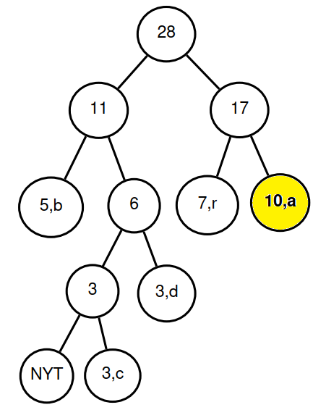
the difficulty of Vitter's algorithm
…101111…
1
r
a
1
Notes:
3c

Slide 6
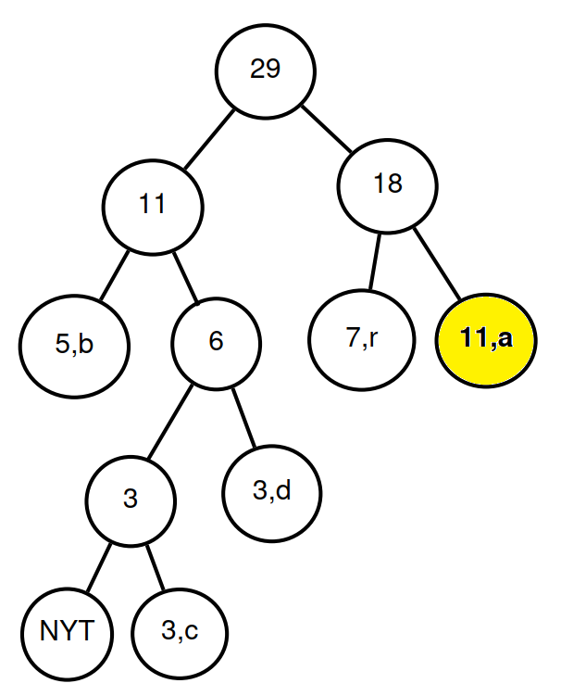
the difficulty of Vitter's algorithm
…101111…
r
a
a
Notes:
3d

Slide 7
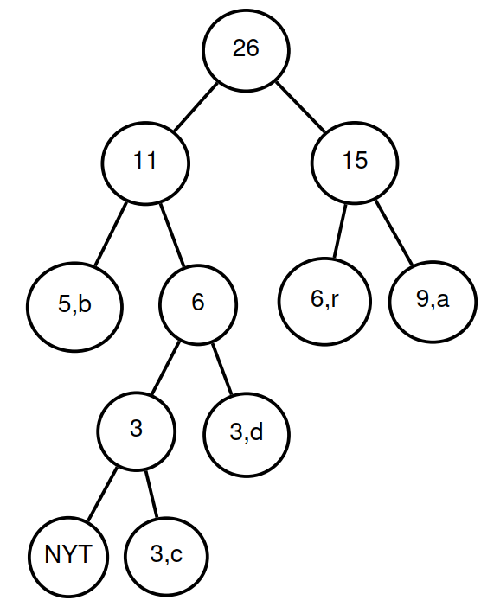
the difficulty of Vitter's algorithm
…101111…->…111111…
1
r
a
a
1
Notes:
4a

Slide 8
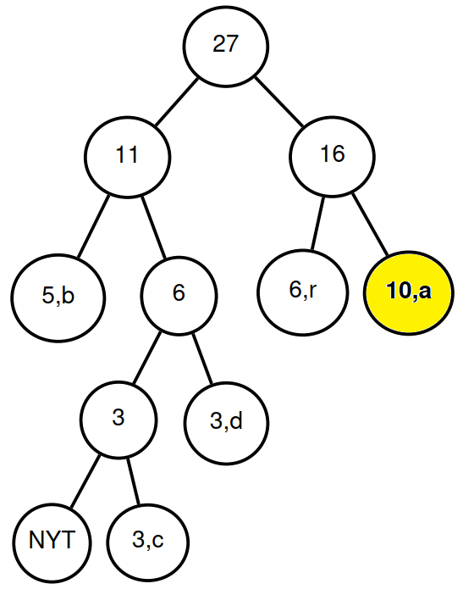
the difficulty of Vitter's algorithm
…101111…->…111111…
1
r
a
a
a
1
Notes:
4b

Slide 9
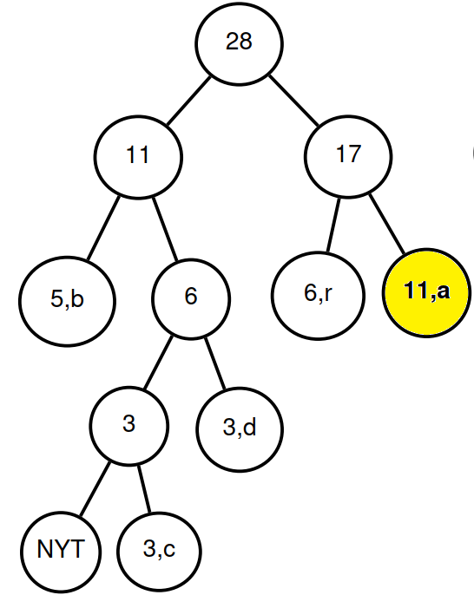
the difficulty of Vitter's algorithm
…101111…->…111111…
1
r
a
a
a
a
1
Notes:
4c

Slide 10
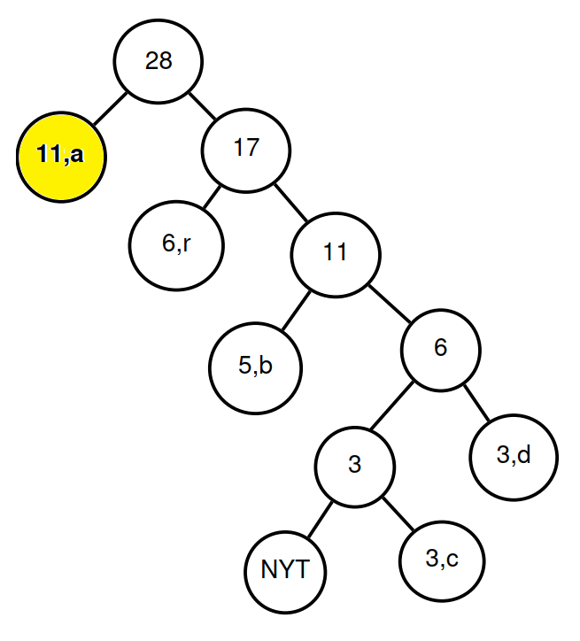
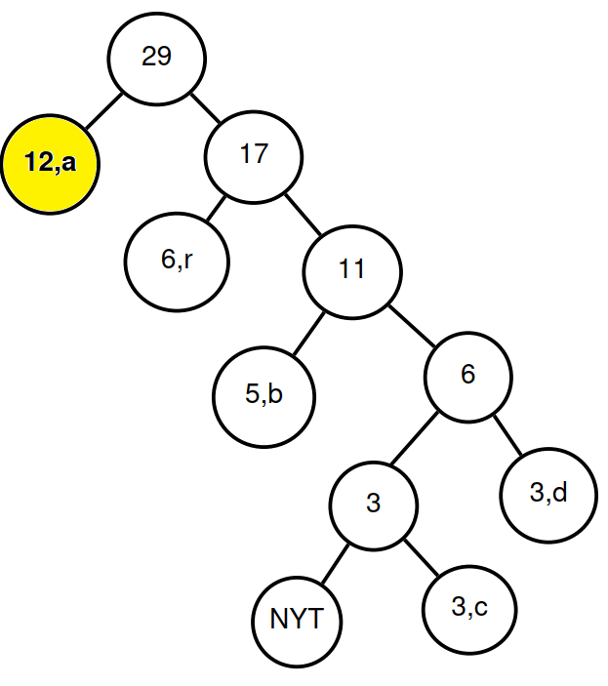
the difficulty of Vitter's algorithm
…101111…->…111111…
r
a
a
a
a
a
Notes:
4d

Slide 11
the difficulty of Vitter's algorithm
…101111…->…111111…
r
a
a
a
a
a
vs
Notes:
R、a頻率被改變外，tree也被改變，失去同步點，解碼就會去錯亂。

Slide 12
Proposed Algorithm
Generalized Dynamic Huff(T, b)
1 HT ← Huﬀman Tree for uniform distribution of Σ
2 while input T is not exhausted do
3 encode/decode the following b characters according to HT
4 update frequencies of Σ according to the last b characters
5 divide all frequencies by 2, rounding up
6 update HT according to updated frequencies

Slide 13
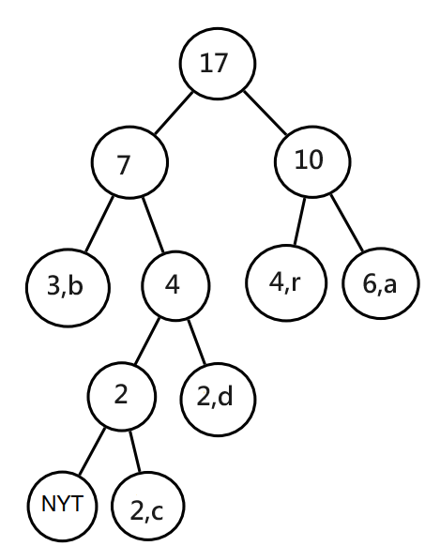
Proposed Algorithm
…1011110010… block size = 5
r
a
a
b
r
a:9+2=11
b:5+1=6
c:3
d:3
r:6+2=8
a:⌈11/2⌉=6
b:⌈6/2⌉=3
c:⌈3/2⌉=2
d:⌈3/2⌉=2
r:⌈7/2⌉=4
1. Spacing out the updates to be done at the end of a block of several characters.
2. Dividing each of them by 2 .

Slide 14
Proposed Algorithm
…1011110010… -> …1111110010… block size = 5
r
a
a
b
r
a
a
a
b
r
a:9+3=12
b:5+1=6
c:3
d:3
r:6+1=7
a:⌈12/2⌉=6
b:⌈6/2⌉=3
c:⌈3/2⌉=2
d:⌈3/2⌉=2
r:⌈7/2⌉=4
1. Spacing out the updates to be done at the end of a block of several characters.
2. Dividing each of them by 2 .

Slide 15
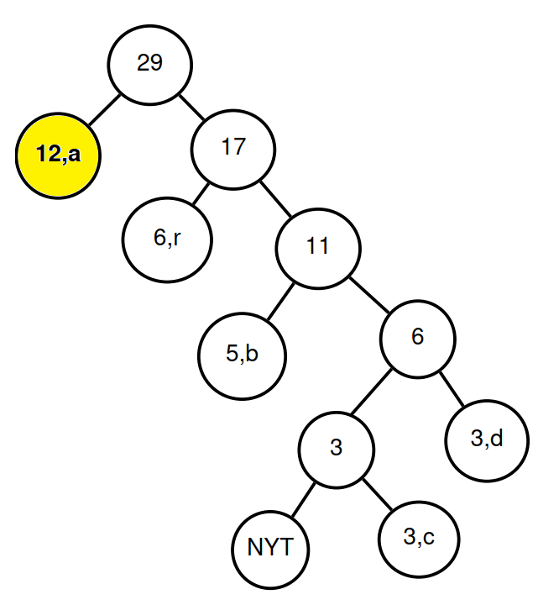
Proposed Algorithm
…1011110010… -> …1111110010… block size = 5
r
a
a
b
r
a
a
a
b
r
Vitter
1. Spacing out the updates to be done at the end of a block of several characters.
2. Dividing each of them by 2 .

Slide 16
Proposed Algorithm
…1011110010… -> …1111110010… block size = 5
r
a
a
b
r
a
a
a
b
r
(step1/step2) | correct | incorrect
a | (11,6) | (12,6)
b | (6,3) | (6,3)
c | (3,2) | (3,2)
d | (3,2) | (3,2)
r | (8,4) | (7,4)
1. Spacing out the updates to be done at the end of a block of several characters.
2. Dividing each of them by 2 .

Slide 17
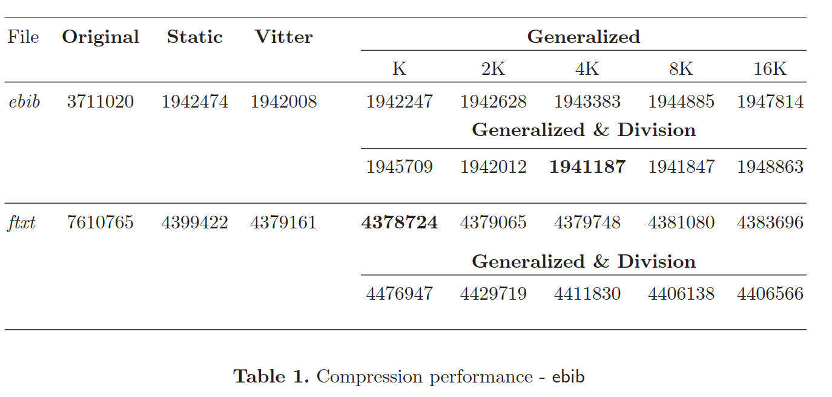
Result

Slide 18
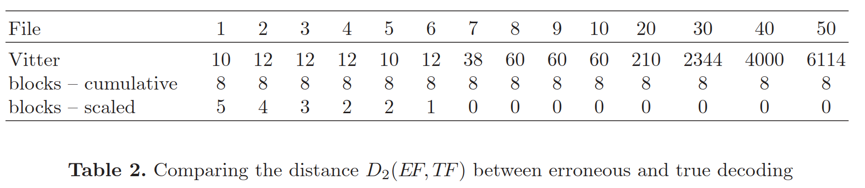

Result
$$D_{2}\left(EF,TF\right)=\sum_{i=1}^{n}{{|ef}_{i}−{tf}_{i}|}$$
Notes:
用頻率差距評估是否同步
File:發生錯誤後的第i個區塊
同步:差距維持在8

Slide 19
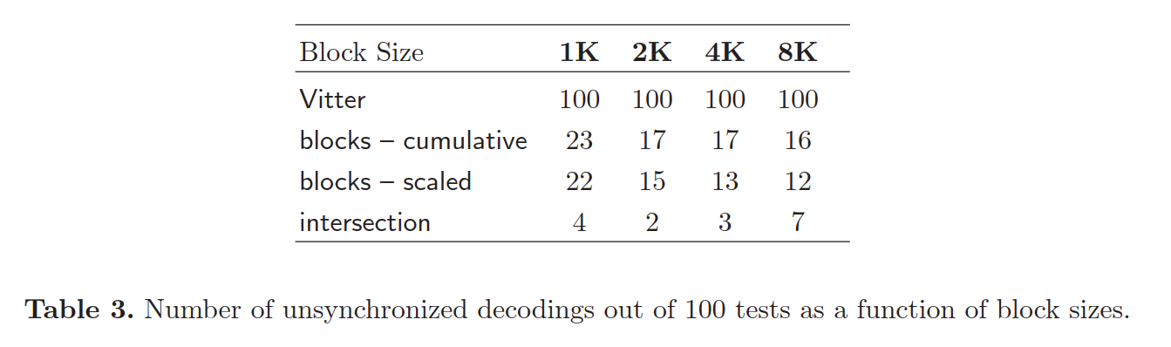
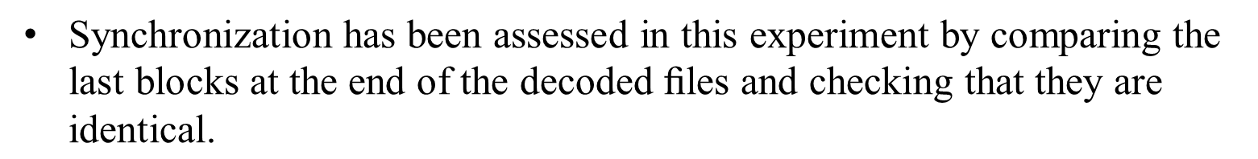
Result
$\text{Synchronization} \text{has} \text{been} \text{assessed} \text{in} \text{this} \text{experiment} \text{by} \text{comparing} \text{the} \text{last} \text{blocks} \text{at} \text{the} \text{end} \text{of} \text{the} \text{decoded}\text{ ﬁ}\text{les} \text{and} \text{checking} \text{that} \text{they} \text{are} \text{identical}\text{.}$
Notes:
用頻率差距評估是否同步
File:發生錯誤後的第i個區塊
同步:差距維持在8
$$\text{Synchronization} \text{has} \text{been} \text{assessed} \text{in} \text{this} \text{experiment} \text{by} \text{comparing} \text{the} \text{last} \text{blocks} \text{at} \text{the} \text{end} \text{of} \text{the} \text{decoded}\text{ ﬁ}\text{les} \text{and} \text{checking} \text{that} \text{they} \text{are} \text{identical}\text{.}$$

Slide 20
Conclusion
This paper introduces a blockwise cumulative frequency update method and a frequency scaling method, which improve robustness against single-bit errors and enhance compression performance.
In blockwise cumulative frequency updates, as long as the error does not occur at the block boundary, there is a chance to restore synchronization before the Huffman tree changes.
Frequency scaling can eliminate small frequency discrepancies.
The larger the block size, the better the compression performance and robustness against single-bit errors.

