Slide 1
An algorithm for solving the longest increasing circular subsequence problem
Yuki Yonemoto, Yuto Nakashima, Shunsuke Inenaga, Hideo Bannai
Information Processing Letters 109.12 (2009): 630-634.
Presenter: Shih-Hong Lee
Date: Sept. 24, 2024

Slide 2
Longest Increasing Circular Subsequence
Given a sequence S = 4,6,2,8,1,3,12,9,5,7,11,10
IIS of S :
S=4 6 2 8 1 3 12 9 5 7 11 10
S=10 4 6 2 8 1 3 12 9 5 7 11
…
S= 12 9 5 7 11 10 4 6 2 8 1 3
…
S=6 2 8 1 3 12 9 5 7 11 10 4

Slide 3
Longest Increasing Subsequence
S=4 6 2 8 1 3 12 9 5 7 11 10
4
4
6
4
6
4
6
8
4
6
8
2
2
2
1
4
6
8
4
6
8
12
4
6
8
12
2
3
2
3
2
3
9
1
1
1

Slide 4
Longest Increasing Subsequence
S=4 6 2 8 1 3 12 9 5 7 11 10
4
6
8
12
4
6
8
12
4
6
8
12
11
2
3
5
9
2
3
5
9
2
3
5
9
1
1
7
1
7
4
6
8
12
10
Time complexity : nloglogn
2
3
5
9
11
1
7

Slide 5
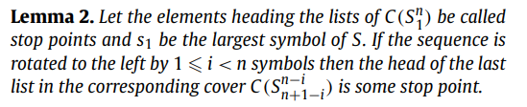
Lemma
S_{rot} = 4,6,2,8,1,3,12,9,5,7,11,10
S = 12,9,5,7,11,10,4,6,2,8,1,3
12
7
11
4
6
8
12
11
9
6
10
2
3
5
9
10
5
3
8
1
7
4
2
1

Slide 6
The cover merging algorithm
S = 4,6,2,8,1,3,12,9,5,7,11,10
S’= 4,6,2,8,1,3 S’’ = 12,9,5,7,11,10
12
7
11
4
6
8
9
10
2
3
5
1

Slide 7
The cover merging algorithm
S = 4,6,2,8,1,3,12,9,5,7,11,10
S’= 4,6,2,8,1,3 S’’ = 12,9,5,7,11,10
7
11
4
6
8
12
10
2
3
9
5
1

Slide 8
The cover merging algorithm
S = 4,6,2,8,1,3,12,9,5,7,11,10
S’= 4,6,2,8,1,3 S’’ = 12,9,5,7,11,10
7
11
4
6
8
12
10
2
3
5
9
1

Slide 9
The cover merging algorithm
S = 4,6,2,8,1,3,12,9,5,7,11,10
S’= 4,6,2,8,1,3 S’’ = 12,9,5,7,11,10
4
6
8
12
11
2
3
5
9
10
1
7

Slide 10
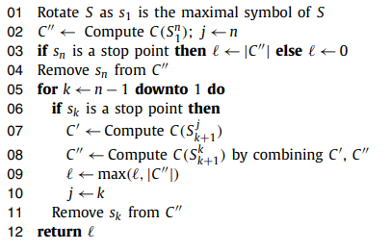
The algorithm computing the LLICS

Slide 11

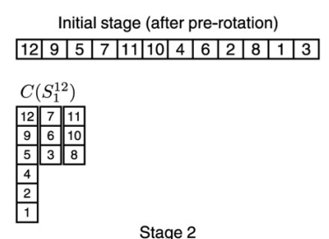
S = 4,6,2,8,1,3,12,9,5,7,11,10
Stop points : 12,7,11

Slide 12

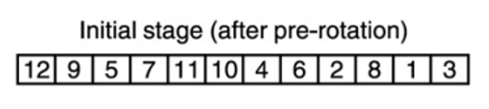
12
7
11
12
7
11
12
7
11
12
7
11
9
6
10
9
6
10
9
6
10
…
9
5
3
8
5
8
5
5
4
4
4
2
2
2
1
1

Slide 13

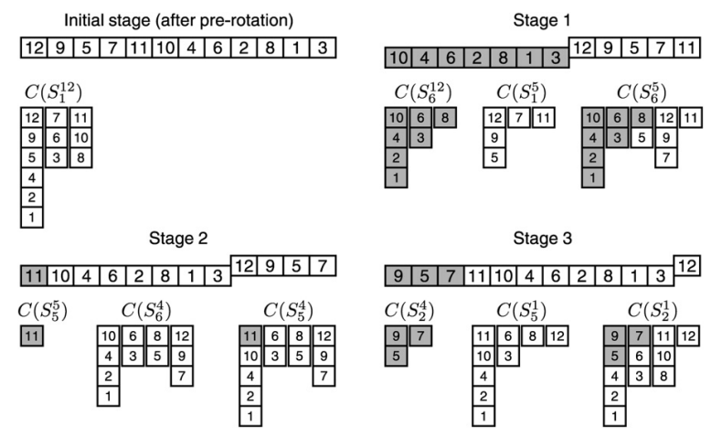

Slide 14
Time complexity of list-based method
Find C(S) : O(n log l)
For each stop symbol
Remove m_{i} symbols to get C(S’’) : O(m_{i})
Construct C(S’) : O(m_{i} log l )
Merge C(S’) and C(S’’) : O(m_{i} l + n)
Totally : O(nl)
Notes:
M is stop points

Slide 15
Time complexity of red-black tree
Totally : O((n+l³⁾ logn)

Slide 16
Thanks

