Slide 1
A global averaging method for dynamic time warping, with applications to clustering
Petitjean, F., Ketterlin, A., & Gançarski, P. (2011).
Pattern recognition, 44(3), 678-693.
Presenter : Jing-Xiang Yang
Date : Sept 24, 2024

Slide 2
ABSTRACT(1)
Mining sequential data is an old topic that has been revived in the last decade, due to the increasing availability of sequential datasets. Most works in this field are centred on the definition and use of a distance (or, at least, a similarity measure) between sequences of elements. A measure called dynamic time warping (DTW) seems to be currently the most relevant for a large panel of applications. This article is about the use of DTW in data mining algorithms, and focuses on the computation of an average of a set of sequences. Averaging is an essential tool for the analysis of data. For example, the K-MEANS clustering algorithm repeatedly computes such an average, and needs to provide a description of the clusters it forms. Averaging is here a crucial step, which must be sound in order to make algorithms work accurately. When dealing with sequences, especially when sequences are compared with DTW, averaging is not a trivial task.

Slide 3
ABSTRACT(2)
Starting with existing techniques developed around DTW, the article suggests an analysis framework to classify averaging techniques. It then proceeds to study the two major questions lifted by the framework. First, we develop a global technique for averaging a set of sequences. This technique is original in that it avoids using iterative pairwise averaging. It is thus insensitive to ordering effects. Second, we describe a new strategy to reduce the length of the resulting average sequence. This has a favourable impact on performance, but also on the relevance of the results. Both aspects are evaluated on standard datasets, and the evaluation shows that they compare favourably with existing methods. The article ends by describing the use of averaging in clustering. The last section also introduces a new application domain, namely the analysis of satellite image time series, where data mining techniques provide an original approach.

Slide 4
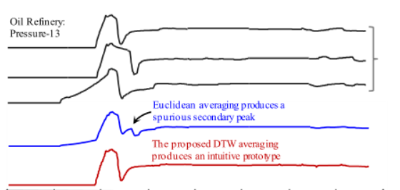
Average of Time Series
Euclidean average
S1 = [S1₁, S1₂, S1₃, S1₄]
S2 = [S2₁, S2₂, S2₃, S2₄]
S3 = [S3₁, S3₂, S3₃, S3₄]
Average C = [C₁ , C₂ , C₃ , C₄]
Euclidean average => produce spurious pattern

Slide 5
Traditional DTW Average methods
Ordering schemes
Tournament scheme
Ascendant hierarchical scheme
sort by DTW distance => S1, S2, S3, S4
(S1, S2) => T1
(T1, S3) => T2
(T2, S4) => C1
S1
S2
T1
C1
S3
T2
S4

Slide 6
Traditional DTW Average methods
Computing the average sequence
One coordinate by association
S1 = [S1₁, S1₂, S1₃, S1₄ , S1₅]
S2 = [S2₁, S2₂, S2₃, S2₄ , S2₅]
One coordinate by connected component
S1 = [S1₁, S1₂, S1₃, S1₄ , S1₅]
S2 = [S2₁, S2₂, S2₃, S2₄ , S2₅]
(S1₁ + S2₁)/2
(S1₂ + S2₂)/2
C = [C₁, C₂, C₃, C₄ , C₅ , C₆]
(S1₁ + S2₂)/2
C = [C₁, C₂, C₃]
(S1₁ + S2₁ + S1₂ + S2₂)/4
(S1₃ + S2₃ + S1₄ + S2₄)/4

Slide 7
Traditional DTW Average methods
NLAAF (Tournament + One coordinate by association)
PSA (Ascendant hierarchical scheme + One coordinate by connected component)
Drawback
The initial approximation error may propagate during averaging.
Average sequence length may be too long or short.

Slide 8
DTW Barycenter Averaging (DBA)
A global averaging method
Iteratively refine the average sequence
Step
Compute DTW to find coordinate associations between each sequence and the temporary average.
Update each average sequence coordinate as the barycenter of associated coordinates.

Slide 9
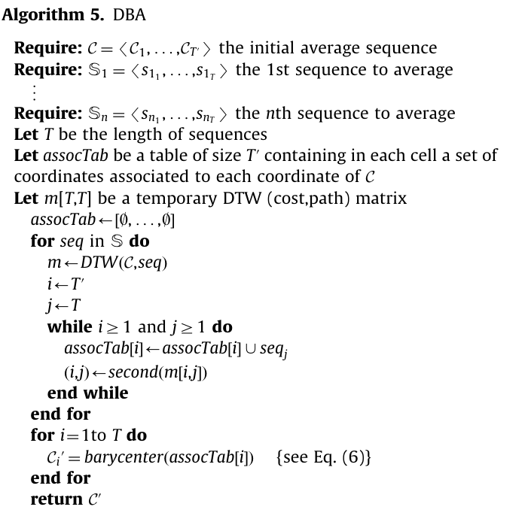

DBA

Slide 10
DBA (Per Iteration)
C = [C₁, C₂, C₃, C₄]
S1 = [S1₁, S1₂, S1₃, S1₄]
S2 = [S2₁, S2₂, S2₃, S2₄]
S3 = [S3₁, S3₂, S3₃, S3₄]
DTW(C, S1) : (C₁, S1₁)、(C₂, S1₂)、(C₂, S1₃)、(C₂, S1₄)
DTW(C, S2) : (C₁, S2₁)、(C₁, S2₂)、(C₂, S2₂)、(C₃, S2₃) 、(C₄, S2₄)
DTW(C, S3) : (C₁, S3₁)、(C₂, S3₂)、(C₂, S3₃)、(C₃, S3₄) 、(C₄, S3₄)

Slide 11
DBA (Per Iteration)
DTW(C, S1) : (C₁, S1₁)、(C₂, S1₂)、(C₃, S1₃)、(C₄, S1₄)
DTW(C, S2) : (C₁, S2₁)、(C₁, S2₂)、(C₂, S2₂)、(C₃, S2₃) 、(C₄, S2₄)
DTW(C, S3) : (C₁, S3₁)、(C₂, S3₂)、(C₂, S3₃)、(C₃, S3₄) 、(C₄, S3₄)
assocTab
C₁
S1₁ | S2₁ | S2₂ | S3₁
S1₂ | S2₂ | S3₂ | S3₃
S1₃ | S2₃ | S3₄
S1₄ | S2₄ | S3₄
C₂
C₃
C₄

Slide 12
DBA (Per Iteration)
assocTab
C₁
S1₁ | S2₁ | S2₂ | S3₁
S1₂ | S2₂ | S3₂ | S3₃
S1₃ | S2₃ | S3₄
S1₄ | S2₄ | S3₄
C₂
C₃
C₄
Update Average Sequence
C1 = (S1₁ + S2₁ + S2₂ + S3₁) / 4
C2 = (S1₂ + S2₂ + S3₂ + S3₃) / 4
C3 = (S1₃ + S2₃ + S3₄) / 3
C4 = (S1₄ + S2₄ + S3₄) / 3
Repeat DBA to converge the average sequence

Slide 13
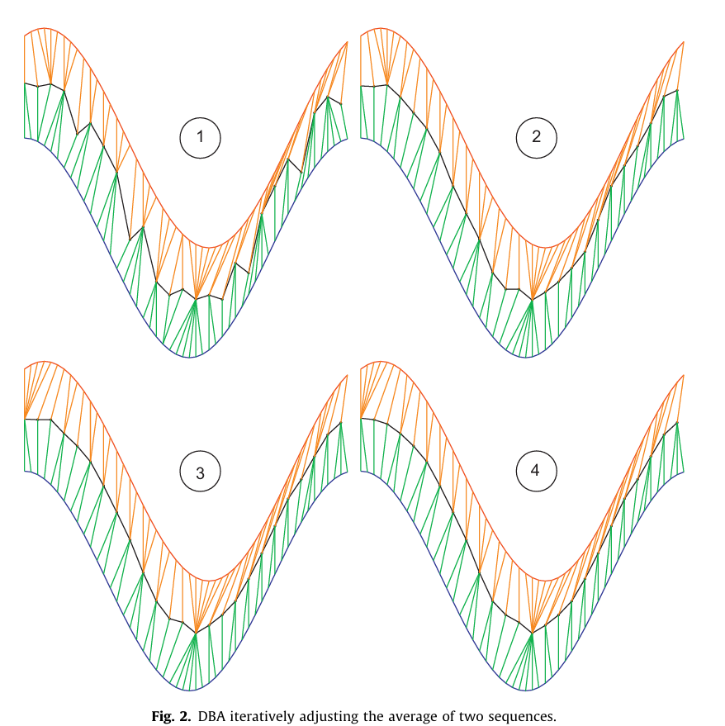
DBA

Slide 14
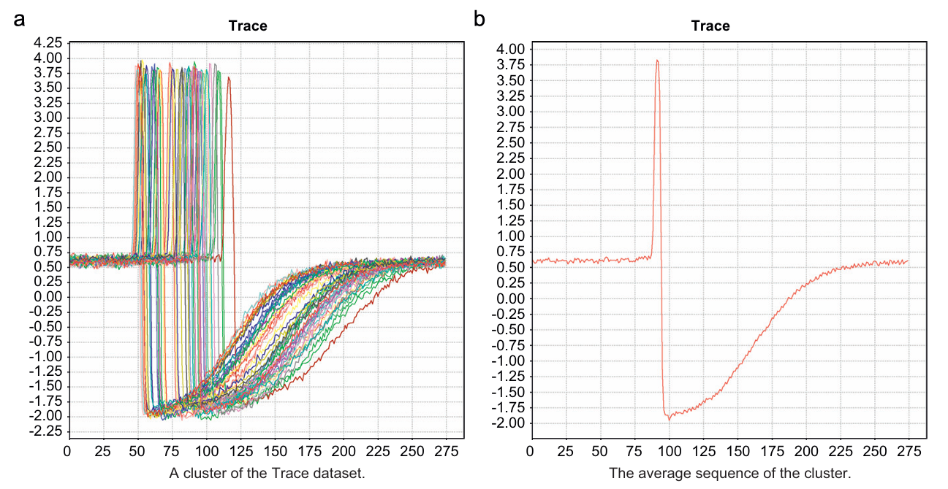
DBA

Slide 15
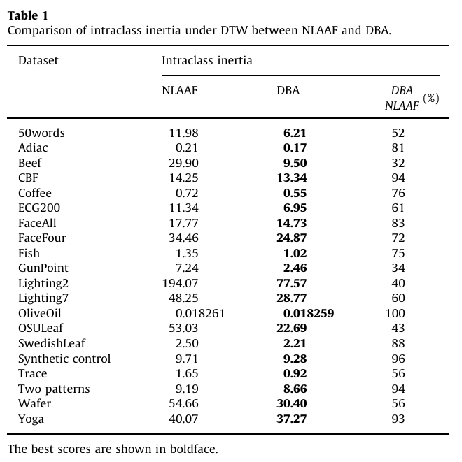
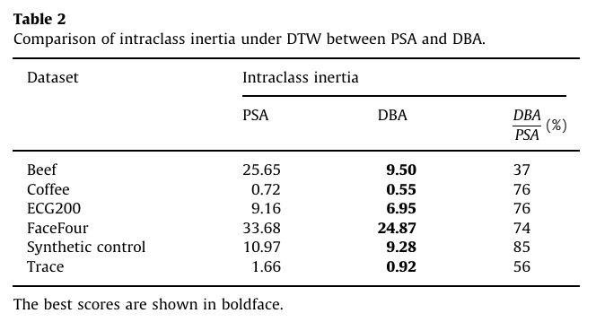
Experiment
Notes:
Inertia measures the distance between data points and their cluster centroids, indicating the compactness within clusters.

Slide 16
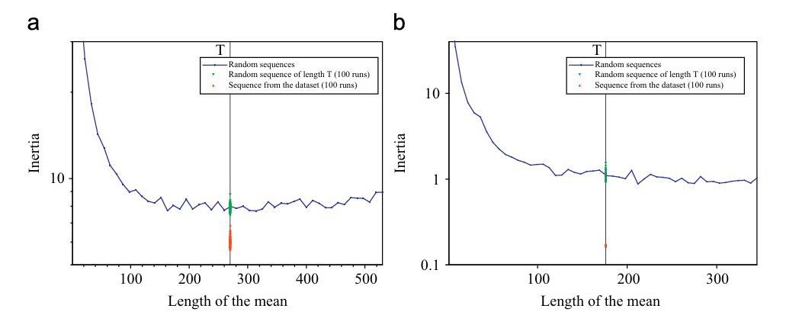
Experiment
An initial average of length T (the data sequence length) is most appropriate.
Randomly selecting a dataset element as the initial average is better.
Notes:
Inertia measures the distance between data points and their cluster centroids, indicating the compactness within clusters.

Slide 17


Time Complexity
N : number of sequences
T : Length of sequence
I : Iteration times
DBA
NLAAF
PSA
Notes:
Inertia measures the distance between data points and their cluster centroids, indicating the compactness within clusters.

Slide 18
Thanks

