Slide 1
Longest Increasing Subsequence Computation over Streaming Sequences
Youhuan Li, Lei Zou, Huaming Zhang and Dongyan Zhao
IEEE Transactions on Knowledge and Data Engineering, vol. 30, no. 6, pp. 1036-1049, 1 June 2018
Presenter: Wen-Yu Chang
Date: Sept. 30, 2024

Slide 2
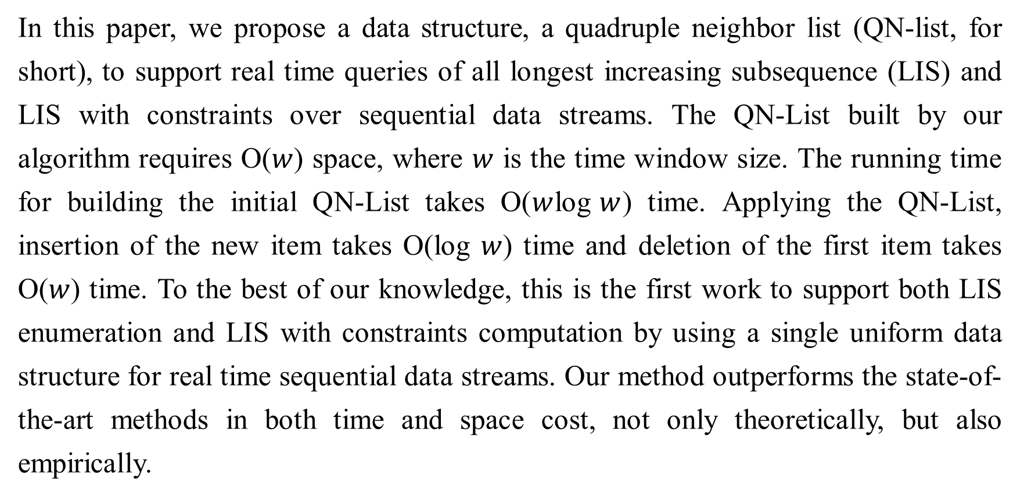
Abstract
In this paper, we propose a data structure, a quadruple neighbor list (QN-list, for short), to support real time queries of all longest increasing subsequence (LIS) and LIS with constraints over sequential data streams. The QN-List built by our algorithm requires O($w$) space, where $w$ is the time window size. The running time for building the initial QN-List takes O($w$log$w$) time. Applying the QN-List, insertion of the new item takes O(log $w$) time and deletion of the first item takes O($w$) time. To the best of our knowledge, this is the first work to support both LIS enumeration and LIS with constraints computation by using a single uniform data structure for real time sequential data streams. Our method outperforms the state-of-the-art methods in both time and space cost, not only theoretically, but also empirically.

Slide 3
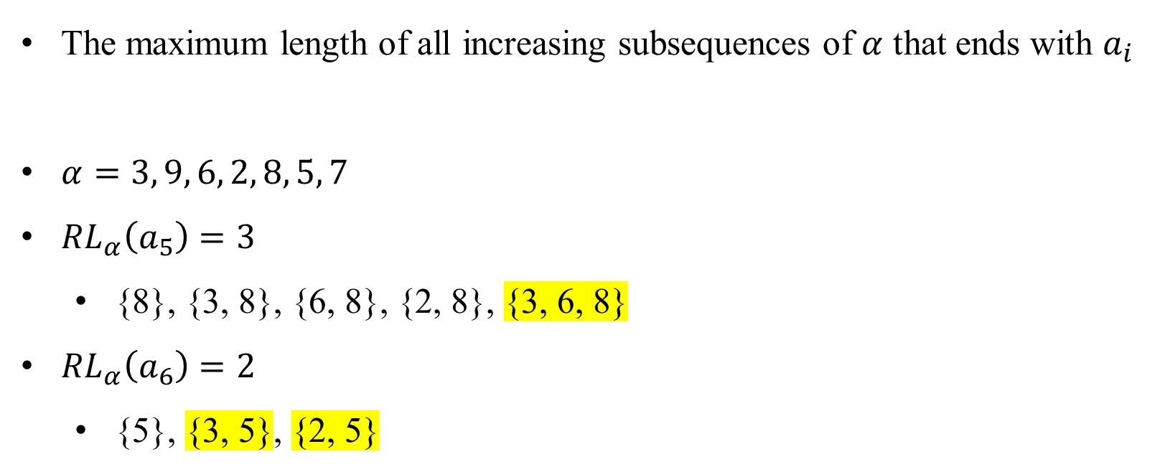
Rising Length
The maximum length of all increasing subsequences of $α$ that ends with $a_{i}$
$α=3, 9, 6, 2, 8, 5, 7$
${RL}_{α}\left(a_{5}\right)=3$
{8}, {3, 8}, {6, 8}, {2, 8}, {3, 6, 8}
${RL}_{α}\left(a_{6}\right)=2$
{5}, {3, 5}, {2, 5}

Slide 4
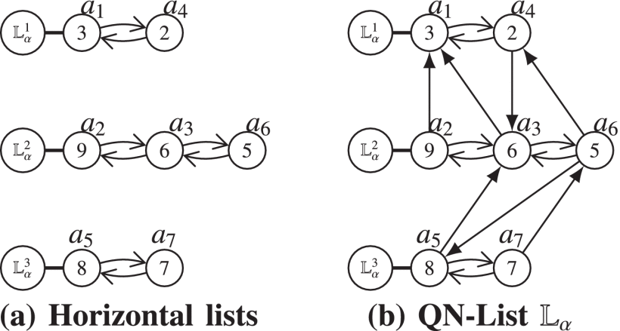
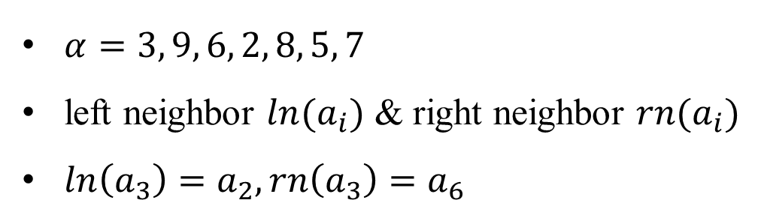
Neighbors (1/2)
$α=3, 9, 6, 2, 8, 5, 7$
left neighbor $ln⁡(a_{i})$ & right neighbor $rn⁡(a_{i})$
$\ln\left(a_{3}\right)=a_{2},\operatorname{rn}\left(a_{3}\right)=a_{6}$

Slide 5
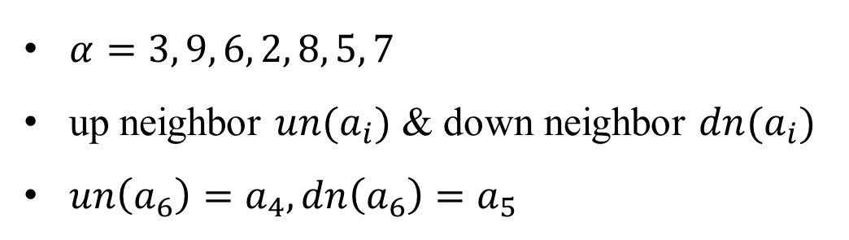
Neighbors (2/2)
$α=3, 9, 6, 2, 8, 5, 7$
up neighbor $un⁡(a_{i})$ & down neighbor $dn⁡(a_{i})$
$\operatorname{un}\left(a_{6}\right)=a_{4},\operatorname{dn}\left(a_{6}\right)=a_{5}$

Slide 6
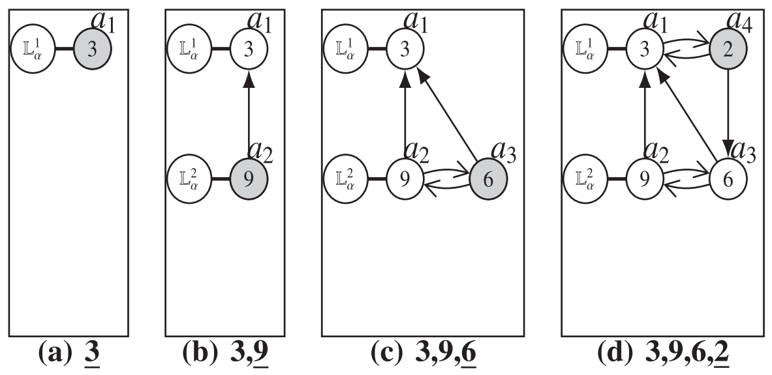

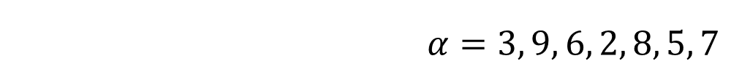
Construction of $𝕃_{α}$
$$α=3, 9, 6, 2, 8, 5, 7$$

Slide 7
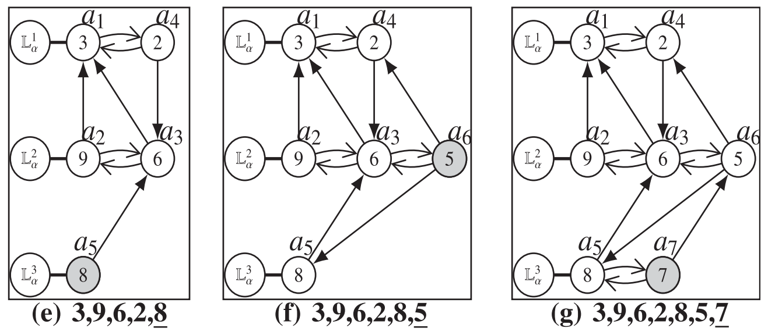
Construction of $𝕃_{α}$
$$α=3, 9, 6, 2, 8, 5, 7$$

Slide 8
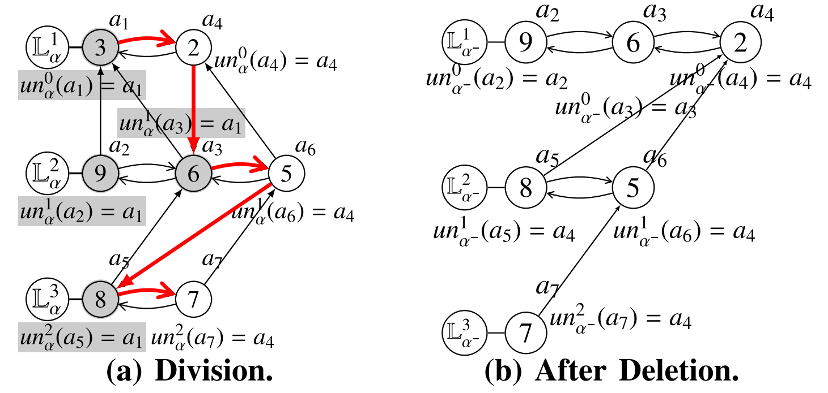
Horizontal Update
$$α=3, 9, 6, 2, 8, 5, 7$$

Slide 9
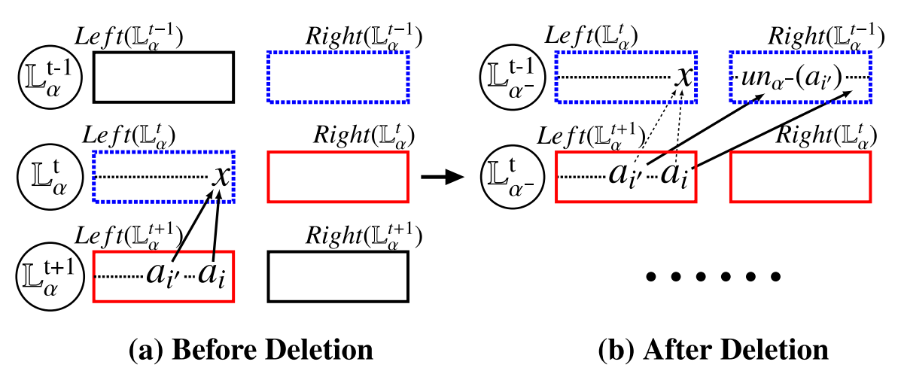


Vertical Update (1/2)
Case 1: Updating up neighbors

Slide 10
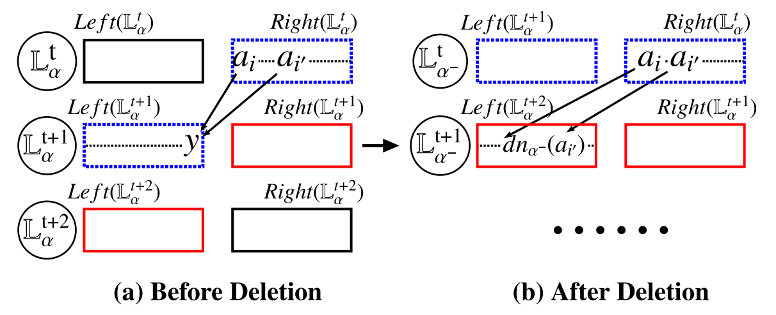

Vertical Update (2/2)
Case 2: Updating down neighbors

Slide 11
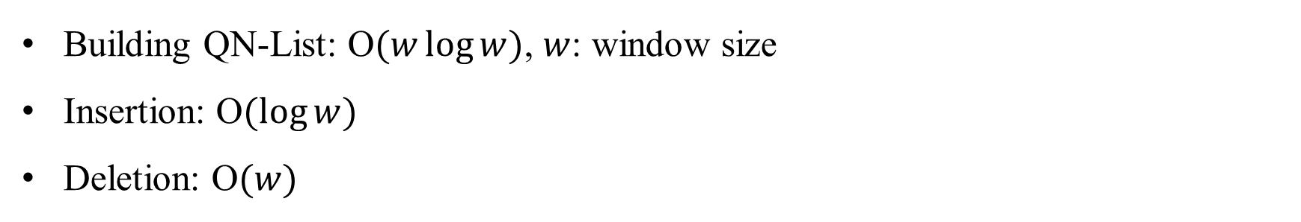
Time Complexity
Building QN-List: O$(w\log{w})$, $w$: window size
Insertion: O$(\log{w})$
Deletion: O$(w)$

