Slide 1
Two Kadane Algorithms for the Maximum Sum Subarray Problem
Joseph B. Kadane
Algorithms 2023, 16, 519.
November 2023, Joseph B. Kadane
Presenter: Tse-Ying Huang
Date: Sept. 30, 2024
Notes:
2014 年第十屆數字技術國際會議
斯洛伐克 日利納

Slide 2
Abstract
The maximum sum subarray problem is to find a contiguous subarray with the largest sum. The history of algorithms to address this problem is recounted, culminating in what is known as Kadane’s algorithm. However, that algorithm is not the algorithm Kadane intended. Nonetheless, the algorithm known as Kadane’s has found many uses, some of which are recounted here. The algorithm Kadane intended is reported here, and compared to the algorithm attributed to Kadane. They are both linear in time, employ just a few words of memory, and use a dynamic programming structure. The results proved here show that these two algorithms differ only in the case of an input consisting of only negative numbers. In that case, the algorithm Kadane intended is more informative than the algorithm attributed to him.

Slide 3
Subarray
-7
4
3
5
8

Slide 4
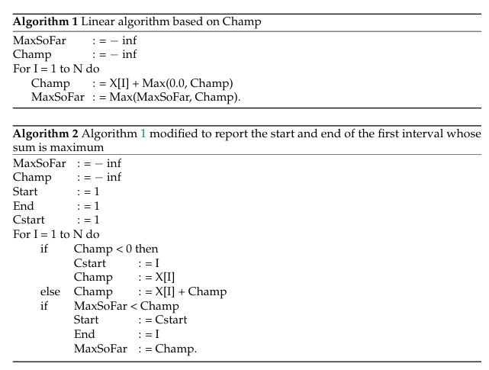
Growing Champions

Slide 5
Algorthim 2
Champ=-inf
MaxSoFar=-inf
Cstart=1
Start=1
End=1
i=1
-7
4
3
5
8
Champ<0
Cstart=1
Champ=-7
If MaxSoFar<Champ
Start=1
End=1
MaxSoFar=Champ=-7
Champ=-7
MaxSoFar=-7
Cstart=1
Start=1
End=1

Slide 6
Algorthim 2
i=2
-7
4
3
5
8
Cstart=2
Champ=4
Start=2
End=2
MaxSoFar=4
Champ=4
MaxSoFar=4
Cstart=2
Start=2
End=2

Slide 7
Algorthim 2
i=3
-7
4
3
5
8
Champ=7
Start=2
End=3
MaxSoFar=Champ=7
Champ=7
MaxSoFar=7
Cstart=2
Start=2
End=3

Slide 8
Algorthim 2
i=4
-7
4
3
5
8
Champ=12
Start=2
End=4
MaxSoFar=Champ=12
Champ=12
MaxSoFar=12
Cstart=2
Start=2
End=4

Slide 9
Algorthim 2
i=5
-7
4
3
5
8
Champ=20
Start=2
End=5
MaxSoFar=Champ=20
Champ=20
MaxSoFar=20
Cstart=2
Start=2
End=5

Slide 10
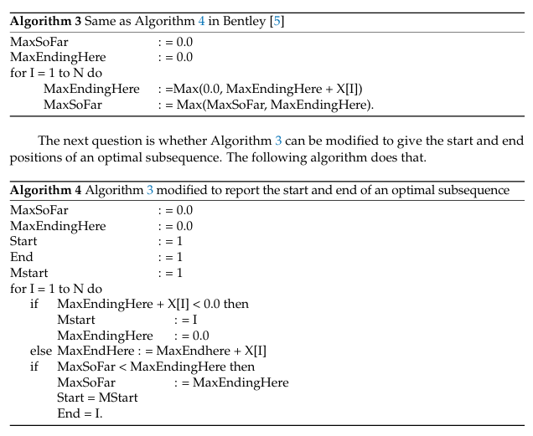
The Linear Algorithm Bentley Gave Me Credit for

Slide 11
Algorthim 4
MaxEndingHere=0.0
MaxSoFar=0.0
Mstart=1
Start=1
End=1
i=1
-7
4
3
5
8
MaxEnding+X[1]<0
Mstart=1
MaxEndingHere =0
MaxSoFar < MaxEndingHere
Start=Mstart=1
MaxSoFar=MaxEndingHere =0
End=1
MaxEndingHere=0.0
MaxSoFar=0.0
Mstart=1
Start=1
End=1

Slide 12
Algorthim 4
MaxEndingHere=0.0
MaxSoFar=0.0
Mstart=1
Start=1
End=1
i=2
-7
4
3
5
8
MaxEnding+X[2]>0
MaxEndingHere =MaxEndingHere +x[2]=4
Start=Mstart=2
MaxSoFar=MaxEndingHere =4
End=2
MaxEndingHere=4
MaxSoFar=4
Mstart=2
Start=2
End=2

Slide 13
Algorthim 4
MaxEndingHere=4
MaxSoFar=4
Mstart=2
Start=2
End=2
i=3
-7
4
3
5
8
MaxEndingHere =7
Start=Mstart=2
MaxSoFar=MaxEndingHere =7
End=3
MaxEndingHere=7
MaxSoFar=7
Mstart=2
Start=2
End=3

Slide 14
Algorthim 4
MaxEndingHere=7
MaxSoFar=7
Mstart=2
Start=2
End=3
i=4
-7
4
3
5
8
MaxEndingHere =12
Start=Mstart=2
MaxSoFar=MaxEndingHere =12
End=4
MaxEndingHere=12
MaxSoFar=12
Mstart=2
Start=2
End=4

Slide 15
Algorthim 4
MaxEndingHere=12
MaxSoFar=12
Mstart=2
Start=2
End=4
i=5
-7
4
3
5
8
MaxEndingHere =20
Start=Mstart=2
MaxSoFar=MaxEndingHere =20
End=5
MaxEndingHere=20
MaxSoFar=20
Mstart=2
Start=2
End=5

Slide 16
Algorthim 2 all-negative-input case
Champ=-inf
MaxSoFar=-inf
Cstart=1
Start=1
End=1
i=1
-7
-4
-3
-5
-8
Champ<0
Cstart=1
Champ=-7
If MaxSoFar<Champ
Start=1
End=1
MaxSoFar=Champ=-7
Champ=-7
MaxSoFar=-7
Cstart=1
Start=1
End=1

Slide 17
Algorthim 4 all-negative-input case
MaxEndingHere=0.0
MaxSoFar=0.0
Mstart=1
Start=1
End=1
i=1
-7
-4
-3
-5
-8
MaxEnding+X[1]<0
Mstart=1
MaxEndingHere =0
MaxSoFar < MaxEndingHere
Start=Mstart=1
MaxSoFar=MaxEndingHere =0
End=1
MaxEndingHere=0.0
MaxSoFar=0.0
Mstart=1
Start=1
End=1

Slide 18
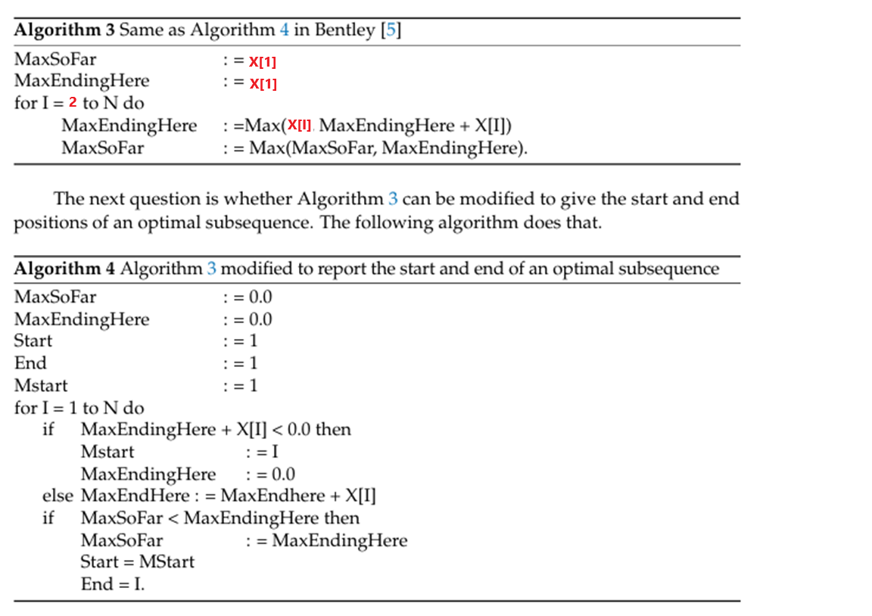
Algorthim 3(Modified)

Slide 19
Conclusion
特性 | Kadane 演算法 (演算法 1 & 2) | Bentley 演算法 (演算法 3 & 4)
時間複雜度 | O(n) | O(n)
空間複雜度 | O(1) | O(1)
是否能找到最大和子陣列的起始和結束位置 | 可以 (演算法 2) | 可以 (演算法 4)
處理全負數輸入 | 返回輸入中最大的數字（絕對值最小） | 返回空集合
其他情況下的結果 | 與 Bentley 算法相同，返回和最大的子陣列 | 與 Kadane 算法相同，返回和最大的子陣列

