Slide 1
Binary Search Tree Visualization Algorithm
Vadym Borovskiy, Jüller Müller, Matthieu-Patrick Schapranow, Alexander Zeier
16th International Conference on Industrial Engineering and Engineering Management(2009)
Presenter: I-Sheng Chen
Date: Oct. 16, 2024

Slide 2
Abstract
Binary search tree is a very common data structure in computer programming. Working with large BSTs can become complicated and inefficient unless a programmer can visualize them. This article contributes with two BST visualization algorithms that draw a tree in time linearly proportional to the number of nodes in a tree.

Slide 3
Drawing BST with Fixed Coordinates(1/4)
(i) The root is always drawn in the (0,0)
(ii) The row index i of any child equals to that of its parent plus 1
(iii) The column index j of a left child equals to doubled column index of its parent, and for the right child j equals to the index of the left child plus 1.

Slide 4
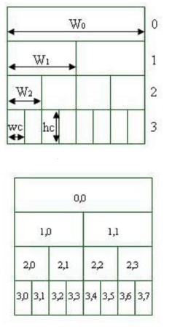
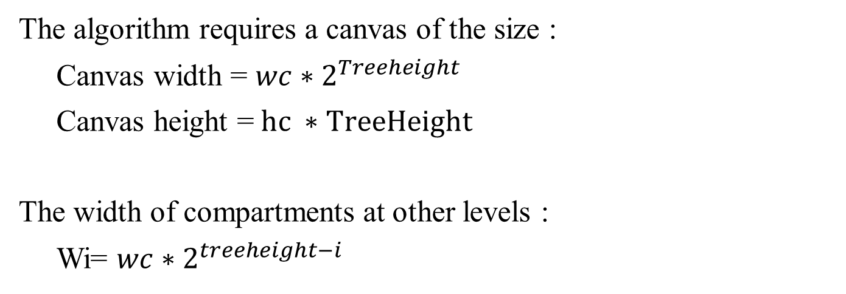
Drawing BST with Fixed Coordinates(2/4)
The algorithm requires a canvas of the size :
Canvas width = $wc∗2^{Treeheight}$
Canvas height =$hc ∗TreeHeight$
The width of compartments at other levels :
Wi= $wc∗2^{treeheight−i}$

Slide 5
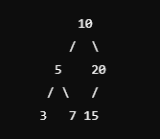
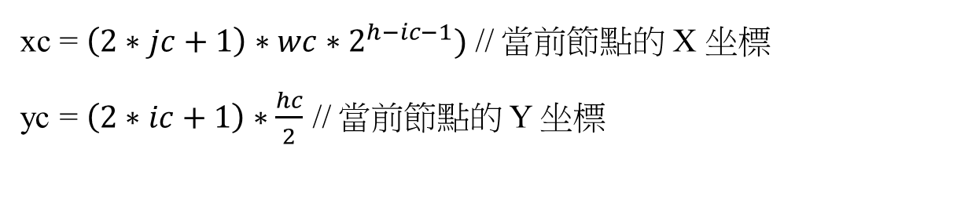
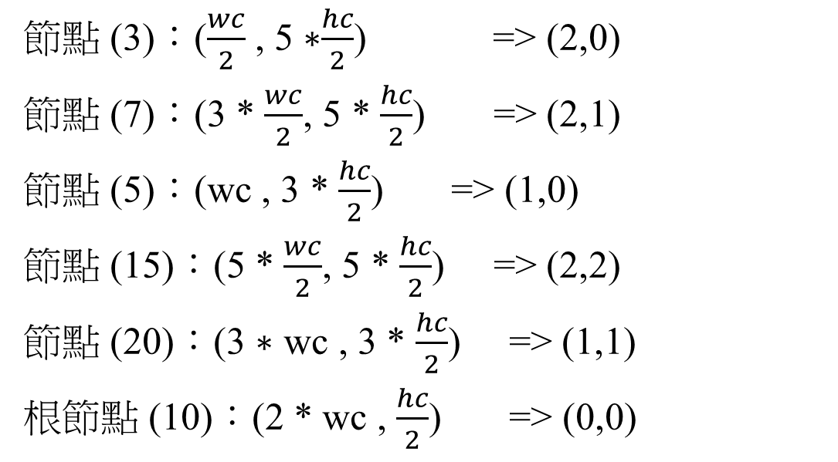
Drawing BST with Fixed Coordinates(3/4)
xc = $\left(2∗jc+1\right)∗wc∗2^{h−ic−1})$ // 當前節點的 X 坐標
yc = $\left(2∗ic+1\right)∗\frac{hc}{2}$ // 當前節點的 Y 坐標
節點 (3)：($\frac{wc}{2}$ , 5 ∗$\frac{hc}{2}$) => (2,0)
節點 (7)：(3 * $\frac{wc}{2}$, 5 * $\frac{hc}{2}$) => (2,1)
節點 (5)：(wc , 3 * $\frac{hc}{2}$) => (1,0)
節點 (15)：(5 * $\frac{wc}{2}$, 5 * $\frac{hc}{2}$) => (2,2)
節點 (20)：(3 ∗ wc , 3 * $\frac{hc}{2}$) => (1,1)
根節點 (10)：(2 * wc , $\frac{hc}{2}$) => (0,0)

Slide 6
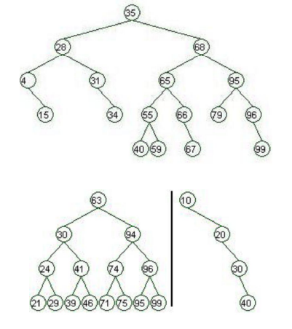
Drawing BST with Fixed Coordinates(4/4)
Disadvantage:
but it has a serious disadvantage. It uses a canvas in the least efficient way. If a tree is close to balanced or even complete this deficiency becomes less obvious. However, if we add only one node to the tree, the algorithm will require a canvas two times as wide as the current one.

Slide 7
Drawing BST with Floating Coordinates(1/3)
Postorder Traversal
Left:
(oX, oY + hc)
right:
(oX+w, oY + hc)
Horizontal offect: (左子點回傳後更新) 右子點回傳後更新
w=stW w+=stw
rX = oX+stW-d/2
vertical offset:
oY =oY+hc

Slide 8
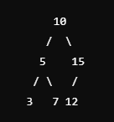
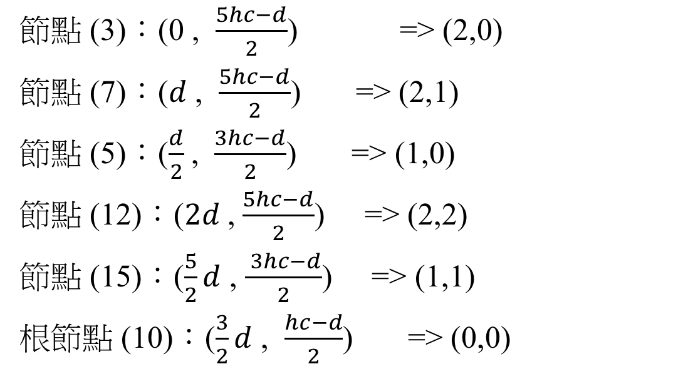
Drawing BST with Floating Coordinates(1/3)
Leaf:
w=d
rX = oX
rX = oX+stW-d/2
節點 (3)：(0 , $\frac{5hc−d}{2}$) => (2,0)
節點 (7)：($d$ , $\frac{5hc−d}{2}$) => (2,1)
節點 (5)：($\frac{d}{2}$, $\frac{3hc−d}{2}$) => (1,0)
節點 (12)：($2d$, $\frac{5hc−d}{2}$) => (2,2)
節點 (15)：($\frac{5}{2}d$ , $\frac{ 3hc−d}{2}$) => (1,1)
根節點 (10)：($\frac{3}{2}d$ , $\frac{hc−d}{2}$) => (0,0)

Slide 9
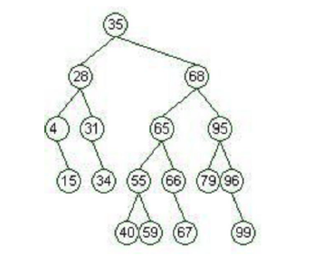

Drawing BST with Floating Coordinates(3/3)
The algorithm requires a canvas of the size :
Canvas width <= $\frac{(wc ∗ (n+1))}{2}$
Canvas height = $hc ∗ TreeHeight$

Slide 10
Conclusion
Fixed Coordinates
Time Complexity: O(n)
Floating Coordinates
Time Complexity: O(n)

Slide 11
Thanks

