Slide 1
The longest almost increasing subsequence problem with sliding windows
Cheng-Han Ho, Chang-Biau Yang.
Theoretical Computer Science 1005 (2024) 114639
Presenter: Wan-Ni Ou
Date: Oct. 16, 2024

Slide 2
Abstract(1/2)
In this paper, we first define the longest almost increasing subsequence with sliding windows (LaISW), a generalization that combines the longest increasing subsequence with sliding windows (LISW) problem and the longest almost increasing subsequence (LaIS) problem.
For a numeric sequence 𝐴, a window size 𝑤 and a tolerance constant 𝑐, the goal of the LaISW problem is to identify the LaIS within all windows of size 𝑤 in 𝐴. In an almost increasing subsequence, slight decreases smaller than 𝑐 are permitted.

Slide 3
Abstract(2/2)
We propose an efficient algorithm for solving the LaISW problem.
Instead of constructing the entire row tower, our algorithm computes the change in drop out (occurrence) for each element in the row tower.
The time complexity of our algorithm is O(𝑛𝐿), and the space complexity is O(𝐿), where 𝑛 and 𝐿 represent the lengths of the input sequence and the LaISW answer, respectively.

Slide 4
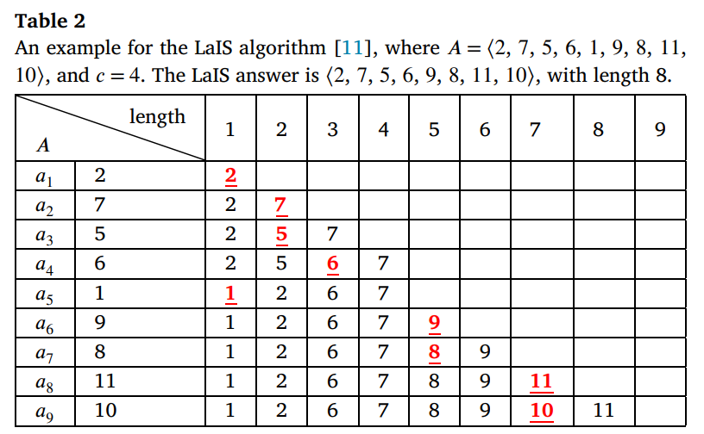
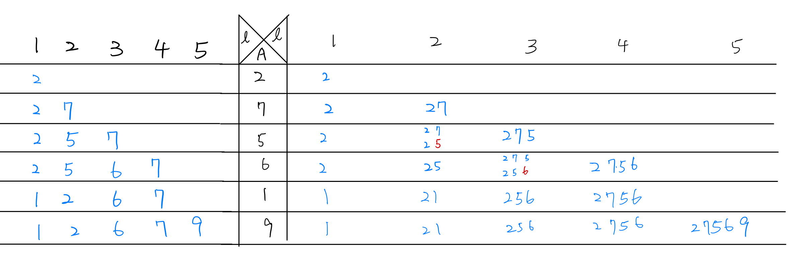
LaIS

Slide 5
LaISW
A = ⟨ 9, 1, 2, 5, 3, 5, 10, 8, 2 ⟩
w = 6
c = 3
A_{2..7} 、A_{3..8}
LCIS = ⟨ 1, 2, 5, 3, 5, 10 ⟩、⟨ 2, 5, 3, 5, 10, 8 ⟩

Slide 6
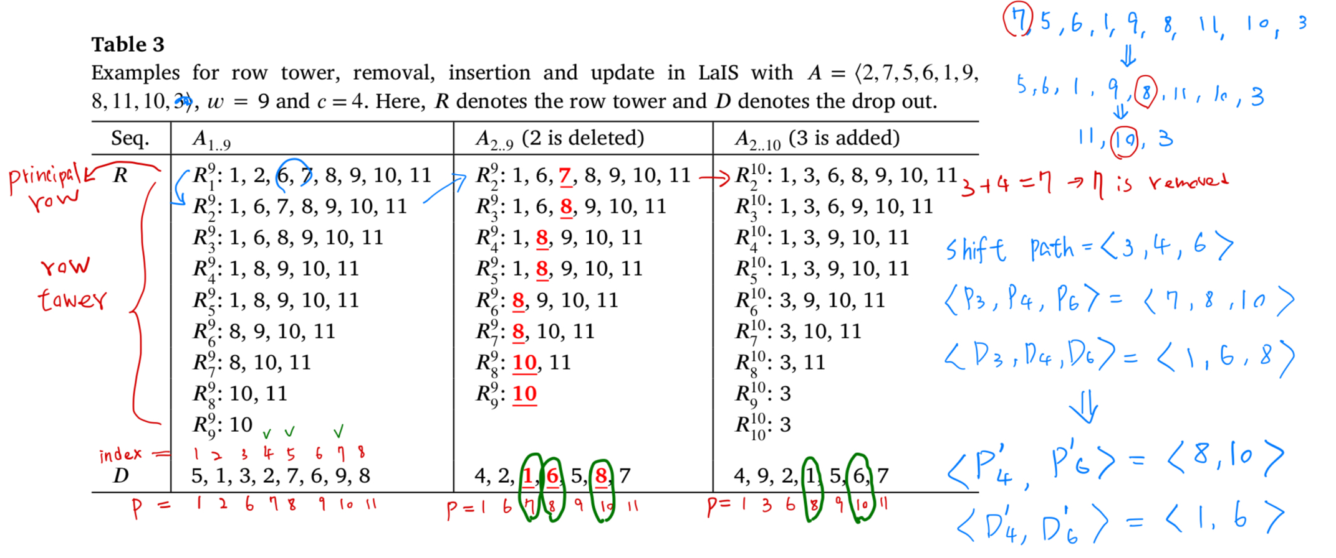
LaIS (row tower and shift path)
A = ⟨ 2, 7, 5, 6, 1, 9, 8, 11, 10, 3⟩

Slide 7
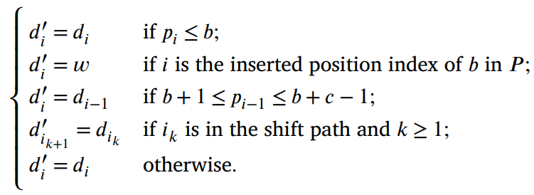
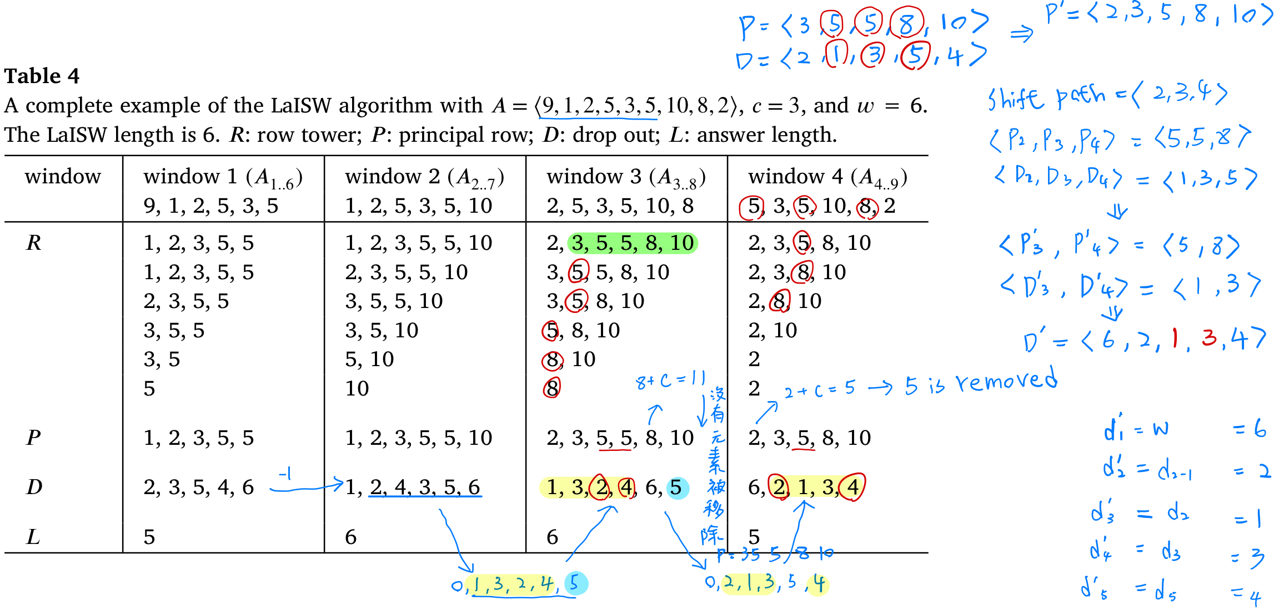
LaISW
A = ⟨ 9, 1, 2, 5, 3, 5, 10, 8, 2 ⟩
c = 3, w = 6

Slide 8
Conclusion
LaISW: Incorporate the concept of ‘almost increasing’ into the LISW problem.
Time Complexity: O(nL)
Space Complexity: O(L)

Slide 9
Thanks

