Slide 1
Mathematizing the Toxin Puzzle
Leonard M. Wapner
Recreational Mathematics Magazine(2024), 10(17), 59-65.
Presenter: Hsin-Chang Yu
Date: Oct. 16, 2024

Slide 2
Abstract
A mathematical model of Gregory Kavka’s “Toxin Puzzle” is constructed to provide the optimal course of action for this thought experiment. But the action suggested by the model is irrational, rendering the model useless for the rational player. Yet, it is the failure itself which provides a deeper insight into the nature of intention and mathematical modeling in general.

Slide 3

Kavka's toxin puzzle
Gregory S. Kavka in 1983
1947-1994

Slide 4




Kavka's toxin puzzle

Slide 5
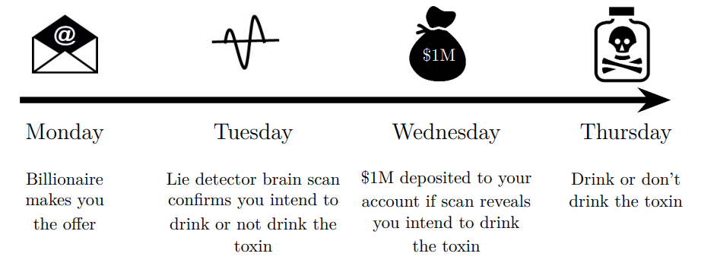
Kavka's toxin puzzle

Slide 6
Mathematical model
Intend to drink, true
Intend to drink, lie
Intend not to drink, true
Intend not to drink, lie

Slide 7
Mathematical model
Intend to drink, true
M: money
T: toxin cost
P_{sen}: probability of lie
P_{spec}: probability of true

Slide 8
Mathematical model
Intend to drink, lie
M: money
T: toxin cost
P_{sen}: probability of lie
P_{spec}: probability of true

Slide 9

Mathematical model
Intend not to drink, true
M: money
T: toxin cost
P_{sen}: probability of lie
P_{spec}: probability of true

Slide 10
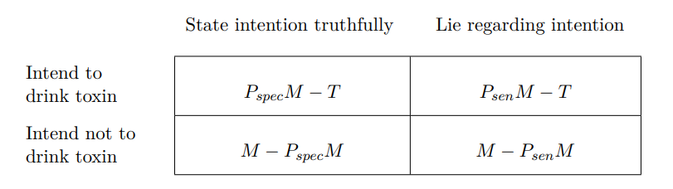
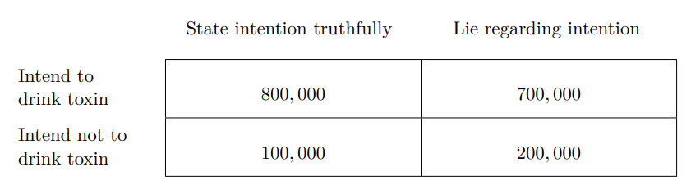
Mathematical model
M = 1’000’000, T = 100’000, P_{sen} = 0.80, P_{spec} = 0.90

Slide 11
Conclusion
Why drink?

Slide 12
Cutting a Round Cake on Scientific Principles
F. G.
Nature(1906), 75(1938), 173.

Slide 13

Cake

Slide 14
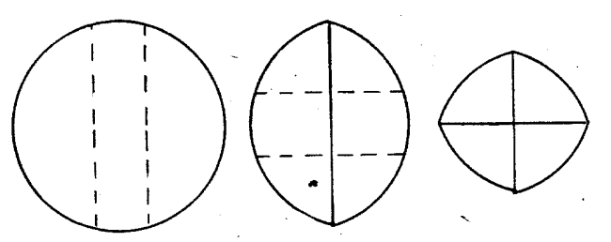
Cutting

Slide 15

Fondant cake

Slide 16
Thanks
Notes:
Given a string S of length n, an integer p ∈ [1..n] is a period of S if S[i] = S[i + p] for all i ∈ [1..n − p].
S[|S| − p + 1] = c

