Slide 1
A Fast Voxel Traversal Algorithm for Ray Tracing
John Amanatides, and Andrew Woo.
Eurographics. Vol. 87. No. 3. 1987.
Presenter: Yen-Yu Chen
Date: Oct.22, 2024

Slide 2
Abstract
A fast and simple voxel traversal algorithm through a 3D space partition is introduced. Going from one voxel to its neighbour requires only two floating point comparisons and one floating point addition. Also, multiple ray intersections with objects that are in more than one voxel are eliminated.

Slide 3
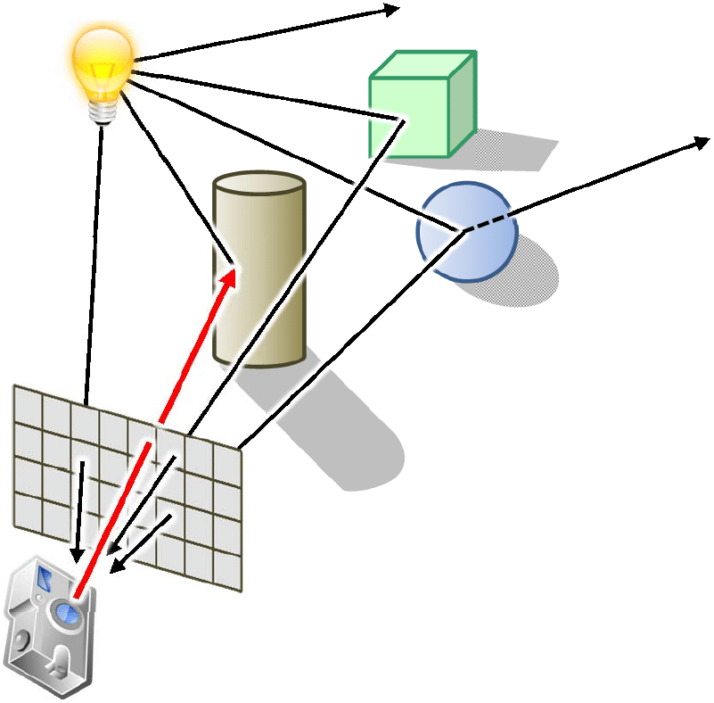
Ray Tracing

Slide 4
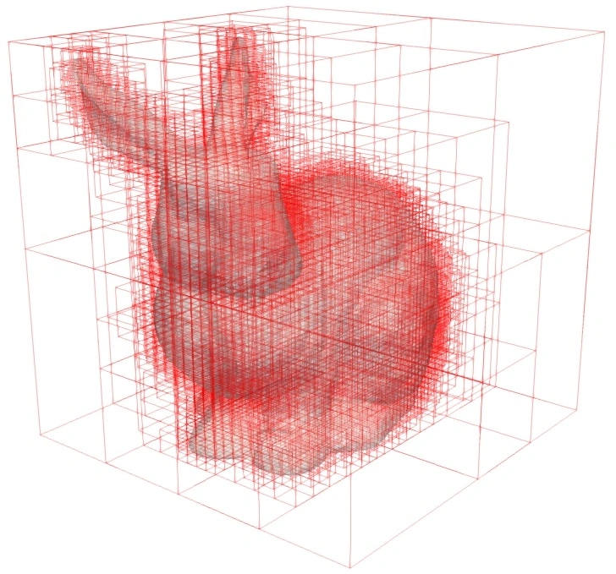
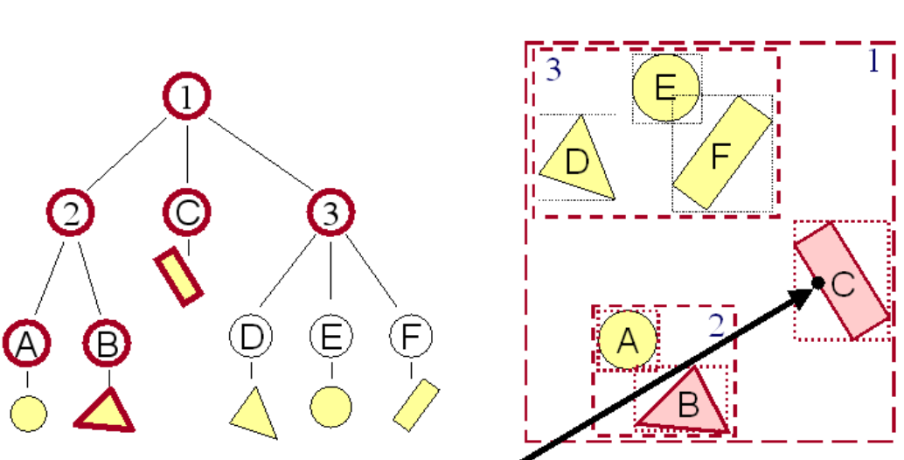
Strategies for Intersection Culling
1. hierarchical bounding volumes
2. space partitioning
Notes:
物體跟光線有 intersection

Slide 5
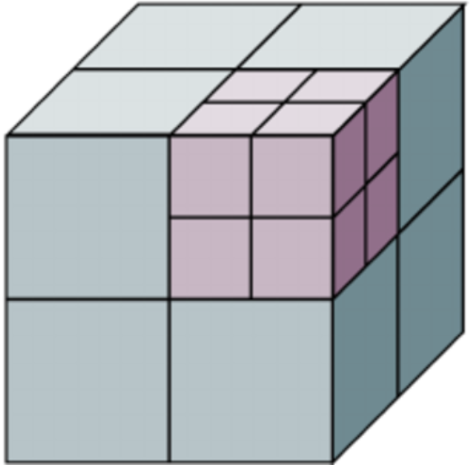
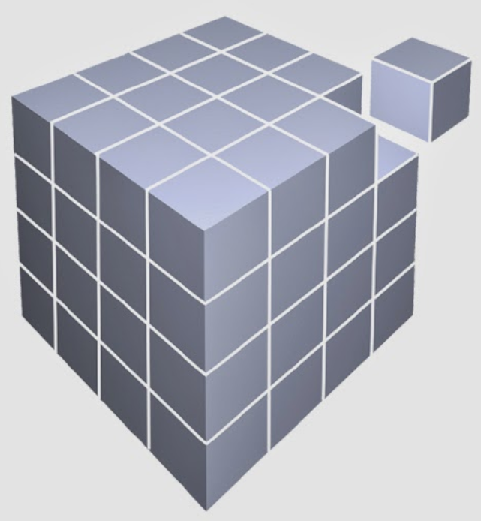
Space Partitioning
1. octrees by Glassner
2. constant size voxel partitioning
Notes:
物體跟光線有 intersection

Slide 6
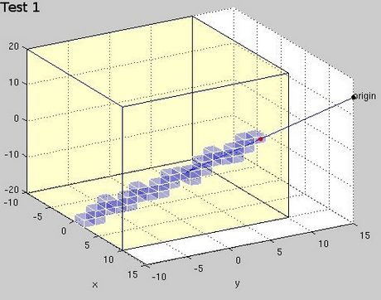
Ray Tracing on Constant Size Voxel Partitioning

Slide 7
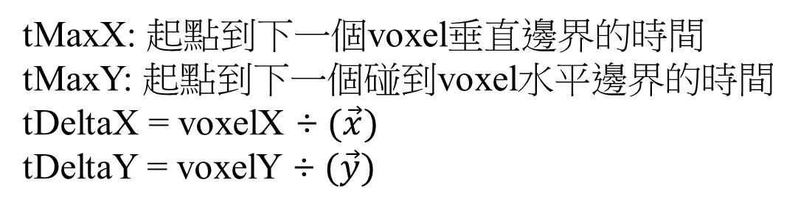



Algorithm
tMaxX: 起點到下一個voxel垂直邊界的時間
tMaxY: 起點到下一個碰到voxel水平邊界的時間
tDeltaX = voxelX ÷ $(\vec{x})$
tDeltaY = voxelY ÷ $(\vec{y})$
(0,0)
$$\vec{y}$$
$$\vec{v}$$
$$\vec{x}$$

Slide 8
Algorithm Initial
tMaxX: 1t
tMaxY: 2.9t
tDeltaX = 1.5t
tDeltaY = 2.1t
tMaxX < tMaxY 第一個走到voxel(0,0)
tMaxX = tMaxX+tDeltaX = 2.5t
(0,0)
$$\vec{y}$$
$$\vec{v}$$
$$\vec{x}$$

Slide 9
Algorithm
tMaxX: 2.5t
tMaxY: 2.9t
tDeltaX = 1.5t
tDeltaY = 2.1t
tMaxX < tMaxY 下一個走到垂直邊界
tMaxX = tMaxX+tDeltaX = 4.0t
(0,0) | (1,0)
$$\vec{y}$$
$$\vec{v}$$
$$\vec{x}$$

Slide 10
Algorithm
tMaxX: 4.0t
tMaxY: 2.9t
tDeltaX = 1.5t
tDeltaY = 2.1t
tMaxY < tMaxX 下一個走到水平邊界
tMaxY = tMaxY+tDeltaY = 5.0t
 | (1,1)
(0,0) | (1,0)
$$\vec{y}$$
$$\vec{v}$$
$$\vec{x}$$

Slide 11
Algorithm
tMaxX: 4.0t
tMaxY: 5.0t
tDeltaX = 1.5t
tDeltaY = 2.1t
tMaxX < tMaxY 下一個走到垂直邊界
tMaxX = tMaxX+tDeltaX = 5.5t
 | (1,1) | (2,1)
(0,0) | (1,0)
$$\vec{y}$$
$$\vec{v}$$
$$\vec{x}$$

