Slide 1
A New Algorithm for Computing Integer Hulls of 2D Polyhedral Sets
Chirantan Mukherjee
LALO 60: Matrices and Polynomials in Computer Algebra: Algorithms and Software
The University of Western Ontario
London, Canada, July 22-24, 2024
Presenter: Pei-Chian Lee
Date: Oct. 22, 2024

Slide 2
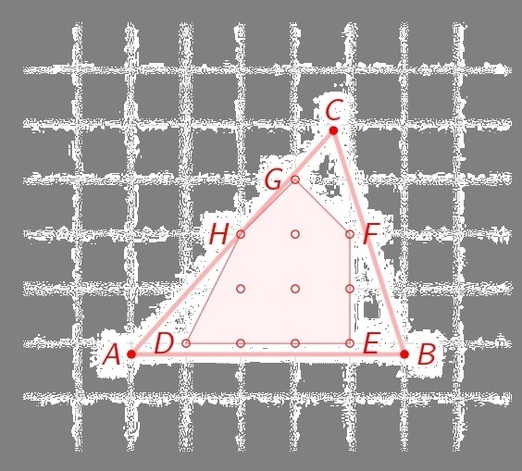

Integer Hulls of Polyhedral Sets
The integer hull $P_{I}$ of a convex polyhedral set P is the convex hull of integer points of P.
The paper focus on the 2D case.
Notes:
3a

Slide 3
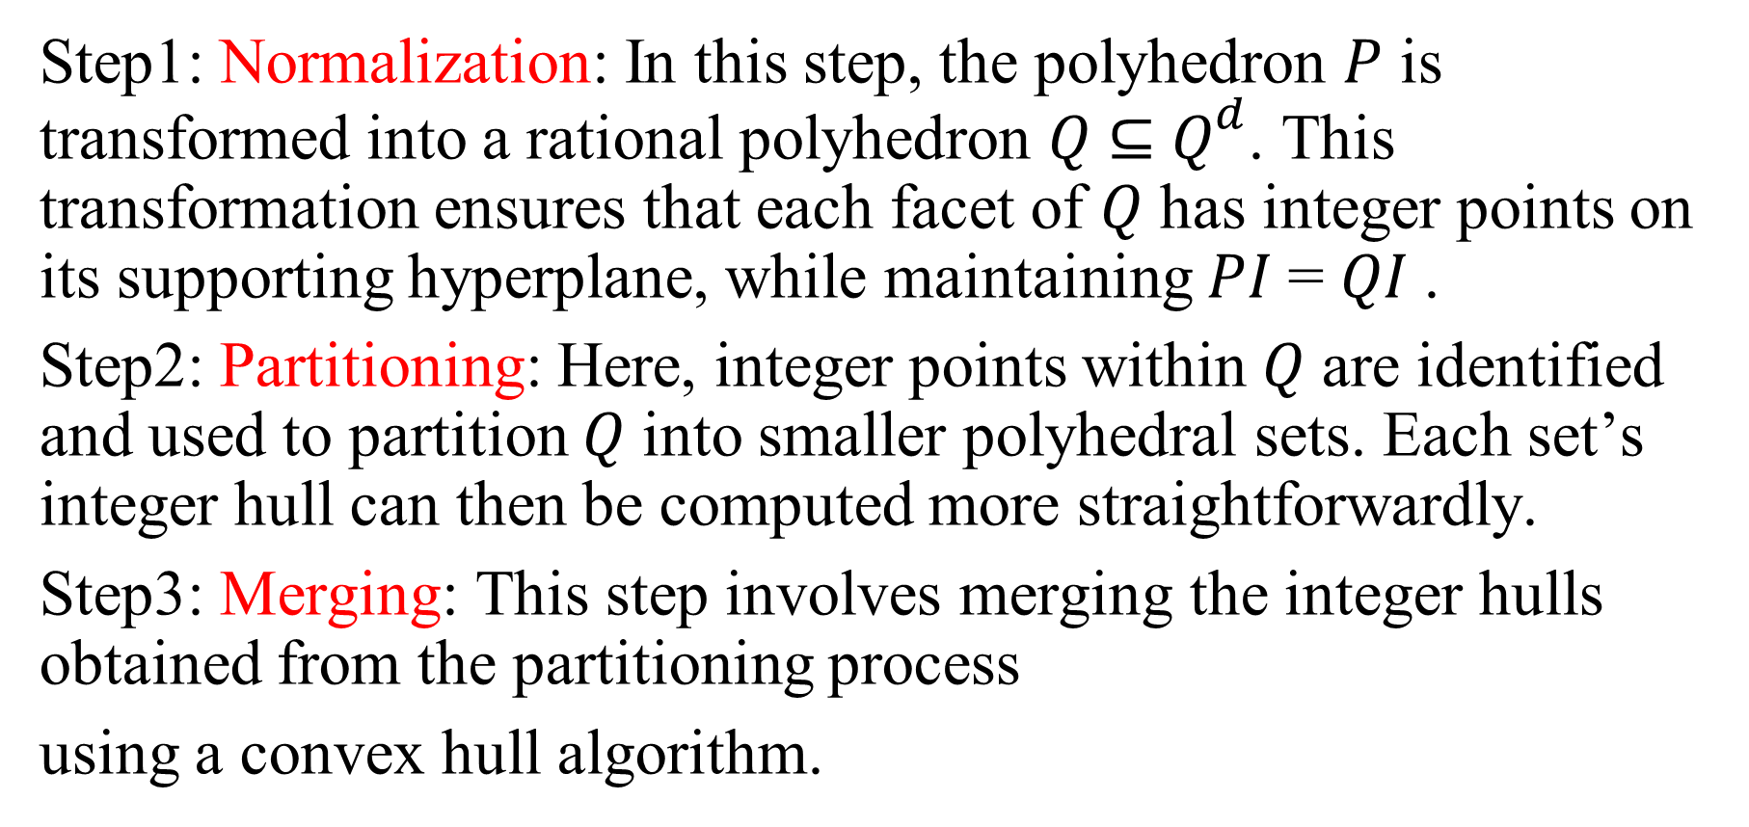
Exisiting Integer Hull Algorithm
Step1: Normalization: In this step, the polyhedron 𝑃 is transformed into a rational polyhedron 𝑄 ⊆ $Q^{d}$. This transformation ensures that each facet of 𝑄 has integer points on its supporting hyperplane, while maintaining 𝑃𝐼 = 𝑄𝐼 .
Step2: Partitioning: Here, integer points within 𝑄 are identified and used to partition 𝑄 into smaller polyhedral sets. Each set’s integer hull can then be computed more straightforwardly.
Step3: Merging: This step involves merging the integer hulls obtained from the partitioning process
using a convex hull algorithm.
Notes:
3b

Slide 4
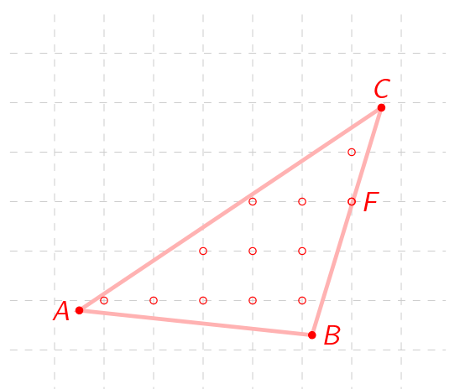
Exisiting Integer Hull Algorithm
example
Notes:
3b

Slide 5
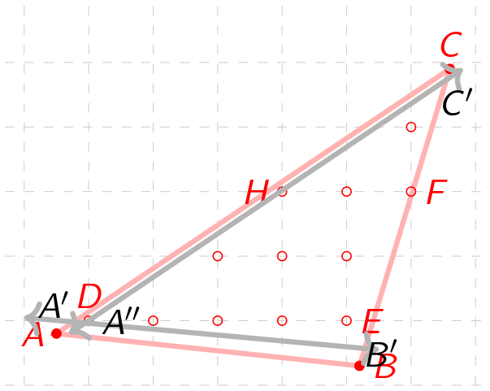


Exisiting Integer Hull Algorithm
Step1: Normalization: In this step, the polyhedron 𝑃 is transformed into a rational polyhedron 𝑄 ⊆ $Q^{d}$. This transformation ensures that each facet of 𝑄 has integer points on its supporting hyperplane, while maintaining $P_{I}$ = ${\text{Q}}_{I}$ .
P -> Q
P = ∆ABC
$\overset{⃡}{AB}$ ->$\overset{⃡}{A′B′}$
$\overset{⃡}{AC}$->$\overset{⃡}{A′′C}$
Q = ∆𝐴′′𝐵′𝐶′

Slide 6
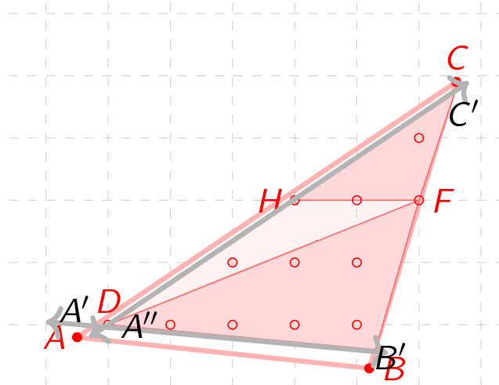
Exisiting Integer Hull Algorithm
Step2: Partitioning: Here, integer points within 𝑄 are identified and used to partition 𝑄 into smaller polyhedral sets. Each set’s integer hull can then be computed more straightforwardly.
(1) the convex hull R = ∆DHF
(2) ∆𝐴′′𝐵′𝐹, ∆𝐻𝐶′𝐹 -> apply a brute force method to search for integer points

Slide 7
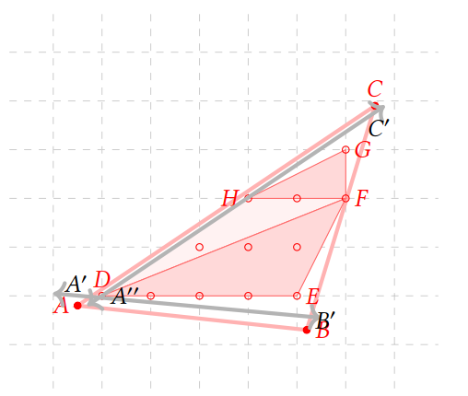
Exisiting Integer Hull Algorithm
Step3: Merging: This step involves merging the integer hulls obtained from the partitioning process using a convex hull algorithm.
the integer points found in each small triangle
the vertices of 𝑅:{D,H,F}
apply a convex hull algorithm to all those points.
Answer : polygon DHGFE

Slide 8
New Integer Hull Algorithm
the same example

Slide 9
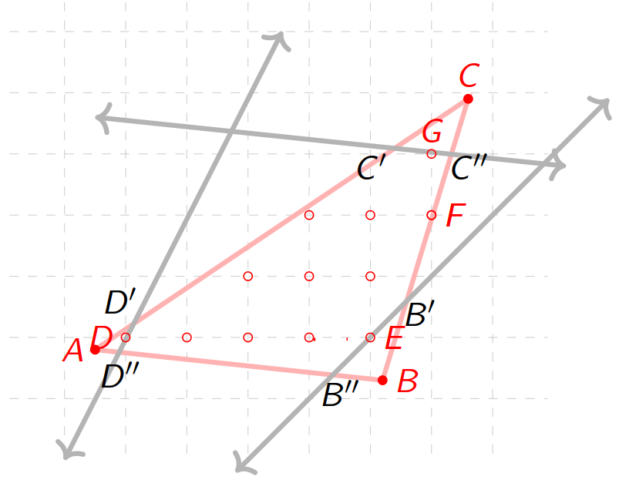

New Integer Hull Algorithm
Step1: Normalization: translate the supporting hyperplane of the facet upwards until it intersects at least one integer point
P -> Q
P = ∆ABC
$\overset{⃡}{AB}$ ->$\overset{⃡}{C^{′}C′′}$
$\overset{⃡}{AC}$->$\overset{⃡}{B^{′′}B′}$
$\overset{⃡}{BC}$->$\overset{⃡}{D^{′′}D′}$
Q = the hexagon 𝐷′′𝐵′′𝐵′𝐶′′𝐶′𝐷′

Slide 10
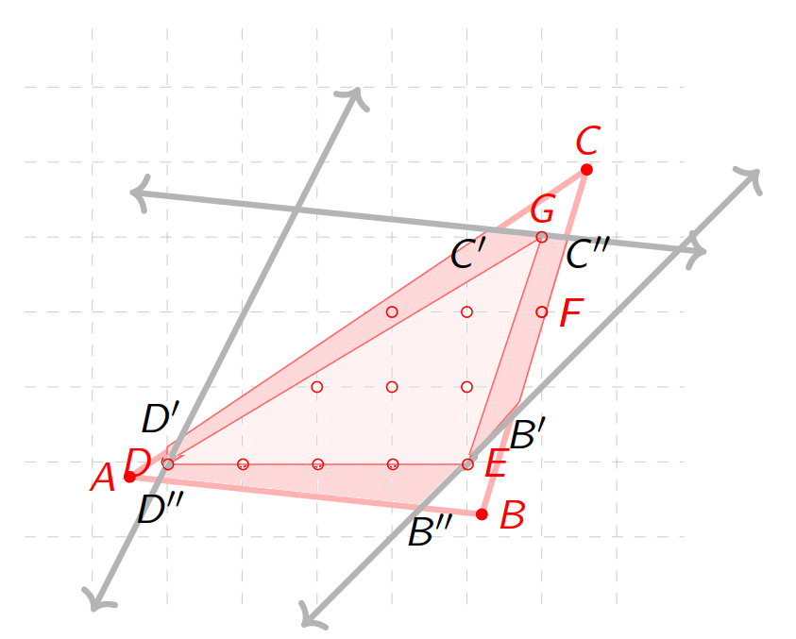
New Integer Hull Algorithm
Step2: Partitioning: Here, integer points within 𝑄 are identified and used to partition 𝑄 into smaller polyhedral sets. Each set’s integer hull can then be computed more straightforwardly.
(1) the convex hull R = ∆DEG
(2) three quadrilaterals 𝐷𝐷′′𝐵′′𝐸, 𝐸𝐵′𝐶′′𝐺 and 𝐷′𝐷𝐺𝐶′-> apply a brute force method to search for integer points

Slide 11
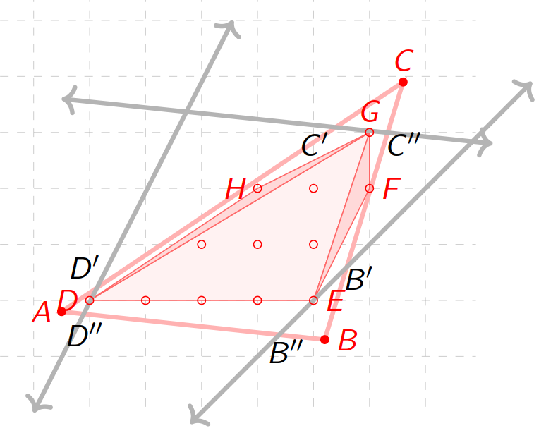
Exisiting Integer Hull Algorithm
Step3: Merging: This step involves merging the integer hulls obtained from the partitioning process using a convex hull algorithm.
the integer points found in each small quadrilateral
the vertices of 𝑅:{D,H,F}
apply a convex hull algorithm to all those points.
Answer : polygon DHGFE

Slide 12
Exisiting vs New
The new algorithm can reduce the area on which the brute force method is applied.
old
new

Slide 13
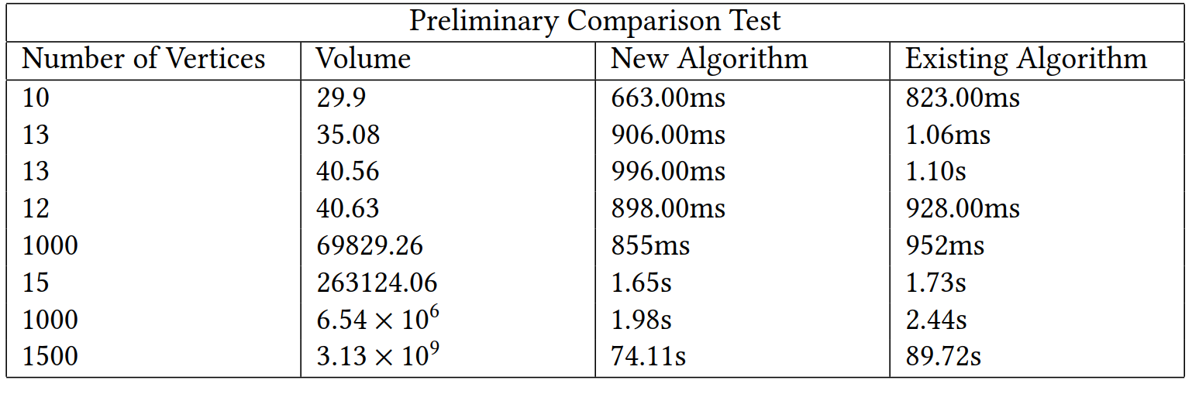
Experimentation Result

