Slide 1
We List Houses
By: Sean Carver & Ngoc Tran
July 31, 2019

Slide 2
Introduction
Are you:
Upgrading to a bigger home?
Moving somewhere else?
Getting a divorce?
...
Feeling stressed? Don’t worry! We can help:
Price your house
Pick the best time to sell
We know what we’re doing! Our Machine Learning models were built on well processed data:
54,425 D.C. residential properties
325 features
Location
Living area
Number of rooms
…
Target variable
Price

Slide 3
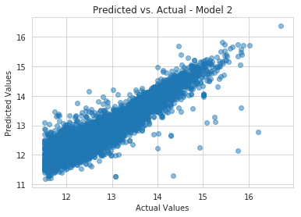
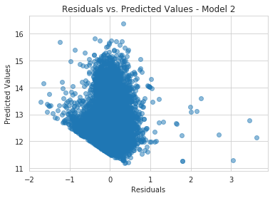
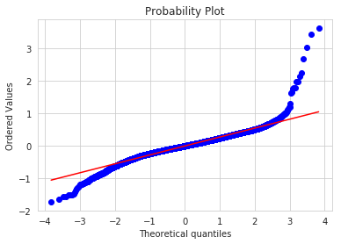
Linear Regression
Linear regression gives client a fair market value for his/her house.
Our best multivariate linear regression model:
Data:
All features
log(Price)
Performance:
Non-overfitting
Adj R-squared on training set: 0.8573
Adj R-squared on test set: 0.8530
Root mean squared error: 0.28

Slide 4
Logistic Regression
The client may already have a sale price in mind (e.g. $1M).
Logistic regression answers the question: what is the probability of selling the house at the target value?
Model Selection: Including sale date is a better model than not including it.
Delta_AIC = 827.2036511688116.
Model Selection: Using 46 dummy variables (for number of bedrooms, number of full bathrooms, number of half-bathrooms, number of extra rooms) is a better model than using 4 quantitative variables for these quantities.
Delta_AIC = 1960.7685314010923 (despite penalty for extra parameters).

Slide 5
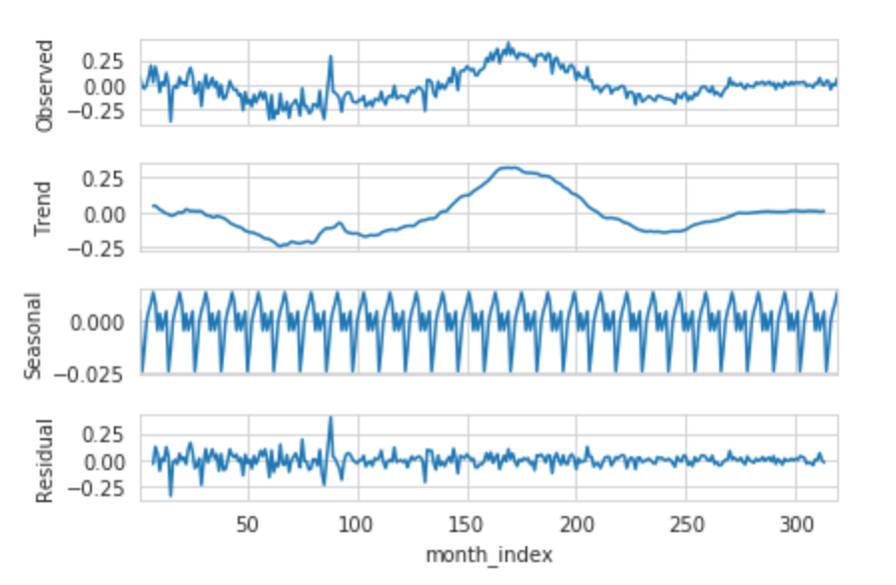
Seasonal Decomposition
1997
2006
2012

Slide 6
Next Steps for Future Improvements
Reduce multicollinearity for model interpretation
Perform further feature engineering and model selection
Use more advanced algorithms for better performance
Build a time-series model for extrapolated predictions

Slide 7
Conclusions
Linear regression gives a client a fair market value for his/her house. It looks like error assumptions are violated for linear models. Further EDA will need to be performed for better feature engineering. More advanced Machine Learning algorithms can produce better results.
Logistic regression gives a client a probability of selling his/her house at a target value. Model selection was performed but more is necessary to obtain the best model.
Dummy variables for numbers and types of rooms work tremendously better than many fewer quantitative variables, despite the penalty for additional parameters. We attribute this behavior to nonlinear effects.
Seasonal decomposition works as expected showing trend and seasonality in residuals.

Slide 8
Questions?

Slide 9
THANK YOU!

Slide 10
Sources
https://www.kaggle.com/christophercorrea/dc-residential-properties
https://scikit-learn.org/stable/modules/generated/sklearn.model_selection.train_test_split.html
https://scikit-learn.org/stable/modules/generated/sklearn.metrics.mean_squared_error.html
https://scikit-learn.org/stable/modules/generated/sklearn.linear_model.LinearRegression.html
https://scikit-learn.org/stable/modules/generated/sklearn.linear_model.LassoCV.html
https://scikit-learn.org/stable/modules/generated/sklearn.linear_model.RidgeCV.html
https://scikit-learn.org/stable/modules/generated/sklearn.linear_model.LogisticRegression.html
https://www.statsmodels.org/stable/generated/statsmodels.tsa.seasonal.seasonal_decompose.html
https://docs.scipy.org/doc/scipy/reference/generated/scipy.stats.probplot.html

