Slide 1

Exception Handling java Annotations javadoc
Java Session - III
on
- Priyanka Gadwe

Slide 2
Agenda
Exception Handling –
Try
Catch
Finally
Throw
Throws
Java Annotations
Java Doc

Slide 3
Java Exception Handling Dealing with Errors Gracefully

Slide 4
What is an Exception
Exceptions are events that occur during the execution of a program that disrupts the normal flow of the program’s execution.
Types of Exceptions
Checked (compile exceptions)-
-Checked exceptions are the ones that are checked during compilation time. If a code within a method throws a checked exception, then it should either be handled by a method or specify it using the throws keyword.
Unchecked (runtime exceptions)-
This exceptions result from faulty logic that can occur anywhere in a software program. For example, if a developer invokes a method on a null object, an unchecked NullPointerException occurs.

Slide 5
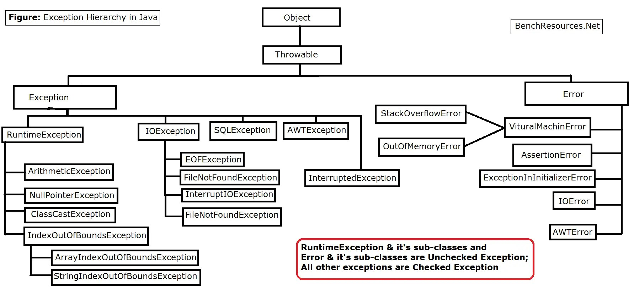

Slide 6
Exception Handling
Five Keyword to handle exceptions –
Try
Catch
Finally
Throw
Throws

Slide 7
Keyword | Description
try | The "try" keyword is used to specify a block where we should place an exception code. It means we can't use try block alone. The try block must be followed by either catch or finally.
catch | The "catch" block is used to handle the exception. It must be preceded by try block which means we can't use catch block alone. It can be followed by finally block later.
finally | The "finally" block is used to execute the necessary code of the program. It is executed whether an exception is handled or not.
throw | The "throw" keyword is used to throw an exception.
throws | The "throws" keyword is used to declare exceptions. It specifies that there may occur an exception in the method. It doesn't throw an exception. It is always used with method signature.

Slide 8
Java Annotations

Slide 9
What Is java Annotation
Annotations in Java are used to provide additional information
Java Annotation is a tag that represents the metadata
i.e. attached with class, interface, methods or fields to indicate some additional information which can be used by java compiler and JVM.

Slide 10
List of Annotations
Built-In Java Annotations used in Java code
@Override
@SuppressWarnings
@Deprecated
Built-In Java Annotations used in other annotations
@Target
@Retention
@Inherited
@Documented

Slide 11
List of Annotations
@Deprecated
This annotation marks that this method is deprecated so compiler prints warning. It informs user that it may be removed in the future versions. So, it is better not to use such methods.
@Override
This annotation assures that the subclass method is overriding the parent class method. If it is not so, compile time error occurs.
@SuppressWarnings
This annotation is used to suppress warnings issued by the compiler.

Slide 12
JavaDoc Documenting Java Code

Slide 13
What is Javadoc
JavaDoc: is a tool in the Java development kit (JDK) used to generate API documentation in HTML format from source code comments.
Javadoc utility enables you to keep the code and the documentation in sync easily.
lets you put your comments right next to your code

Slide 14
Various tags
/** ... */: This denotes the start and end of the JavaDoc comment. It's a multiline comment that starts with /** and ends with */.
@author: The author of the class or method.
@version: The version of the class or method.
@since: The version or date when the class or method was introduced.
@param: Used to describe the parameters of a method. The parameter name should match the method signature.
@return: Used to describe what a method returns. It is used only for methods that have a non-void return type.
@throws: Used to document the exceptions thrown by a method.
@deprecated: Used to indicate that a class, method, or field is deprecated and should no longer be used. An explanation of the deprecation can be provided after the tag.

Slide 15
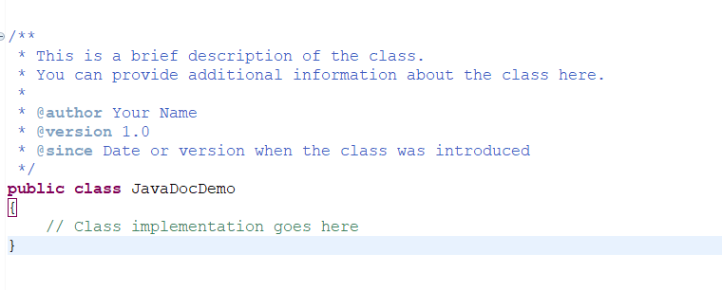
For Classes:

Slide 16
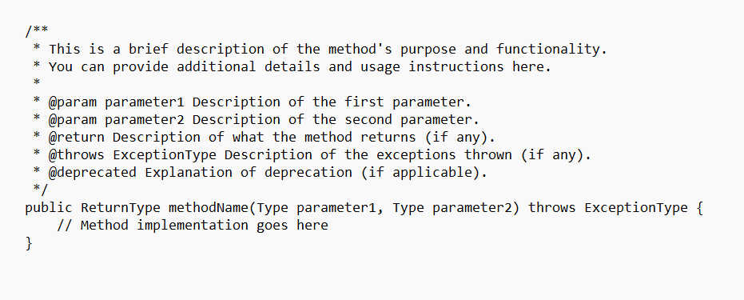
For Methods:

Slide 17
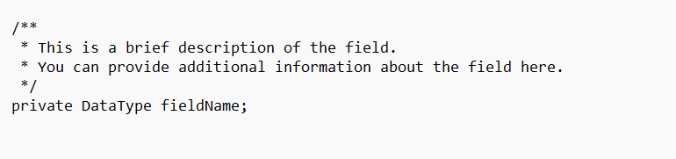
For Fields

Slide 18
Any Questions ??

Slide 19


