Slide 1
REGEX IN PYTHON
WOMEN WHO CODE - DC
NEHA TIWARI

Slide 2
CODE OF CONDUCT
WWCode is a non-profit organization dedicated to inspiring women to excel in technology careers. We are committed to our mission statement and equally committed to providing a harassment-free experience for everyone regardless of gender, gender identity and expression, sexual orientation, ability, physical appearance, body size, race, ethnicity, age, religion, socioeconomic status, caste or creed. We do not tolerate harassment of event participants in any form. Event participants violating these rules may be sanctioned or expelled permanently, at the discretion of the event organizers, which in most cases are members of the WWCode leadership team.
MONTHLY PYTHON LAB
WWCode has a monthly Python lab on the 3rd Wednesday and a Beginners Night @Fiscal Note every other first Wednesday of the Month from 6:30-8:30pm.
JOIN THE SLACK COMMUNITY
Join the Slack community at http://bit.ly/wwcdcslack

Slide 3
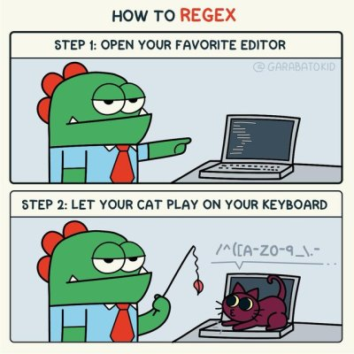

Slide 4
What is a Regular Expression/Regex?
A Regular Expression is a special text string for describing a search pattern. It is a technique developed in theoretical computer science and formal language theory.
Initially, it was most widely used with Perl. Now, most programming languages provide regex capabilities either built-in or via libraries.
Notes:
The syntax is fairly similar across most languages, with some exceptions.

Slide 5
Regex is especially useful for text processing tasks like data wrangling, search and replace, web scraping, validating user input etc. Specifically, you can use them to:
verify whether input fits into the text pattern,
to find text that matches the pattern within a larger body of text,
to replace text matching the pattern with other text or rearranged bits of the matched text,
to split a block of text into a list of subtexts, among other things.

Slide 6
RE Module:
Regex can be used in most programming languages. In Python the “re” module provides regex support.
Simply, import re
Main functions in re module:
re.match()
re.search()
re.findall()
re.sub()

Slide 7
Code:
Colab Notebook
Github repo

Slide 8
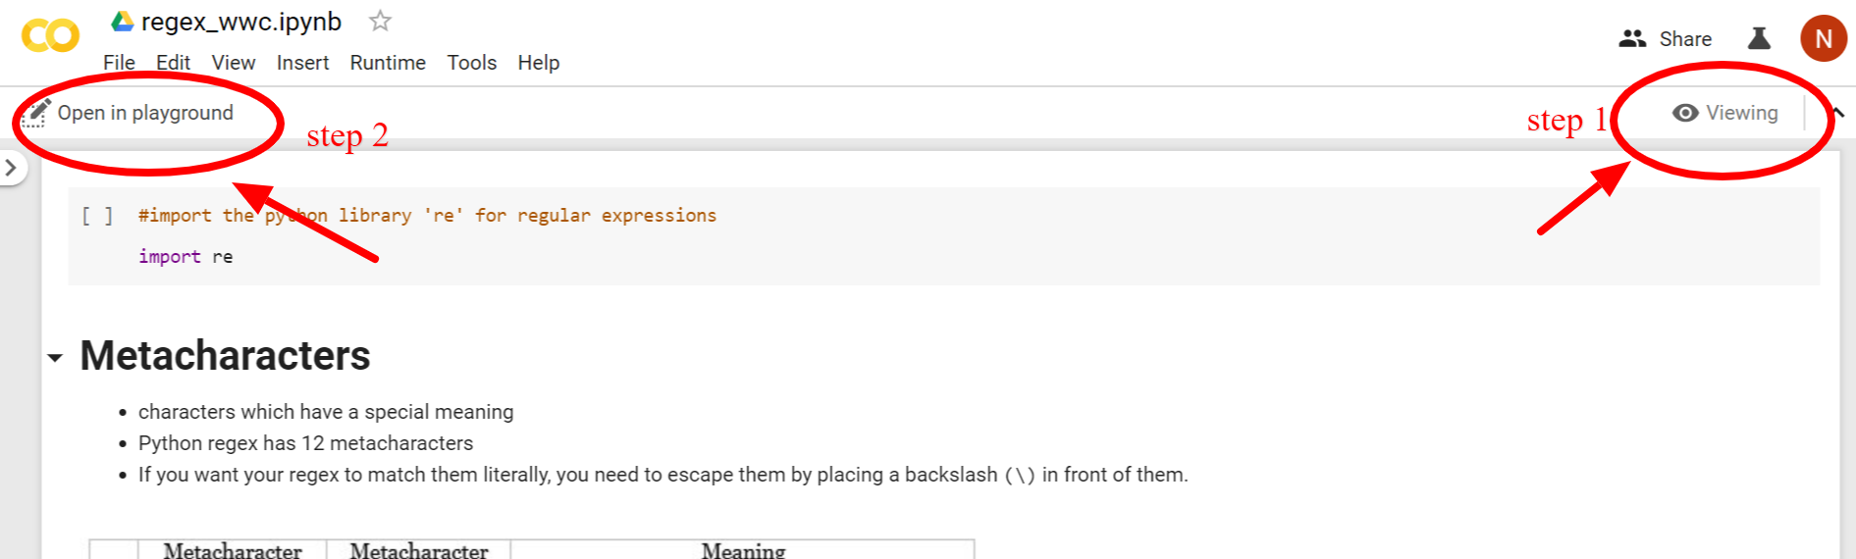
How use Colab?
Go to the Colab link

Slide 9
The notebook is currently in viewing mode.
Click on ‘Open in playground mode’ on the top left
Notebook is now in editing mode.
The first time you run a code chunk it will ask if you wish to continue, click on ‘Run anyway’

Slide 10
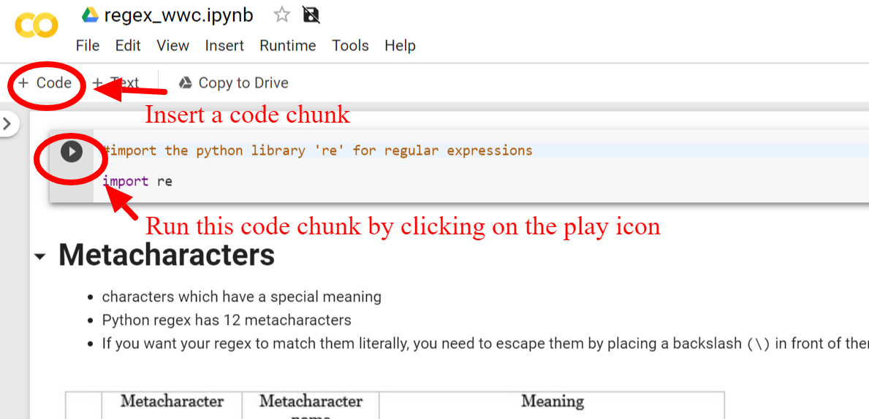

Slide 11
References:
RE library documentation
Regular Expression Pocket Reference: Tony Stubblebine

Slide 12
Thanks!!
Questions?
Feedback?

