Slide 1
Lesson 10: Tidy data

Slide 2
Learning objectives
Describe the concept of tidy data
Determine whether a dataset is in tidy format
Use tidyr::pivot_wider() and tidyr::pivot_longer() to reshape data frames
Use tidyr::unite() and tidyr::separate() to merge or separate information from different columns

Slide 3
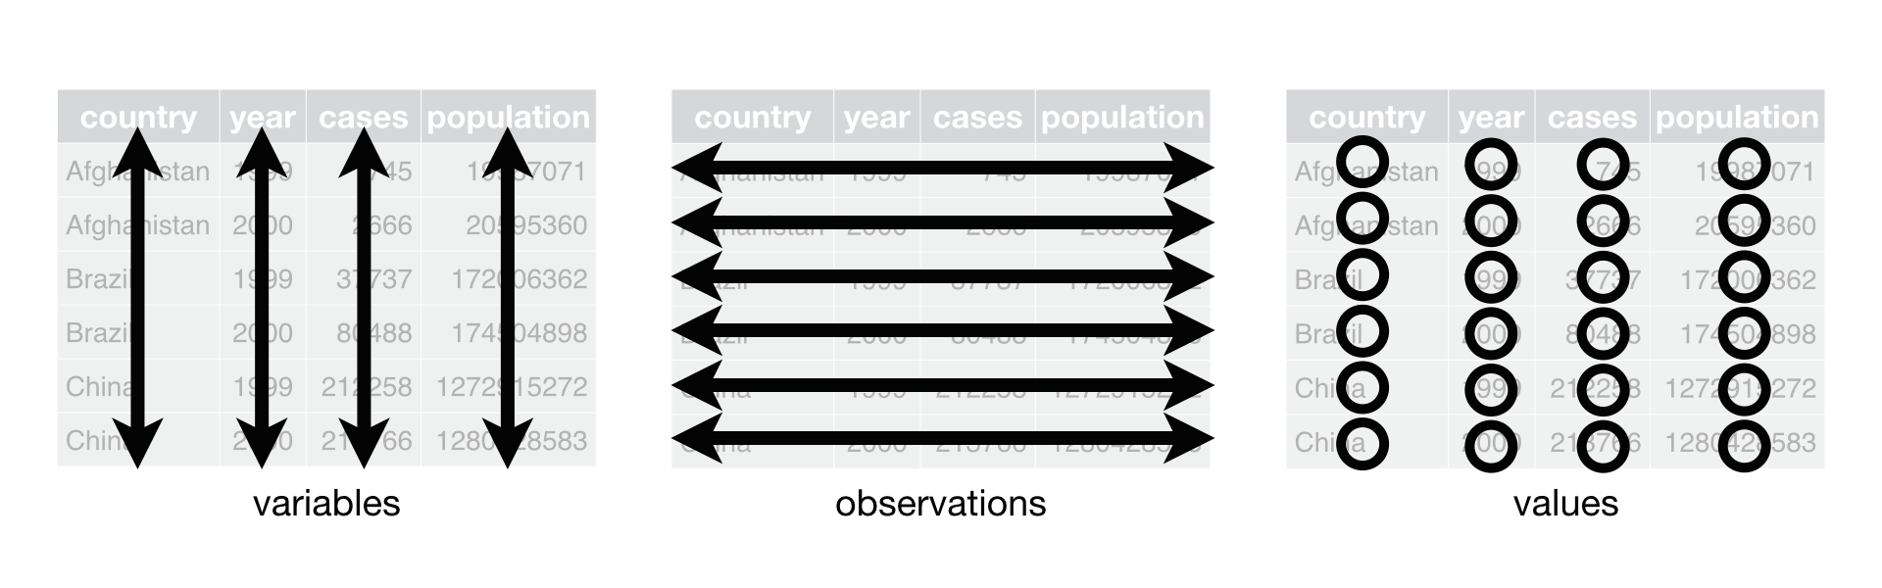
Three inter-related rules that make a dataset tidy:
Each variable is a column; each column is a variable.
Each observation is a row; each row is an observation.
Each value is a cell; each cell is a single value.

Slide 4
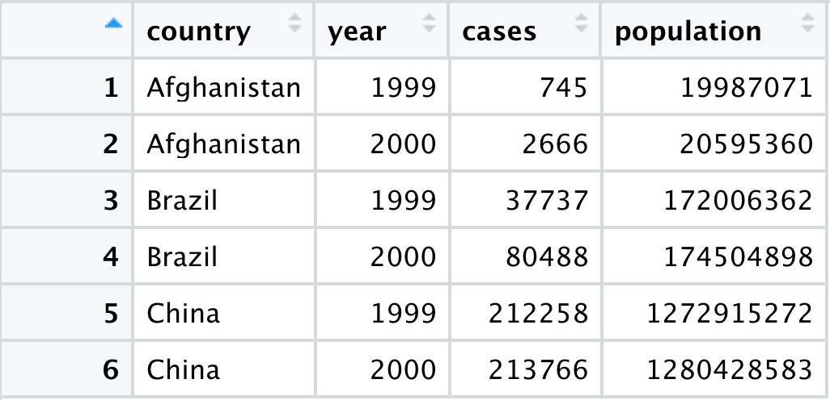
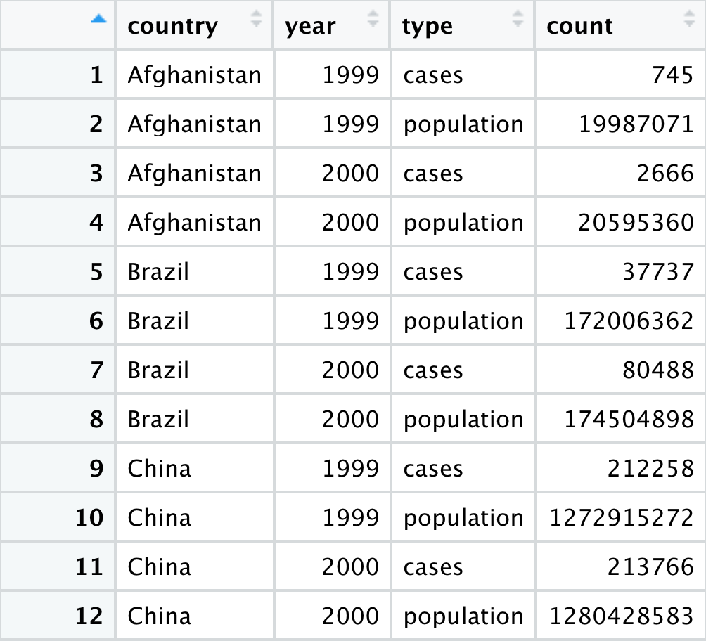
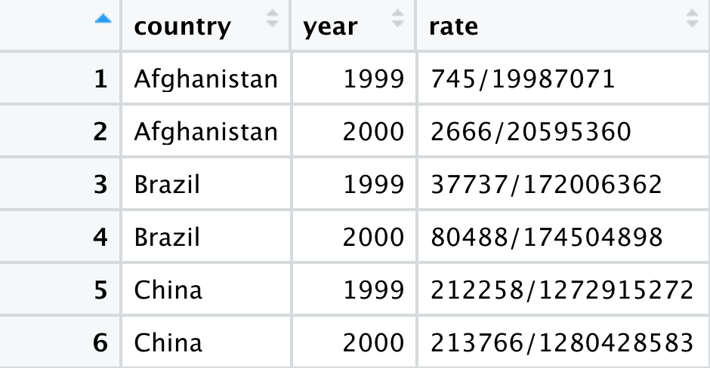
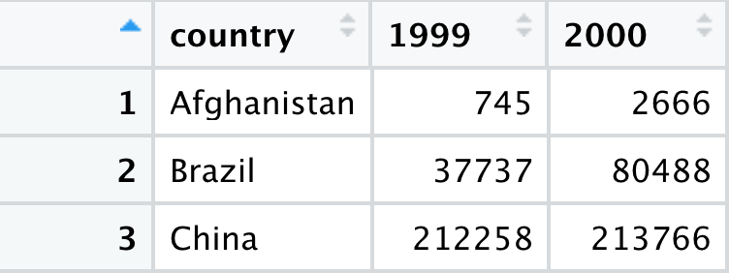
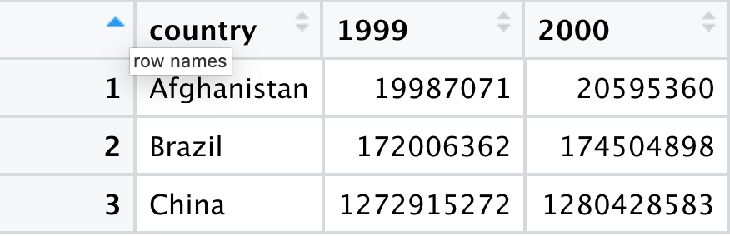
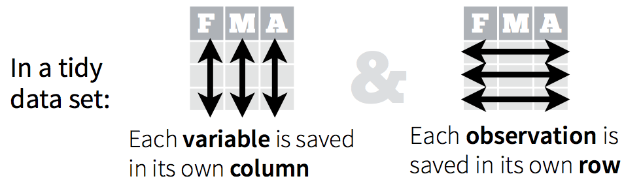
Different ways to display the same data
Which structure is tidy?

Slide 5
Different ways to display the same data
Tidy data

Slide 6
Exercise
Compute the rate for table2, and table4a + table4b. You will need to perform four operations:
Extract the number of TB cases per country per year.
Extract the matching population per country per year.
Divide cases by population, and multiply by 10000.
Store back in the appropriate place.
Which representation is easiest to work with? Which is hardest? Why?

Slide 7
If I had one thing to tell biologists learning bioinformatics, it would be “write code for humans, write data for computers”
— Vince Buffalo (@vsbuffalo)

Slide 8
Common problems
One variable might be spread across multiple columns and sometimes values have ended up in column names
One observation is spread across multiple rows

Slide 9
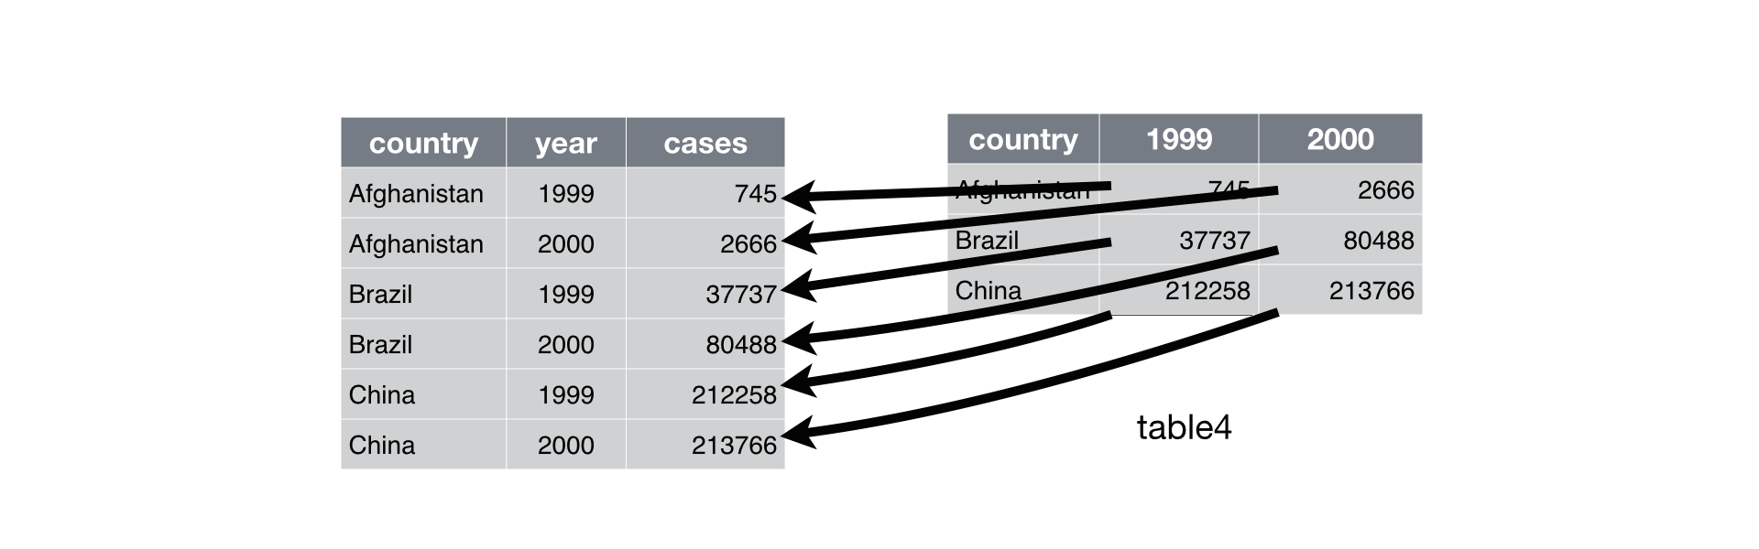
pivot_longer()
table4a %>%
pivot_longer(c(`1999`, `2000`), names_to = "year", values_to = "cases")

Slide 10
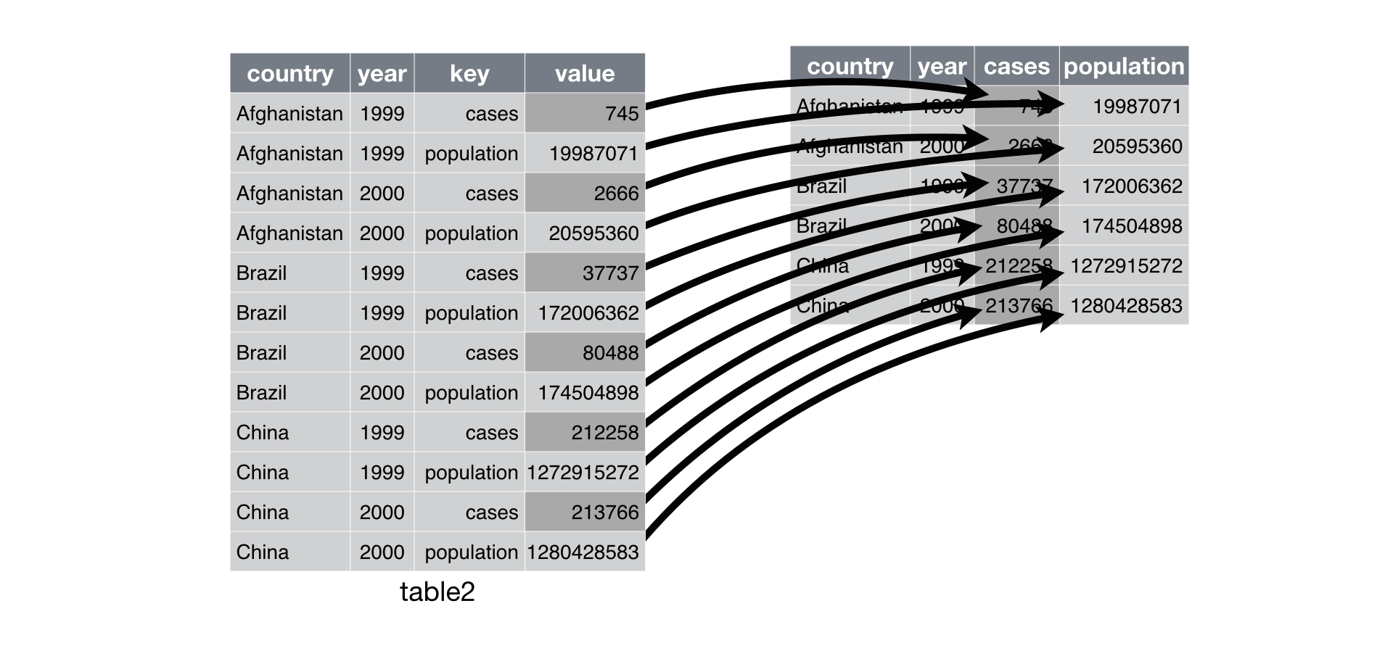
pivot_wider()
table2 %>%
pivot_wider(names_from = type, values_from = count)

Slide 11
separate()
table3 %>%
separate(rate, into = c("cases", "population"))
By default, separate() will split values wherever it sees a non-alphanumeric character (i.e. a character that isn’t a number or letter)

Slide 12
Exercise – LOTR data
After tidying the data and completing your analysis, you may want to output a table that has each race in its own column. Let’s use the pivot_wider() function to make such a table and save it as “lotr_wide”
OPTIONAL: Use the pivot_longer() function to transform you lotr_wide back to tidy format.

Slide 13
Exercise
Make a barchart that shows how many words are spoken by males and females in each of the movies.
First with the tidy dataset
Then with the wider dataset you just created (with Male and Female word counts in different columns)

Slide 14
Exercise – coronavirus data
Convert the coronavirus dataset to a wider format where the confirmed cases, deaths and recovered cases are shown in separate columns
With this wide format data, make a bar chart of the total number of confirmed cases, deaths, and recoveries per day for the US

