Slide 1
PRIMs tutorial
Unit 3: Extended Vision

Slide 2
Limitation of PRIMs (& ACT-R)
Goal
Input
LTM
WM
We will extend the set of PRIMs to access chunks directly connected to those in the buffers

Slide 3
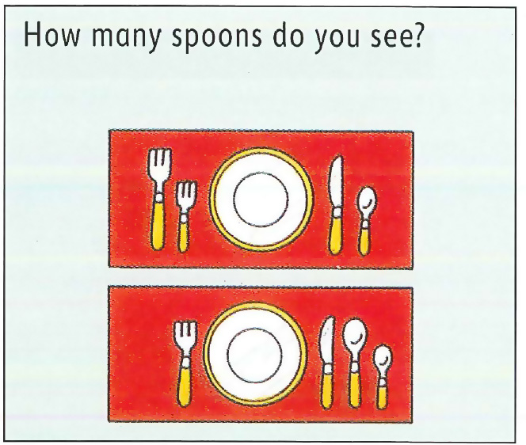
Starting with Vision

Slide 4
In a model
define visual {
(screen1 screen nil placemat1)
(placemat1 placemat placemat2 item1)
(placemat2 placemat nil item5)
(item1 utensil item2 nil fork)
(item2 utensil item3 nil fork)
(item3 utensil item4 nil knife)
(item4 utensil nil nil spoon)
(item5 utensil item6 nil fork)
(item6 utensil item7 nil knife)
(item7 utensil item8 nil spoon)
(item8 utensil nil nil spoon)
}

Slide 5
Traversing this tree with the new >> and << PRIMs
>>V2
V<<

Slide 6
In the spoons example
operator init-count-spoons {
WM1 = nil
V1 = screen
==>
>>V3 // shift to the first placemat
>>V3 /// shift to first item in the placemat
zero -> WM1
}

Slide 7
operator count-item {
V1 = item-type
V4 = target
RT1 = nil
==>
count-fact -> RT1
WM1 -> RT2
}
operator update-count-up {
RT1 = count-fact
V2 = nil
==>
RT3 -> WM1
V<<
}

Slide 8

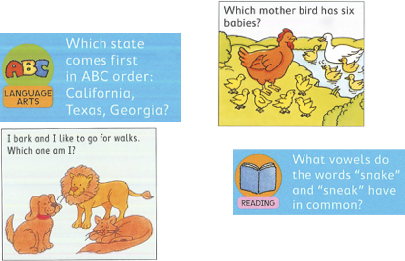
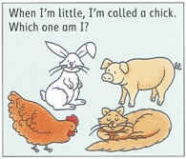
Assignment: model one or more cards

Slide 9
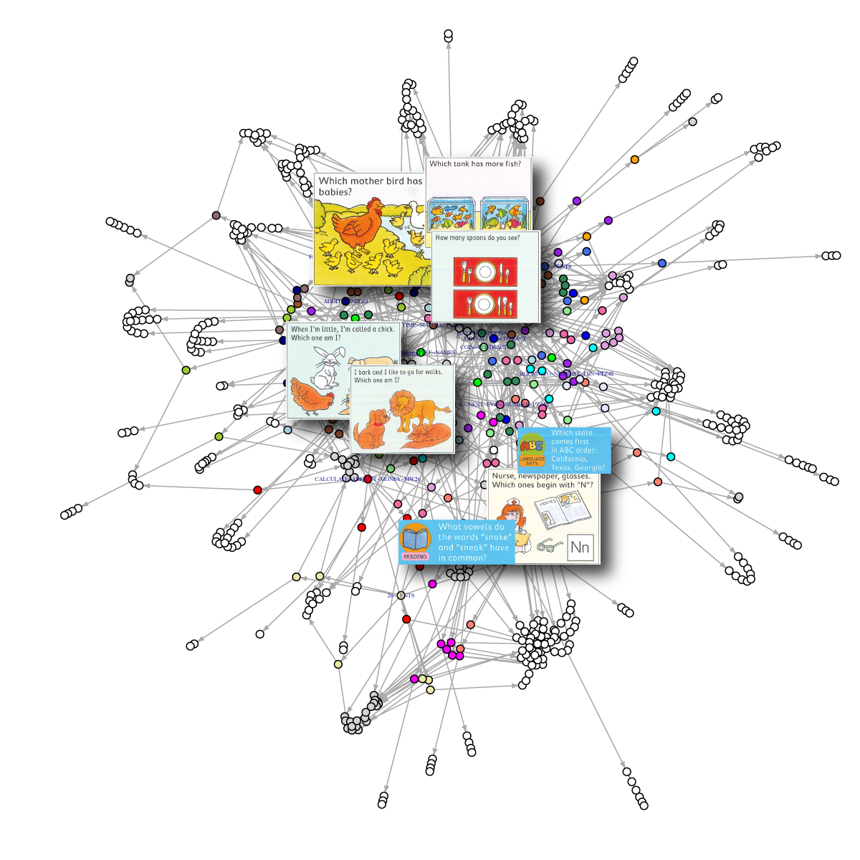

Slide 10
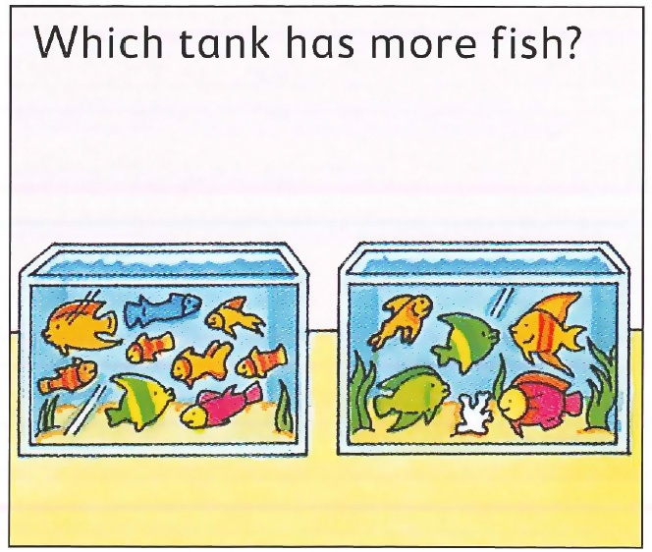
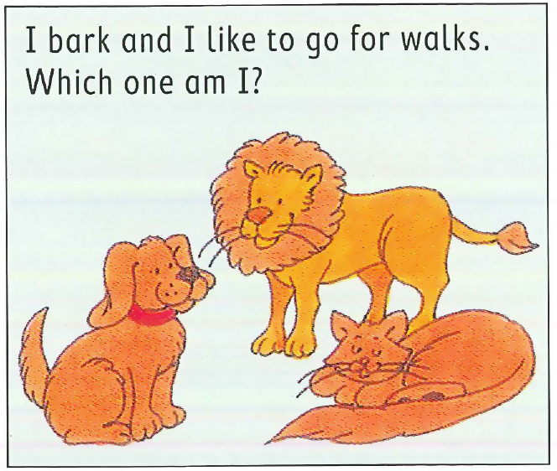
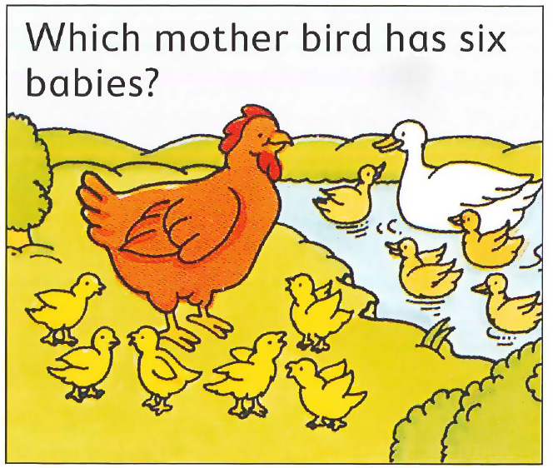

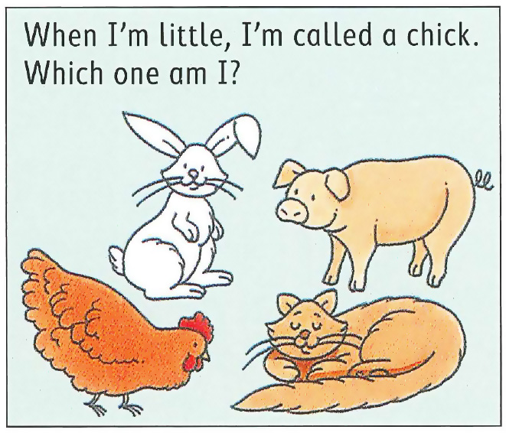


How much transfer among these different tasks?
20 x
42 %
1 x
62%
20 cards total

