Slide 1
PRIMs tutorial
Unit 2: Multiple Goals, Variable binding, Evaluation operators, Far transfer

Slide 2
Production Rules/Operators

Slide 3
Multiple Goals
Sometimes we need more than one Goal to do a task, or we want to model situations in which we have multiple unrelated goals that we do in parallel
In PRIMs, we can have multiple active goals

Slide 4
PRIMs associations
Start-Count
Goal
Count
Daydream
Iterate
Final

Slide 5
Implementation
You can set more than one goal as part of the task:
initial-goals: (read-equation transform arithmetic)
You can add/change goals using PRIMs:
transform -> G2
Make sure to declare symbols you want to use as goals:
goals: (transform)

Slide 6
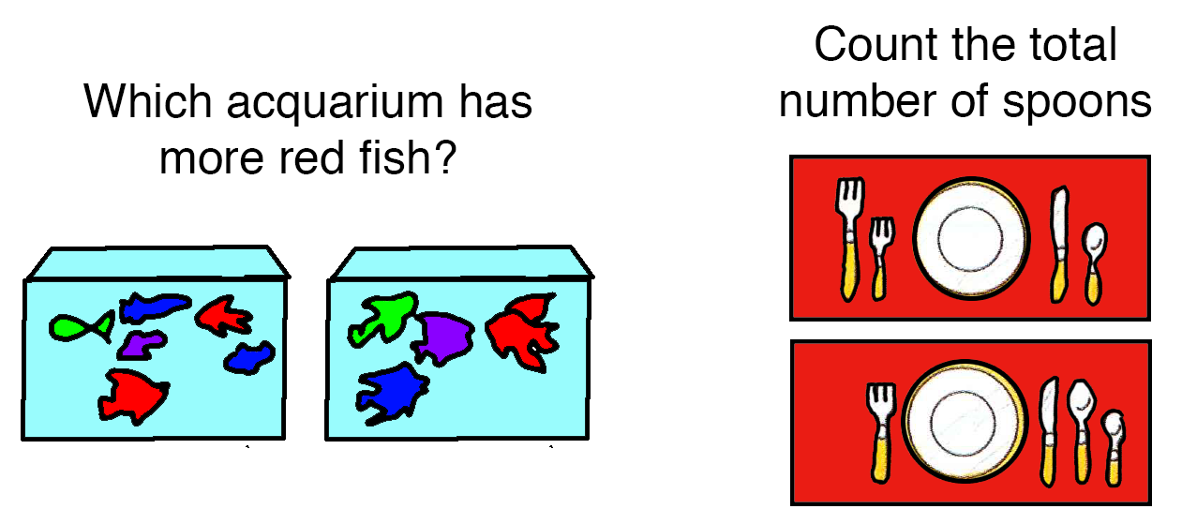
How to make goals more flexible?

Slide 7
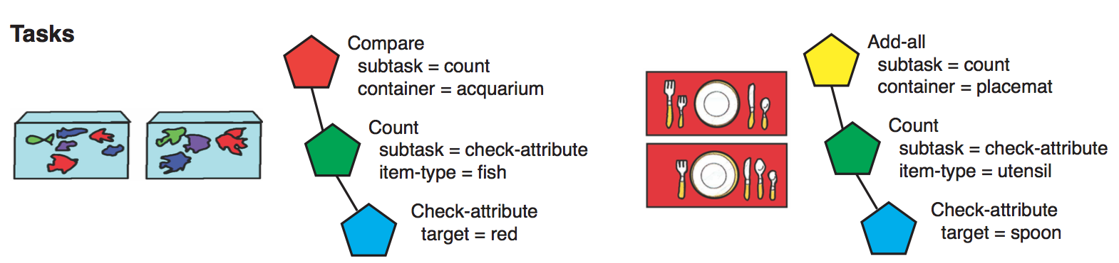
What we want is

Slide 8
In Unit 1
operator start-count {
V1 <> nil
WM1 = nil
==>
V1 -> WM1
count-fact -> RT1
V1 -> RT2
say -> AC1
V1 -> AC2
}
operator start-semantic {
V1 <> nil
WM1 = nil
==>
V1 -> WM1
property -> RT1
V1 -> RT2
subvocalize -> AC1
V1 -> AC2
}

Slide 9
Better
operator start {
V1 <> nil
WM1 = nil
==>
V1 -> WM1
fact-type -> RT1
V1 -> RT2
action -> AC1
V1 -> AC2
}

Slide 10
Specify bindings in the goal
set-goal(“count", ["fact-type","count-fact"], ["action","say”])
set-goal("semantic", ["fact-type","property"], ["action","sub-vocalize”])
Implementation issue: declare indirections in task definition
references: (fact-type action)

Slide 11
Benefits
Model can reuse operators completely
And can therefore also discover missing operators and borrow them from other goals

Slide 12
How to discover what to do in a new task?
Construct new operators
Reuse old operators
Trial-and-error
Using examples
Using instruction
Using explicit reasoning

Slide 13
Trial-and-error (possibly guided)
If we are successful in using an operator for a particular goal, we increase the association with that goal
We also increase the base-level activation of the operator

Slide 14
define task count-learn {
initial-goals: (count-learn)
default-activation: 1.0
ol: t
rt: -2.0
lf: 0.2
default-operator-self-assoc: 0.0
goal-operator-learning: t
reward: 10.0
beta: 0.1
references: (fact-type action final-action final-response final-response-negative)
}

Slide 15
Equations

Slide 16
Far transfer
Transfer between tasks that do not resemble each other
Overlap is in a few key operators that determine the strategy

Slide 17





Task Switching (food/size)
Respond to fruit/veg
Respond to size
Respond to fruit/veg
. . .
left
left
right
right
left

Slide 18
Stroop
Stroop task:
BLUE or PIANO or RED
Name the color of the ink as fast as possible
Typical result: people are slower when there is a mismatch between the word and the ink.

Slide 19
Two strategies
Proactive: anticipate next trial
Reactive: wait for stimulus, the decide
This version of task switching requires a proactive strategy
Key: preparation is a separate goal

Slide 20
First step in task switching
operator prepare-for-stimulus {
V1 = fixation
G2 = nil
==>
prepare -> G2
}
Here, prepare is bound to a goal that determines the next task (prepare-next)

Slide 21
define goal prepare-next {
operator set-first-task {
V1 = fixation
WM1 = nil
==>
foodtask -> WM1
one -> WM2
nil -> G2
wait -> AC1
}
...
}

Slide 22
operator determine-next-task-retrieve-count {
V1 = fixation
RT1 = nil
WM1 <> nil
==>
count-fact->RT1
WM2->RT2
}

Slide 23
operator determine-next-task-decide-to-stay {
RT1 = count-fact
RT3 = two
==>
RT3 -> WM2
nil -> G2
wait -> AC1
}

Slide 24
operator determine-next-task-decide-to-switch {
RT1 = count-fact
RT3 = three
==>
one -> WM2
othertask -> RT1
WM1 -> RT2
}
operator set-other-task {
RT1 = othertask
==>
RT3 -> WM1
nil -> G2
wait -> AC1
}

Slide 25
Two choices for preparation in Stroop
Each choice is in a separate goal that is not initially associated with Stroop:
default attend
attend color

Slide 26
In Stroop we need to do a similar thing
operator prepare-for-stimulus {
V1 = fixation
G2 = nil
==>
prepare -> G2
}
Now prepare is bound to focuscolor
define goal focuscolor {
operator attendjustcolor {
V1 = stim
V2 = nil
==>
attendcolor -> AC1
}
}

Slide 27
Competes with
operator just-wait (activation=1.5) {
"Just wait for the stimulus"
V1 = fixation
==>
wait -> AC1
}
operator attend (activation=1.5) {
V1 = stim
V2 = nil
==>
attend -> AC1
}

Slide 28
Running the model multiple times: taskswitchstrooptransfer.bprims
repeat 10
reset
run stroop stroopcontrol 50
reset
run taskswitching taskswitching 300
run stroop strooptransfer 50

Slide 29
Transfer
If we do task-switching before Stroop, the prepare operator will receive extra activation, and is therefore more likely to be chosen
If we do Stroop without preparation, the just-wait operator is the more likely candidate, because it has a higher base-level activation

Slide 30
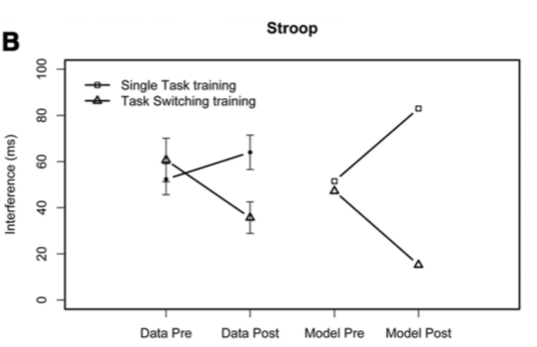
Results of the model

Slide 31
Assignment: Multi-column multiplication
Starting point is a model of multi-column addition
In this model we will ignore the complexities of perception (which is particularly tricky in multi-column multiplication)

Slide 32
Assignment: Multi-column multiplication
Three forms of transfer
Goal as whole (addition is part of multiplication)
Individual operators (with different variable instantiations)
Overlapping sequences of PRIMs

